Slide 1




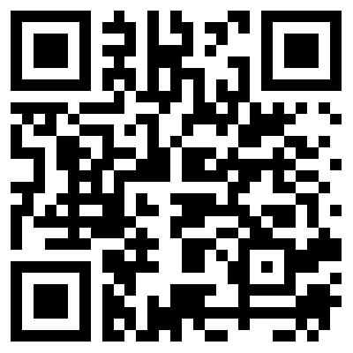
41 hours of recordings.
22 teachers each recorded for 3 to 5 consecutive weeks.
Children (N = 118) aged 5 to 11. Groups of 4 -7.
School regions of high or low socio-economic status.
417,025 word corpus.
Additional measures of teacher experience, and children’s reading ability and motivation.
Using corpus methods to identify teacher strategies in guided reading
Liam Blything, Andrew Hardie, Kate Cain, Lancaster University, UK
Proportion of each question type differed by SES:
3. Forms of wh-questions
High challenge: adverbs - how, where, when, why
Low challenge: determiners - which, what, whose, and pronouns - who
No effect of year group:
  1. Why use corpus methods?
  A corpus is a large collection of written and/or spoken language.
  We have collected a 417, 025 word spoken language corpus of teacher-child interactions during guided reading, from over 40 hours of recordings.
  Guided reading is intended to support text comprehension: in regular sessions, 4-6 children, grouped by ability, work with a teacher on a book.
  Corpus analysis tools (e.g., CQPweb; Hardie, 2012) enable computer-based searches of large-scale data that are fast, precise, and reliable.
  Our first analysis examined whether teachers’ question asking was related to children’s year group and/or socio-economic status (SES).
2. Question types
Wh-qs: how, when, where, why, which, what, who?
Non-interrogative questions: rising intonation
Tag questions: isn’t it? shouldn’t it? etc.
Wh-questions was the predominant type of question asked by teachers across all year groups:
Year Group
Year Group
Proportion of each wh-question form differed by SES:
SES
SES
Next steps: To explore whether teachers’ question asking is related to children’s reading ability and/or reading motivation, and how teachers’ questions influence the quality of children’s responses.
Hardie, A (2012). CQPweb – combining power, flexibility and usability in a corpus analysis tool. International Journal of Corpus Linguistics, 17, 380-409.
Website: http://cass.lancs.ac.uk/?page_id=92
Contact: l.blything@lancaster.ac.uk
QR
HERE

