Slide 1

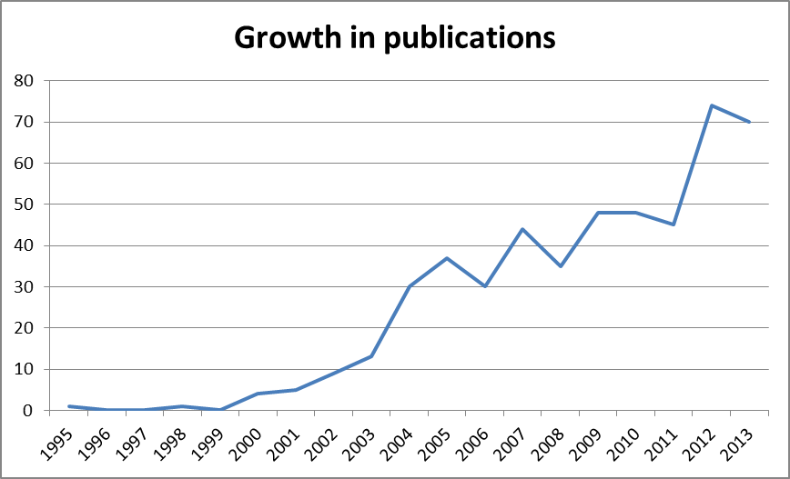


Improving online learning in palliative care:
A comprehensive review
Sean Hughes, Nancy Preston, Sheila Payne
International Observatory on End of Life Care, Lancaster University, UK
Background
A pan-European study (InSup-C) examining best practice in integrated palliative care in advanced cancer and chronic disease aims to develop an
un-moderated elearning resource to disseminate study results. This platform will provide wide access to an educational programme designed to enhance professional education and practice in integrated palliative and end of life care across Europe.
Methods
A comprehensive literature review explored current practice in online palliative and end of life care education.
Review question:
What does the literature tell us about the models, development and efficacy of online learning in palliative and end of life care education?
A search of MEDLINE, ERIC, CINAHL, AMED, PsycInfo and Academic Search Complete databases was conducted. This yielded 1441 hits reduced to 1084 on removing duplicates. Following examination of titles and abstracts, 26 papers were selected for narrative review. Bibliometric analysis (Table One) shows trends in peer reviewed published output.
Results and recommendations
Evidence for the efficacy of un-moderated elearning platforms was lacking in the literature
Blended learning approaches which included tutor input, peer interaction through discussion boards or elements of face to face tuition were more frequently reported
Un-moderated programmes were said to improve access for remote learners and those with resource constraints
Asynchronous delivery provided flexibility for those studying alongside work or other commitments
Further research into the efficacy of un-moderated elearning models and into the sustainability of a positive impact on practice is urgently required
Table One:
Trend in online learning related publications: 1995 to 2013
(583 hits using search terms: online learning and evaluat* in Medline, AMED, CINAHL, PsycINFO, Academic Search Complete)
For further information:
sean.hughes@lancaster.ac.uk
www.lancaster.ac.uk/fhm/research/ioelc
On behalf of InSup-C: Integrated palliative care in advanced cancer and chronic disease: www.insup-c.eu
(EC FP7 Grant no: 305555)

