Slide 1
SDN-based Control and Operation of the
IP Ran in 4G and LTE Environments
Huaimo Chen, Quintin Zhao – Huawei huaimo.chen@huawei.com quintin.zhao@huawei.com
Daniel King – Old Dog Consulting daniel@olddog.co.uk
www.isocore.com/mpls2013

Slide 2
Problem Space – IP RAN
The IP RAN provides connectivity for IP-based mobile broadband (MBB) from LTE and 4G base stations.
  Traditionally high-speed mobile connections have been copper and MLPPP, then IP (PWE and MPLS).
Ratio of MBB subscribers to total mobile subscribers is expected to grow from 15% in 2011 to nearly 40% in 2016.
  However, it is important to maintain traffic classes and QoS.
MBB market is forecast to grow to $1 trillion by 2016, with the bulk of the growth coming from mobile broadband services.
  China is leading the World in MBB services.
  At the end of 2012 China Mobile 25⁽¹⁾ had deployed more than 500,000 nodes to support MBB services.
1. PTN Market Research 2013 Frost & Sullivan

Slide 3
Requirements for 4G and LTE - IP RAN
Service requirements
  Service delivery across a variety of access speeds (3G, 4G/LTE and and Wifi)
  Rapid deployment of services
  Current LTE services exceed 20, and can be as fast as 100Mbps
  Cell-site capacity of multiple Gbps
Technical requirements for MBB deployment and operation, include:
  Effective management of large AS topologies
  Reduce internal AS convergence times
  Scalability of the network
  Carrier grade availability and reliability
  Quality of Service (QoS) and Quality of Experience (QoE)
  Network Virtualization and abstraction

Slide 4
IP RAN Enabling Technologies
Software Defined and Flexible Networks
  Automated service planning, with “plug and play”
  Fast Troubleshooting and Problem Resolution
  Dynamic Deployment Protocols and Rapid Services Launch
    Separate and abstract elements within the network, using both centralized and distributed control planes
  Make the Network programmable
    Automated service deployment and operation
    Scalable and predictable policy enforcement
  Application-based Network Operations (ABNO) architecture.
  Centralized control of network services
  ABNO provides the mechanisms to request and setup new services, using well-defined standards based path computation, provisioning and reservation protocols and procedures
Topology-Transparent Zone (TTZ)
  Deployed for network virtualization, resolving internal AS scalability and convergence
Enhanced MPLS Procedures and Protocol extensions.
  Multi-topology
  Support separation of traffic across low latency (for mobile voice) and high capacity (for mobile data) links

Slide 5





IP RAN Enabling Technologies:
Automated Service Planning, Plug and Play
Mobile Backhaul： Complex services planning
Planning IP Address
Dividing IGP Area
Planning CSG&AGG ring relations
SDN-based Mobile Backhaul：Free Services Planning
Main
Central Controller
AGG
AGG
Backup
Planning IP Address
Dividing IGP Area
Planning CSG&AGG ring relations
CSG
Control Agent
CSG
Control Agent
Saving
CSG
Control Agent
Plug and Play，Zero Touch for Basic Network
 | Current IP RAN Access Solution | Central Controlled IP RAN
IGP | Yes | Automatic deployment
RSVP-TE | Yes | No
Solution
Protocol

Slide 6




IP RAN Enabling Technologies:
Dynamic Deployment Protocols and Rapid Services Launch
Mobile Backhaul
Central Controlled IP RAN
Last Mile
Access
Aggregation
RNC/SGW/MME
Last Mile
Access
Aggregation
RNC/SGW/MME
IGP/LDP/RSVP
Virtual-cluster enable
Configure remote-interface
CSG
L2VPN
CSG
L2VPN
IGP/LDP/RSVP
STM-1
STM-1
RSG
BSC
Main
RSG
BSC
BTS
E1
AGG
BTS
Control Agent
AGG
E1
Control Plane
CSG
STM-1
CSG
STM-1
ATM
ATM
Control Agent
Central Controller
Control Plane
NodeB
ATM RNC
NodeB
ATM RNC
GE
GE
Eth
Eth
Control Agent
Control Plane
Backup
AGG
RSG
AGG
RSG
IGP/LDP/RSVP
IGP/LDP/RSVP
NodeB / eNB
CSG
IGP/LDP/RSVP
IP RNC/S-GW/MME
NodeB / eNB
CSG
IP RNC/S-GW/MME
Protocol-based point-by-point services launch
Service-based end-to-end services launch
Simple protocol
Automatic configuration
Lowers skill requirements of staff
Improves efficiency of services launch

Slide 7

IP RAN Enabling Technologies:
Fast Troubleshooting and Problem Resolution
Mobile Backhaul
SDN-based Mobile Backhaul
Each node sends alarm independently
NMS
Trouble shooting on each node
Alarm analysis for Locating root causes of fault
Trouble shooting only on Central Controller
NMS
Last Mile
Access
Aggregation
RNC/SGW/MME
Last Mile
Access
Aggregation
RNC/SGW/MME
CSG
CSG
RSG
STM-1
RSG
STM-1
BSC
AGG
BSC
BTS
AGG
BTS
Control Agent
Main
E1
E1
Control Plane
CSG
STM-1
CSG
STM-1
ATM
ATM
Control Agent
Central Controller
Control Plane
NodeB
GE
ATM RNC
NodeB
GE
ATM RNC
Eth
failure
Eth
failure
Control Agent
Control Plane
Backup
AGG
RSG
AGG
RSG
CSG
IP RNC/S-GW/MME
NodeB/eNB
CSG
IP RNC/S-GW/MME
NodeB/eNB

Slide 8
IP RAN Enabling Technologies
Application-based Network Operations
Framework for centralized control of network services using well-defined technologies
ABNO provides the mechanisms to request and setup new services, using well-defined standards based path computation, provisioning and reservation protocols and procedures
  Well-known northbound and southbound interfaces
    Application: JSON/XML/SOAP, etc.
    Network: PCEP, RSVP-TE, LDP, OSPF, ISIS, etc.
  Deterministic management of services using PCE
    Stateful, stateless, active, P2P/P2MP, concurrent path computation, PCC-initiated, PCE-initiated
OSS / NMS / 4G / LTE Service Orchestrator
Policy Agent
ABNO Controller
OAM Handler
ALTO Server
VNTM
PCE
I2RS Client
Databases TED
LSP-DB
Provisioning Manager
Client Network Layer
Server Network Layer

Slide 9
IP RAN Enabling Technologies
Topology-Transparent Zones
Scaling management during the deployment and operation of IP RANs.
  Especially challenging if ASs already exist and are connected
  Need to reduce network configuration and management of LSAs
A group of routers connected by links with Topology-Transparent Zone (TTZ) ID
  Virtualized as a group of TTZ edge routers fully connected or as a single router
  Links, routers inside TTZ are NOT advertised to routers outside of TTZ
RT
T3
R6
T3
R6
T2
T2
T3
R2
R2
T1
T1
T6
T1
T6
T5
T7
R8
T5
T7
R8
T9
T9
T4
T8
T4
R3
T4
T8
R3
T10
R10
T10
TTZ
T10
R10
R5
TTZ
R11
A single router
A group of TTZ edge routers

Slide 10
IP RAN Enabling Technologies:
Smooth Migration to TTZ
Migration to TTZ with minimum interruption
Configure TTZ: routers in TTZ work as normal and prepare for TTZ
Allow router to TTZ after it is ready for TTZ
Activate TTZ: all routers in TTZ transfer to work as TTZ routers in ms
Normal link
TTZ link states “viewed” after configure TTZ
(LSA with TTZ TLV or LSA with I bit generated and distributed)
2. Allow it to TTZ after it has a complete TTZ topology as configured
TTZ link
Normal links
T2
T3
R6
R1
R2
T1
R7
T6
T5
T7
R8
R3
T9
T4
T8
R9
R4
T10
R5
TTZ
R10
R11
3. Activate TTZ after all routers in TTZ are allowed to TTZ.
(Generate and distribute LSA for virtualizing TTZ.
Transfer to TTZ)
Generate and distribute LSA for virtualizing TTZ after receiving LSA. Transfer to TTZ.
Page 10

Slide 11
Simple Set up of E2E TE LSP in AS with TTZ
RT
T3
R5
T2
R1
T1
R6
T6
T5
T7
R7
T9
T4
T8
R8
Destination
R2
T10
R3
TTZ
R9
Source
R4
R10
Find path from R3 to R6 in a normal way
Find path from T4 to T7 in a normal way
Path for LSP is computed easily in a normal way
LSP can set up along the path computed

Slide 12
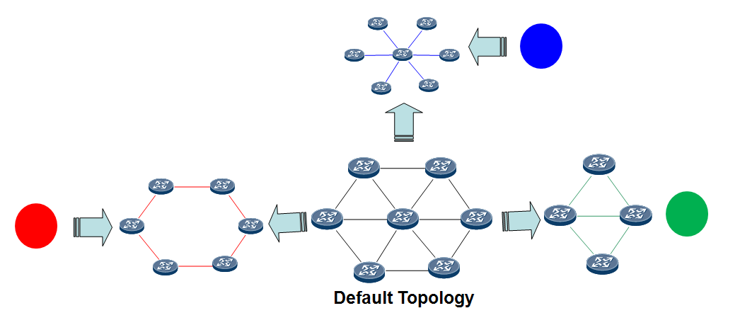
IP RAN Enabling Technologies:
MPLS MT – Network Virtualization
Proposed a new virtual network ID design where the single network ID is used to across the service and IGP/MPLS/SDN/ domains to identify the virtual topology corresponding to each individual abstract topology based on the physical topology where the each topology is corresponding to an VPN service and topology pair.
CE2 (VPN_Gold)
CE1 (VPN_Gold)
PE1
PE2
P1
CE2 (VPN_Green)
CE1 (VPN_Green)
P2

Slide 13
Summary
The technologies described meet the service and technical requirements for todays and tomorrows IP RAN
Rapid deployment of services with flexibility, automation and required Quality of Service (QoS) and Quality of Experience (QoE)
  SDN Framework and controller (ABNO)
Carrier grade availability and reliability
  Deterministic path computation and traffic engineering via PCE
  Smooth Migration and path protection
Effective scaling of network
  Topology-Transparent Zones
  Internal AS management and rapid convergence
Network Virtualization and segmentation for customer, and application types
  MPLS multi-topology

Slide 14
Thanks!

