Slide 1
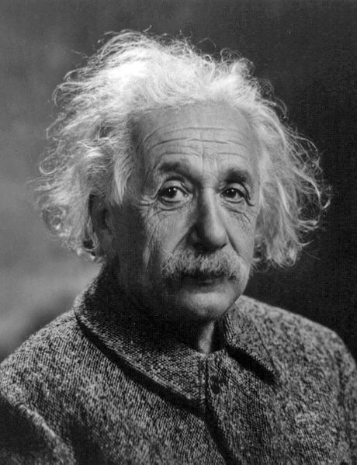
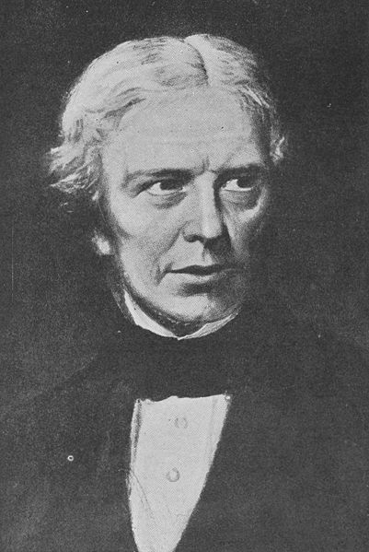
Were Wilson and Wilson right?
A re-evaluation of a classic electromagnetism experiment
Albert Einstein
Michael Faraday
What’s the big argument about?
Let’s use differential forms to solve the problem!
Yes – the Wilsons were right!
In the 1800’s Faraday showed that moving a conductor in a magnetic field created an electric field. Einstein built on this work with his theory of relativity, and expanded it by calculating magnetic fields in moving insulators.
In 1913 Wilson & Wilson performed an experiment seen as a classic confirmation of Einstein’s work. An insulating cylinder was rotated in an axial magnetic field B₀ with
speed Ω , and a radial electric field was measured. Following Einstein’s calculations for a linearly moving slab, Wilson predicted that at low speeds, the field would be
Here r is the distance from the axis of rotation while ε_{r} and μ_{r} are electromagnetic properties of the insulator.
The experiment confirmed the theory, and all was well for 80 years. Then in 1995, Pellegrini & Swift questioned Wilson’s derivation. They argued that because a rotating body and one in linear motion were inherently different, the calculations weren’t valid and the field should be:
The whole basis of special relativity was being questioned.
But using the modern language of differential forms we can solve Maxwell’s equations and the relevant boundary conditions to find a solution in a simple and elegant way.
Now all we do is work through Maxwell’s equations. We choose a suitable ansatz for F giving an axial magnetic field and radial electric field. Then we work out what G is, using the 4-velocity vector V (c is the speed of light):
Solving Maxwell’s equations and boundary conditions for an external axial magnetic field B₀ gives us:
At low speeds, when rΩ<<c, this agrees with Wilson & Wilson’s prediction for the field. So they were right!
Maxwell’s equations:
dF=0
d∗G=0
F is the Maxwell two-form encapsulating the e and B fields, while G is the excitation two-form containing d and H fields.
Boundary conditions:
[F]∧dΦ=0
[∗G]∧dΦ=0
Here Φ represents the boundary. The [ ] symbol means we subtract the value on one side of the boundary from that on the other side, while ∗ and ∧ are special operators.
Constitutive relations:
This is the best bit. The constitutive relation linking F and G is encoded in terms of the 4-velocity vector V. Because the relation is valid for accelerating frames, it can be used for rotating bodies, meaning that we don’t need to worry about Pellegrini & Swift’s argument.
A versatile method for electrodynamics
This procedure can be followed to get solutions for harder problems such as the rotating sphere shown below, or even for problems with time-dependent boundary conditions such as linearly accelerating media.
Ω
Applied asymptotic external electric field e∞ = E₀ dz
What is the induced radial electric field e?
Applied external magnetic field B₀
Rotating dielectric sphere
What magnetic field
is induced inside and outside the dielectric?
Rotating dielectric cylinder
Ω
Cherry Canovan, 2nd year PhD student, Department of Physics. Supervisor: Professor Robin Tucker. Faculty of Science and Technology Research Conference, 15th December 2009

