Slide 1
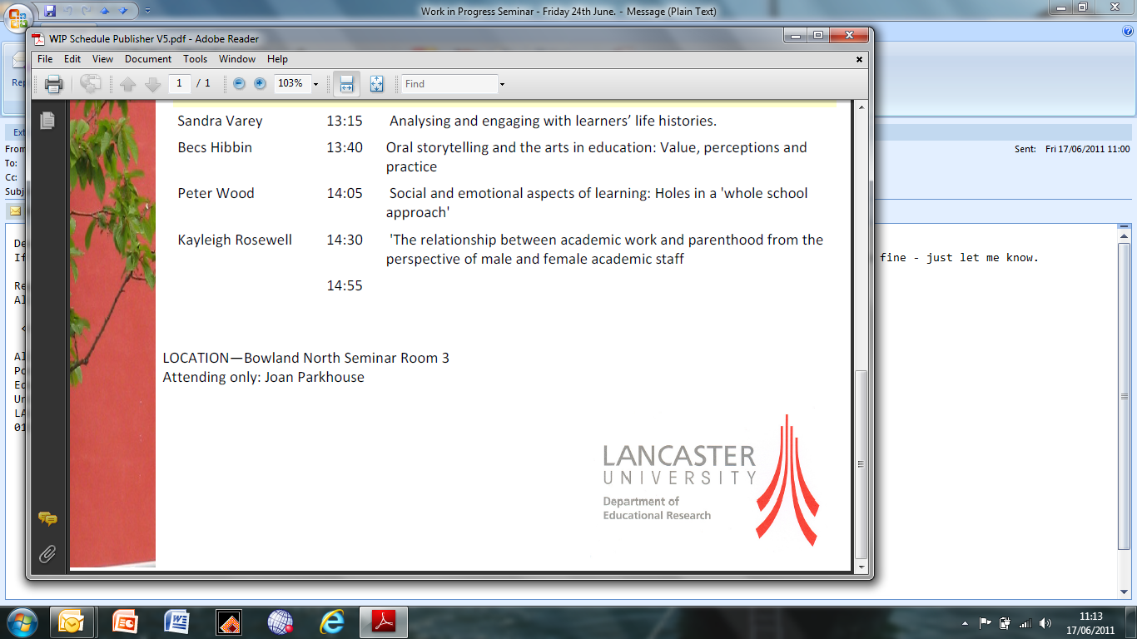
Exploring the under-representation of women in UK Higher Education senior academic leadership through gender and leadership development lenses.
Background
This poster profiles research into the under-representation of women at Vice Chancellor level in UK Higher Education. Less than 15% of Vice Chancellors are women, whereas women make up 51% of the general population, almost 50% of early career academics and, before long, 60% of higher education students. The research presented in this poster explores why so few women are Vice Chancellors, and whether anything can be done to increase the number. It also examines whether leadership development can make a difference to increasing women’s representation in senior academic leadership.
Research Questions
To what extent is the under-representation of women in senior academic leadership a result of gendered senior leadership culture?
How can this culture be interpreted and understood in terms of Communities of Practice of Masculinities?
How well do women academics operate in UK Higher Education senior leadership Communities of Practice of Masculinities?
What is the value of leadership development in addressing the under-representation of women in senior academic leadership?
Research Methods and Mapping of the Literature
This poster addresses a gap in the literature by drawing on data generated by in-depth interviews with 20 women Vice Chancellors/Pro Vice Chancellors across the UK. Most of these interviews were conducted face-to-face, with a small number carried out over the telephone.
Analytical and Theoretical Framework
Paechter’s concept of masculinities and femininities as Communities of Practice is being employed and explored through this project, because of the emphasis in this research on masculinities in higher education academic leadership circles. This theoretical framework will be critically examined, and possibly refined and reinterpreted as a result of this research.
Research Findings and Contribution to Knowledge
This research is examining the under-representation of women at VC level in the UK in order to: contribute to the on-going debate in this area across all sectors; test out the hypothesis around communities of practice of masculinities; and recommend leadership development interventions that will make a difference for women. Themes from the data include: value of confidence, resilience, and ambition; need for sponsorship and support; experience of ‘masculinities’ leadership behaviours; lack of career planning; impact of ‘critical mass’ of women at the top; navigating gendered leadership cultures by fitting in; the private space.
Paula Burkinshaw MA Chartered FCIPD, PGR student, Educational Research, Lancaster University

