Slide 1
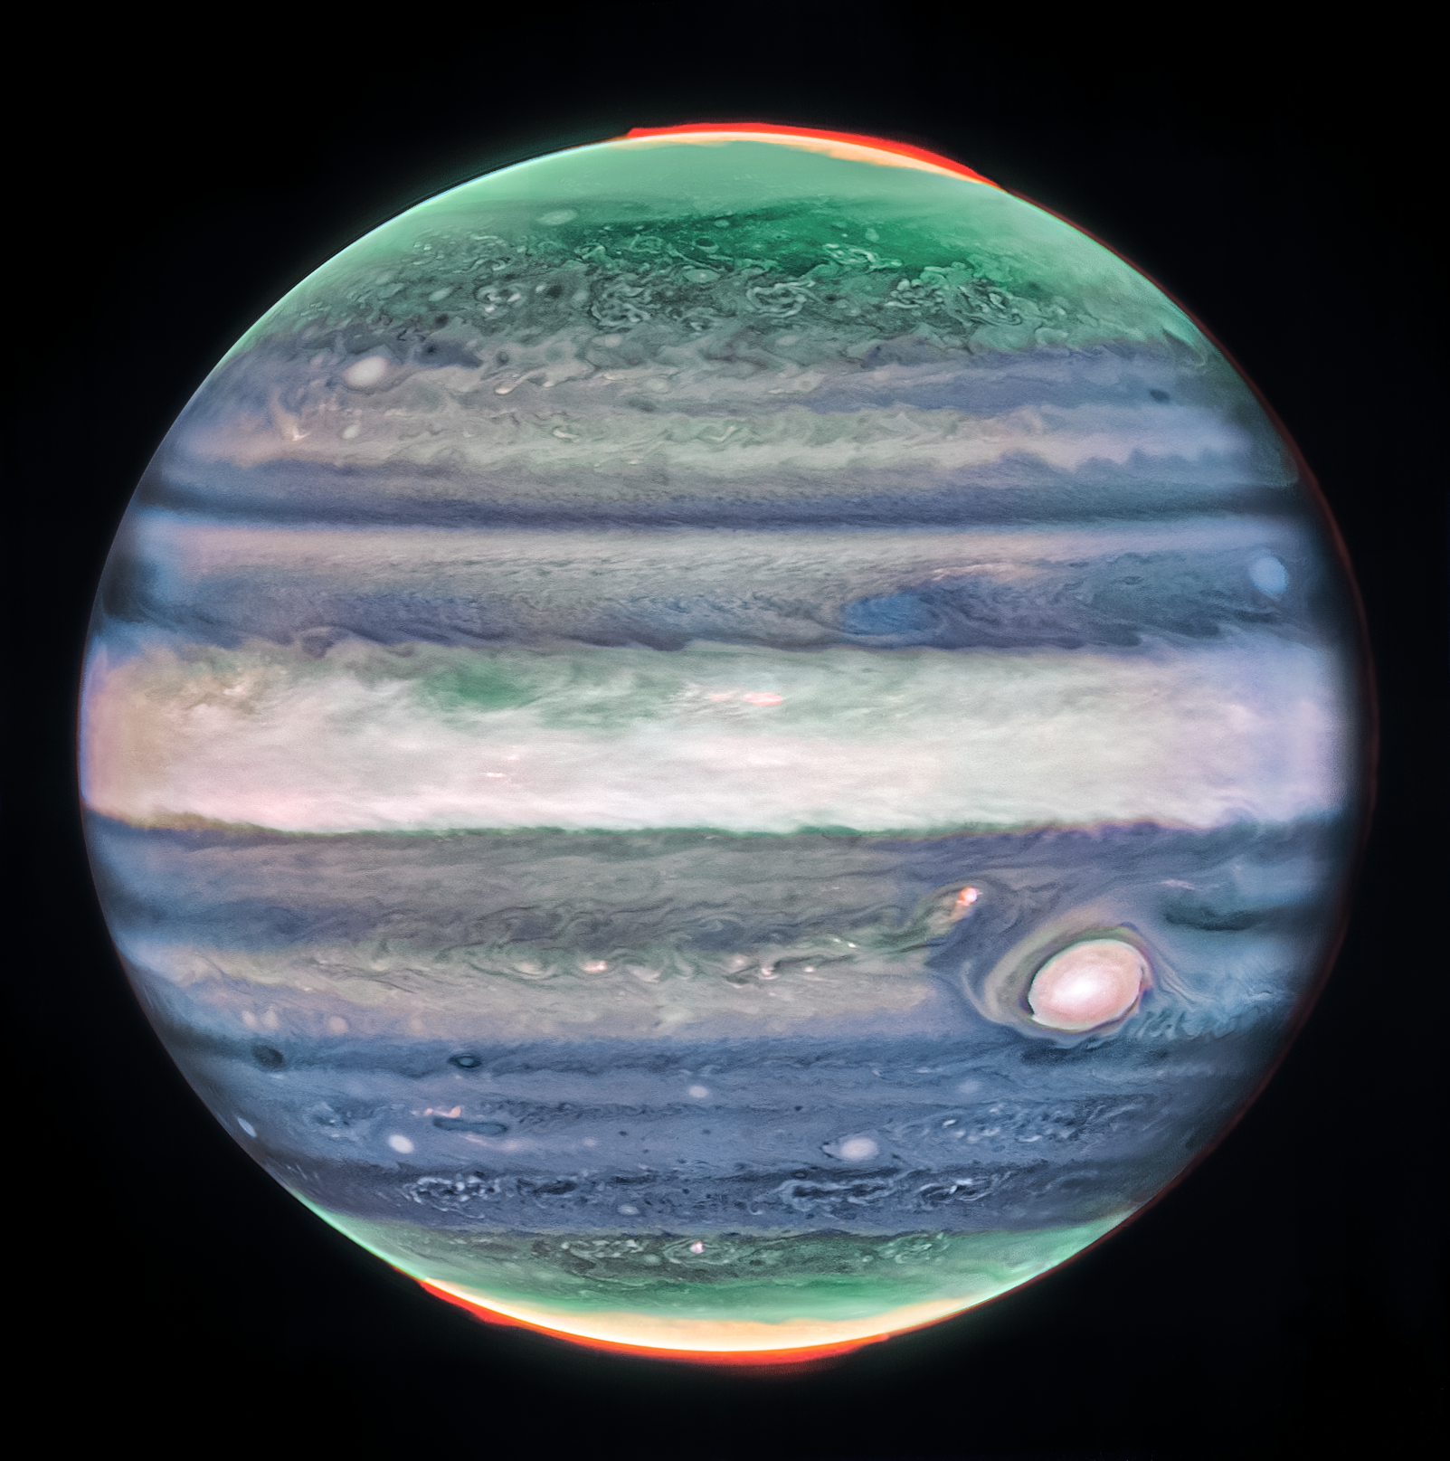
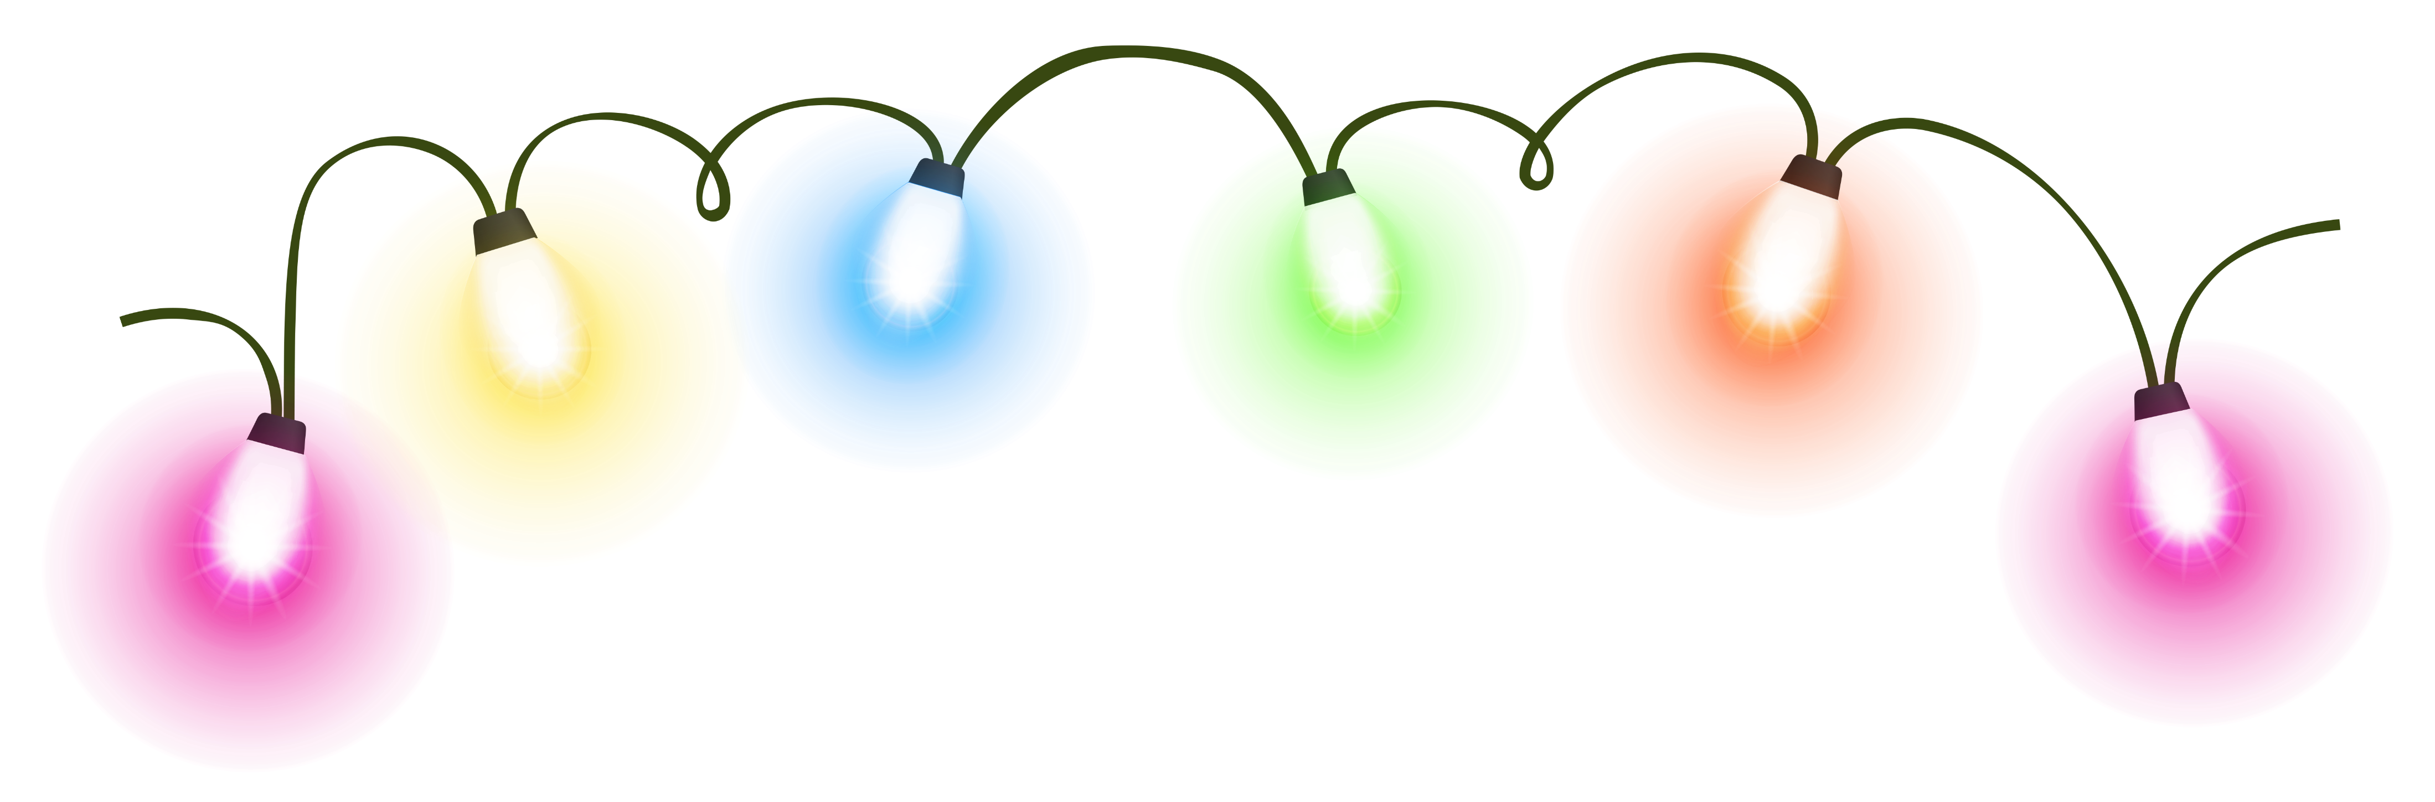
Jupiter’s 1,000,000W Fairy Lights

Slide 2
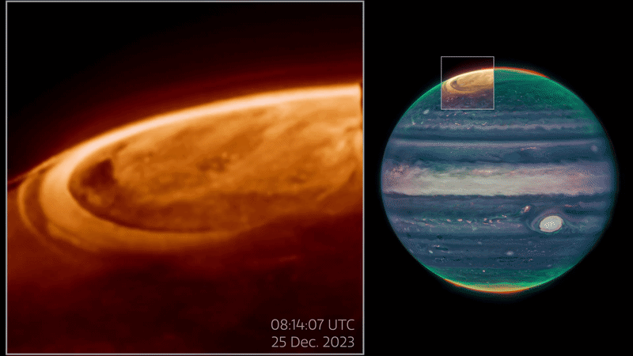
JWST Video of Jupiter’s IR Aurora

Slide 3
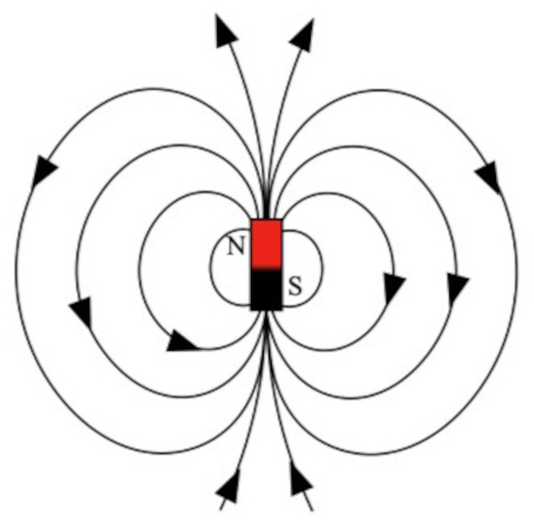
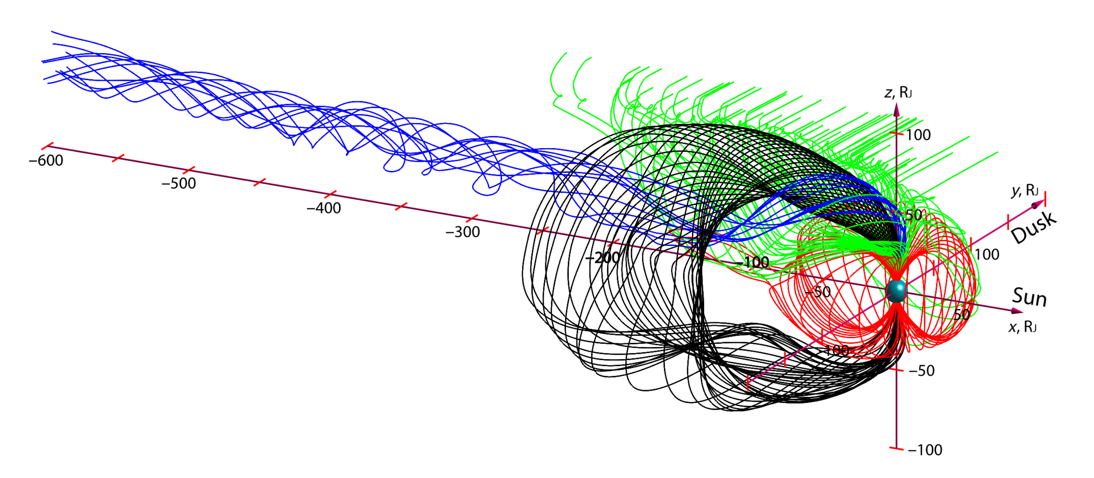
Jupiter’s magnetosphere
Zhang et al., 2021
Jupiter’s magnetosphere is complicated and highly dynamic.
Energetic particles will follow magnetic field lines and precipitate into the atmosphere.
s.farr1@lancaster.ac.uk

Slide 4
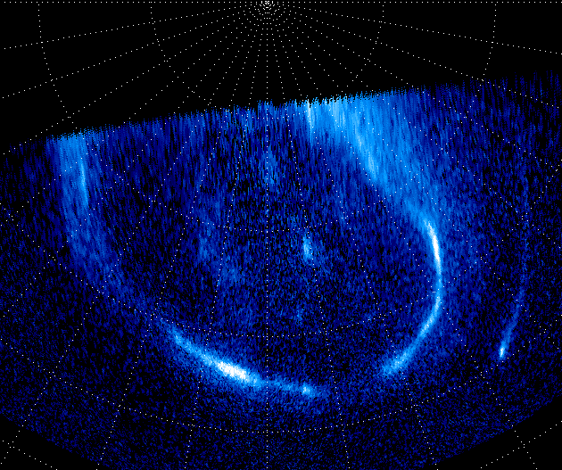
Jupiter’s Northern Aurora using HST
Auroral Beads:
Form within the main emission
Local times between midnight and dawn
Driven by processes ~50R_{J} from Jupiter
Separated longitudinally by ~1,500km
Palmaerts et al., 2024
Notes:
Introduce the connection between aurora and magnetic field.

Slide 5
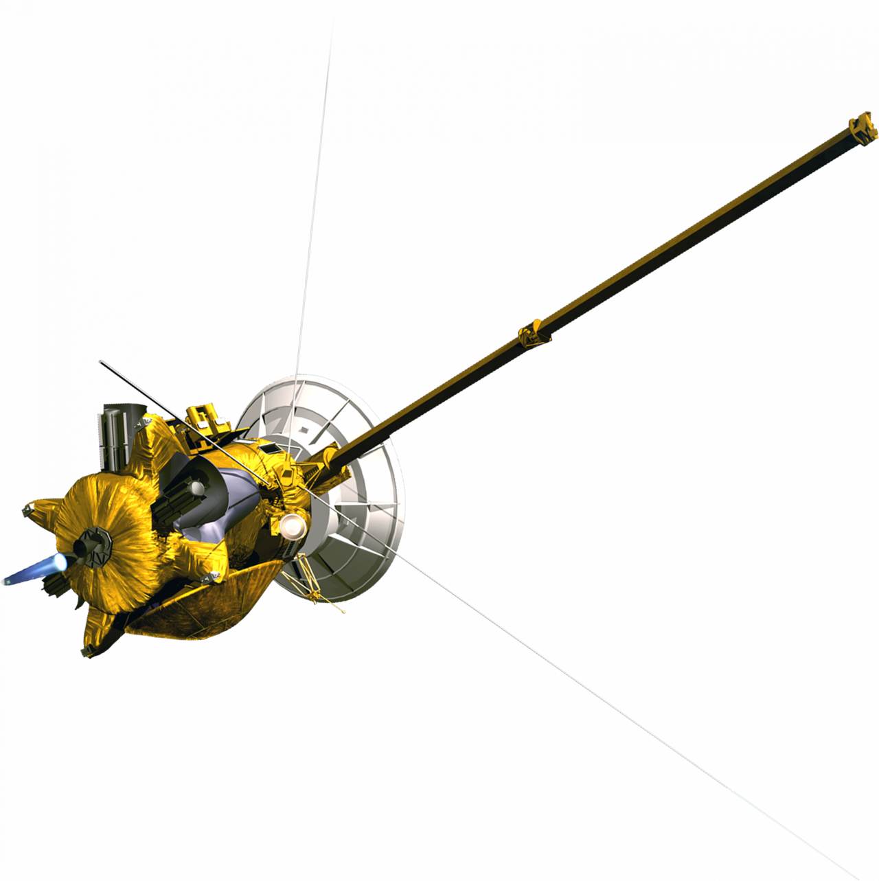
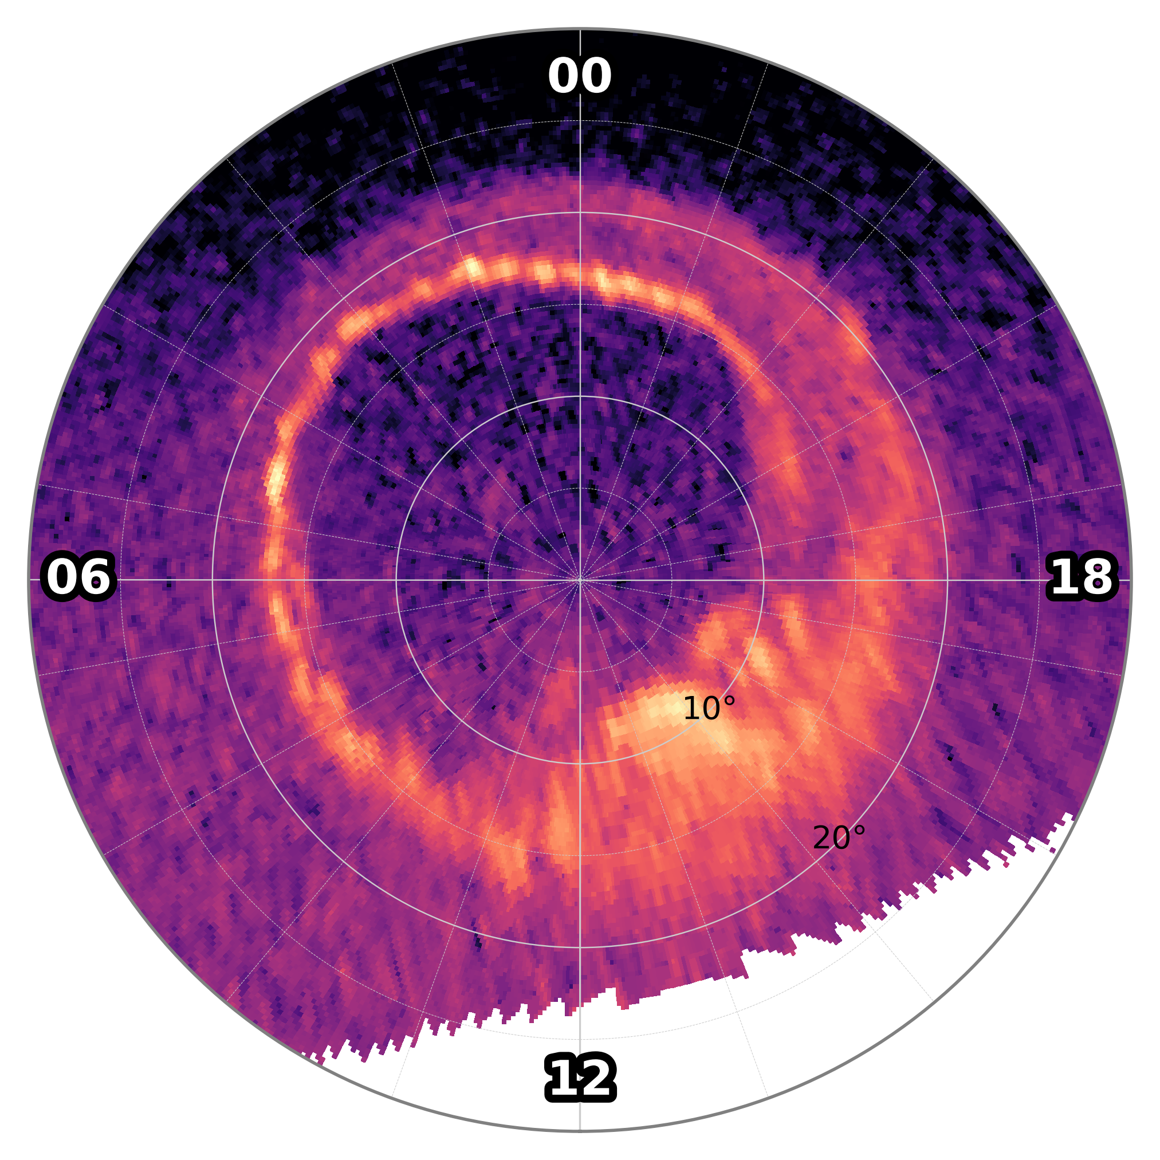
Auroral beads & electron precipitation
UV image of Saturn’s aurora:
s.farr1@lancaster.ac.uk
Notes:
Explain the mapping process for an in-situ spacecraft.

Slide 6
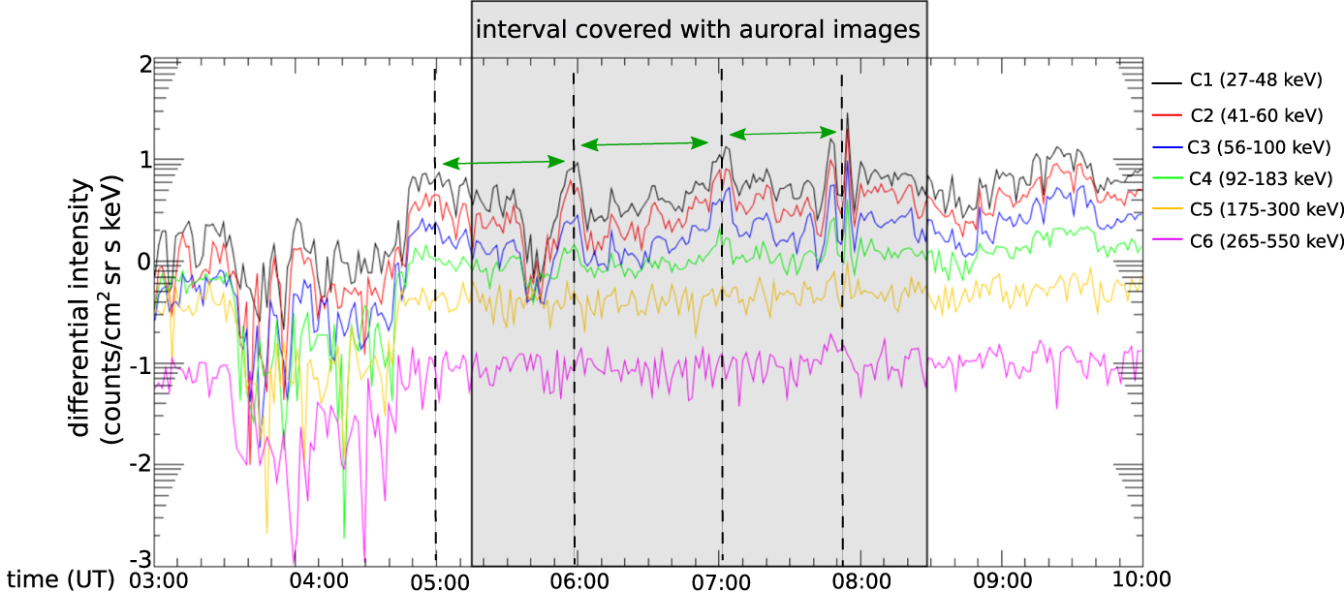
Auroral beads & electron precipitation
UV image of Saturn’s aurora:
Simultaneous energetic electron data:
Radioti et al., 2019
Peaks in low-energy electrons with a ~1hr period, matching the spatial structure of the beads
s.farr1@lancaster.ac.uk
Notes:
Direct connection between aurora enhancements and precipitating electrons.

Slide 7
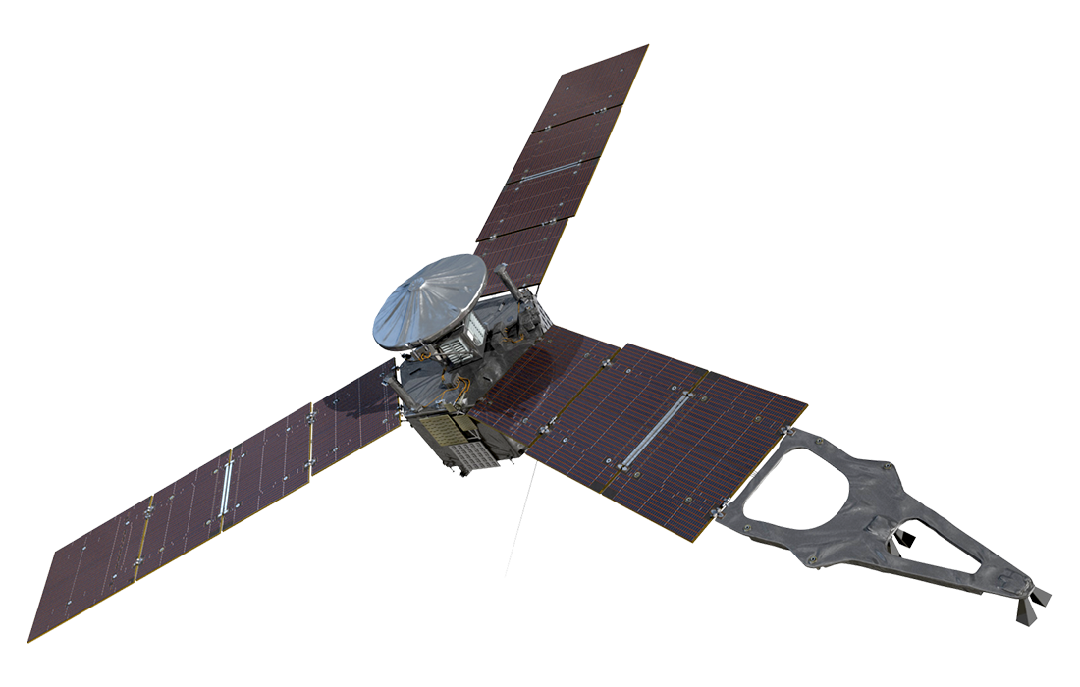
How to investigate them at Jupiter
We will use the Juno spacecraft that’s been orbiting Jupiter since 2016.
Relevant instrumentation:
  Energetic particle detector (JADE/JEDI)
  Magnetometer (MAG)
  Ultraviolet spectrograph (UVS)
Look for signatures with periodicities matching auroral beads.
Talk TLDR:
Jupiter’s magnetic field is complicated and dynamic
Within the similarly complicated aurorae, we occasionally see transient ‘auroral beads’
How these form is a mystery, but analysis of in-situ particle/field data feasible
s.farr1@lancaster.ac.uk

