Slide 1
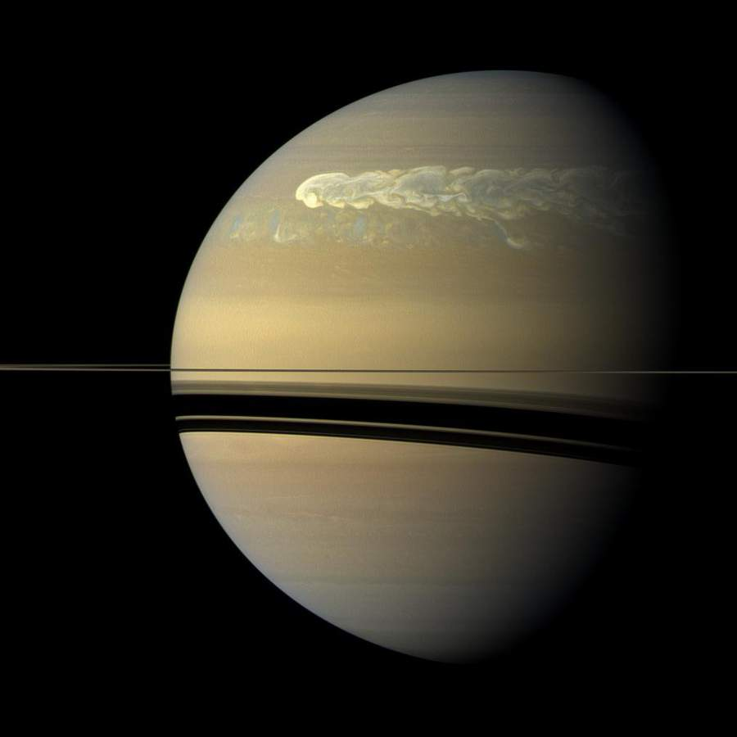
Investigating the magnetosphere-ionosphere coupling currents driving auroral emission in Saturn’s southern hemisphere
Sam Farr¹, Sarah Badman¹, Licia Ray¹, Gabrielle Provan², Stan Cowley²
¹Lancaster University ²University of Leicester

Slide 2
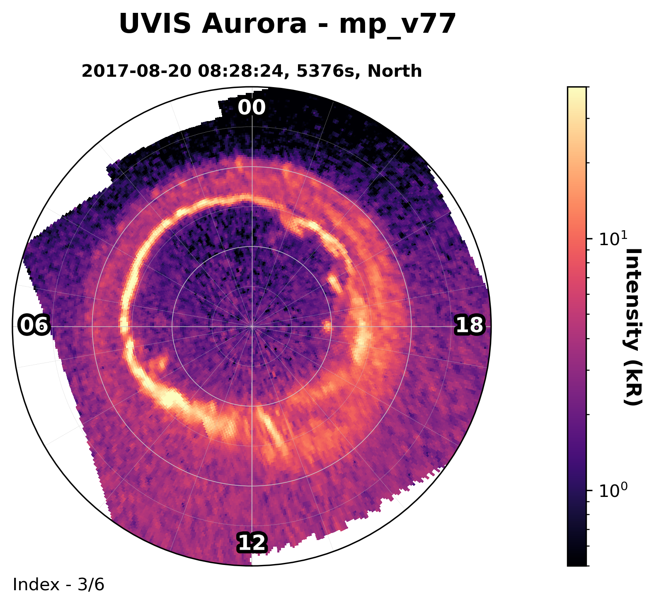
Study Question
1
Saturn rapidly rotates every 10.5hrs
Magnetosphere is filled with material predominantly from Enceladus
Axially symmetric within ~8Rs¹
Aurora generated via flow shears in magnetospheric plasma
Why do we see different structures between dawn and dusk in UVIS images? What processes may be driving the dusk variability?
¹Bunce et al., 2003

Slide 3
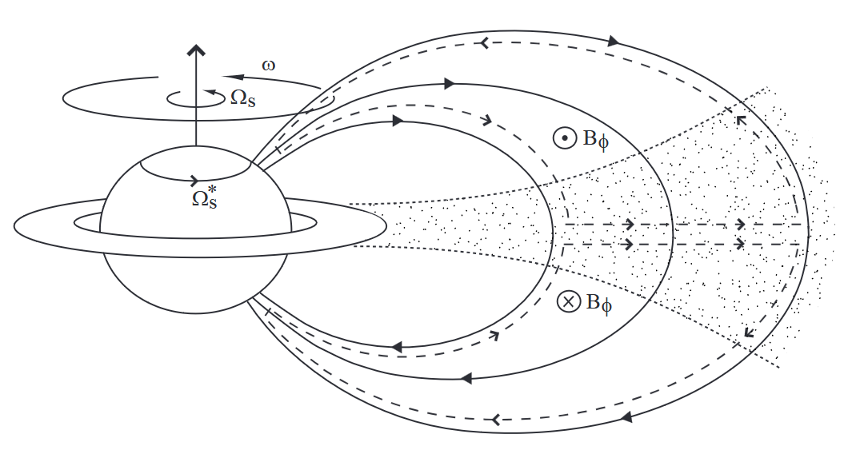
Saturn FAC Systems
Subcorotation
2
Field lines loaded with material ejected from Enceladus (4Rs)
Mass-loading of equatorial field lines drive FACs that close in the ionosphere
(Bunce et al., 2003)

Slide 4
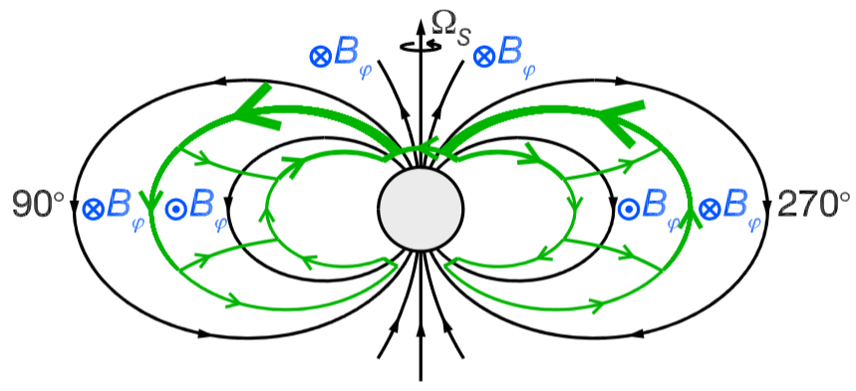
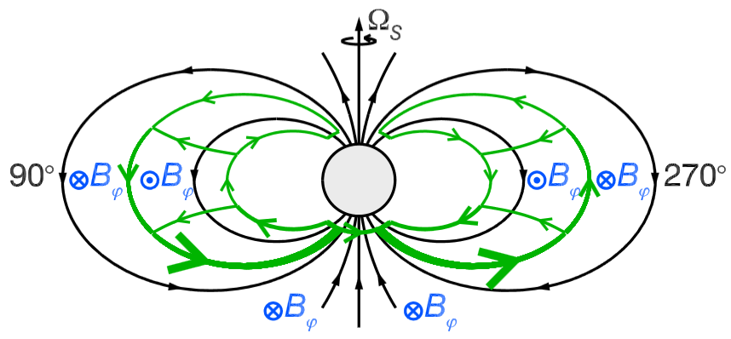
Saturn FAC Systems
Planetary Period Oscillations (PPOs)
3
Not axially symmetric
Rotating with periods of 10.8hrs (north) and 10.7hrs (south)
Magnitude and period varies with season¹
(Hunt et al., 2014)
¹Provan et al., 2019

Slide 5
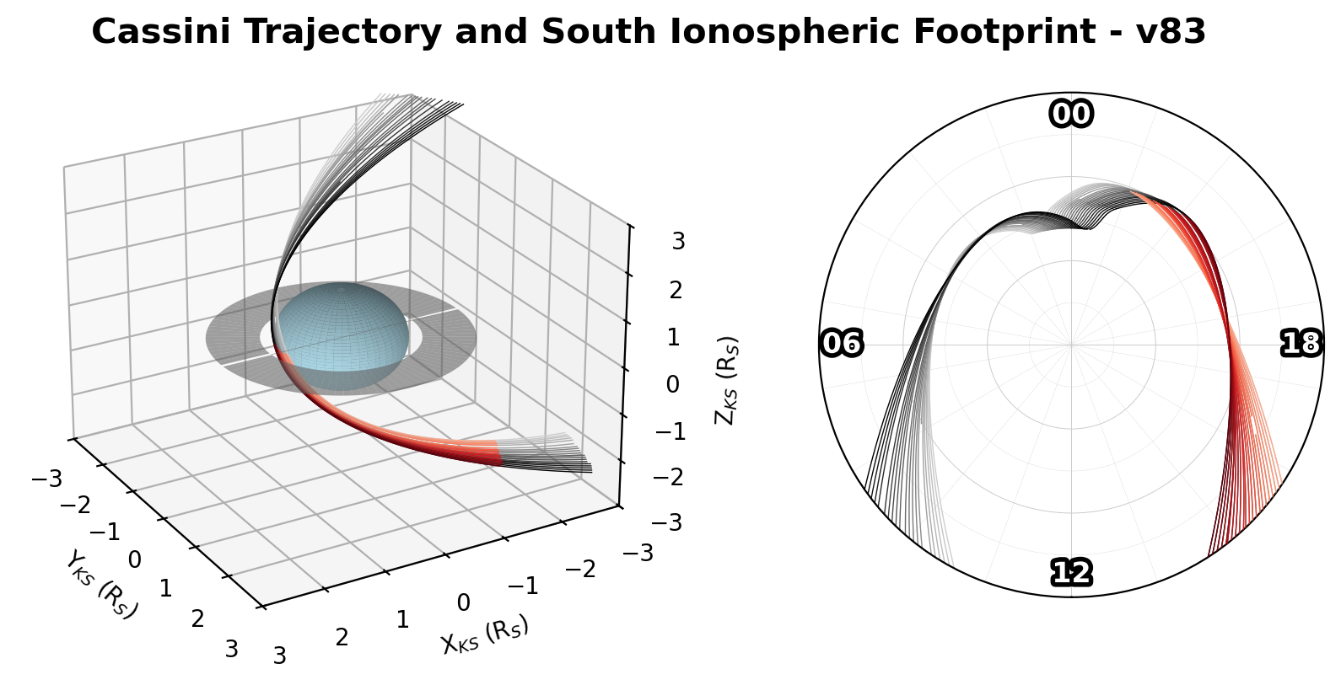
Cassini-Huygens Dataset
4
Magnetometer data from final 22 orbits (April – September 2017)

Slide 6
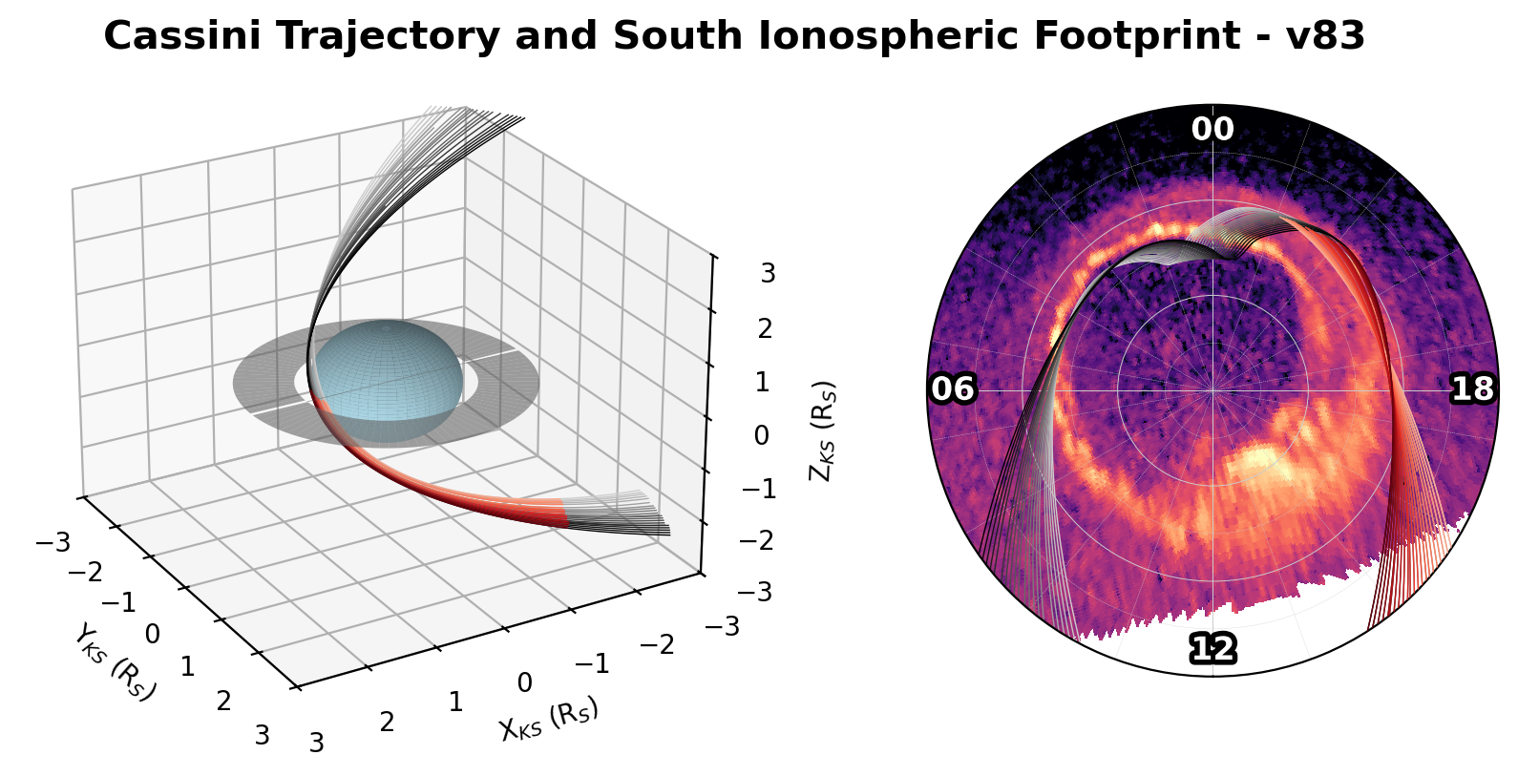
Cassini-Huygens Dataset
4
Magnetometer data from final 22 orbits (April – September 2017)
Multiple similar orbits, covering 15-19hr local time
Trajectory sweeps azimuthally through FAC region
FAC crossing occurs over ~1hr of 154hr orbit

Slide 7
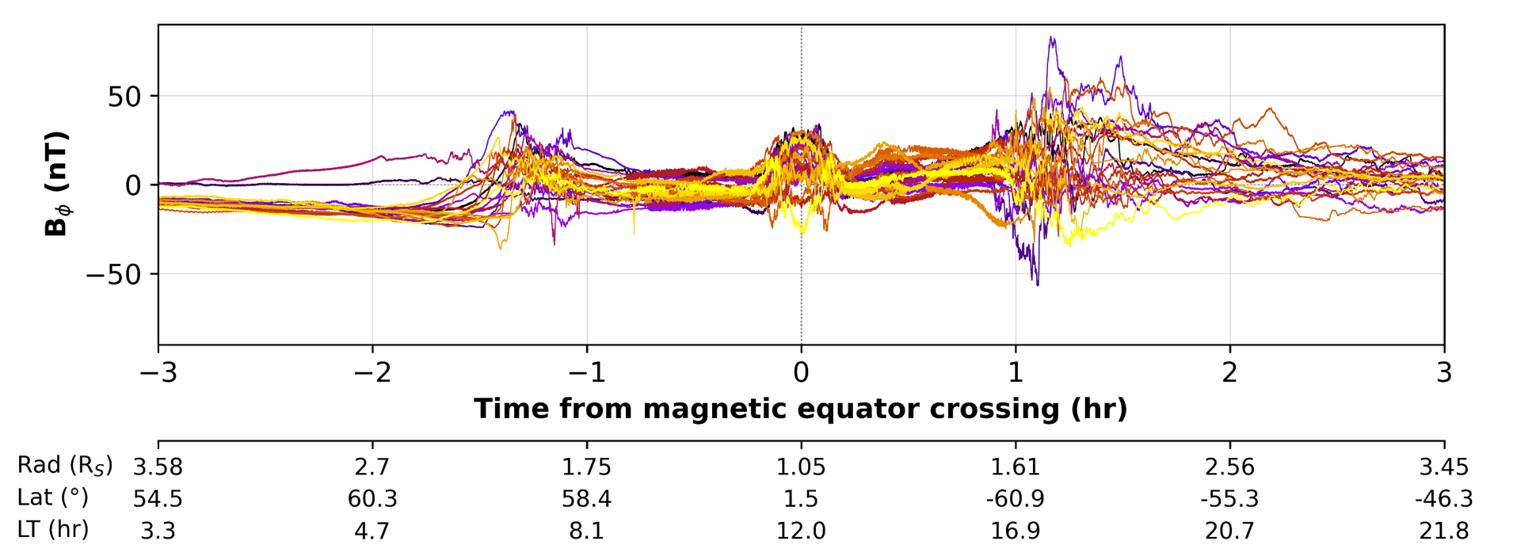
Cassini-Huygens Dataset
4
Magnetometer data from final 22 orbits (April – September 2017)
Multiple similar orbits, covering 15-19hr local time
Trajectory sweeps azimuthally through FAC region
FAC crossing occurs over ~1hr of 154hr orbit

Slide 8
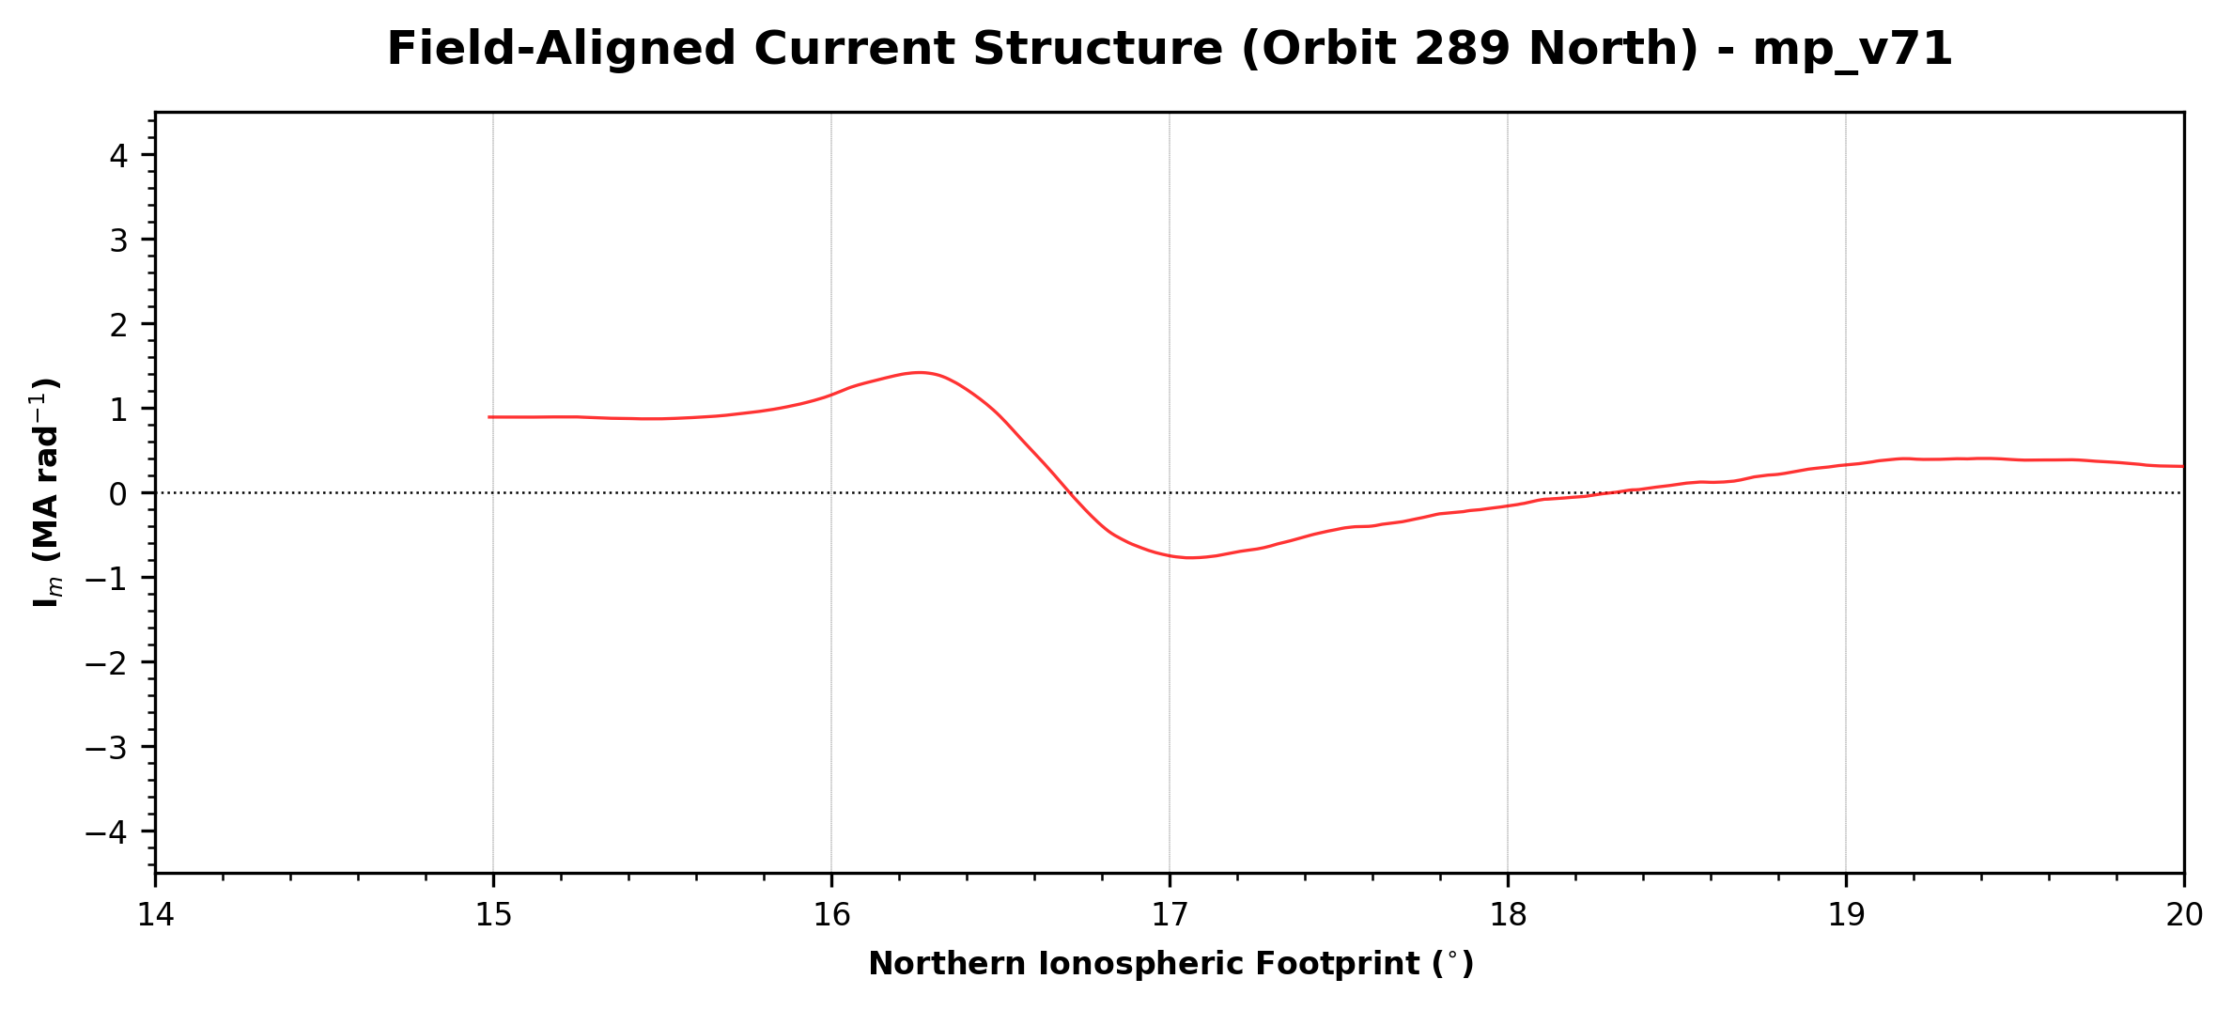
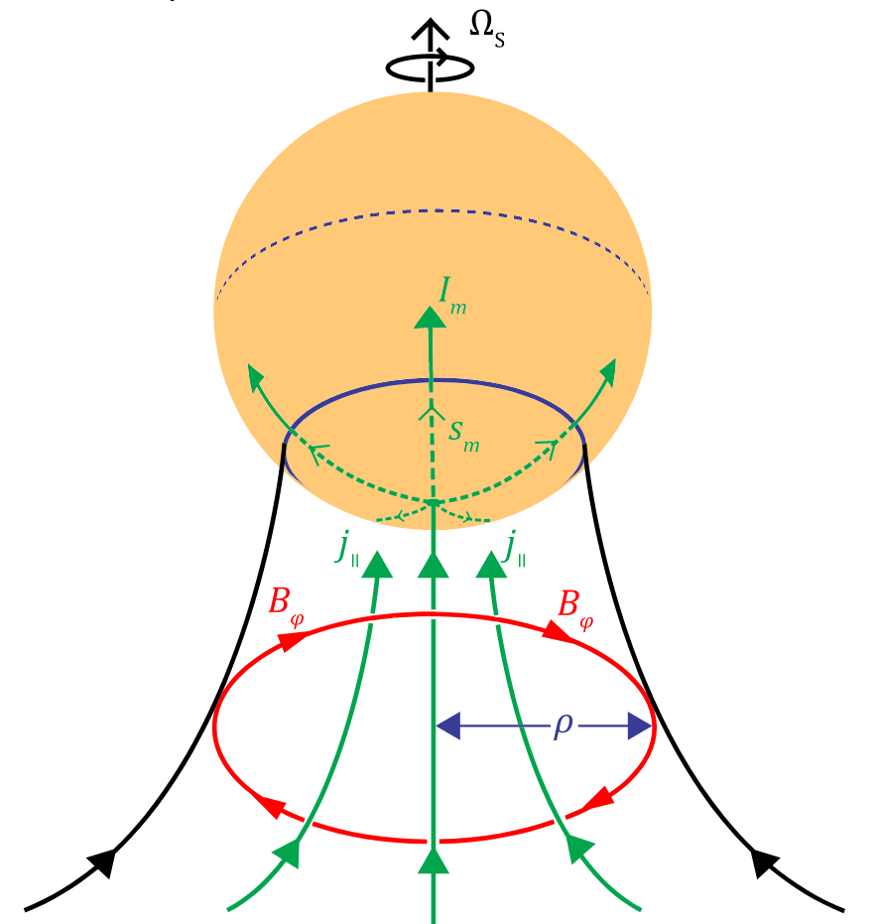

Determining FAC Magnitude
5
Using Ampere’s law, we determine the ionospheric meridional current:
$$I_{m}=−\frac{ρB_{φ}}{μ_{0}}$$
(Hunt et al., 2014)
Notes:
Repeat picking out the up/down currents on algorithm plot

Slide 9
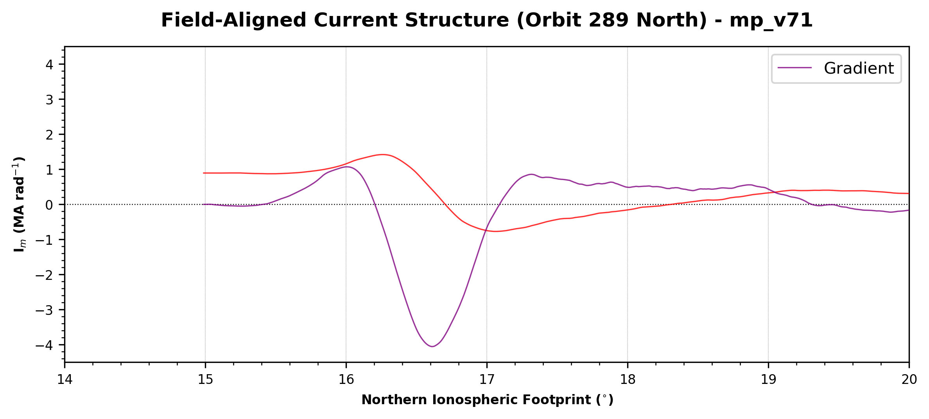
Determining FAC Magnitude
5
Using Ampere’s law, we determine the ionospheric meridional current:
$$I_{m}=−\frac{ρB_{φ}}{μ_{0}}$$
(Hunt et al., 2014)
Notes:
Repeat picking out the up/down currents on algorithm plot

Slide 10
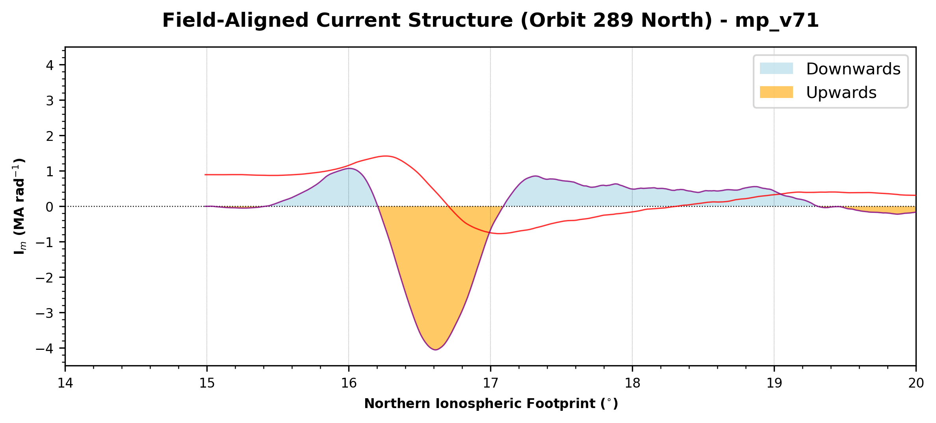
Determining FAC Magnitude
5
Using Ampere’s law, we determine the ionospheric meridional current:
$$I_{m}=−\frac{ρB_{φ}}{μ_{0}}$$
(Hunt et al., 2014)
Notes:
Repeat picking out the up/down currents on algorithm plot

Slide 11
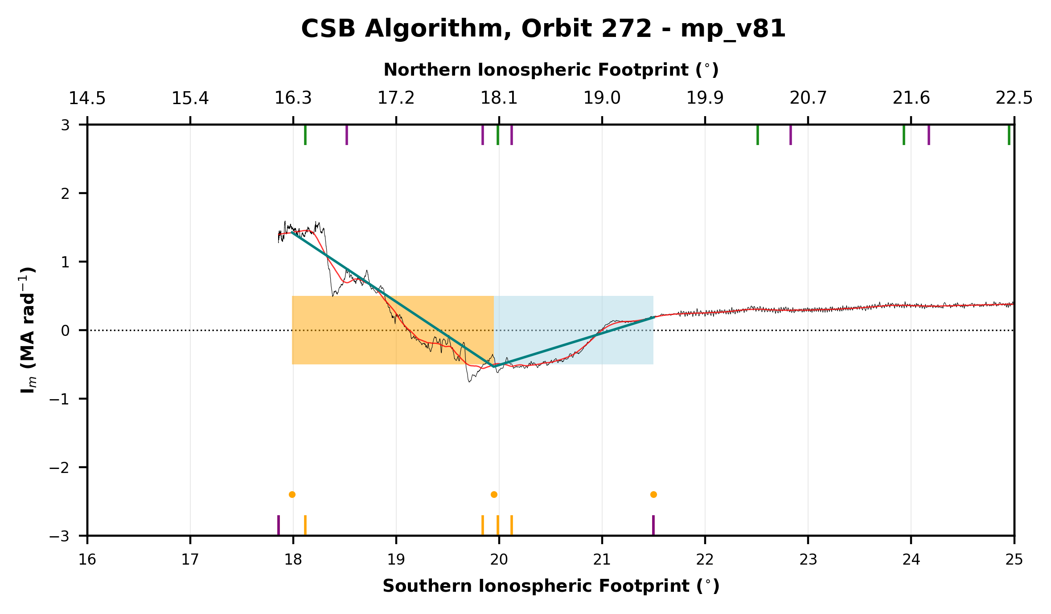
Determining FAC Magnitude
5
Using Ampere’s law, we determine the ionospheric meridional current:
$$I_{m}=−\frac{ρB_{φ}}{μ_{0}}$$
(Hunt et al., 2014)
Notes:
Repeat picking out the up/down currents on algorithm plot

Slide 12
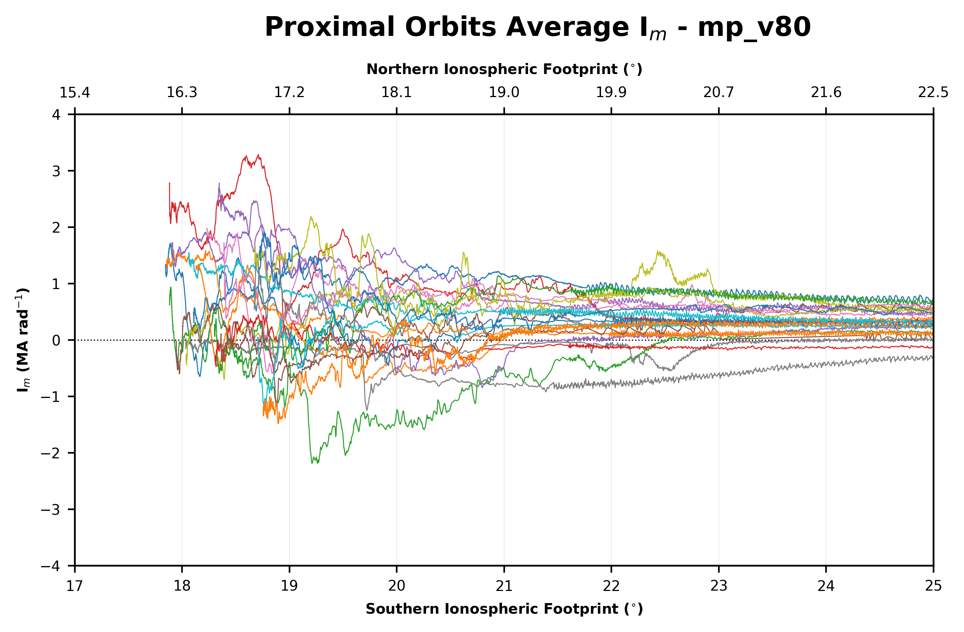
Average I_{m} Profile
6
Increased variability ~18-21°
Poleward limit is constrained by orbital trajectory
Some examples of atypical FAC widths 1-3°, 1-2 MA rad⁻¹ upwards and ~0.5 MA rad⁻¹ downwards
Regularly, multiple thin sheets <1° in width, <5 MA rad⁻¹ of either sense

Slide 13
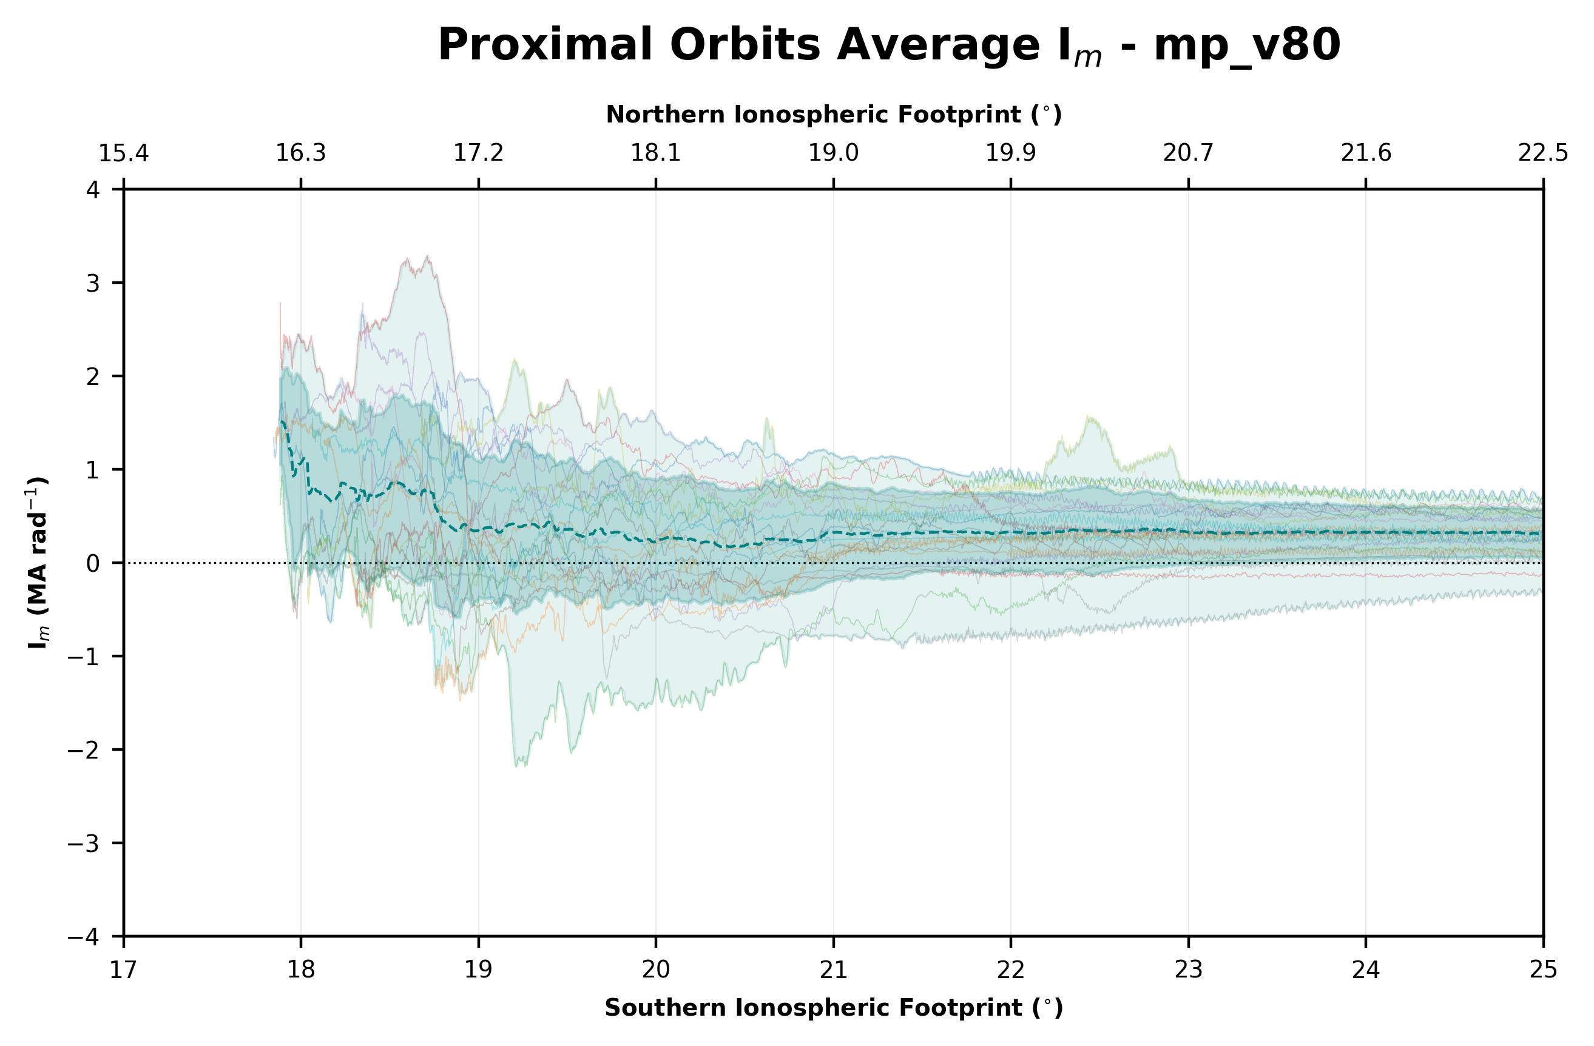
Average I_{m} Profile
6
Increased variability ~18-21°
Broadly decreasing I_{m} suggesting distributed upwards FACs
Poleward limit is constrained by orbital trajectory
+ve I_{m} indicates lagging B-field on this field line, -ve indicates leading

Slide 14
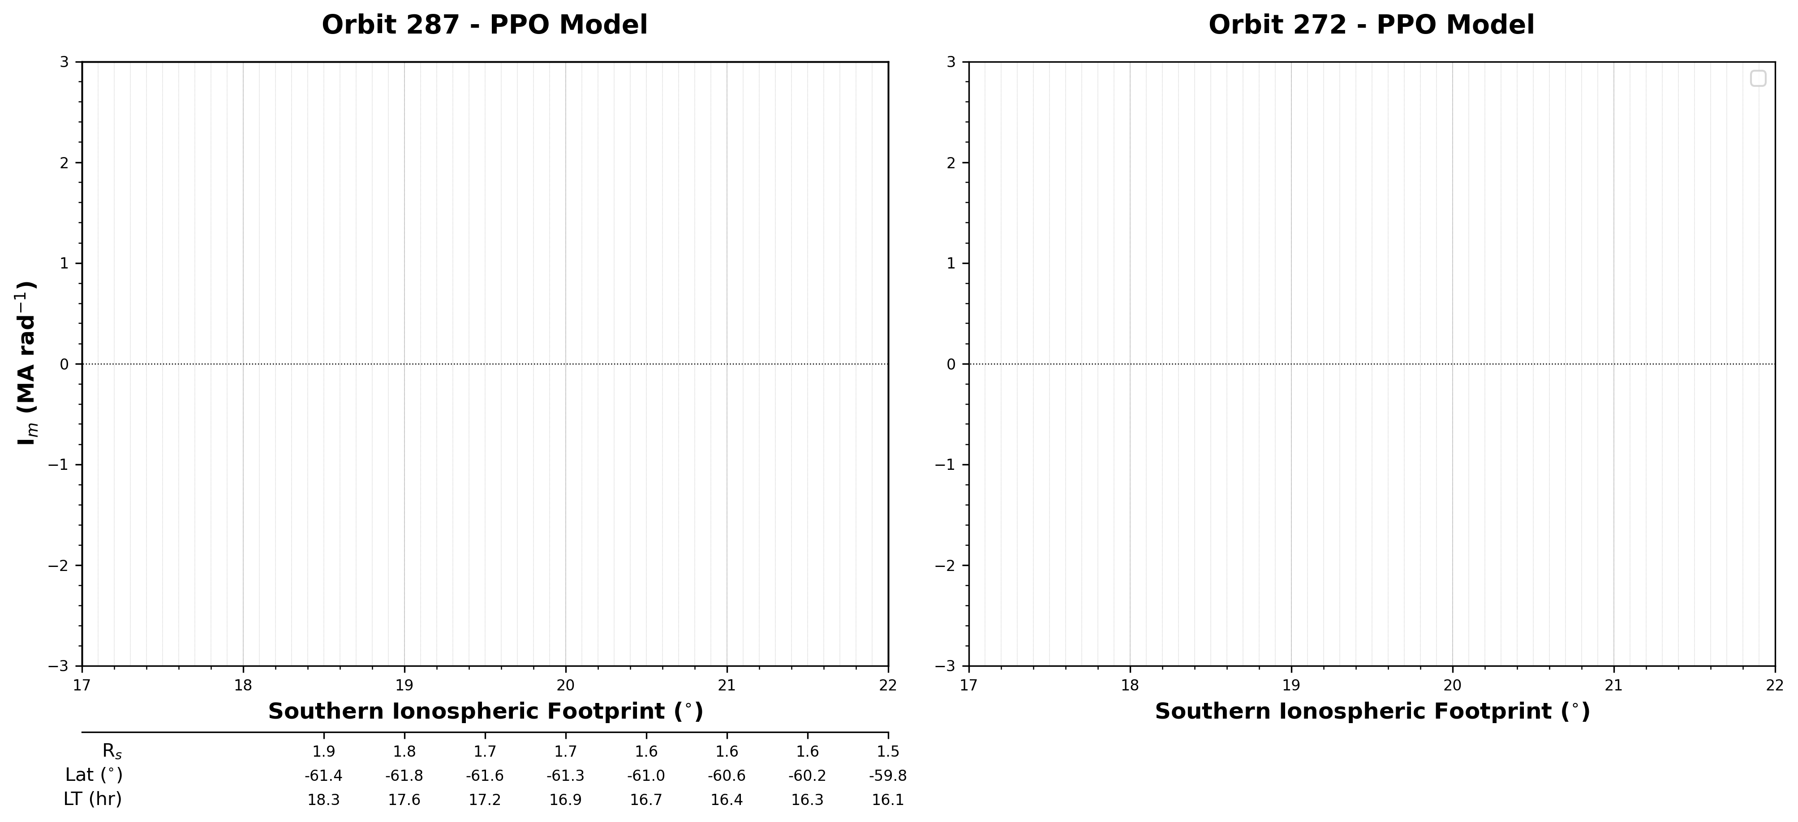
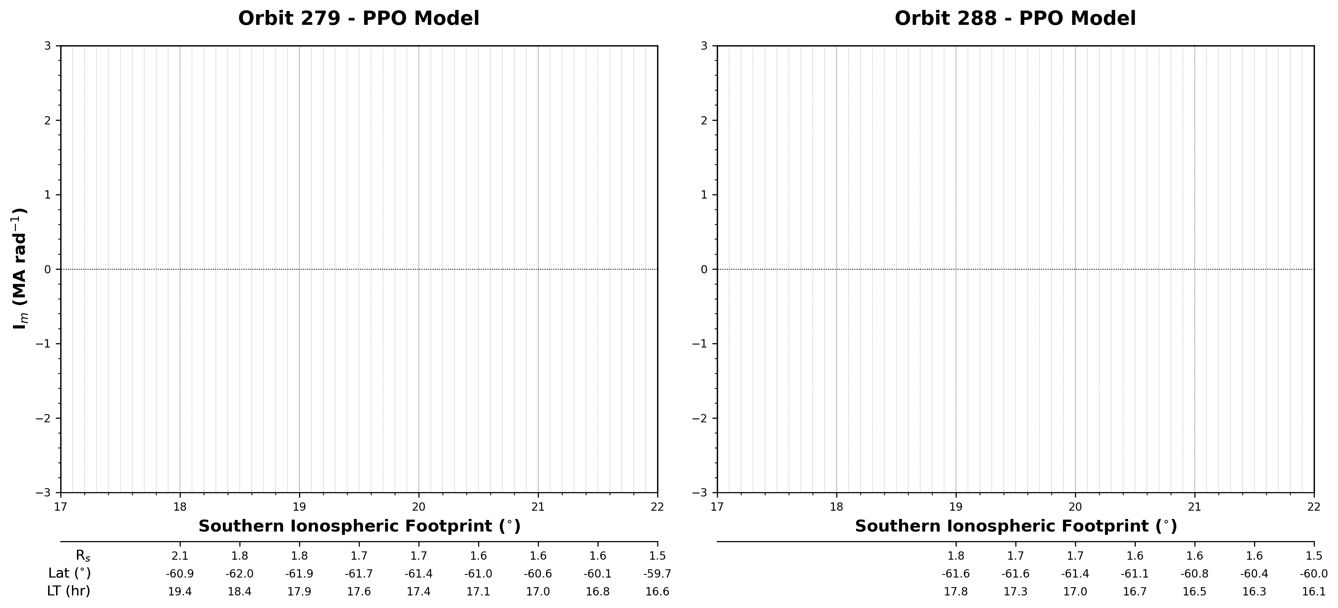
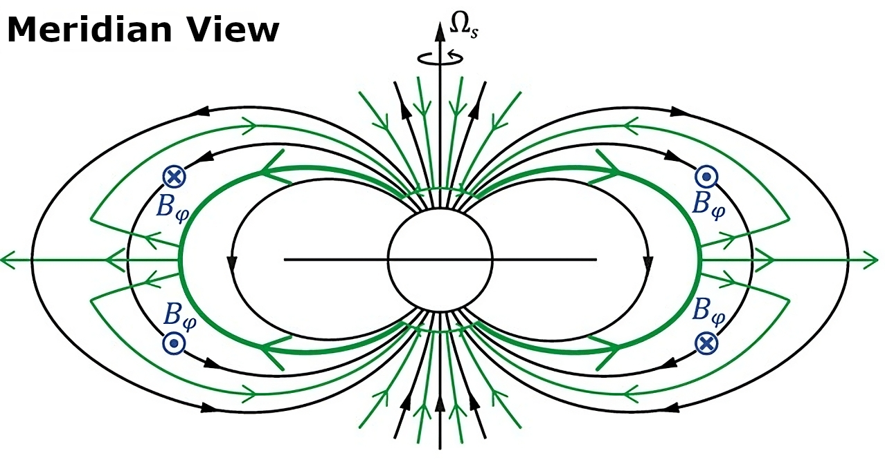
PPO Modelling
7
FAC Structure Reminder
Subcorotation:
Bradley et al., 2018
PPOs (North/South):
Hunt et al., 2014

Slide 15
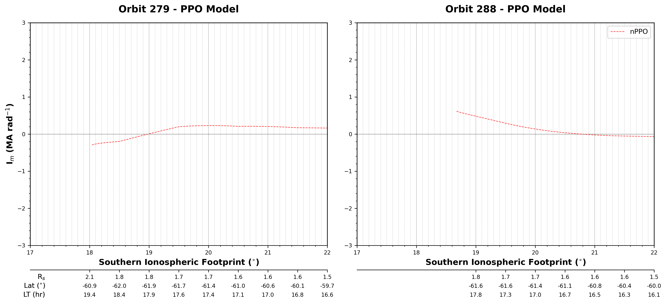
PPO Modelling
7
FAC Structure Reminder
Subcorotation:
Bradley et al., 2018
PPOs (North/South):
Hunt et al., 2014
Notes:
Assumption – only large-scale variations are PPO-related
Andrews et al., 2010

Slide 16
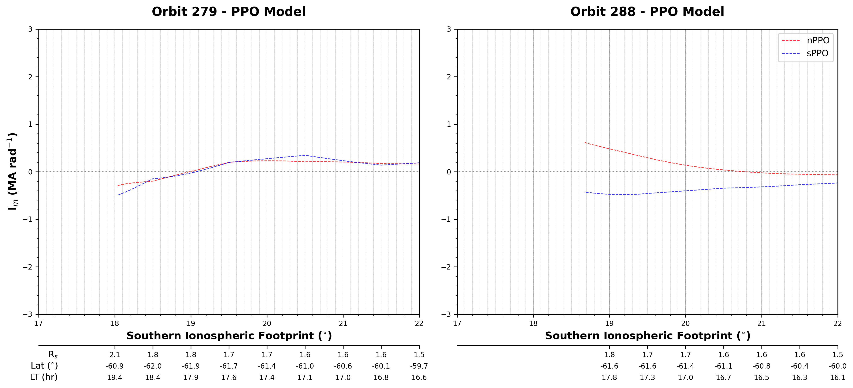
PPO Modelling
7
FAC Structure Reminder
Subcorotation:
Bradley et al., 2018
PPOs (North/South):
Hunt et al., 2014

Slide 17
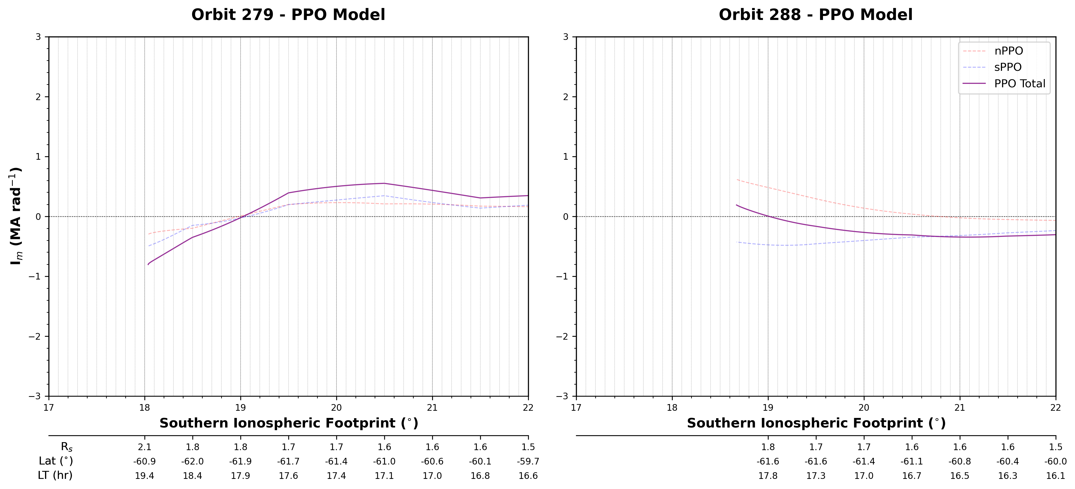
PPO Modelling
7
FAC Structure Reminder
Subcorotation:
Bradley et al., 2018
PPOs (North/South):
Hunt et al., 2014

Slide 18
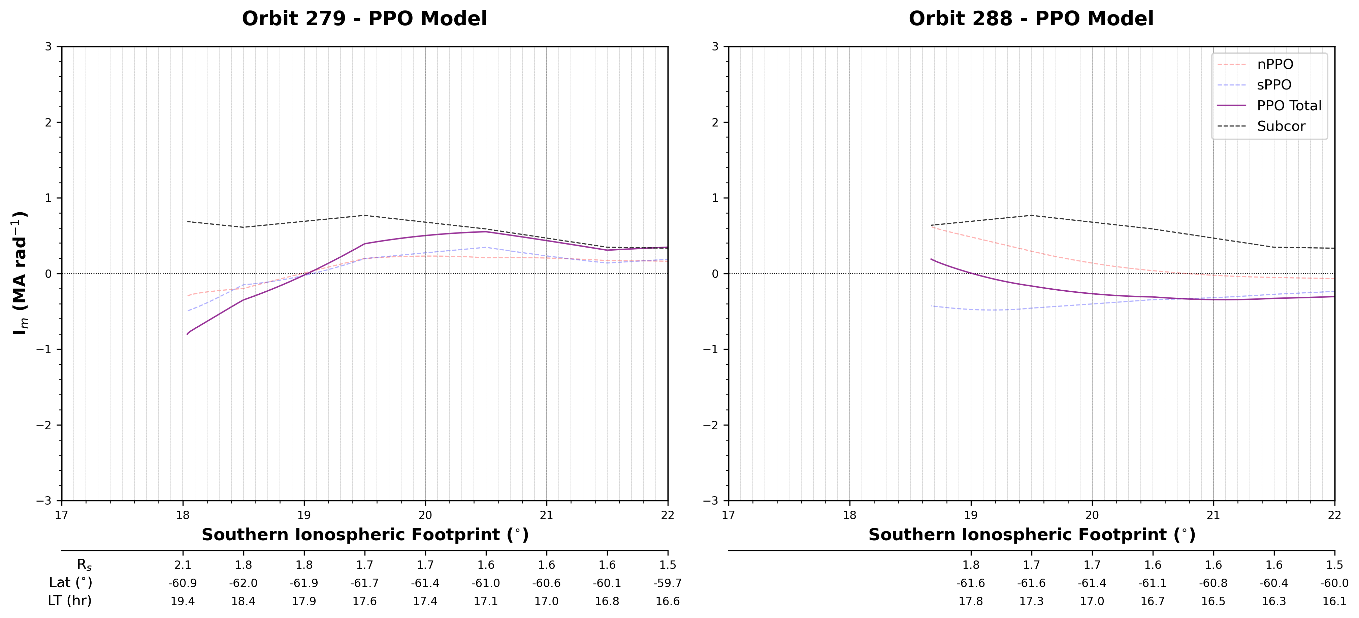
PPO Modelling
7
FAC Structure Reminder
Subcorotation:
Bradley et al., 2018
PPOs (North/South):
Hunt et al., 2014

Slide 19
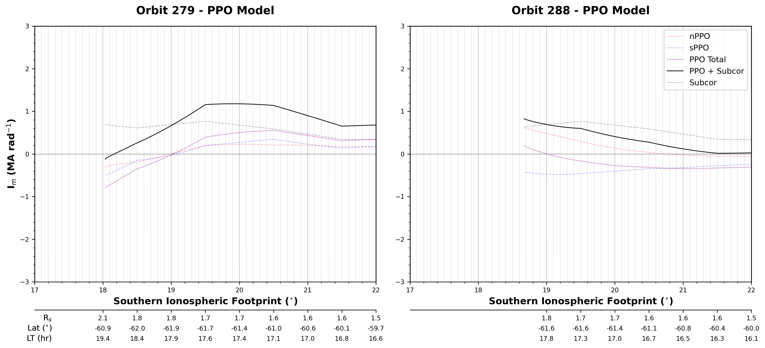
PPO Modelling
7
FAC Structure Reminder
Subcorotation:
Bradley et al., 2018
PPOs (North/South):
Hunt et al., 2014

Slide 20
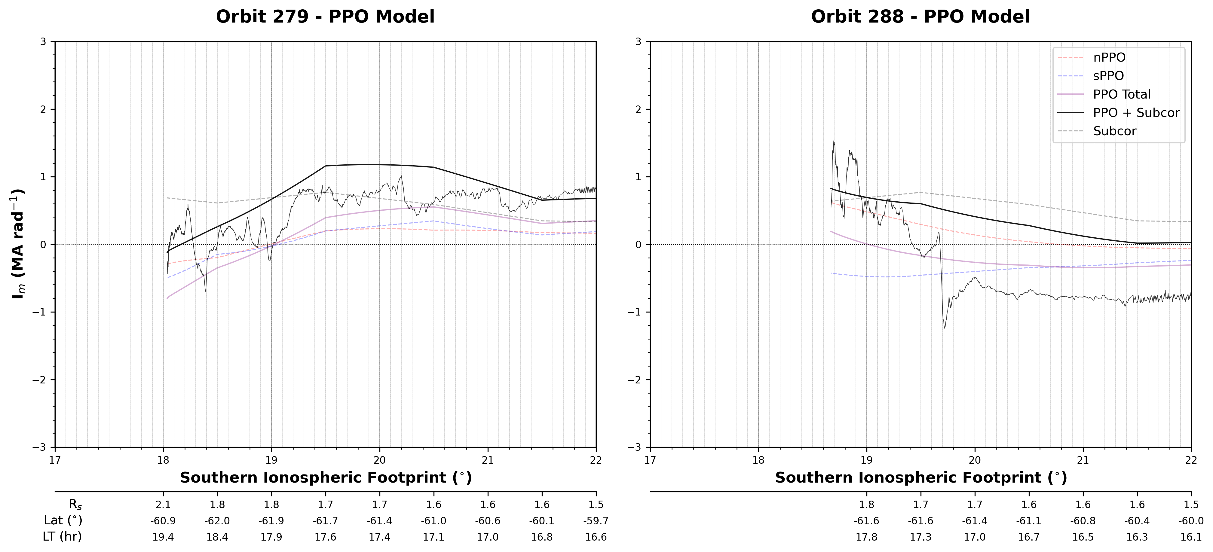
PPO Modelling
7
FAC Structure Reminder
Subcorotation:
Bradley et al., 2018
PPOs (North/South):
Hunt et al., 2014

Slide 21
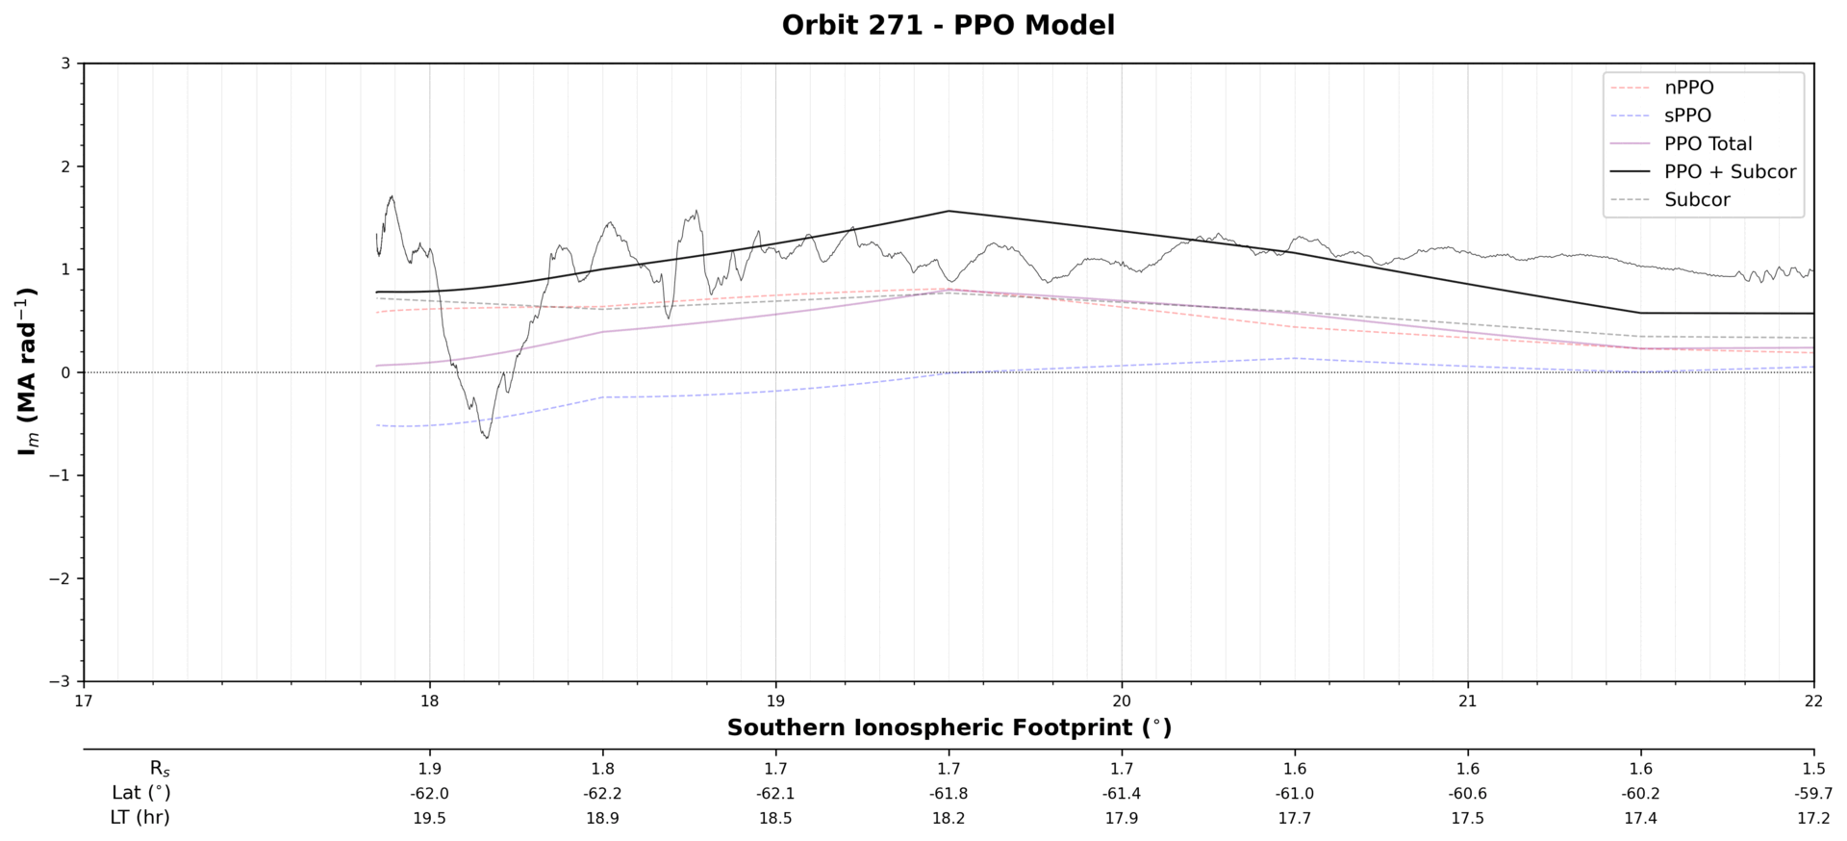
PPO Modelling
8
PPOs influence broad structure, deviations of up to ~1 MA rad⁻¹ occur across colatitude range
Other magnetospheric drivers must drive finer scale structure, independent of PPO systems

Slide 22
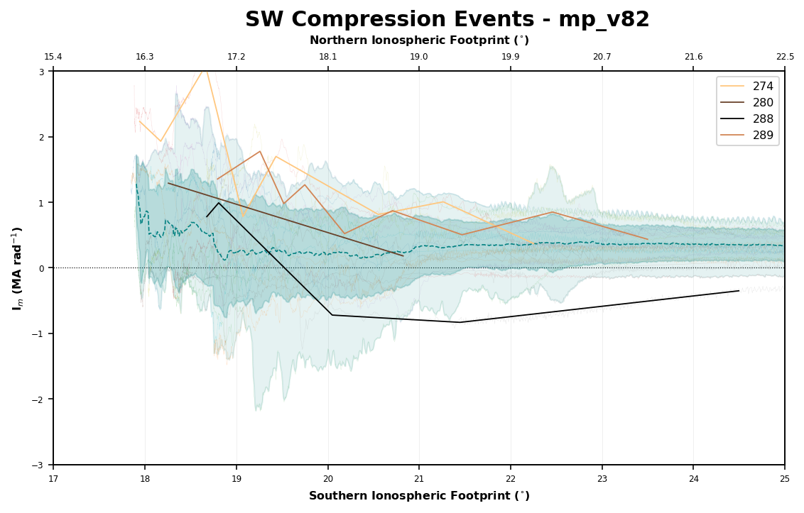
Solar Wind Influences
9
Solar wind compression event times from Bradley et al., 2018
Meredith et al., 2018 determines SW driven auroral emission lifetime of ~10-20hrs
Enhanced upwards FAC could support existence of partial ring current
Leading field late into compression could support fast return flows
Orbit | Time between SW compression start and observation (hrs)
274 | 17
289 | 25
280 | 54
288 | 84

Slide 23
Conclusions
10
FAC structure on the dusk side is highly variable with a greater number of thin sheets forming than during dawn. Average lagging behaviour.
PPO systems influence broad structure, some cases see deviation, small scale structures aren’t PPO driven.
Passes under SW compression show initial filamentation and strong lagging configuration. Transitioning to a smooth, leading configuration.

Slide 24
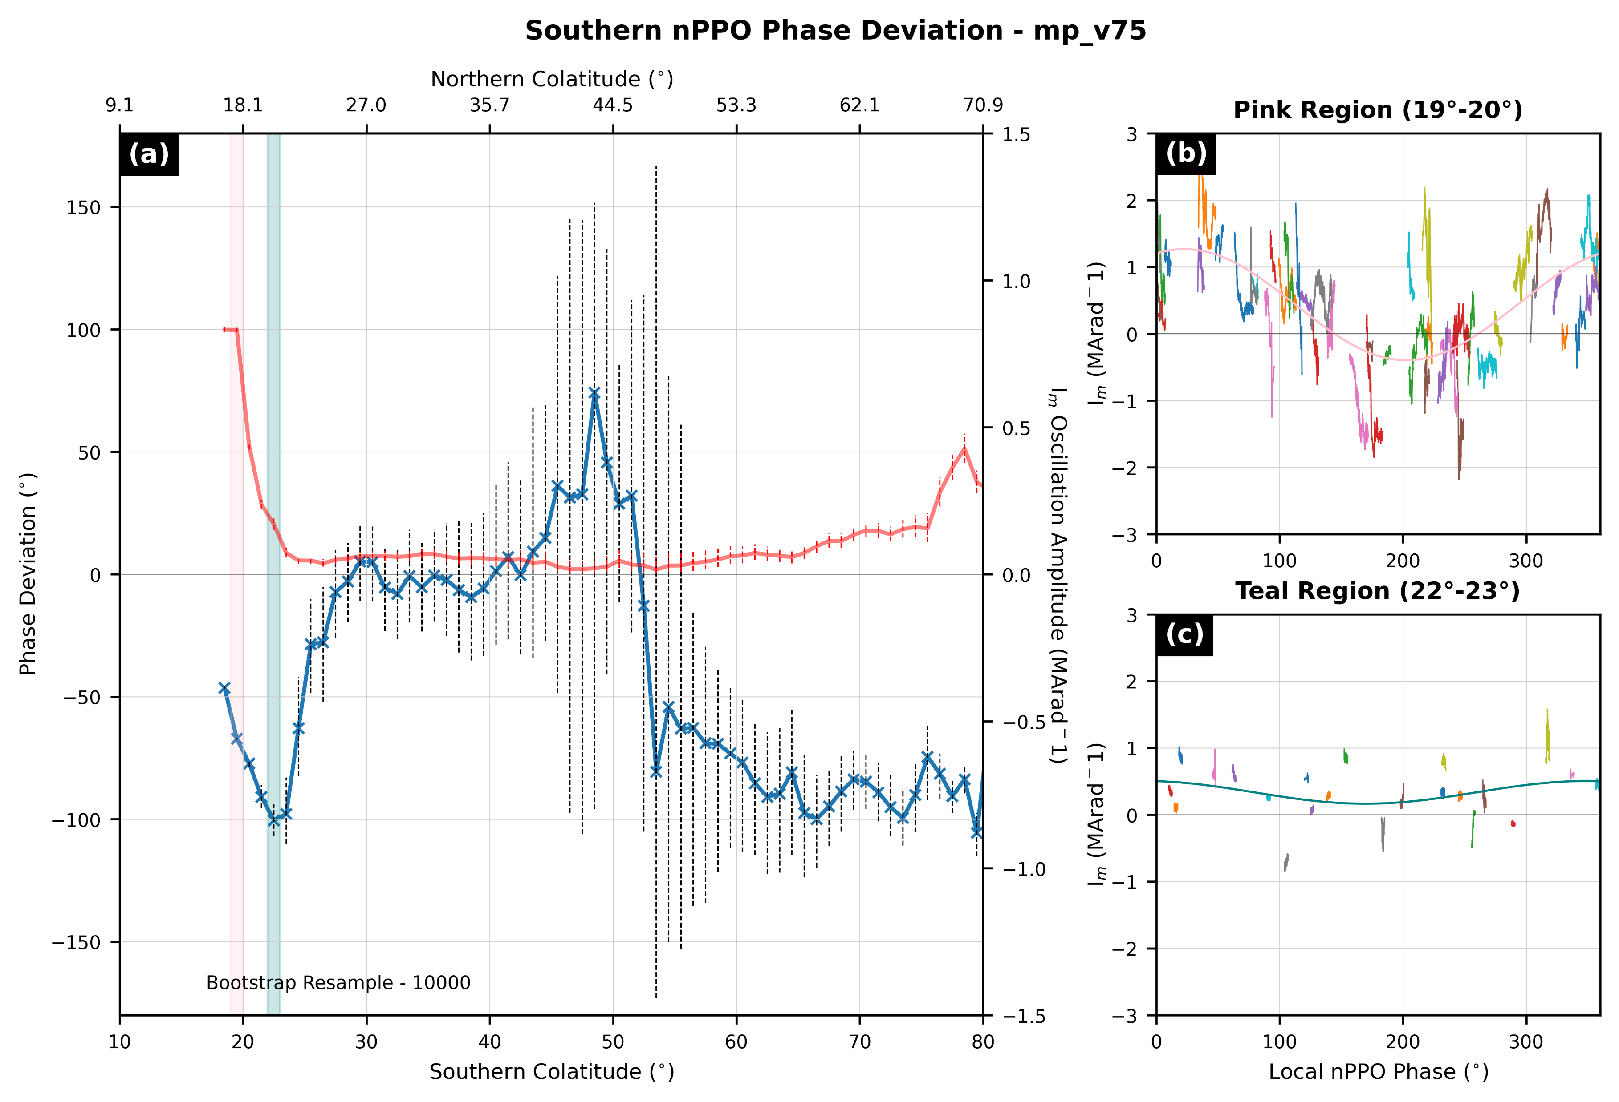
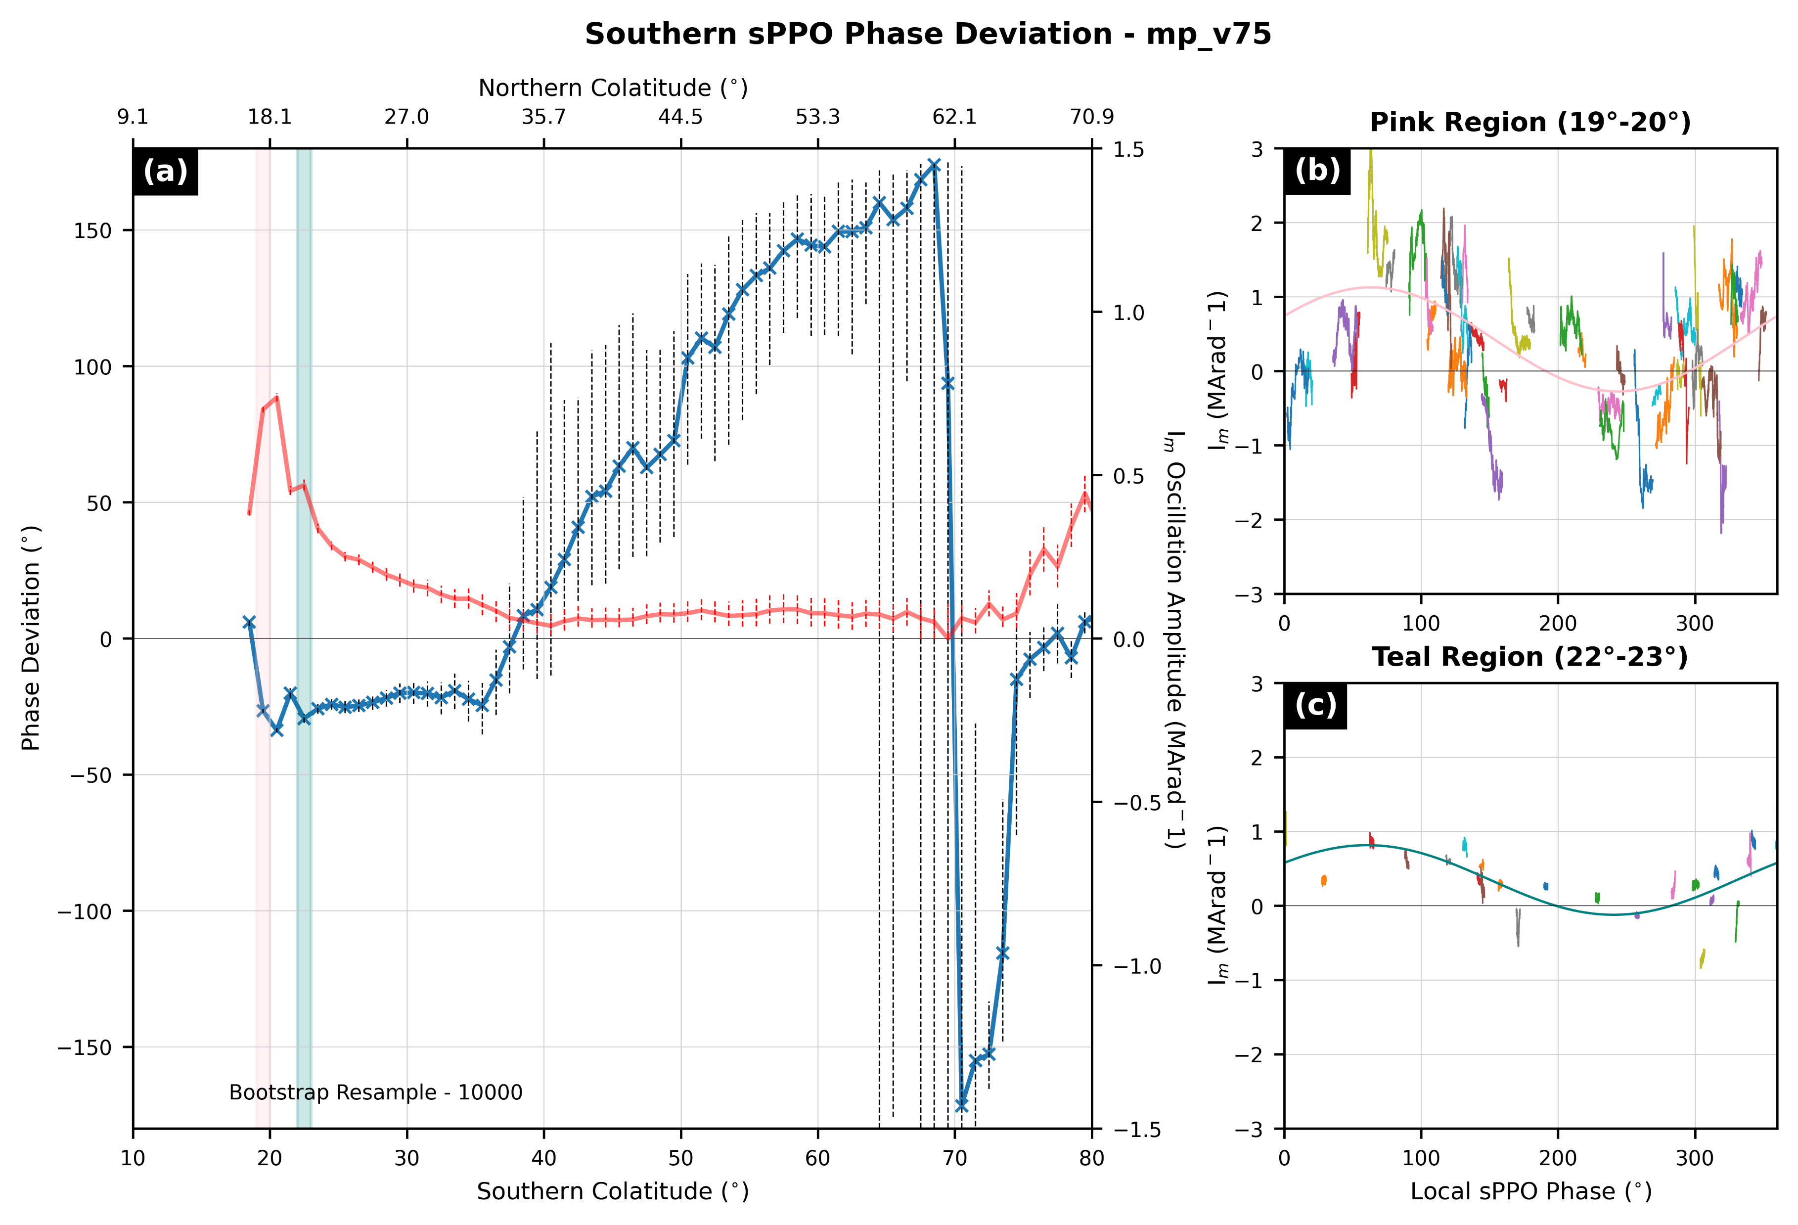
Backup 1 – PPO Model

Slide 25
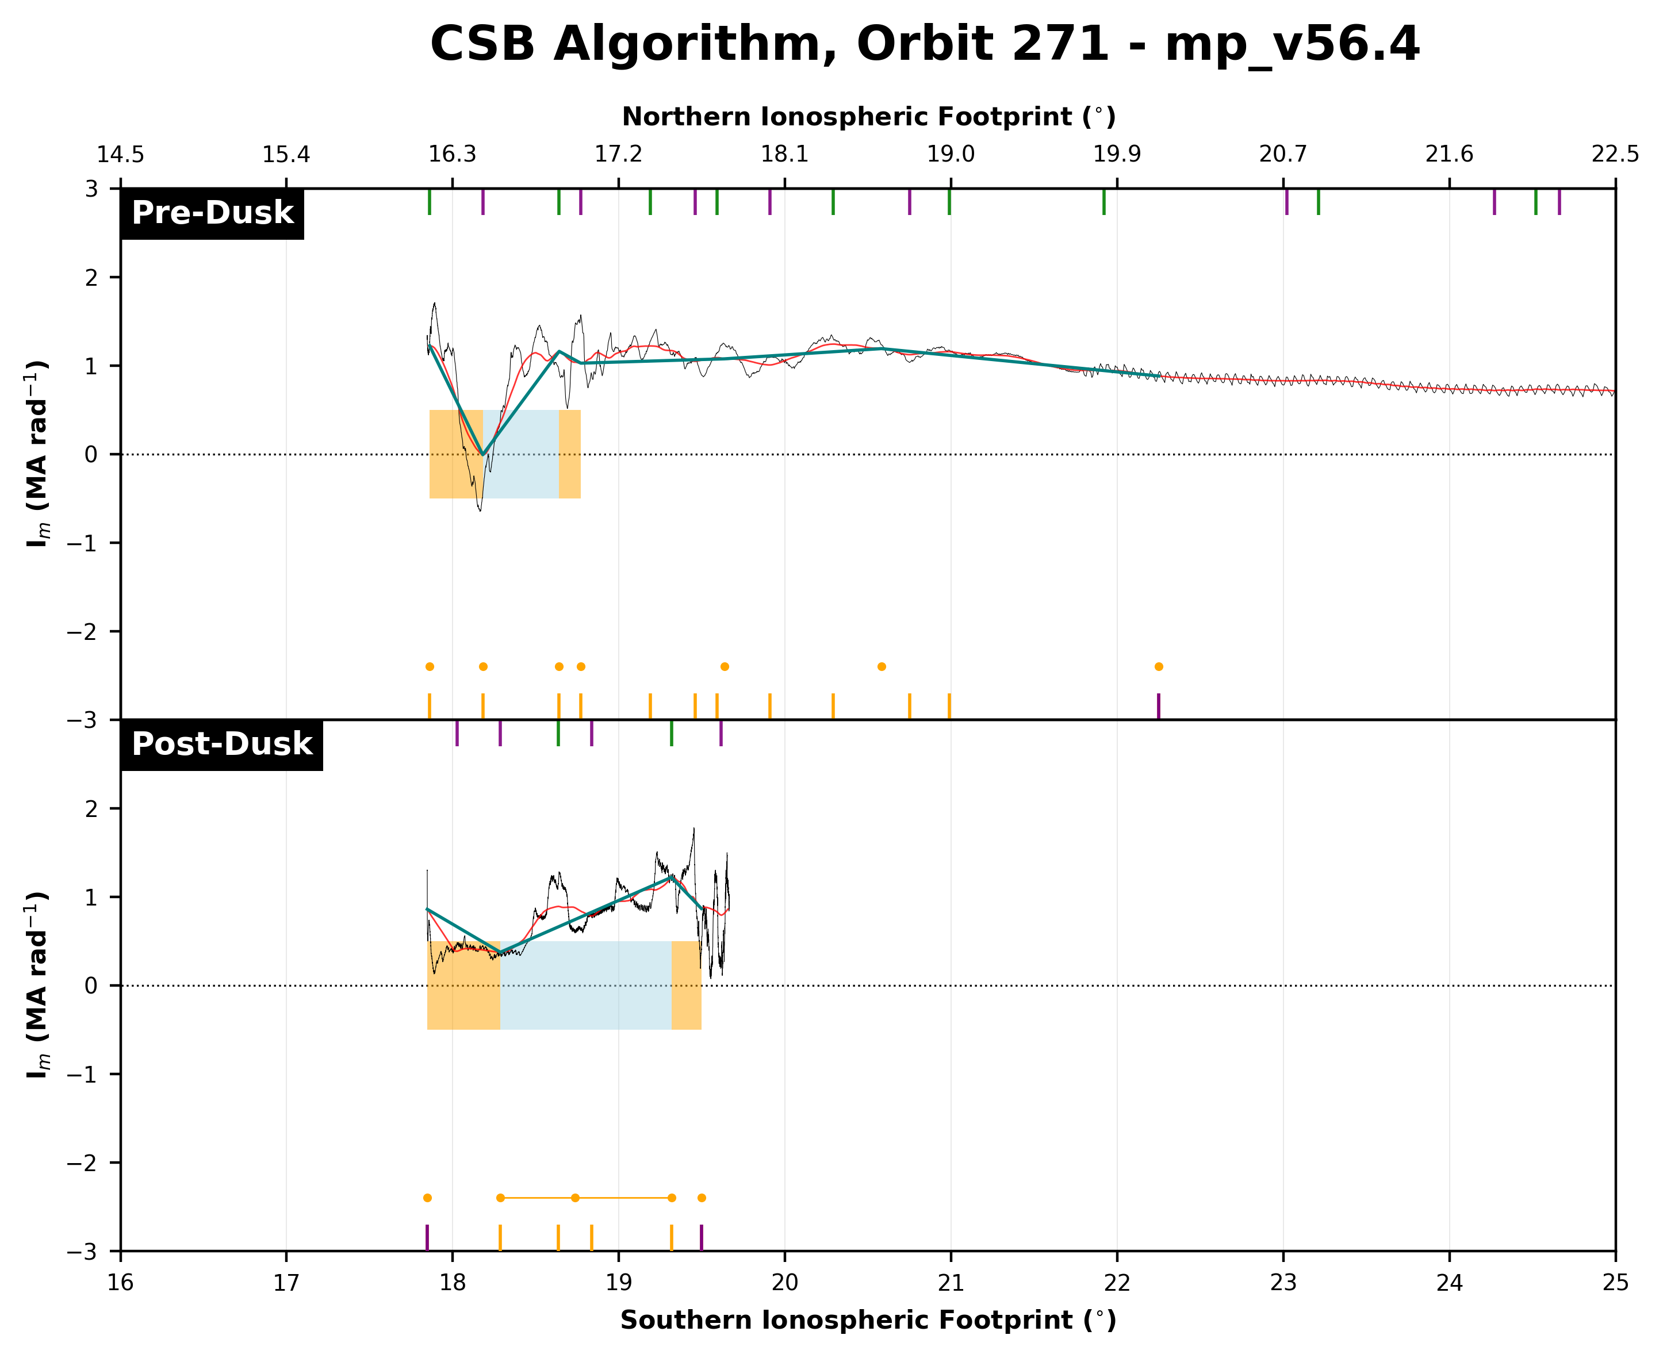
Backup 2 – Algorithm

Slide 26
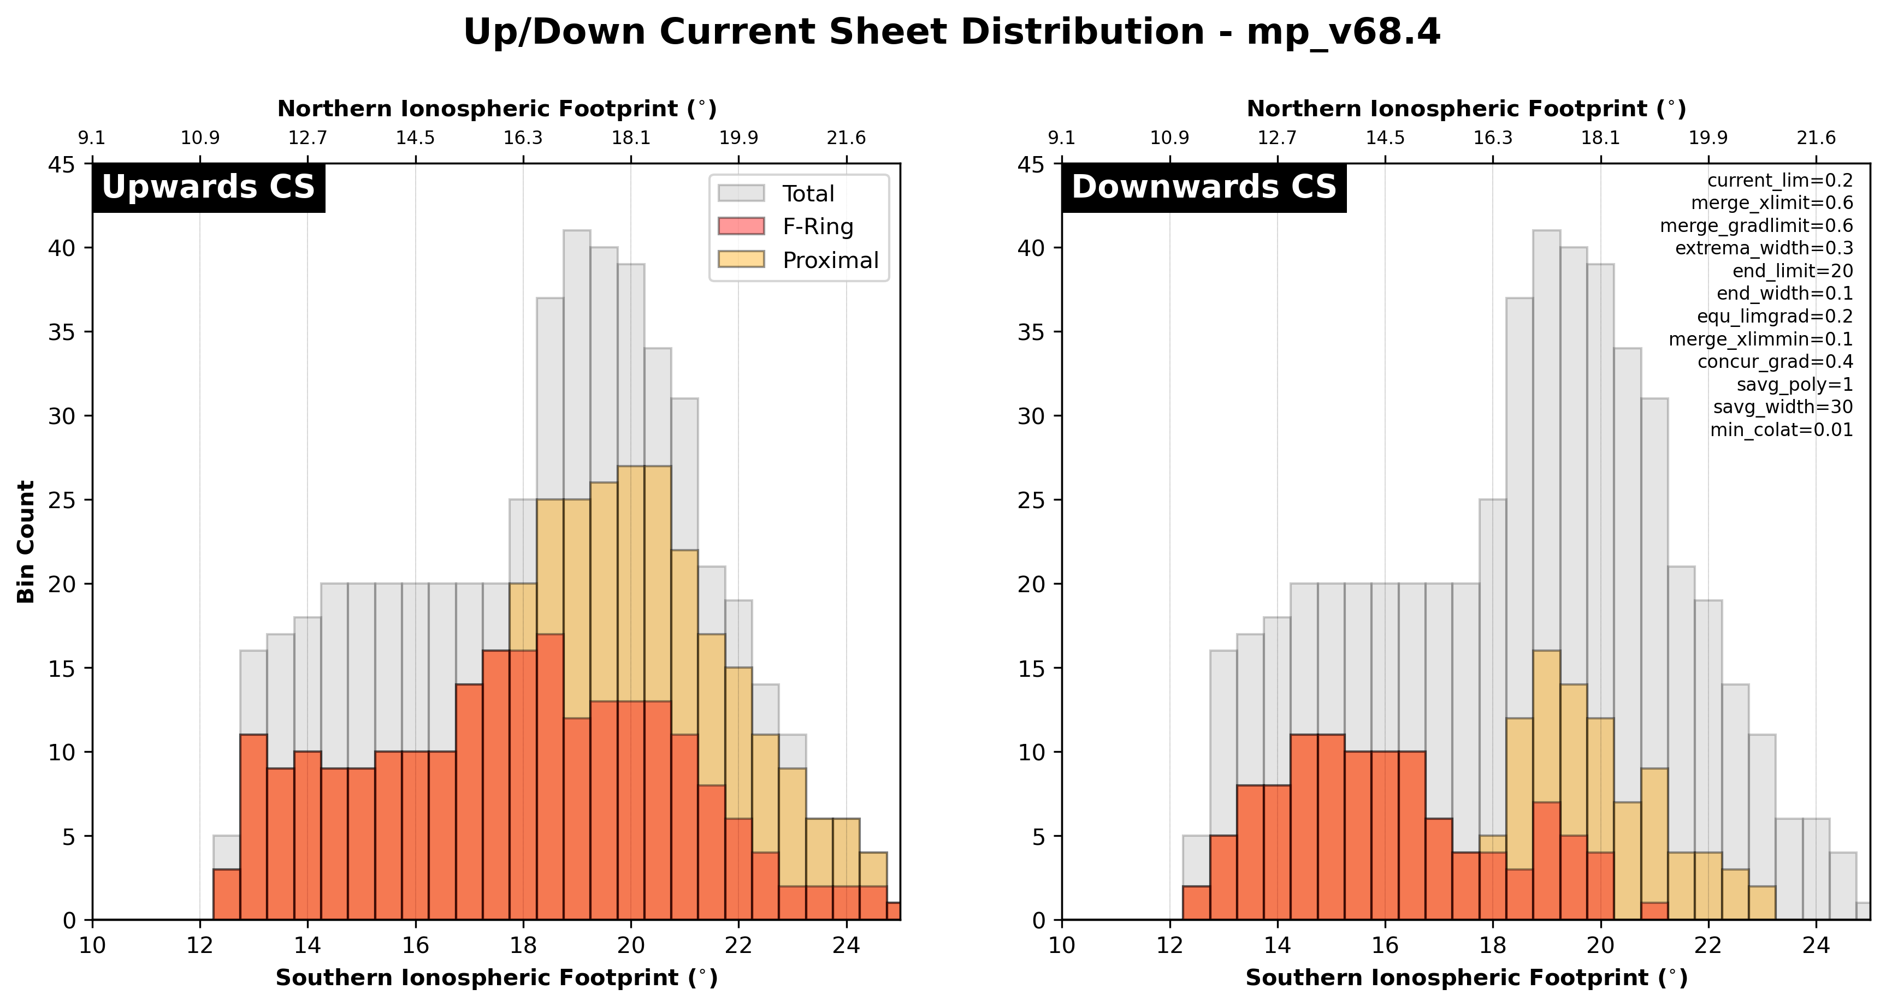
Backup 3 – Algorithm Output

Slide 27
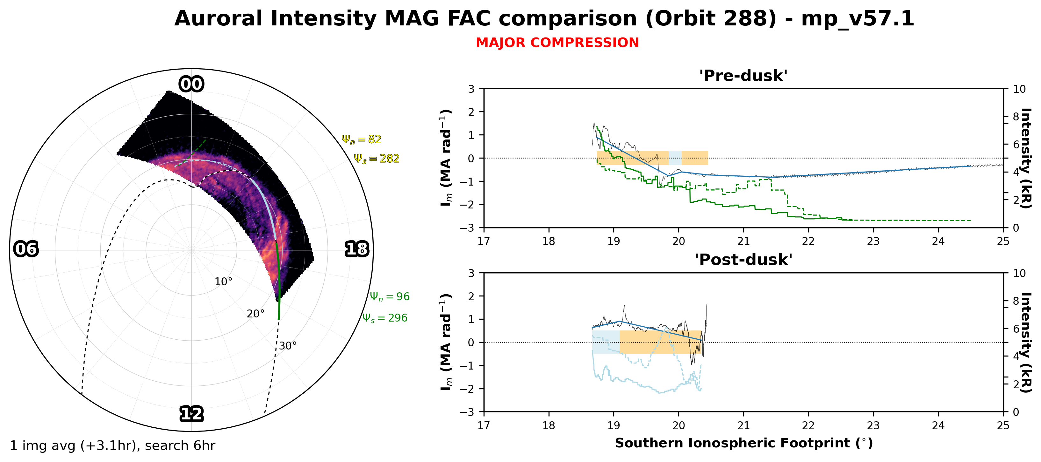
Backup 4 – UVIS Emission
Limited by UVIS images close to MAG observations:
Orbit No. | Images within +3hr | Images within +6hr
279 | 0 | 3
287 | 3 | 5
288 | 0 | 3
290 | 0 | 4
291 | 0 | 3
292 | 0 | 3

