Slide 1
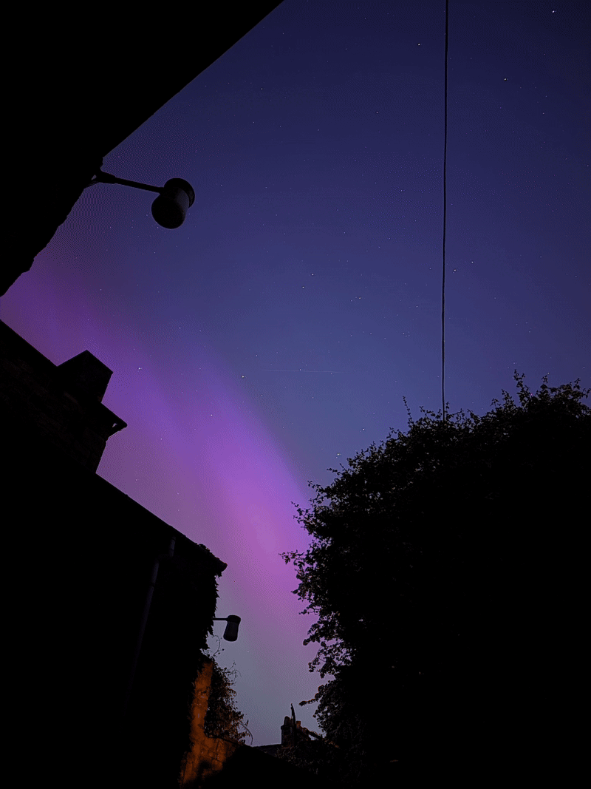
A---Aurora Borealis?
On Saturn?
Different between hemispheres?
Asymmetric between dawn and dusk?
Sam Farr, Dr. Sarah Badman

Slide 2
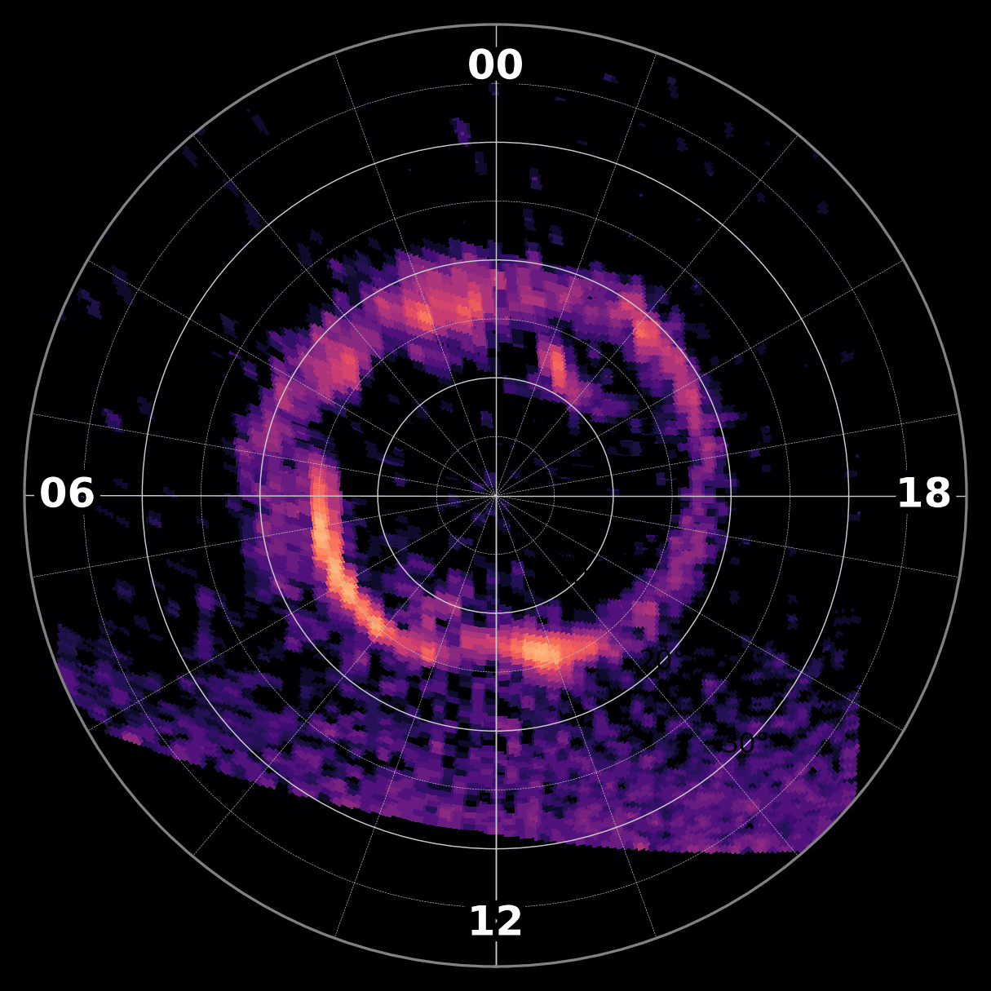
Saturn’s Aurorae
Main emission driven by dynamics in the magnetotail
‘Polar arcs’ suggest noon-midnight magnetospheric differences
Emission evolves significantly over time
High-latitude emission driven by solar wind conditions

Slide 3
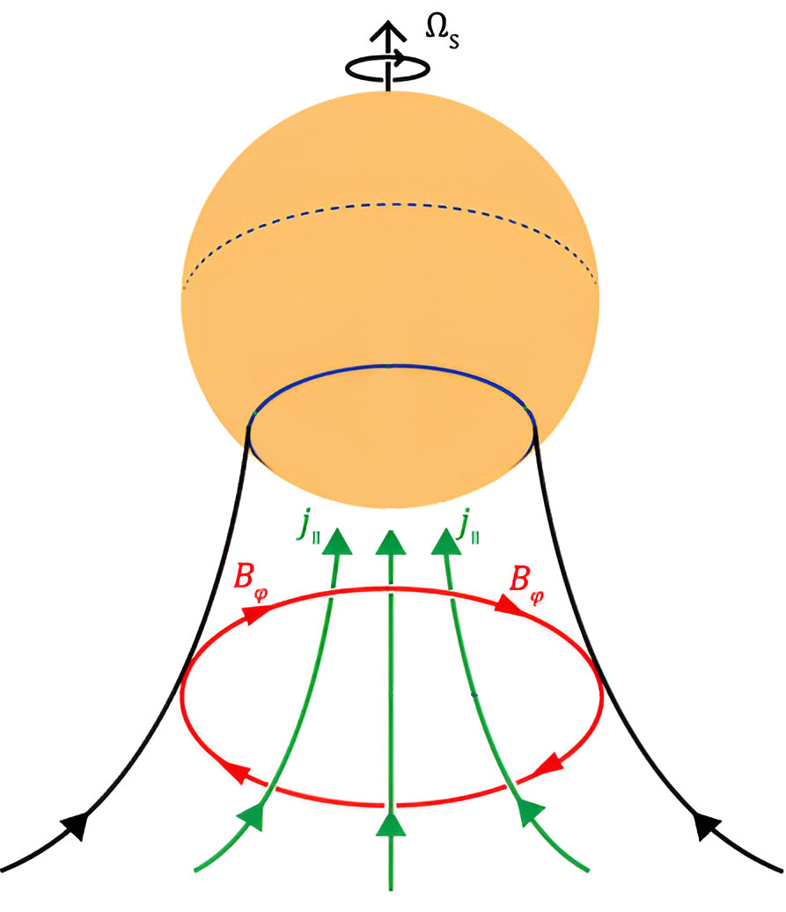
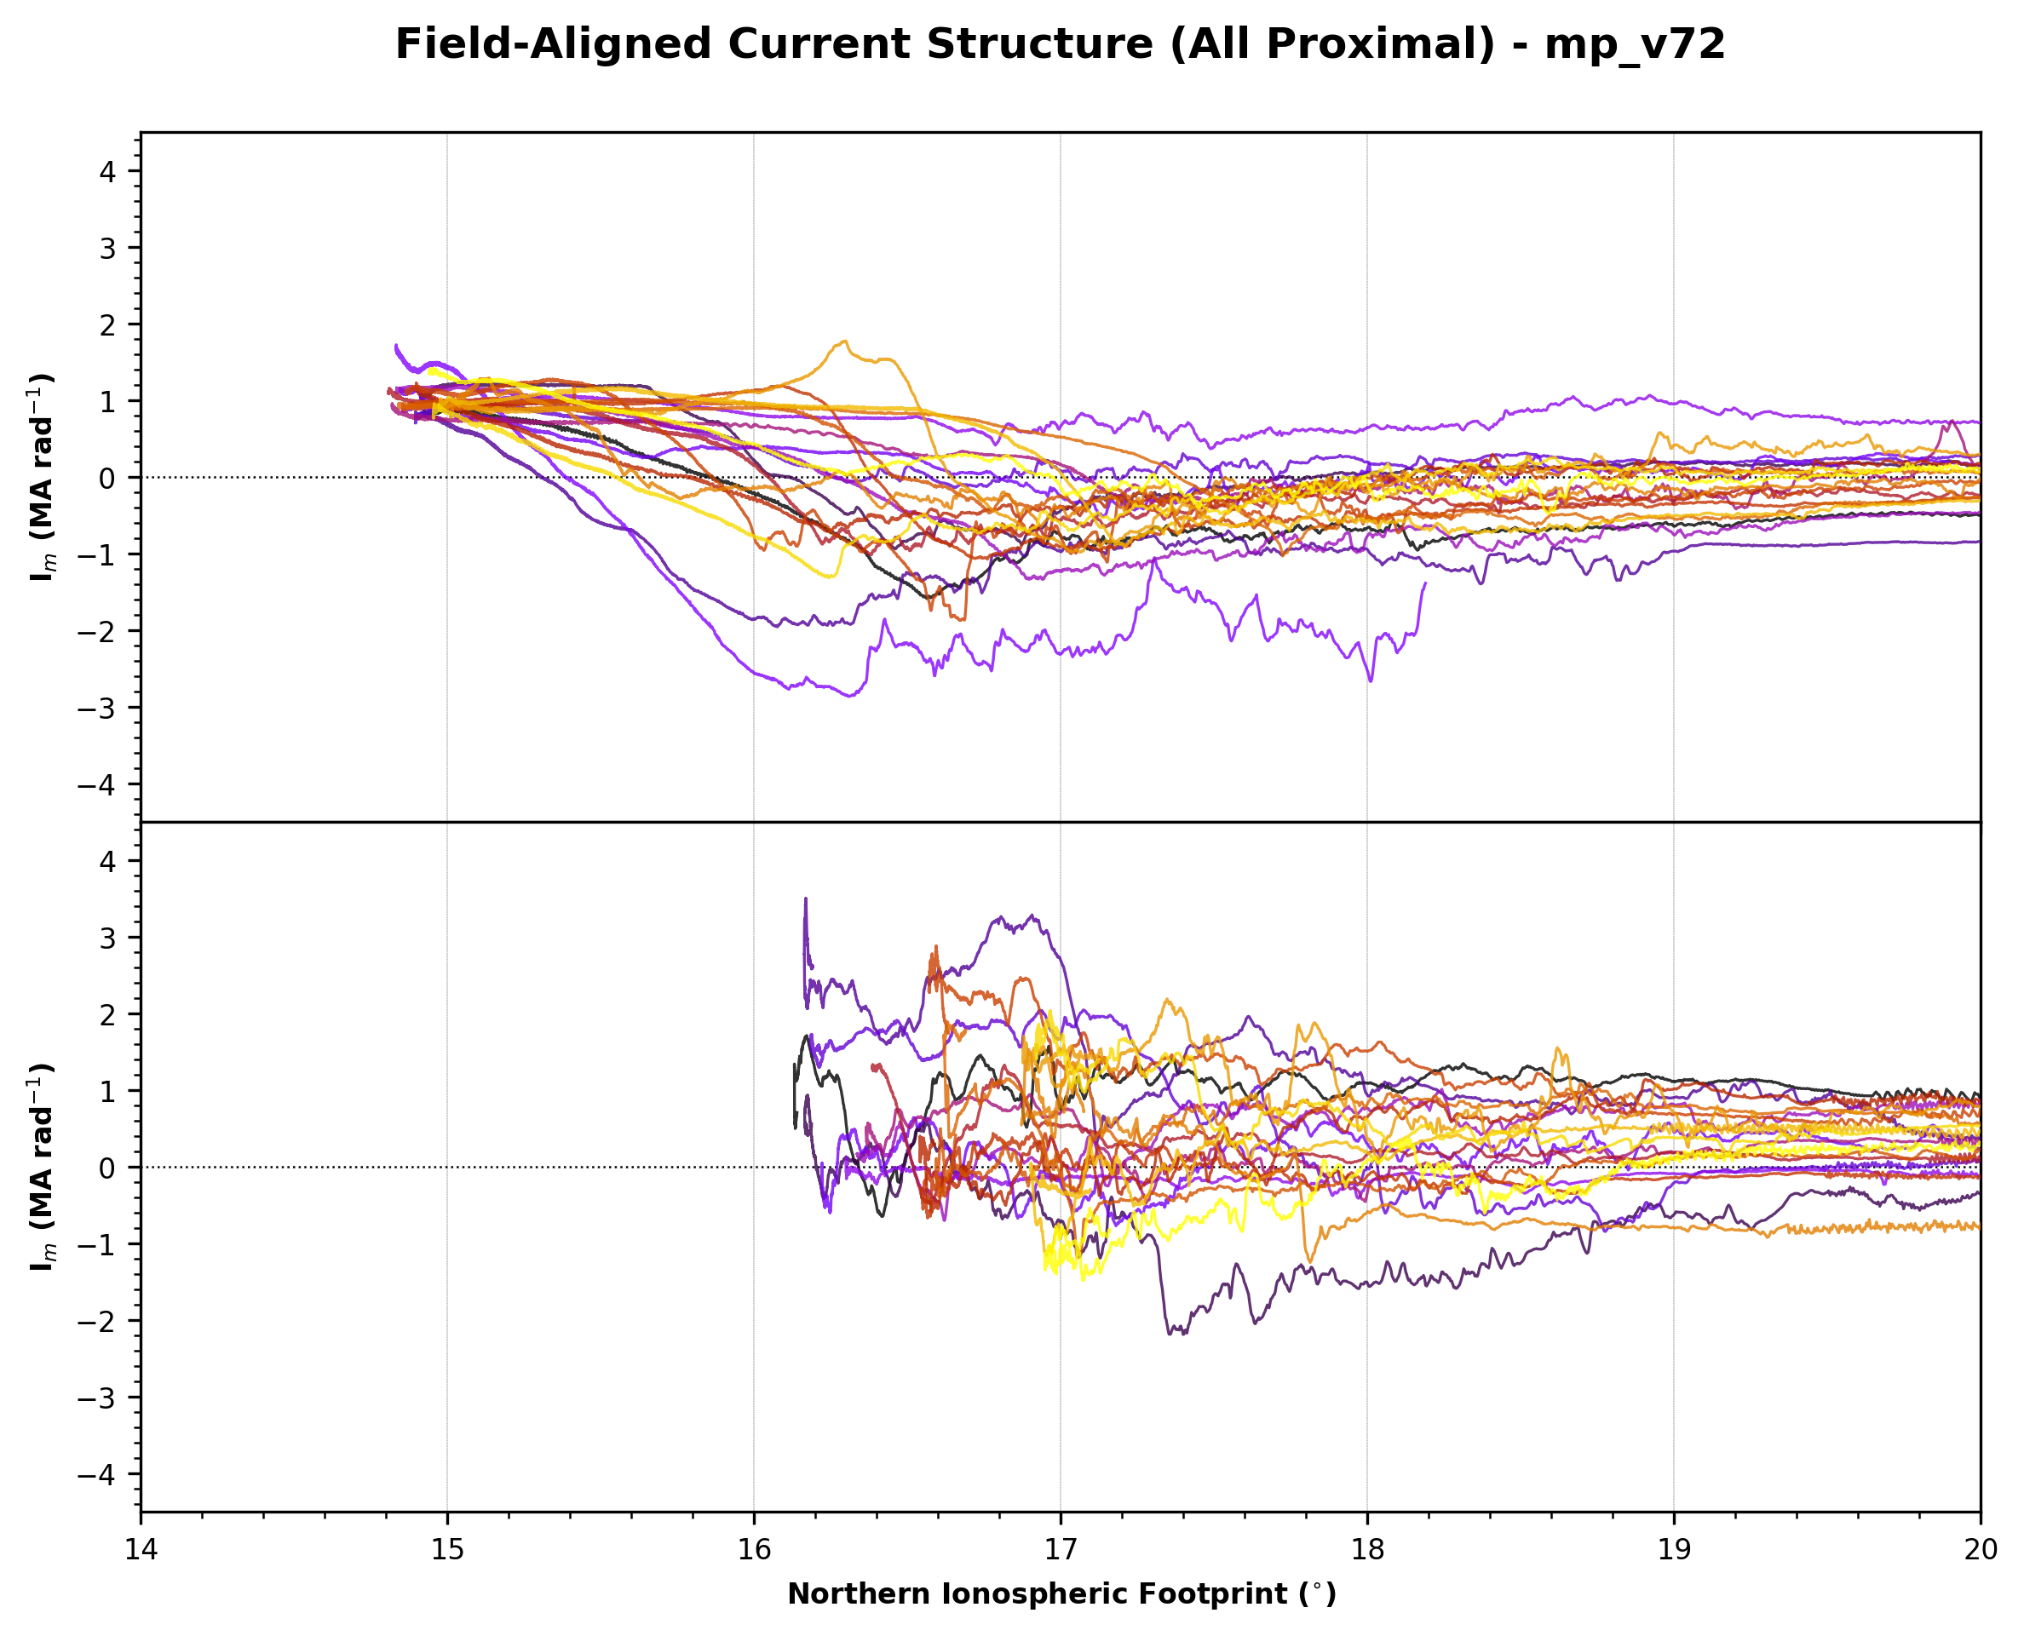
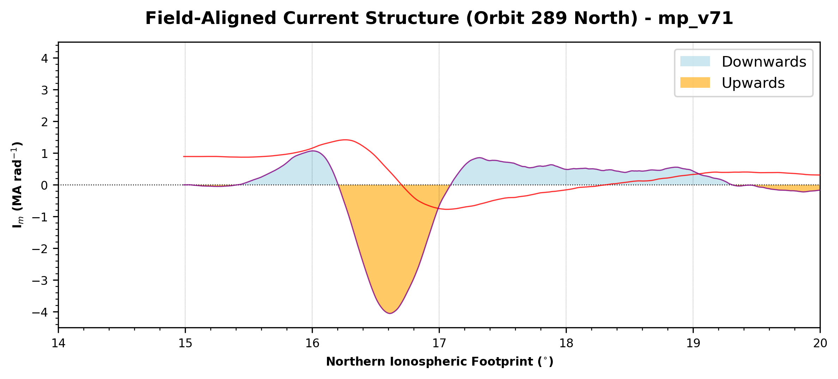
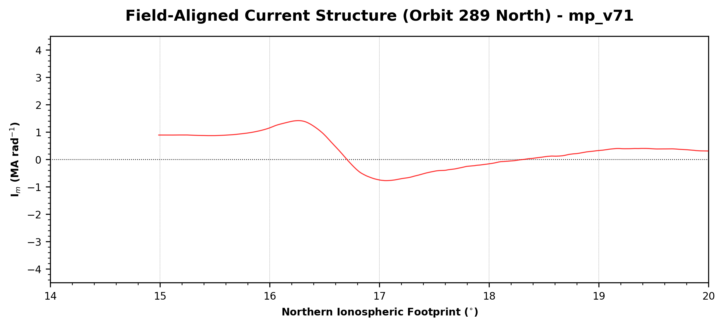
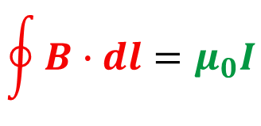
1. How do we measure field-aligned current using MAG?
3. Noisy and asymmetric data between dawn/dusk
$$\oint{B∙dl=μ_{0}I}$$
Charge particles follow magnetic field lines
Saturn’s has an axisymmetric magnetic field
2. What does Cassini measure during an orbit?
TLDR(oL)…
Saturn has aurora!
Aurora tell us about the magnetosphere!
I’m investigating what drives variability between dawn/dusk!

