Slide 1


North West School of Emergency Medicine
A QUALITATIVE STUDY OF REFLECTIVE PRACTICE (BALINT)
GROUPS FOR EMERGENCY MEDICINE RESIDENT DOCTORS
d.darbyshire@lancaster.ac.uk

Slide 2
WHY?
BALINT
STUDY
First to look at impact on EM doctors
Step up to ST3 challenging
Used in mental health and GP training
semi-structured interviews
Higher levels of stress
anxiety
burnout
Facilitated reflective practice
Holistic understanding of impact on
retention, resilience and experience of work
Higher levels of attrition at end of ST3
May help reduce anxiety, stress and burnout

Slide 3
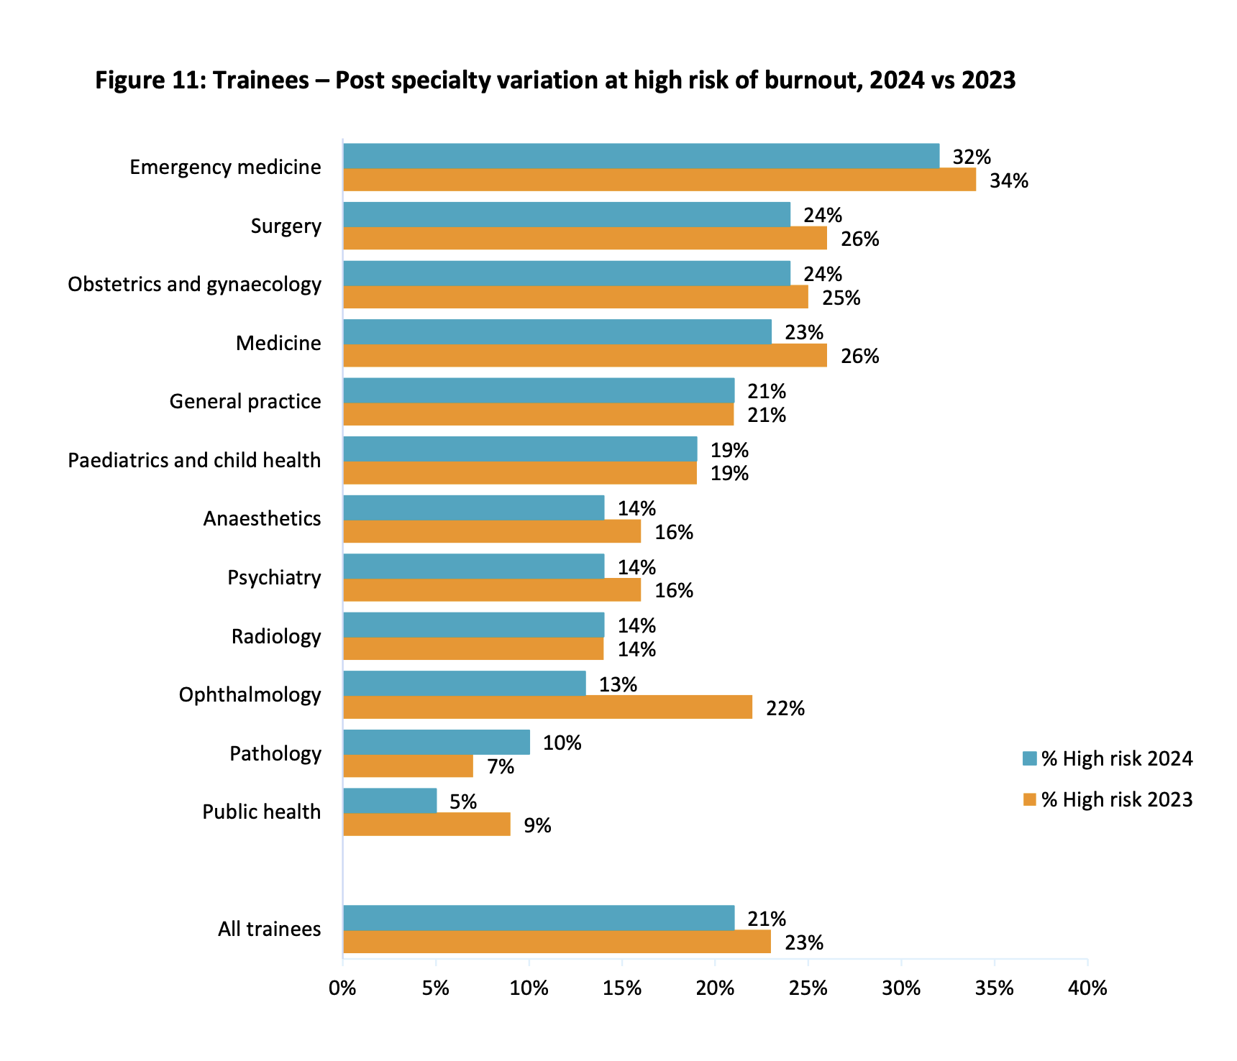
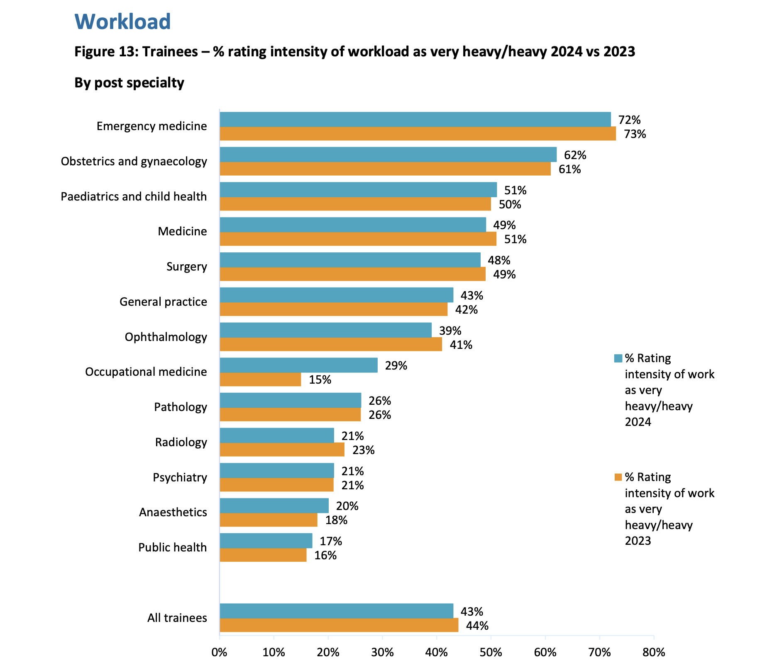
Why Emergency Medicine ST3s?
Notes:
EM top of chart for burn out
ST3 year – exams, children, challenges of stepping up to independence

Slide 4
WHY?
BALINT
STUDY
First to look at impact on EM doctors
Step up to ST3 challenging
Used in mental health and GP training
semi-structured interviews
Higher levels of stress
anxiety
burnout
Facilitated reflective practice
Holistic understanding of impact on
retention, resilience and experience of work
Higher levels of attrition at end of ST3
May help reduce anxiety, stress and burnout

Slide 5
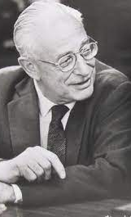
Balint Groups
Focus on the emotions of the clinician and the patient arising from the consultation
First described by Michael Balint in 1950s
Space to talk about emotionally disturbing cases or where there’s difficulty understanding or engaging the patient
Meet regularly in a group with a leader or leaders
Leaders hold boundaries and purpose of the group
Sessions end when time has run out
Mandatory in core psychiatric training
Notes:
Schwartz rounds are a one off – a different collection of professionals potentially each time, more structured – include clinical and non clinical staff, talk about the emotional aspect of the work but with the primary aim of improving staff well-being.

Slide 6
WHY?
BALINT
STUDY
First to look at impact on EM doctors
Step up to ST3 challenging
Used in mental health and GP training
semi-structured interviews
Higher levels of stress
anxiety
burnout
Facilitated reflective practice
Holistic understanding of impact on
retention, resilience and experience of work
Higher levels of attrition at end of ST3
May help reduce anxiety, stress and burnout

Slide 7
Constraints (Opportunity)
Small group
Resources
Timescale

Slide 8
Methods
Research Questions
Aim to develop an understanding of the impact of Balint group on EM trainees
What is the trainees' experience of the Balint group?
What impact has the Balint group had on the trainees' work?
Has the Balint group impacted trainee resilience?
Has the Balint group had any impact on career sustainability?
What is the trainees' experience of the ST3 training programme?
What impact has the ST3 training programme had on the trainees' work?
What is the experience of those leading and organising the Balint programme?
Semi structured interview
Participants: 8 Balint, 2 organisers, 3 non-Balint

Slide 9
Steps
May 2023
First contacted about project
Sep. 2023
Ethics Application and LMS Funding Bid
Sep. 2023
Balint Group Started
Oct. 2023
Funding for transcription and other project costs
Feb. 2024
Qualitative Interviewing Training (Funded by NW EM)
Mar. 2024
Ethics Approval
May–July 2024
Interviews (and 1 in September)
Oct. 2024
Analysis Training and Starting
Jan 2026
Paper in the EMJ

Slide 10
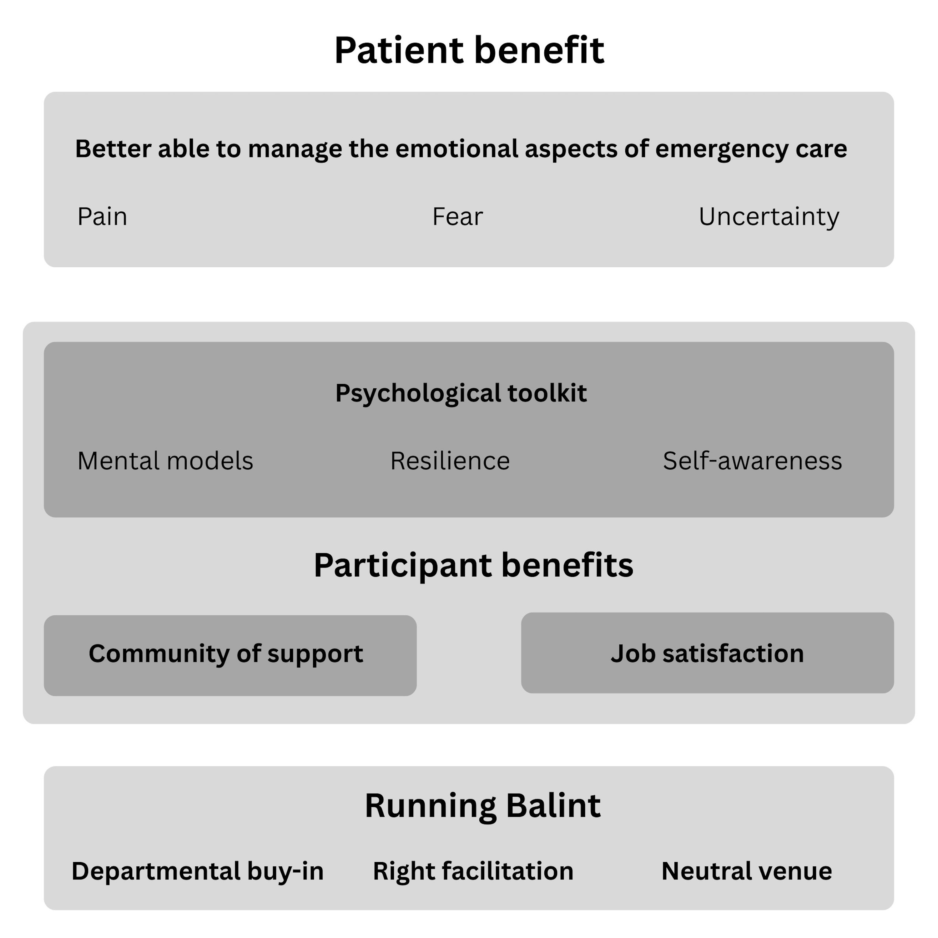

Slide 11
Patient benefit:
Emotions of emergency medicine
— managing the emotional aspects of emergency care
“A few more tools to try and manage different personality types, different types of patients.”

Slide 12
Patient benefit:
Emotions of emergency medicine
— teaching others to manage the emotional aspects of emergency care
“So it’s given me a great deal of insight into my communication skills and the way I view the patient- doctor relationship. In fact, I used Balint only recently. I was discussing a patient with one of my trainees, and she really couldn’t get to the bottom of what was going on with this patient, … Because of Balint, I was able just to step back and say, ‘Do you think maybe that the reason you’re struggling with trying to get a grip on this gentleman is because he’s also struggling with trying to get to grips with his life?’ So there was that mirroring of the way she was feeling and the way he was, which I would never have thought of prior to doing Balint.”

Slide 13
Participant benefit:
Develop a psychological toolkit
— improved self- awareness
“…validated in a way, some reassurance at times that how you're feeling, that can be completely normal, and the reaction you’ve had to that situation is a pretty normal reaction to have…”
Participant benefit:
Develop a psychological toolkit
— developing mental models
“mental models on how to navigate a similar situation that might arise”

Slide 14
Participant benefit:
Develop a psychological toolkit
— resilience
“I think that the concept of somebody being resilient and it being all on them to be resilient, I find quite difficult because I think we all can be resilient and then not be resilient based on what’s going on in our lives at the time. I think that in terms of the ability to process difficult cases and then move forward from them, whether you call that resilience or not, I think has massively been helped by being part of the Balint group for me.”

Slide 15
Participant benefit:
Community of support
—getting to know colleagues
“Commonality in worries that they had with regard to consultations that were particularly challenging and sharing”
Participant benefit:
Community of support
—help with feelings of isolation
“It’s an isolating career in some ways because you are often by yourself, it’s lone practice.”

Slide 16
Participant benefit:
Job satisfaction
—appreciation that it is a difficult job
“I think it’s definitely helped me appreciate that it is a difficult job and it made me quite impressed at times at what my peers do and what my colleagues do.”
Participant benefit:
Job satisfaction
—reflecting on sustainable working
“I think that being able to do that going forward is going to be extremely helpful with regards to having an ED career”

Slide 17
Participant benefit:
Job satisfaction
—retaining ST3 resident doctors
“Trainees feel supported, then that will hopefully stop them from dropping out”
“So, yes, probably in the sense that I'm not actively thinking about dropping out of training or changing career paths and things at the minute”

Slide 18
Running Balint:
Buy- in from hospital sites
“The biggest thing was trying to get buy- in from our hospital sites for our ST3s”
Running Balint:
Neutral space
“There is something wholly unnatural about taking a case that you’ve just been through and speaking about it in the hospital that you’re working in, in a clinical environment and with the people that are around you all the time. What you actually need is to be away from the hospital.”
“What you actually need is to be away from the hospital.”

Slide 19
Running Balint:
Regular groups
“It was a set time, the same time every week.”
Running Balint:
The right facilitator(s)
“It’s really good having [ED facilitator] there as a much more experienced A+E Consultant and getting her perspective on things”
“And then [psychiatry facilitator] as well from that psychiatry perspective, has given really great insights, I think she’s slightly more the patient’s advocate at times and says this is probably why they’ve reacted in such a way, or she would offer insights about a person’s upbringing or their learned behaviours of how to react to stressful or difficult situations. And I think it’s made me understand why patients react the way they do to certain things.”

Slide 20
Running Balint:
Challenge of training and retaining facilitators
“Enough facilitators and the right mix of facilitators is going to be one of the challenges if this were to go out to different sets of trainees, different year groups of trainees”

Slide 21
VALUE ADDED
Research experience
Networks
Capacity building

Slide 22
Progress?
2023-24: This data set
2024-25: Ran again, really successful
2025-26: Inadequate recruitment – didn’t run!
  Pilot in Core Medical Training
  Study looking at barriers to accessing Balint

Slide 23
Collaborators
Richard Parris, NHS England NW School of Emergency Medicine
Hannah Cappleman, NHS England North West School of Psychiatry
Jane Shlosberg, Wythenshawe Emergency Department
Jade Baker, Royal Oldham Hospital Emergency Department
Harriet Kennedy, Manchester Royal Infirmary Emergency Department
Rhiannon Conway, Salford Royal Hospital Emergency Department
Alex Johnson, Emergency Department, Stepping Hill Hospital
Geoff Haynes, Manchester Royal Infirmary and Royal Manchester Children’s Hospital Emergency Departments

Slide 24
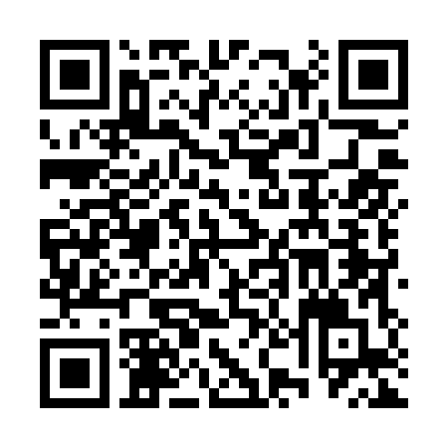
LINK TO PAPER
Email: d.darbyshire@lancaster.ac.uk

