Slide 1
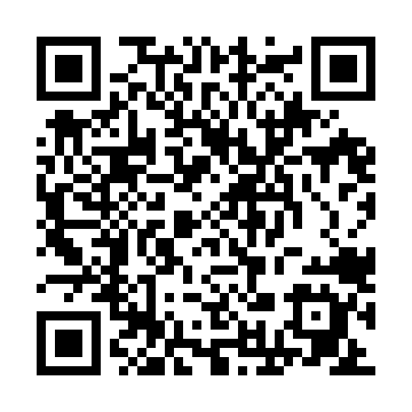
Adolescent Mental Health
National Quality Improvement Project (QIP)
Rationale
Standards
20% of adolescents experience a mental health problem in any given year.
70% of children and adolescents who experience mental health problems have not had appropriate interventions at a sufficiently early age.
54% of respondents to a 2022 RCEM survey reported that mental health services for children and adolescents were generally poor or awful. This has not improved since the last survey in 2018.
Half of respondents said children and young people facing mental health crises arriving between 3 and 7pm experienced waits of 12-24 hours to see a specialist mental health professional.
An emergency department attendance is an opportunity for a focused psychosocial assessment. NICE recommends timely and parallel assessment for those attending emergency departments with mental health presentations.
Standard 1
All adolescent patients attending the emergency department with mental health problems should have an emergency clinician initiated psychosocial assessment documented.
Standard 2a
They should be responded to by mental health liaison services within one hour of referral.
Standard 2b
They should have a parallel assessment by the emergency and mental health teams for onwards care plan or discharge within 4 hours of arrival to the ED.
Timeline
Inclusion/exclusion
May 2023
QIP Topic Competition
October 2023
Winners announced at RCEM ASC
January 2024
Team confirmed
February 2024
Induction, initial meeting, chair appointed
Development of standards
March 2024
Standards reviewed by QECC
2024/2025
IT system redeveloped
QIP streamlined
Information pack re-written
Inclusion criteria
All 10–17-year-olds presenting to the Emergency Department with any of these criteria:
Mental health problems
Substance abuse
Social/safeguarding concerns
Psychological distress/crises
Intentional overdose
Self-harm (either self-injury or self-poisoning)
Exclusion criteria
Age (years): Less than 10, more than 17
Accidental Self-Harm
Any patient who was unable to undergo a mental health examination or risk assessment in the ED due to their physical condition:
    - Unable to provide a clinical history
    - No source of collateral history
    - No clinical history on electronic patient records
    - Requiring resuscitation care
    - Brought in dead
July 2025
Pre-pilot
February 2026
QIP Live
Three years
2026
2027
2028
November 2026
Open for registrations
QIP Info Pack
Requirement
Form a local QIP team
Input 5 cases per week
RCEM support
The QIP will be run over a 3-year period. The longer duration should allow better planning and effective iteration. This should lead to improved patient care. Participating ED's can see how they perform as compared to National mean. This should enable ED's revisit changes implemented and plan further PDSA cycles.
The RCEM platform includes a dashboard with graphs showing your ED’s performance as soon as data are entered to benchmark against yourself.
The dashboard graphs are SPC charts (where applicable) with built in automatic trend recognition, so you are able to easily spot statistically significant patterns in your data.
The portal has built in tools to support local QI initiatives, such as an online PDSA template.
Once you have completed a PDSA template with your team, this is overlaid onto your dashboard charts so you can easily see the impact of your PDSA.
RCEM have also published a QI guide to introducing a range of excellent QI methodologies to enhance QI knowledge and skills.
11th March 2026 12-1
Free webinar for more info.
Co-chairs: Lalarukh Asim, Deon Louw
Deputy chair: Jessica Green
RCEM senior quality officer: Lucas Dalla-Vecchia
Team members: Daniel Darbyshire, Katie Manning
Link to QIP website
Any questions? Contact rcemqip@rcem.ac.uk

