Slide 1
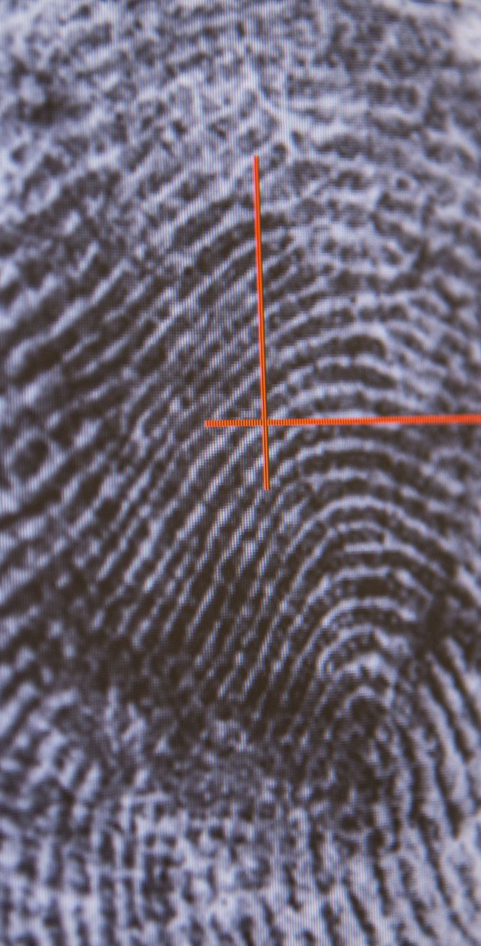
The Digital Intimacy of Post-True Crime: Fan Experience of 'Murder, Mystery and Makeup’
Dr. Judith Fathallah
Lancaster University and Coventry University
judith.fathallah@coventry.ac.uk
Mailing List: Jiscmail.ac.uk/MAKING-MEANING-TRUE-CRIME

Slide 2
Introduction
Explores fan motivations for engaging with Bailey Sarian’s 'Murder, Mystery and Makeup' (MMM)
Post-true crime genre focuses on emotion, affect and storytelling over factual precision
Hypothesis: parasocial relationships will be key to fan enjoyment
Findings: PRS weaker than expected; postdigital intimacies (Evans and Ringrose 2025) as better framework
Notes:
Introduce the context and theoretical motivation for the study, linking genre to affect and media theory.

Slide 3
True Crime & Gender
Women dominate true crime audiences (Vicary & Fraley 2010; Boling & Hull 2018)
Motivations: psychology, safety, fascination with justice procedures
Scholars link PSRs to true crime hosts in new media (Gaynor 2024; Pavelko and Myrick 2020; Schulenberg 2021).
Notes:
Establish gendered patterns of media consumption and the appeal of true crime across platforms.

Slide 4
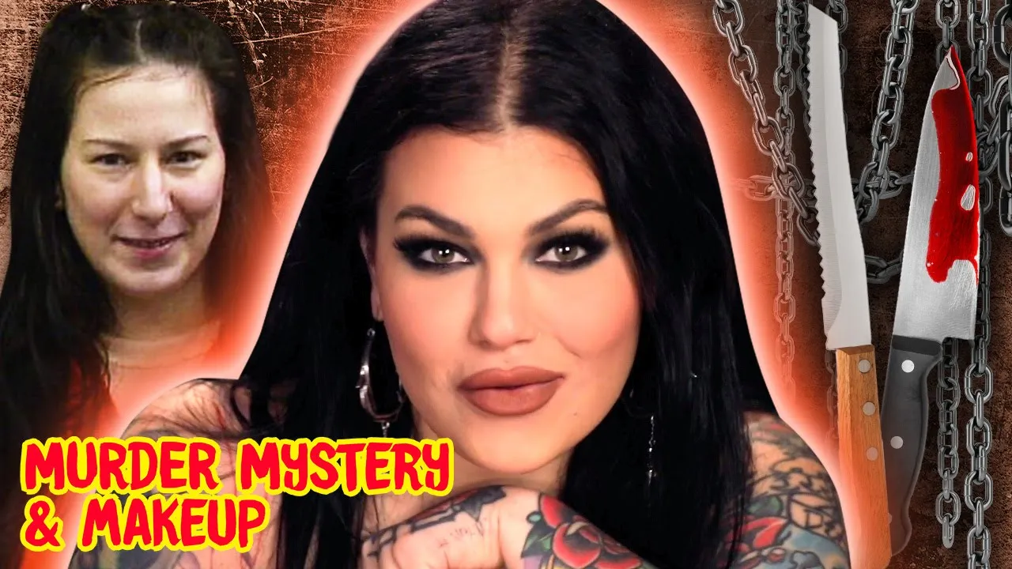
Parasocial Relationships
PSRs: one-sided relationships with media figures (Horton & Wohl 1956)
PSI vs. PSR: interaction vs. enduring relationship (Liebers and Schramm 2019).
Relevance: PSRs adapted to YouTube, podcasts, influencers (e.g. Ballantine and Martin 2005; Sanderson 2009, Kurtin et. al 2018; Reinikainen et. al 2020).
Notes:
Provide a framework for PSRs, noting how interactional intimacy can extend into perceived relationships.

Slide 5
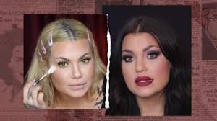
MMM Encourages PSRs
Uses direct audience address: 'my beautiful friends’ (c.f. Thelwall 2022)
Forward-facing camera, eye contact, personal disclosures (c.f. Hartmann and Goldhoorn 2011)
Catchphrases build ritualistic connection
Notes:
Present the media cues that theoretically foster PSRs with Sarian’s audience.

Slide 6
Methodology
74 participants surveyed on Reddit (r/BaileySarian, r/MorbidPodcast, etc.)
Mix of Likert scales, open-text responses, demographics
Ethical approval from Lancaster University; open data shared CC-BY at https://doi.org/10.17635/lancaster/researchdata/717.
Notes:
Clarify recruitment strategy, ethical compliance, and commitment to open research.

Slide 7
Participant Demographics
92% identified as women; most aged 25–44
Majority based in the U.S., some global representation, some fans interpret ‘nationality’ as ‘ethnicity/heritage’- quite diverse
Demographic similarity to Sarian supports relatability hypothesis
Notes:
Highlight demographic trends and their potential role in fostering fan identification.

Slide 8
Media Use Habits
Fans integrate MMM into daily routines: chores, work, crafting
Preferred platforms: YouTube (80%), Spotify, Apple Podcasts
Use reflects postdigital embedding in mobile, intimate spaces
Notes:
Show how format and platform influence the way media is consumed affectively and physically.

Slide 9
Affect Over Fact
Fans seek emotional resonance, not factual rigor
'Likeability' and 'genuineness' outrank 'credibility' and 'expertise'
Supports genre definition of post-true crime as affect-centered
Notes:
Discuss the implications for genre theory and audience priorities.

Slide 10
Host-Centric Enjoyment
Fans cite Sarian’s personality and voice as central appeals
Narrative style praised for balancing levity and respect
Makeup artistry and true crime interest are secondary
Notes:
Illustrate why fans choose MMM over other true crime formats.

Slide 11
Reaction to Potential Ending
Most fans say they'd feel sad, disappointed, or 'gutted'
Language reflects affective loss
Fans express empathy for Sarian’s wellbeing and choices
Notes:
Show how affective investment is complex, not always relational.

Slide 12
Weaker-than-Expected PSRs
60% don’t view Sarian as occupying a social role (friend, teacher, etc.)
Few fans expressed desire for direct interaction
Emotional closeness exists without formal PSR structure
Notes:
Challenge assumption that PSRs dominate new media fandom.

Slide 13
Postdigital Intimacies
Postdigital = web of human, tech, media and material relations (Evans & Ringrose 2025)
Not just digital intimacy, but entanglement of physical and virtual experiences
Affective ties not bound by traditional social roles
Notes:
Offer postdigital intimacy as a more fluid and encompassing alternative to PSR theory.

Slide 14
Postdigital Intimacy in Practice
Fans engage with MMM during creative, often gendered activities (e.g., crochet, makeup)
Example: nail technicians playing MMM for clients
Media becomes part of embodied, shared experiences
Notes:
Describe intimate, embedded, and ritualistic uses of the media.

Slide 15
Critical and Ethical Awareness
Fans critique MMM and true crime genre for potential ethical oversights
Empathy extended to victims/survivor, not just host
Self-aware about tensions between entertainment and exploitation
Notes:
Underscore fans’ reflexivity and critical engagement.

Slide 16
Conclusions
Post-true crime prioritizes feeling over fact
PSRs present but weaker than expected
Postdigital intimacy better explains how fans connect with text, tech, and each other
Notes:
Summarize central theoretical and empirical contributions.

Slide 17
Implications for Research
Full study will be published in ‘Alternative Voices in True Crime’, ed. George Larke-Walsh
Re-examine assumed dominance of PSRs in YouTube and similar forms
More attention to media-embodied affective flows
Explore ethical, material, and human-tech entanglements
Notes:
Encourage broader frameworks for studying media affect.

Slide 18
Study Limitations
Small, Reddit-recruited sample may limit generalizability
Self-reported data: some category confusion, neglect of ‘silent fans’
Ambivalence about PSRs may reflect stigma or critique
Notes:
Be transparent about scope and constraints of the study.

Slide 19
References
Ballantine, Paul W., and Martin, Brett A.S. (2005). Forming parasocial relationships in online communities. Advances in Consumer Research, 13(2), 197-202.
Boling, Kelli S., & Hull, K. (2018). Undisclosed information—Serial is My Favorite Murder: Examining motivations in the true crime podcast audience. Journal of Radio & Audio Media 25 (1), 92–108.
Evans, Adrienne, and Ringrose, Jessica. (2025). More-Than-Human, More-Than-Digital: Postdigital Intimacies as a Theoretical Framework. Social Media + Society, 11(1). https://doi.org/10.1177/20563051251317779
Fathallah, Judith (2025). “I guess moral of the story is if you’re going to kill somebody do it in Texas?” ‘Murder, Mystery and Makeup’ as post-true crime. Popular Communication, 23(3), 248–265. https://doi.org/10.1080/15405702.2025.2552778
Gaynor, Stella M. (2023). ‘What else can I add?’: Inverting the narrative through female perspectives in Falling for a Killer, My Favorite Murder, and Murder, Mystery, and Make Up . In: Larke-Walsh, G. (ed.) True crime in American media (pp. 180-196). Routledge.
Hartmann, Tilo, and Goldhoorn, Charlotte. (2011). “Horton and Wohl Revisited: Exploring Viewers’ Experience of Parasocial Interaction.” Journal of Communication 61, no. 6: 1104–1121. https://doi.org/10.1111/j.1460-2466.2011.01595.x.
Kurtin, Kate S., O'Brien, Nina, Roy, Deya, & Dam, Linda (2018). The development of parasocial interaction relationships on YouTube. The Journal of Social Media in Society, 7(1),233- 252
Liebers, Nicole, Schramm Holger (2019). Parasocial interactions and relationships with media characters—An inventory of 60 years of research. Communication Research Trends, 38, 4–31.
Pavelko, Rachelle L., & Myrick, Jessica Gall (2020) Muderinos and Media Effects: How the My Favorite Murder Podcast and its Social Media Community May Promote Well-being in Audiences with Mental Illness, Journal of Radio & Audio Media, 27:1, 151-169, DOI: 10.1080/19376529.2019.1638925
Thelwall, Mike, Mas-Bleda, Amalia, Stuart, Emma, Makita, Meiko, & Abdoli, Mashid. (2022). I’m Nervous about Sharing This Secret with You: YouTube Influencers Generate Strong Parasocial Interactions by Discussing Personal Issues. Journal of Data and Information Science, 7(2), 31 - 56. https://doi.org/10.2478/jdis-2022-0011
Reinikainen, Hanna, Munnukka, Juha, Maity, Devdeep, & Luoma-aho, Vilma (2020). ‘You really are a great big sister’ – parasocial relationships, credibility, and the moderating role of audience comments in influencer marketing. Journal of Marketing Management, 36(3–4), 279–298. https://doi.org/10.1080/0267257X.2019.1708781
Sanderson, James (2009). “You are all loved so much”: Exploring relational maintenance within the context of parasocial relationships. Journal of Media Psychology: Theories, Methods, and Applications, 21(4), 171–182. https://doi.org/10.1027/1864-1105.21.4.171
Schulenberg, Kelsea S. (2021). ‘You’re in a cult, call your dad:’ An investigation into the true crime podcast My Favorite Murder and its online fan communities. [MA dissertation]. Clemson University.
Vicary, Amanda M., & Fraley, R. Chris (2010). Captured by true crime: Why are women drawn to tales of rape, murder, and serial killers? Social Psychological and Personality Science (1)1, 81–86.
Notes:
Wrap up and open the floor for discussion.

