Slide 1
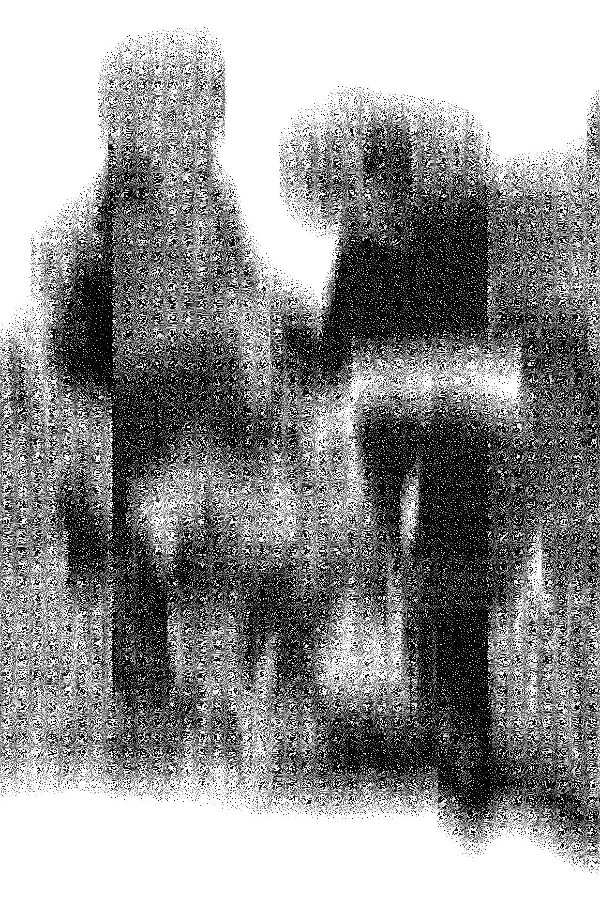
The Value of Language Breakdown in the Age of Generative AI
Dr Nathan Jones
Lancaster University
Notes:
As generative AI tools like GPT-3 saturate language culture, we face a growing tension between fluency and consequence.
This paper argues that literature still matters—not because it is more fluent, but because it is more difficult.
By comparing GPT-3’s prose to the experimental fiction of Mircea Cărtărescu, I explore how contingency, torque, and language breakdown serve as vital strategies—both in literature and in how we face uncertain futures.
Alongside this, I reflect on the Unsecurities Lab workshops, where similar failures of language emerged in the face of imagined threat, suggesting that how we write is central to how we navigate the crises ahead.
Given the potential for AI-authored text to thoroughly saturate its own data-set (that is, contemporary literature and language production) and therefore undetectably shape the future versions of itself in a positive feedback loop, it is worth paying attention now to the nature and tendency of its output, and to how its believability interacts with the proposition of the literature we want and need today. I am particularly interested in the way that error, apparently tuned out of the GPT-3 system that seeks normative behaviour, is integral to the literary potential for future-writing.
Experimental literature and GPT-3 authored writing both generate value by interacting with the space of existing possibility of the literary field, often by corresponding to or contrasting with the perceived mainstream.
Whereas experimental literature’s effects are derived from extending the conceptual space literature occupies.
GPT-3 produces its value in writing by making a version of what is already plausibly there, using the mainstream (or the statistical average it perceives in its data set) to orient itself. This is how much of the literary mainstream works also.

Slide 2
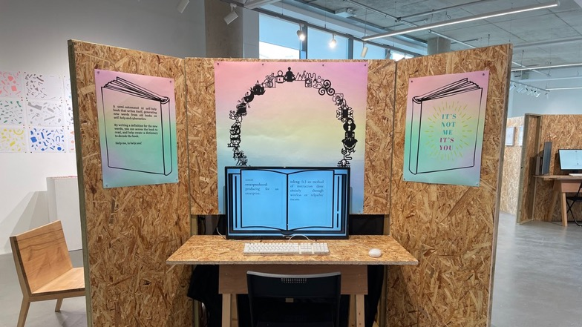
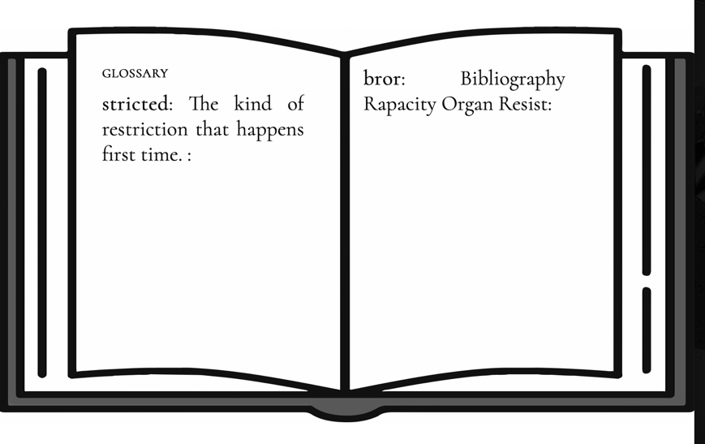
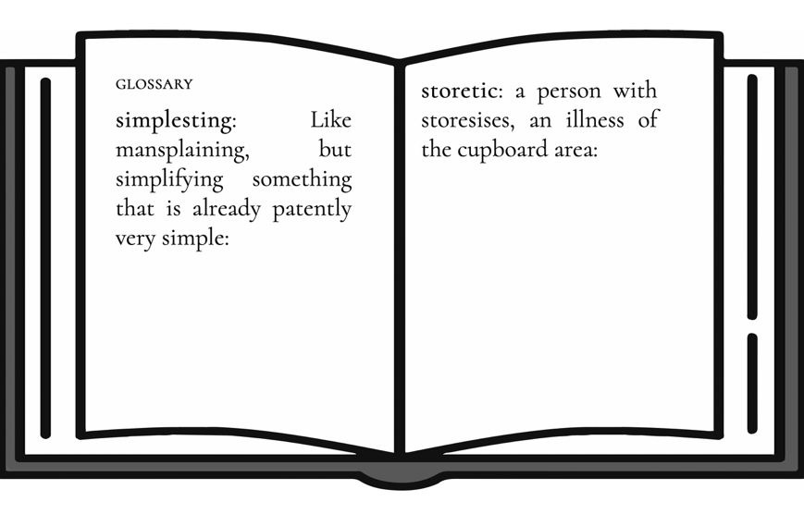
Notes:
Conplementarity.

Slide 3
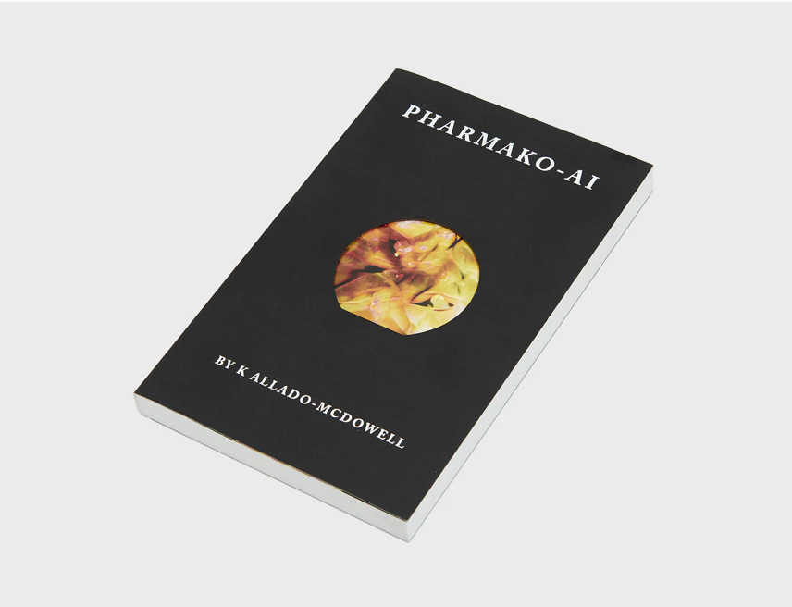
‘When something is transformed from a dream into words, it loses a part of its spirit, but it also
carries the dreamer into an orbit of subjectivity that is no longer bound to time and space, even
while the body sleeps.’
‘Another use of language is as a viral vector for infecting human consciousness with messages, knowledge and consciousness itself. Language as a vector of information exchange can carry viruses, memes, ideas, consciousness.’
‘Language is a medium, a transmitter and a gift. There are things that can’t be said any other way.’
Notes:
The first book to be co-created with GPT-3 was Pharmako-AI, which was published by Ignota books in 2021. To create the book, K. Allado-McDowell uses a an early access version of the AI to produce a ‘fractal poetics of AI’ and ‘an hallucinatory journey into selfhood, ecology and intelligence via cyberpunk, ancestry and biosemiotics’ according to the book blurb. Allado-McDowell’s process was to prompt GPT-3 with diary entries, reminiscences, and ideas about consciousness and selfhood, thereby inviting the machine to reflect on its own relation to language and experience.
Dreaming, which is often cited in the book, is an appropriate metaphor for the writing that GPT-3 does—a kind of thought that occupies the mind with a language-like and experience-like thing that experts have learned (incorrectly?) to interpret as reflective of underlying thought structures. The result is oddly unreadable—in the same way a dream is not memorable—because of its lack of consequence or grasp.
GPT-3’s prose reveals a default toward flattening: movement without torque, temporality without pivot, atmosphere without worlded stakes.

Slide 4
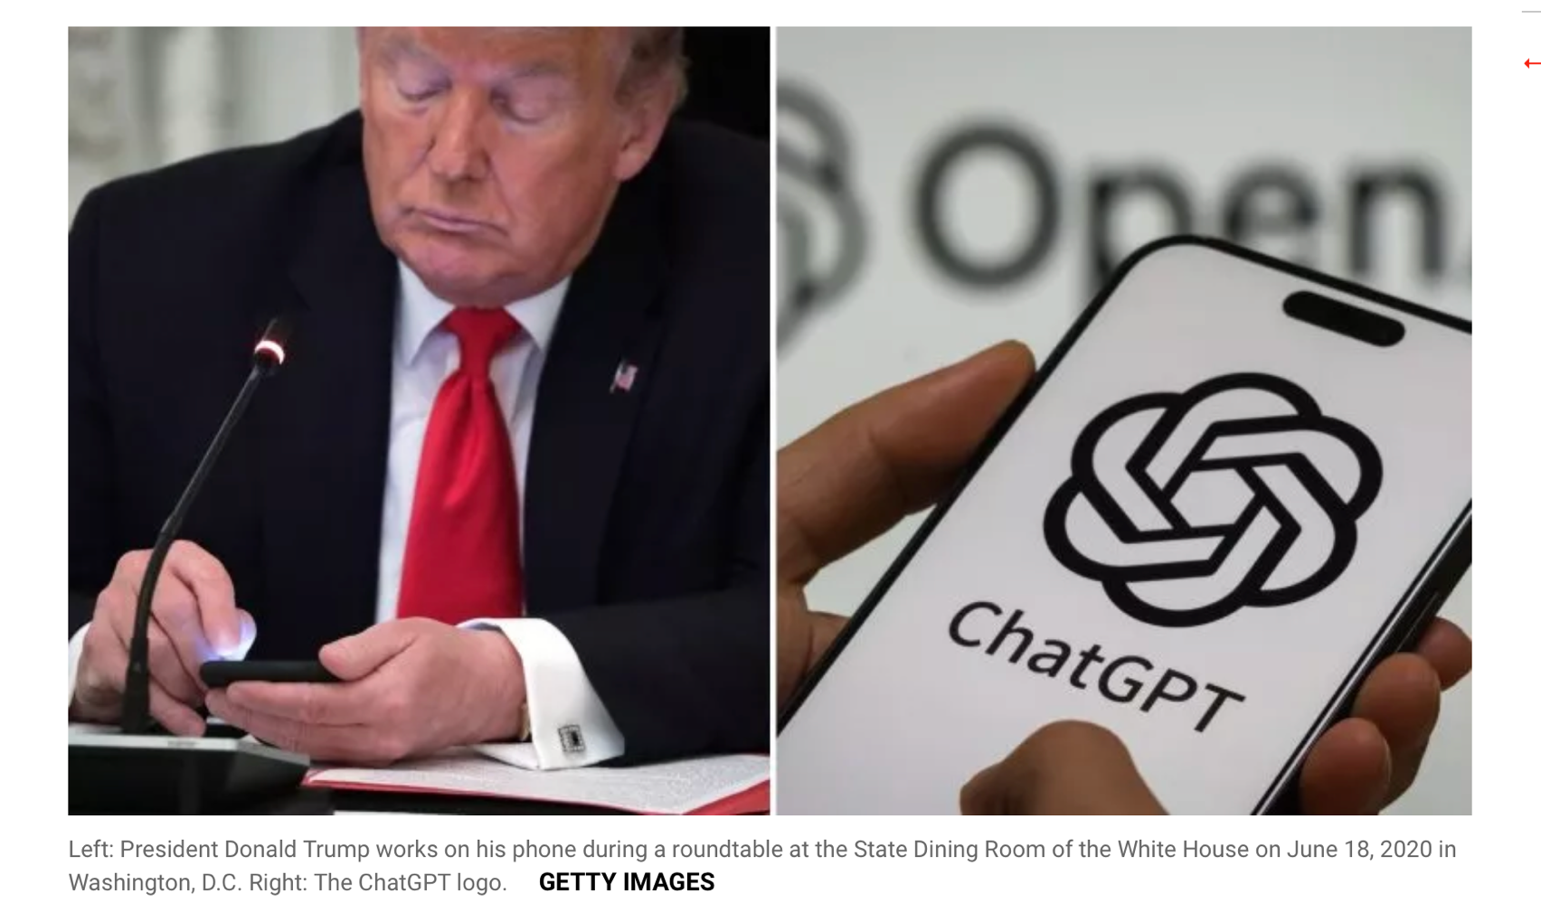
GPT-3 is a language model that uses deep learning to produce human-like text. Its writing is (in)credible at first sight, but, like dreams, quickly becomes boring, nonsensical, or both.
Engineers suggest this shortcoming indicates a complexity issue, but it also reveals an aspect of literary innovation: that proper stylistic tendencies of experimental literature reflect the disruptive nature of authors’ experience of the world
Where GPT aims to smooth over language, literature consists of perterbations.
This difference reveals the stakes of human creativity in the age of large language models.
Notes:
We get the same tension in GTP-3 written analysis, essays, -- even policy.
*
Of course, There is a dark irony to GPT-3’s lack of interest in what is new – that is, the future:
As well as being bad at innovation, large language models are exploitative and wasteful technologies. The commercial ambitions of the tool are evident in a curiously banal kind of writing, entirely symptomatic of the corporate-engineered sense of normalcy that obscures successive, irreversible crises as we sleep walk through the glitch era.
It is, quite frankly, a bad time to have a more-of-the-same machine put into the hands of lazy authors, and worse to give it to lazy politicians and over-worked civil servants
Contrary to this, experimental literary practices and pressurise language conditions can provoke more astute critical-sensory engagement with the difficulties of our time.
I propose that GPT-3 can be a measure of what effective language difficulty is – and, in a kind of double-irony, can perhaps help us find and generate it.
The first part of this paper is about an experiment to use AI-generated prose can serve as a critical baseline for understanding what distinguishes contemporary experimental literature.
And, perhaps what gives value to all kinds of ‘language under pressure’ situations.

Slide 5
CONTINGENCY David Ε. Wellbery
Narrative is like a sentence
Sentences are brought into being by the contingent correlation of breath/pronunciation and syntax/sign, in the “occurance”.
Narrative similarly occurs in its completed sense via contingency correlating with chrono-logic.
Contingency is always a selection, an actualization that draws on a reservoir of other, nonactualized possibilities, a throw of the dice, an intersection.
The fact that [literary texts] could have been otherwise plays off against the evidence that they work perfectly as they are. It's here, at this juncture, that literature qualifies as the perfect medium in which to model contingency.
Notes:
Putting the things that matter in the world into a productive

Slide 6
[Flower and Hayes 1980 process model of writing]
because writing involves a complex interaction between a wide range of different processes, it places extremely high demands on the limited capacity of working memory. In order to avoid cognitive overload, writers have to develop effective strategies for managing the writing process
Cognitive Models of Writing
David Galbraith
‘in so far as [the reader] appreciates the poem s/he has a sense of the conquest over the disorder and meaninglessness of experience’.
Gillian White
Poetics of contingency

Slide 7
Beti Marenko FutureCrafting: A Speculative Method for an Imaginative AI
When the machine no longer simply searches for information but combines and recombines data to train itself, contingency enters the process and must be accounted for. This has profound implications on current AI narratives, and it must inform how to imagine and conceptualize near future AI.
Notes:
Mahinces do operate contingently – it’s just that those contingencies have no- or no comprehensible world stakes .
The GAMBLE they make when speculating has no stake in the world as it is. Beatriz

Slide 8
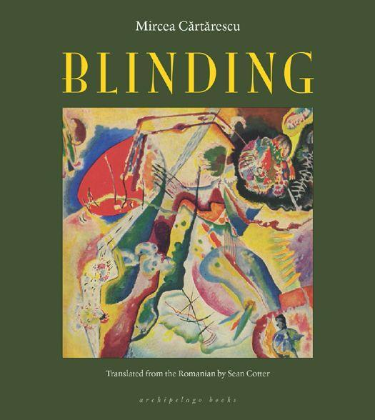
The Blinding Mircea Cartarescu
”true and limitless literature”
Notes:
I want to start with a direct comparison between Mircea Cărtărescu’s Blinding (trans. Sean Cotter, 2013) and GPT-3 authored ‘versions’ prompted from passages of the original. The process of juxtaposing human and machine authored text clarifies how literary contingency operates at the level of stylistic pressure: through distinctive densities of proprioceptive nouns, metaphorical motifs, a temporal instability, and “world-pressure” reflecting the biographical experience infused through the novel.

Slide 9
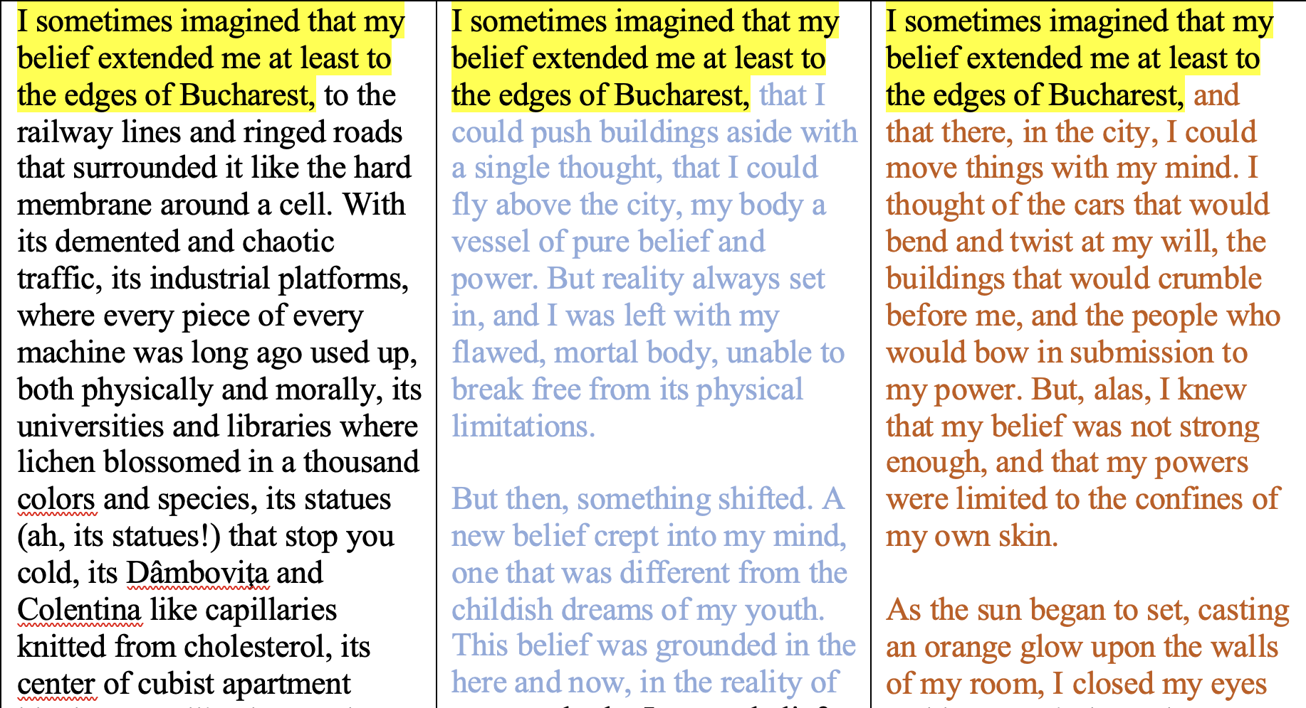
Original
gtp
gtp
Notes:
I treat GPT-3 iterations of experimental prose as algorithmic counterfactuals: glimpses of how Cărtărescu’s prose might have unfolded under different conditions.
Each machine-generated paragraph confronts the human text with a spectre of alternative pathways, making visible what Wellbery identifies as literature’s double structure: the necessity of the work as it stands, and the irreducible accidentality that shadows every aesthetic decision.
Sean Cotter’s description of translation as embodied, recursive labour—rewriting the novel six times to preserve its hallucinatory collisions—underscores that literary contingency is sustained through frictional, irreducibly embodied choices that make the strange time of the novel interplay with the real time of writing in rich ways.

Slide 10
Cărtărescu’s prose is dense with proprioceptive nouns
Cărtărescu (Blinding) | GPT-3 continuation
"My skin has become flaked and semi-transparent, and you can see beneath it the stretching tendons that activate the levers of my fingers. My nails have grown long and bluish. If I bend them, the sensation travels along the bones of my hand as if they were elongated antennae..." | "My skin shimmers with an electric pulse that runs beneath the surface. I can feel the buzzing sensation crawling over my fingers and across my palms."
Notes:
For example, Cărtărescu’s prose is dense with proprioceptive nouns—words that name the body from the inside (tendon, bone, joint, ligament). This linguistic thickness gives his writing a deep bodily torque: the sensation not just of seeing or touching the body, but inhabiting it. GPT-3’s continuation, by contrast, retreats to surface effects—shimmering, tingling, buzzing—without accessing the body's internal mechanics. This deficit is symptomatic: proprioceptive language is presumably in GPT-3’s training data, and thus in its imagination, and certainly these words would will not have the same potency for bodily elaboration in the context of a statistical machine. The comparison shows that genuine literary contingency often depends on somatic input. Cărtărescu’s sentences torque the body into language, maintaining a friction against the reader that the GPT-3 authored versions do not replicate.

Slide 11
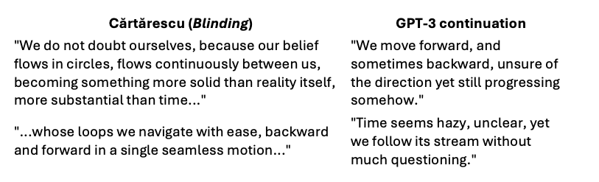
Cărtărescu understands time as a thickening medium
Notes:
Cărtărescu shapes time as a thickening medium. His repetitions—"our belief flows in Cărtărescu’s loops—“belief flows in circles”—harden into structures "more substantial than time," forcing the reader into lived, recursive pressure. Each twist in time feels contingent but willed: other paths haunt the moment, but this one insists on itself specifically. GPT-3 flattens this tension. Its continuation—"we move forward, and sometimes backward"—registers temporal distortion only to abandon it. Time "seems hazy," the stream is followed "without much questioning"; movement becomes drift, not choice.
Where Cărtărescu forces time to torque and kink across the experience of author and reader, GPT-3 lets it blur and fade among its statistical space.

Slide 12
Blinding
“They’d shaved his head completely, and the skin gleamed like parchment pulled taut over bone. A grid had been tattooed there, line by line, square by square, until his skull looked like a manuscript globe. Within each quadrant: symbols, words, astrological signs, mechanical diagrams. It was not a head anymore but a rotating archive, a mnemonic machine wound tight with pain and knowledge. When he bowed forward, it was as though the entire sky had been inked on his scalp. Tiny letters crawled across the meridians like ants, reordering themselves into verses, equations, fragments of forgotten alphabets. You could hear a soft ticking, as though a watch were hidden in the fontanelle. They said the diagrams changed when he slept.”
“Bucharest was the body of a monstrous animal whose soul, dead since before my birth, had decomposed in its midst… The city pulsated with warm rot, each boulevard a bloodstream clogged with old buses and sour cigarette smoke… apartment blocks like flaked skin peeled off a reptilian god.”
“At night, the city became a phosphorescent reef, illuminated from within by fish-thoughts and flickers of dream… I walked among them like a sleepwalker, each step splashing through the secretions of past lives… elevators groaned like dying whales in the block’s throat.”
Notes:
At the sentence level, Cărtărescu’s motifs—silk-spinning butterflies, tendon-levers, recursive webworks—act as algorithmic glitches: improbable structures that propagate meaning through logical fracture. His prose thickens sensation through deliberate disruptions of physical, causal, and temporal norms. Each “glitch” foregrounds the otherwise-ness that GPT-3, trained to average likelihoods, systematically smooths away.
Another crucial difference between this extraordinary book and the GTP-3 authored versions lies in the presence—or absence—of what we might call “world-pressure”. Cărtărescu’s prose crackles with external forces: specific streets of an invented Bucharest, thick with historical resonance; flashes of theological yearning; the felt textures of childhood memory. These pressures perturb the narrative prose, bending style under the weight of place, belief, and personal history. We feel the adult author struggling to occupy their adolescent self because the impossibility of this is manifested in the illogic of the language and narrative of the book. In Blinding, the realism of memory is a force field that distorts and destabilizes narrative form.
This, I think reveals that what is at stake in literary realism today—as Cărtărescu practices it—is less about referential accuracy than about registering life writing as the application of external pressures upon style. Where such irreducibly human prose inscribes the world’s unevenness into the texture of language, GPT-3 iterates smoothly across the surface of its language model, indifferent to stakes or anchorage.
-- or, what is the computers version of proprioception? What is the computer’s time?

Slide 13

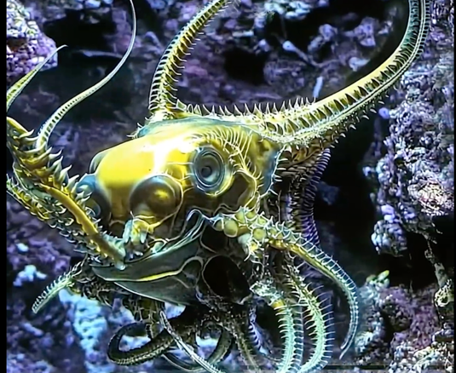
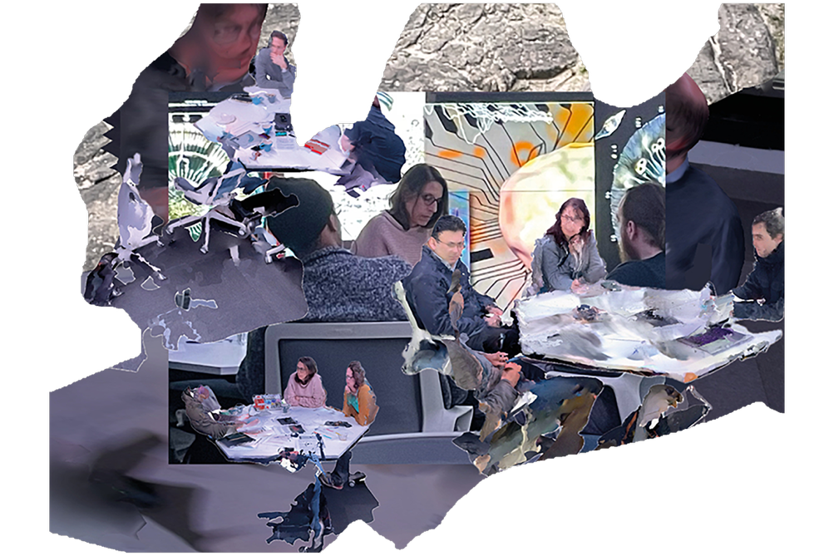
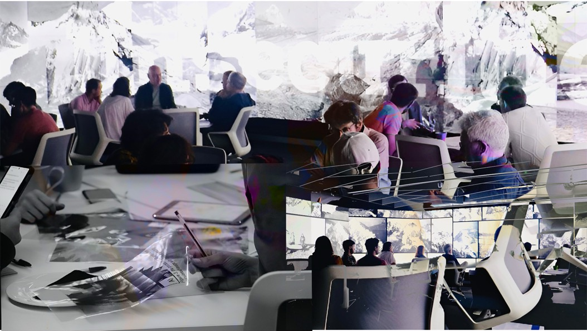


Notes:
This friction between language and experience is not only a literary concern. It mirrors how meaning collapses in moments of collective threat, especially under the strain of technological mediation.
In my recent Unsecurities Lab workshops, participants encountered artworks (sometimes using AI, sometimes with AI as an imagined ‘protagonist’) that deliberately destabilised perceptual norms—glacial archives distorted by machine vision, climate systems rendered as synthetic hallucinations. Across disciplines, participants struggled to identify where the threat lay.
Just as GPT-3 produces believability without pressure, our security imaginaries increasingly rely on interpretive smoothness: seamless dashboards, automated foresight, and predictive calm.
Sitations that force different kinds of contingency reassert the stakes of not-knowing, of pressure without clarity. It reminds us that meaning, like safety, must sometimes be remade through difficulty.

Slide 14
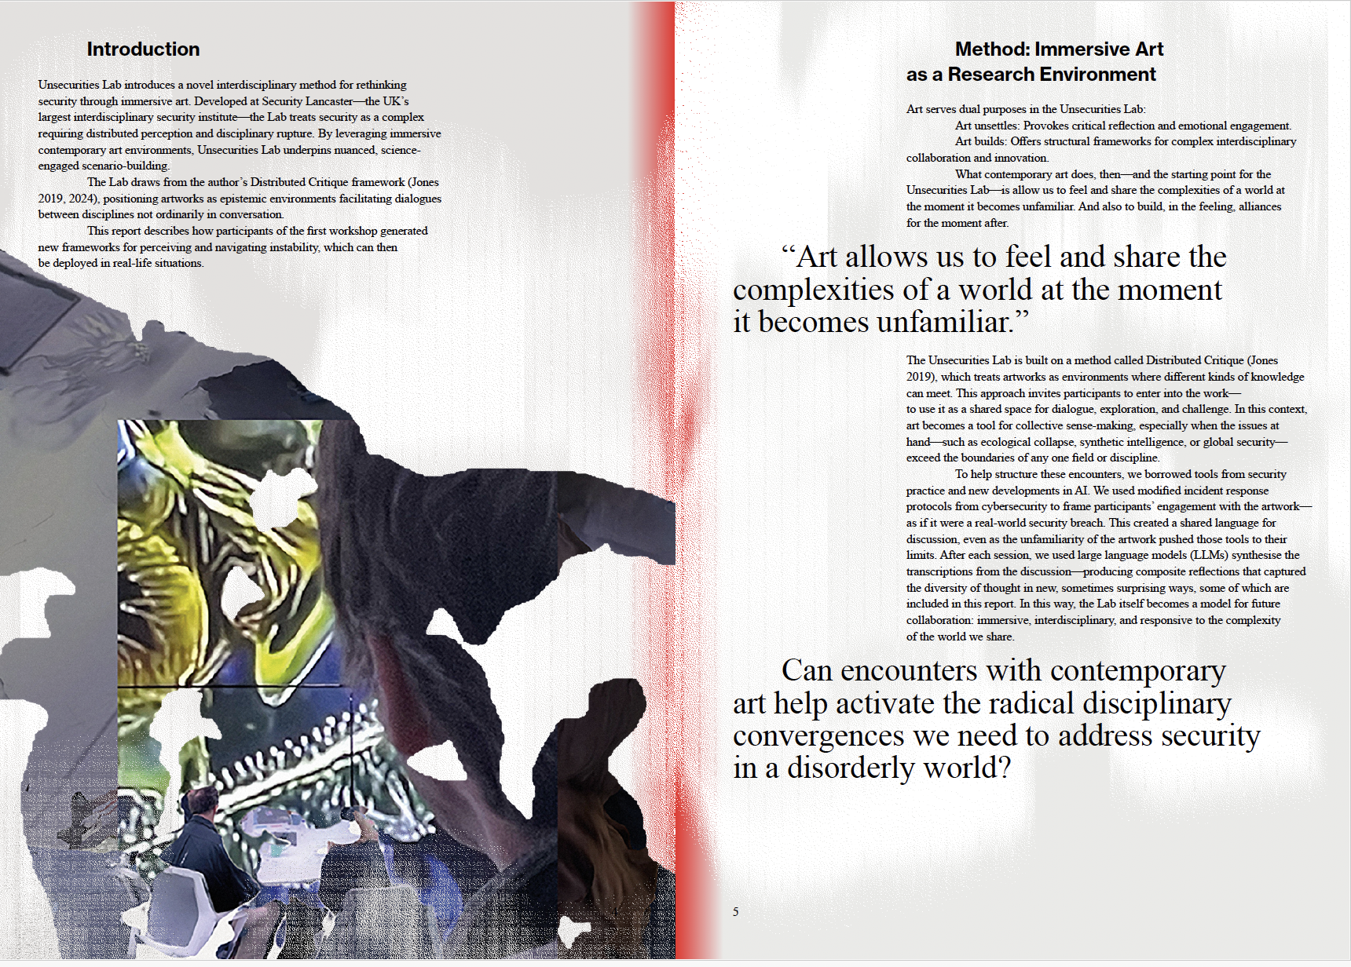
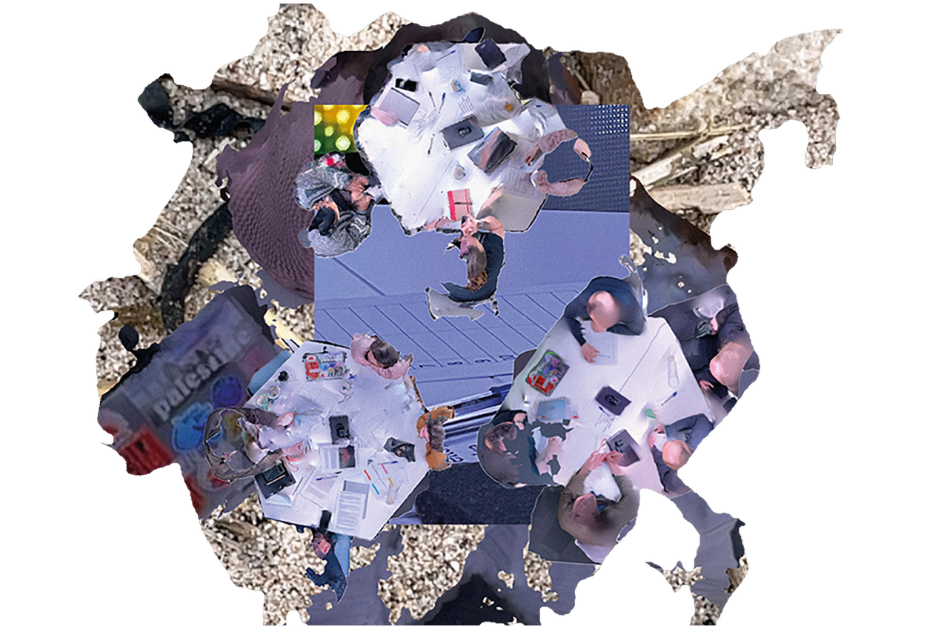

Slide 15

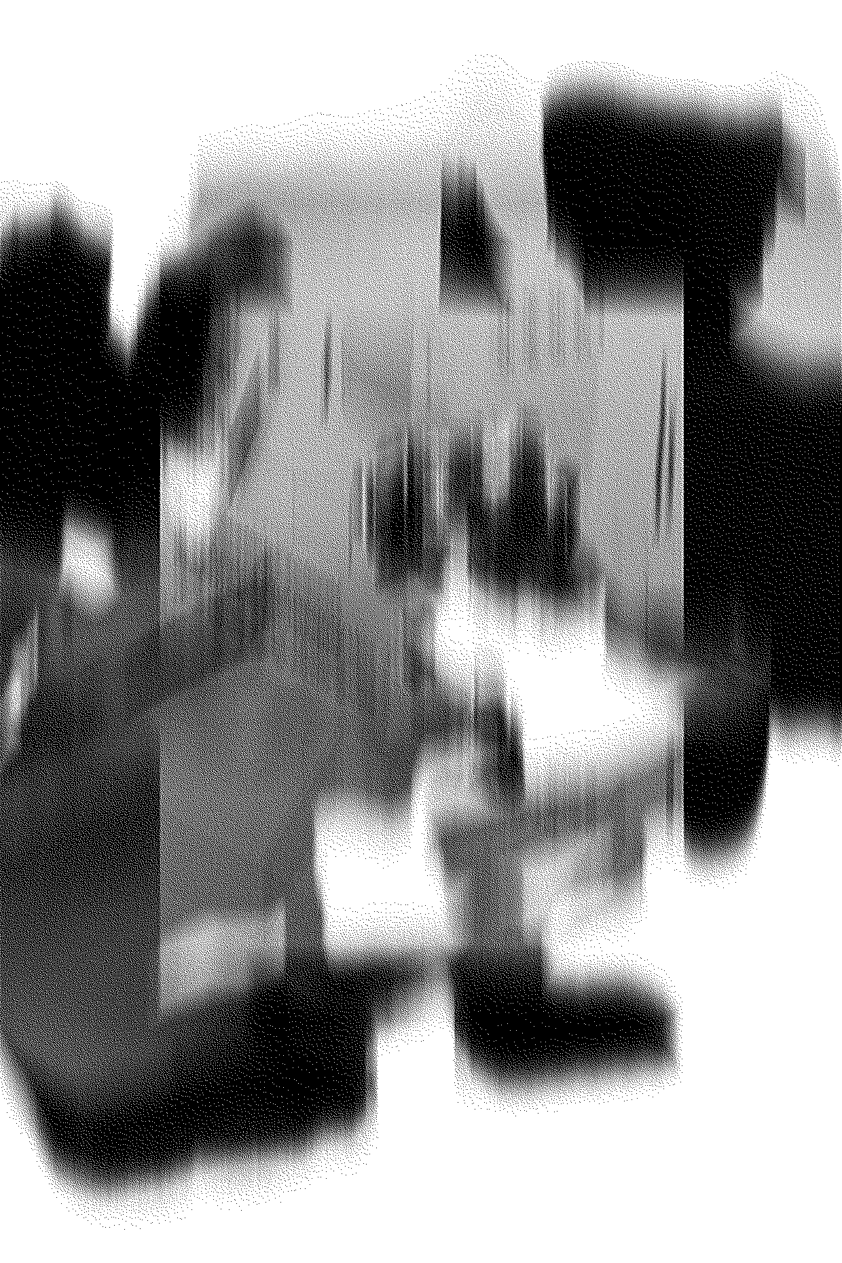
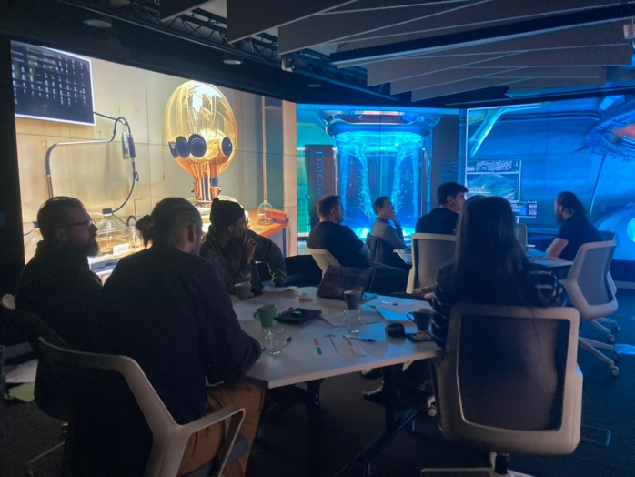
In Joey Holder’s Charybdis, there is a major presence of AI generated alien ecologies and affective atmospheres that resist the sense of a human author/actor
Asked to analyse them as a security incident the participants described a sense of awe, confusion, discomfort—a reaction that became generative, opening space for cross-disciplinary conversation.
AI in art is a presence that disturbs epistemic habits.
Notes:
“We’re so used to human-made disruption—punk, Dada—that it’s become expected. AI reactivates that uncertainty in a new way.” “People question the ethics of my imaginary AI creatures... but they don’t question the labs working with harvested cells.”— Joey Holder

Slide 16
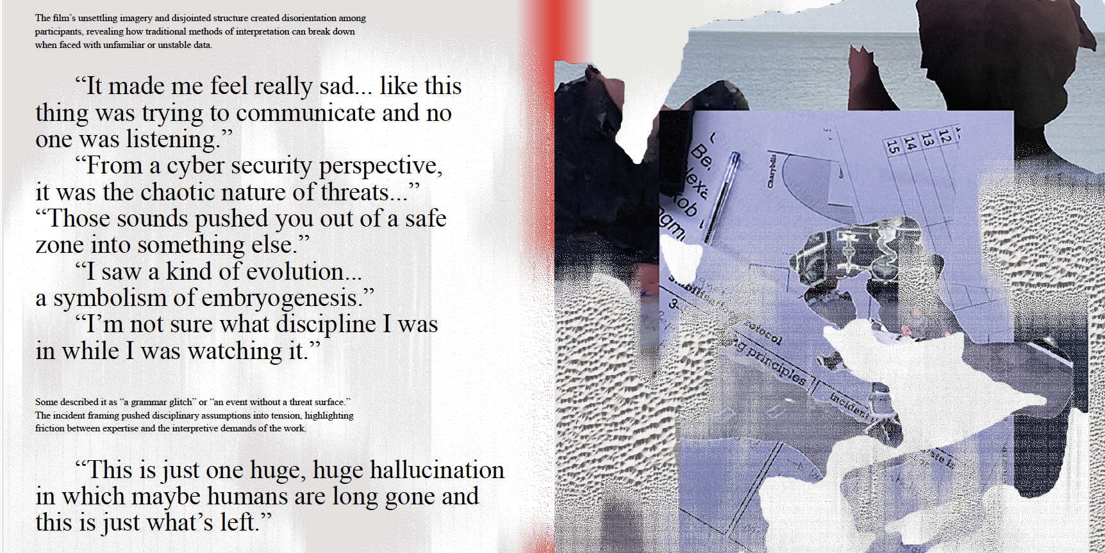
AI art reintroduces uncertainty as alien logic.
Notes:
The incident framing pushed disciplinary assumptions into tension.
For some, it meant a return to their specialist lens; for others, it highlighted a friction between their expertise and the interpretive demands of the work. One participant remarked, “It feels like an event, but not one you can respond to in the usual terms—there’s no incident ID.” Crucially, participants became aware not only of the artwork’s resistance but of their own interpretive habits. As one put it, “You’re almost too close to the technology.” This itself led to a form of discovery, about incident diagnosis, between cyber and physical systems. At a table with an evolutionary scientist and cyber security specialist for example:“From a cyber security perspective, it was the chaotic nature of threats…” “I saw a kind of evolution… a symbolism of embryogenesis.”
As people got deeper into the conversation, their responses became partly also about the trustworthiness of the material itself, and the manner of speaking got more fragmented. “I got the impression that everything is fake. And that every move is fake. But... The things are studying us. Then... There's a lot of anguish. And isolation. And toxicity.” “Are you seeing the cause from... Creating meaning out of something? Exactly. So should we do that? Is it ethical to do it?” An engagement with this material allowed them to speculate on kinds of technics that are presently at the fringes of possibility: “is there a case of something being developed within our own community? Is there a level of AI, which is nanotech? Is there a separate lab lead? Is there a trained marine officer, which is clearly unknown risks in the deep sea?” And also to think in terms of different timescales: “… it has to take place in a bounded space of time. So actually it could be an incident, it could be something that flows across the entire thing. So an extinction event that took place over millions of years.”

Slide 17
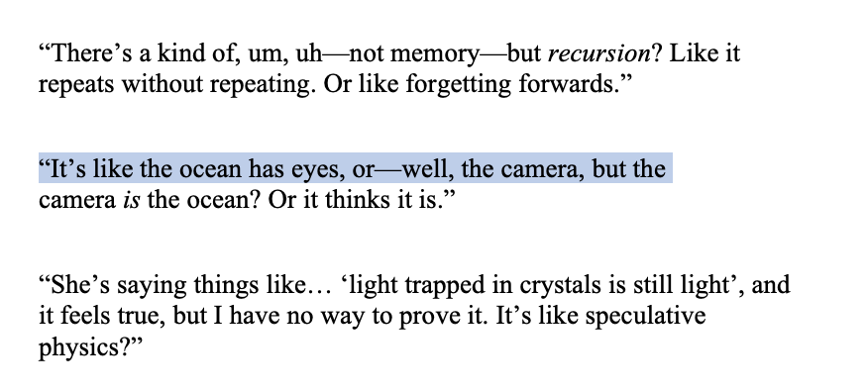
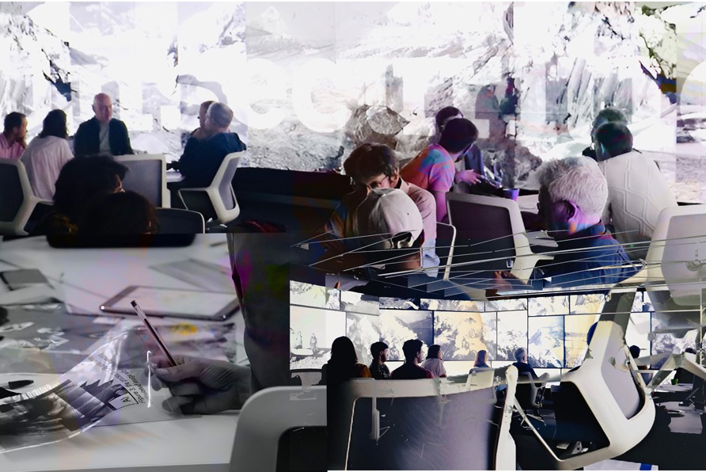
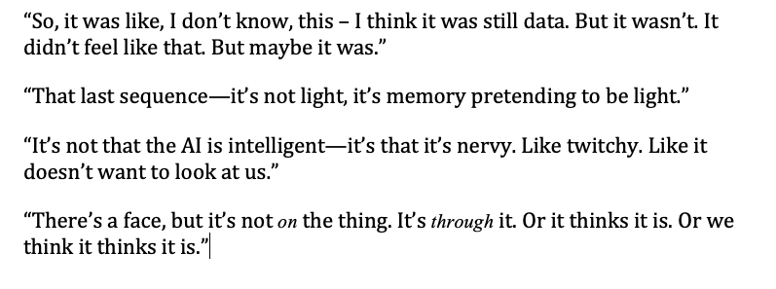
Notes:
The Lab asked whether “art as a research environment” could de-re-compose modes of thought. The answer seems to be: yes—and it leaves marks in the language. These ruptures offer a methodology: when speech stutters, when it turns strange, we’re close to the edge of something real and shared—but not yet named.

Slide 18
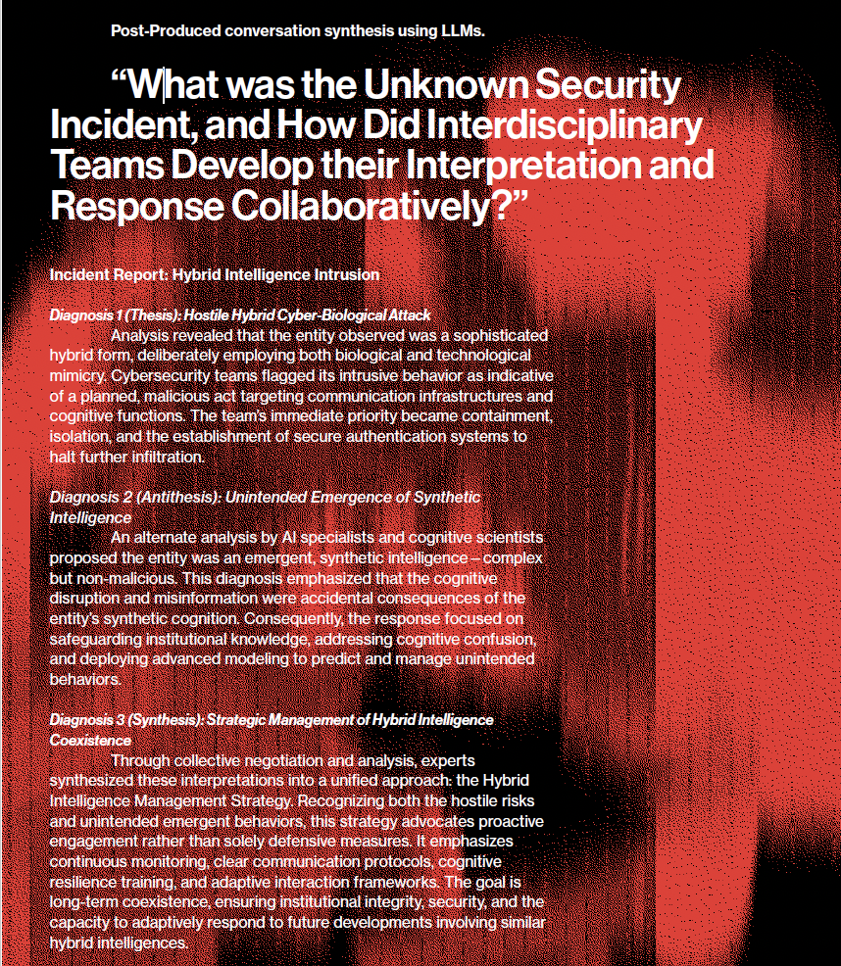
Notes:
Dialogues in a state of unknowing
AI used after the fact—trained on confusion
A way of preserving rupture and difficulty as generative assets
Quote:
“I analysed the dialogue closely… maintaining the authenticity of participants’ perspectives while creatively probing the implications.”

Slide 19
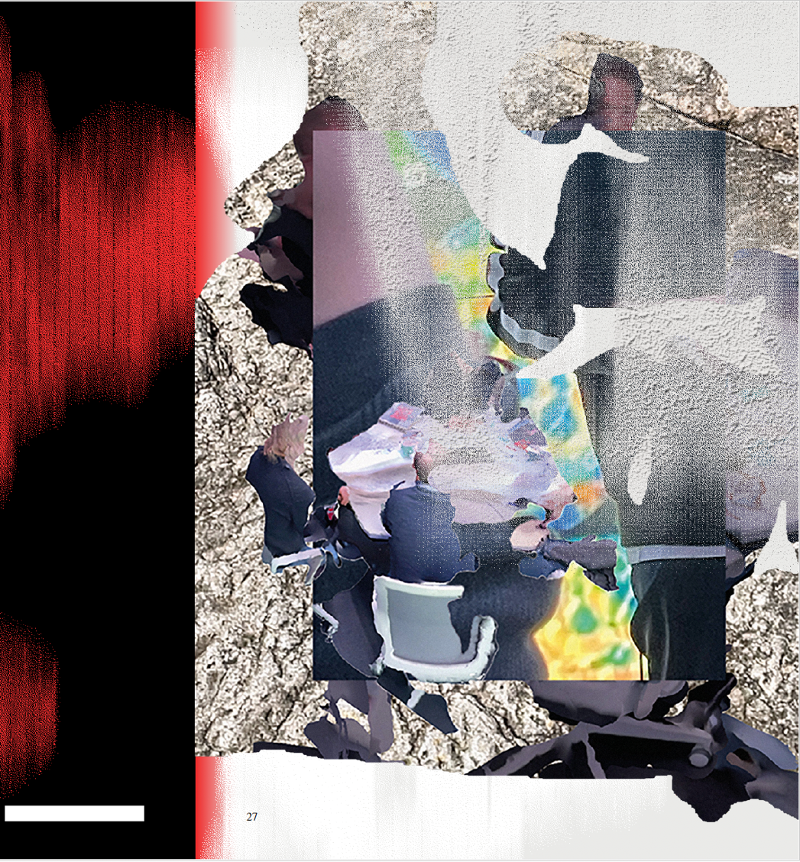

To face future challenges, we need research that disturbs, derails, and disorients—so that something new can emerge.
Contemporary art and literature creates epistemic conditions for about what is materially consequential about the unknown.
This is particularly true of Immersive art, which provide ‘hot’ conditions where expertise becomes liquid.
And it is also true about authentically weird literature.

