Slide 1
Choosing Open Access for Books: Author Agency and the Open Book Collective
Dr. Judith Fathallah, Lancaster University, Coventry University, Open Book Collective
www.openbookcollective.org
judith@openbookcollective.org

Slide 2
My argument
• In discussions of transition to an equitable, sustainable future for OA publishing, author choices are often neglected
• We as the authors of academic works and textbooks have a role to play and a degree of agency in our publishing choices
• Legacy publishing strategies no longer produce the rewards they did for earlier academic cohorts: more of us are precariously and tenuously employed: see UCU 2021; 2023: Research staff are 68% FTC!!
• Authors should be working with librarians to enable a just transition both in their publishing choices and in their choice of the works they choose to request and assign, to create a landscape that is more sustainable for everyone

Slide 3
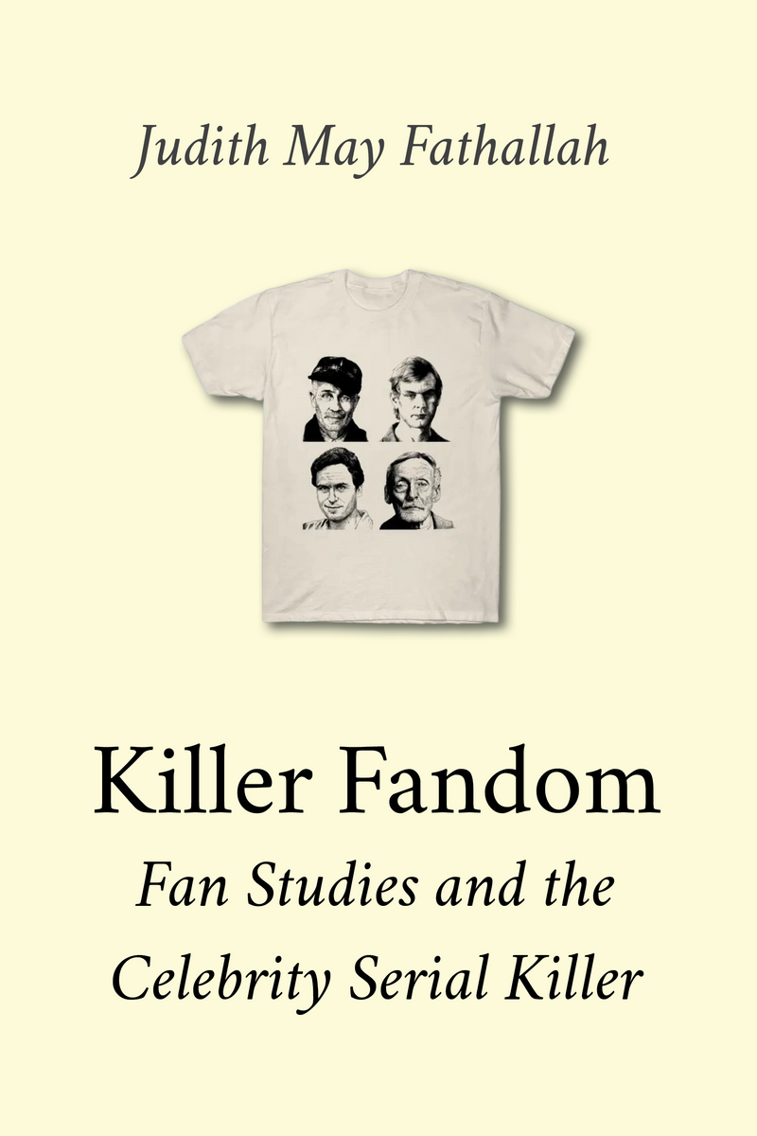
My journey with book publishing
2017, Amsterdam University Press, made OA by Knowledge Unlatched
2020, Iowa University Press, no OA edition
2023, mediastudies.press, Diamond OA

Slide 4
Why I chose OA, and mediastudies.press
Work with the Open Book Collective: ethical imperative of OA
Citation advantage is real
Now 135 (13 Sep)

Slide 5
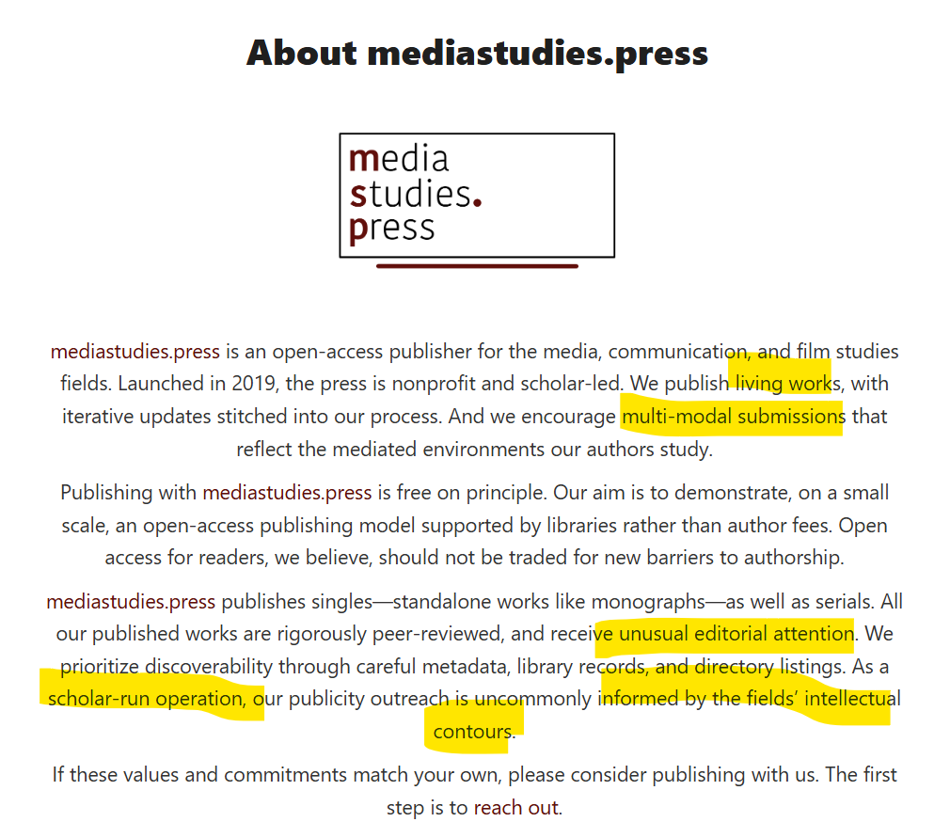

Slide 6
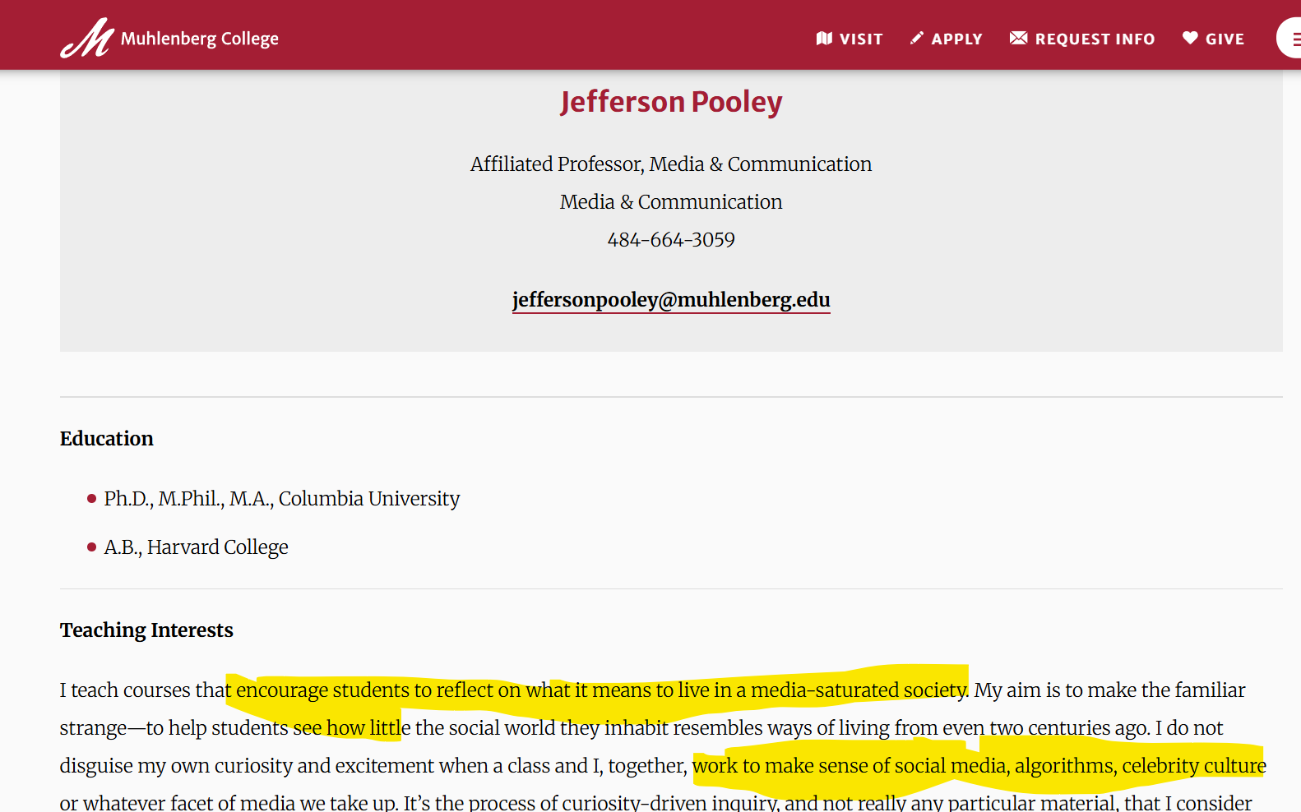

Slide 7
Press/student/broader interest in my work (Book launch, New Books Network, talk at Millersville University, use in syllabi)
The implicit contract of prestige publishing is broken anyway: there is no reward for publishing with “big names”. Replace prestige with 'soundness':
How is research chosen for publication by the press? What are its editorial and production standards? How does it engage with new developments in book production? How widely are its works disseminated, and is its business model sustained by hefty charges levied on authors or readers?*.
Innovative publisher, high production values meeting OBC membership standards, more likely to accept an unusual pitch, NO BPC! How?
*Lucy Barnes, "Is prestige a problem? Considering the usefulness of prestige in academic book publishing". http://doi.org/10.11647/OBP.0173.0114

Slide 8
In conclusion
There are varied, high quality, sustainable options for OA book publishing without BPCs
If we believe in an equitable transition to Open Access, we need to exercise our power of choice regarding whom we choose to publish with
The citation advantage and openness of our work is probably more personally beneficial anyway than the “prestige” of legacy publishers, which don’t result in permanent contracts anyway
Authors should work with librarians to ensure library budgets are going to support the right publishers and the OA future we believe in.

Slide 9
Introducing the Open Book Collective
Kevin Sanders
Open Access Engagement lead, Open Book Collective
All slides CC BY
Open Book Futures is a Copim community project funded by

Slide 10
Builds on Diamond OA funding models
Securing sustainable funding via renewable support from dozens of universities

Slide 11
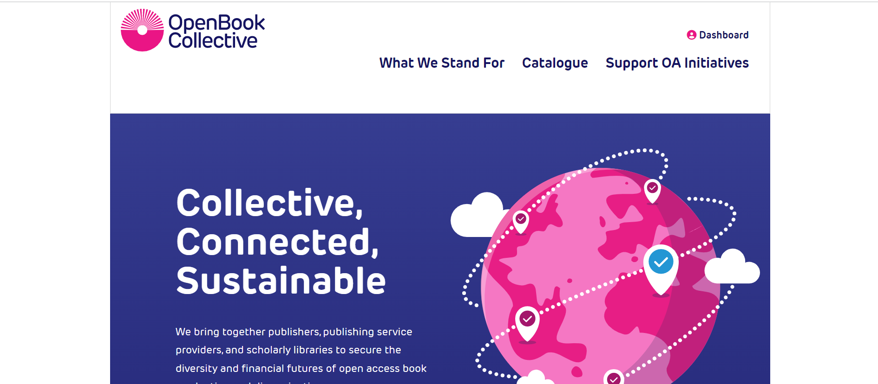
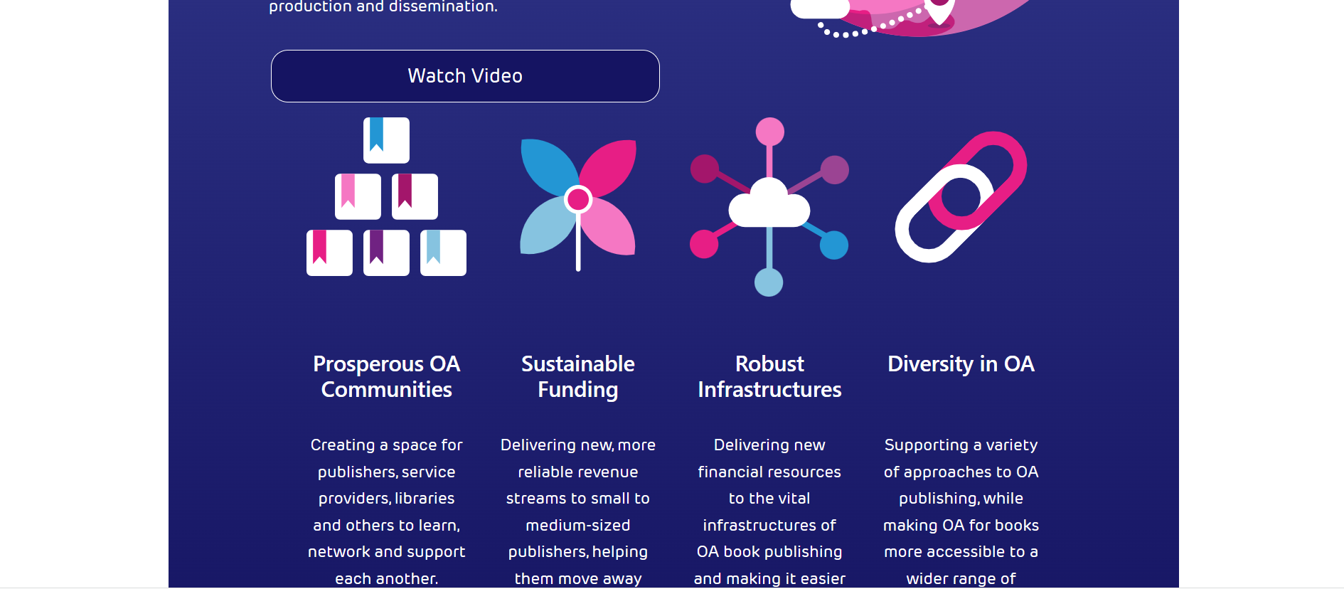

Slide 12
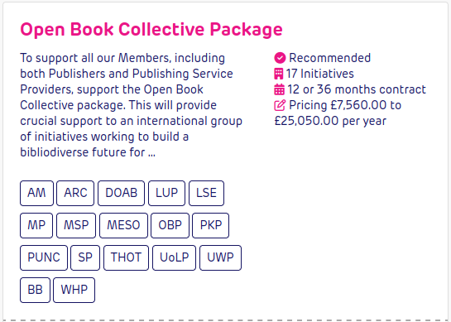
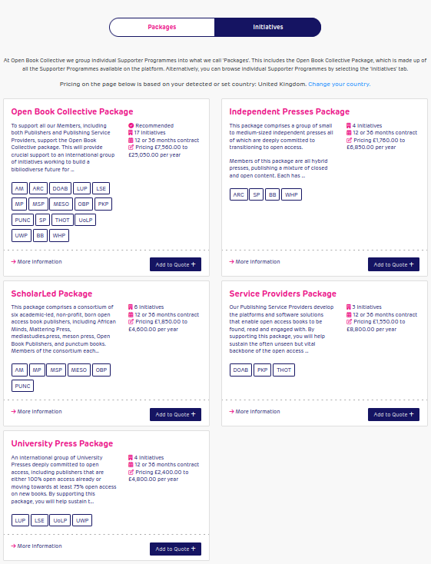
All OBC members have their own individual, tiered annual Supporter Programme
Pricing varies according to each organisation’s needs
Each Supporter Programme includes benefits to subscribers (e.g. annual reporting, usage data, discounts on hard copies)

Slide 13
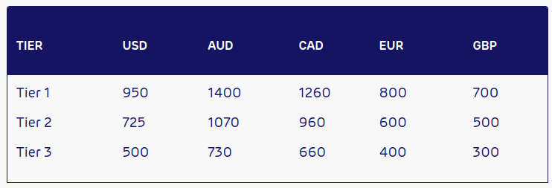
Our fees for supporters: A case study
Subscription Fee for Tier 1 institution (10,000+ FTE), for 12 months
£700
Supporter Processing Fee @ 5%
£35
Total payment request
£735

Slide 14
Making it easier to support multiple OA initiatives
Select supporter programmes
Decide on a term (1 or 3 years)
Harmonise renewal dates
Confirm consolidated subscription
Receive a single, annual payment request

Slide 15
A trusted collective
Non profit
Community governed
Stringent membership criteria
Sustainable
A charity, regulated by the Charity Commission of England & Wales
Our library, publisher, and service provider members have direct control over the future of the organisation
Ensuring we support only trusted OA infrastructures & publishers producing peer reviewed scholarship of the highest quality
80+ supporting members. Grant funded until April 2026. Recent external review confirmed OBC will be financially self-sufficient post-project

Slide 16
Supporting fairer OA publishing, globally
Helping build an open source ecosystem of OA book publishing infrastructures
OBC members contribute to the Collective Development Fund: A grant giving fund to build OA capacity
3 grants issued so far (£37,500), including to found Zimbabwe’s first OA university press
Press releases for first three Collective Development Fund grants

Slide 17
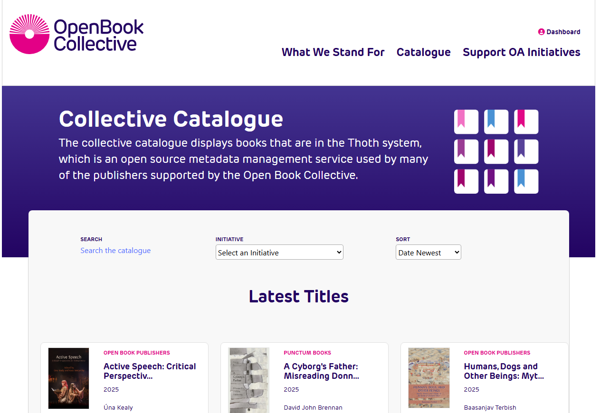
Publishers with consistent metadata
Key metadata requirements
Information on open licenses used
Thema (preferred) or BISAC subject classifications
Chapter level metadata
Author institution via ROR ID

Slide 18
Stay in touch
@openbookcollective.bsky.social
@openbookcollect@mastodon.social
info@openbookcollective.org


