Slide 1





Choosing Open Access for Books As a Precarious Scholar
Dr. Judith Fathallah, Lancaster University, Coventry University, Open Book Collective www.openbookcollective.org
judith@openbookcollective.org

Slide 2
My argument
In discussions of transition to an equitable, sustainable future for OA publishing, author choices are often neglected
We as the authors of academic works and textbooks have a role to play and a degree of agency in our publishing choices
Legacy publishing strategies no longer produce the rewards they did for earlier academic cohorts: more of us are precariously and tenuously employed.
Authors should be working with librarians to enable the transition both in their publishing choices and in their choice of the works they choose to request and assign, to create a landscape that is more sustainable for everyone

Slide 3
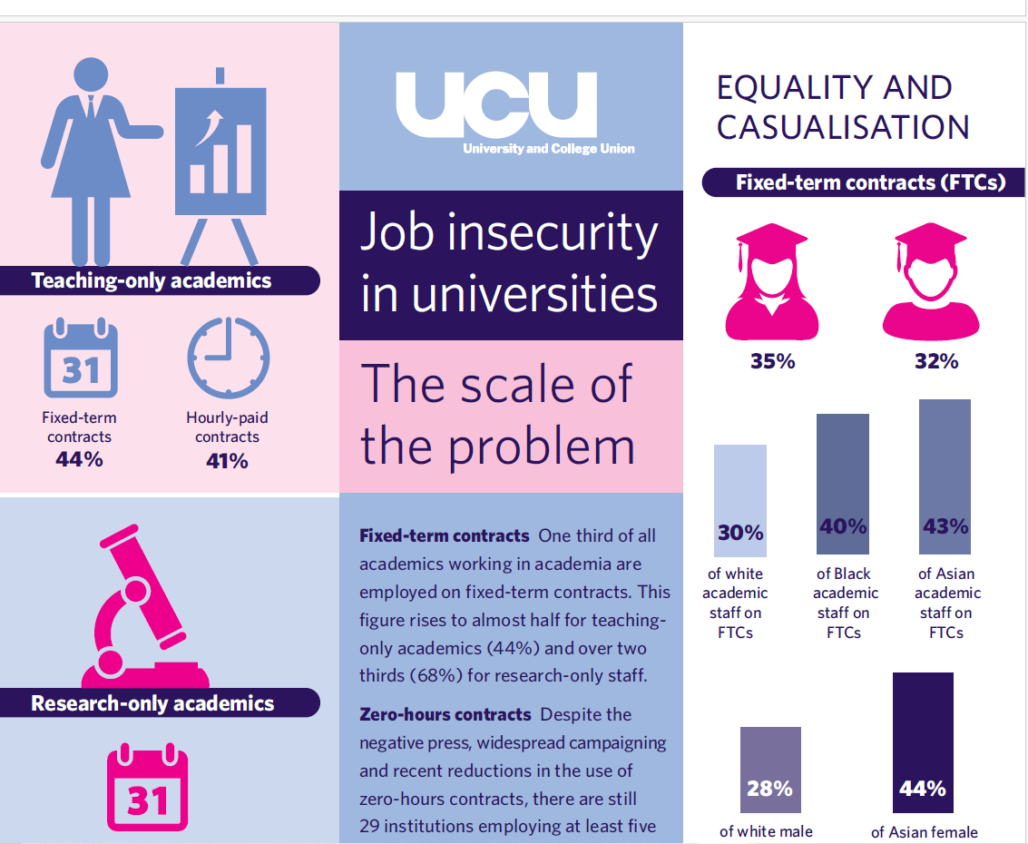
UCU study from 2021

Slide 4
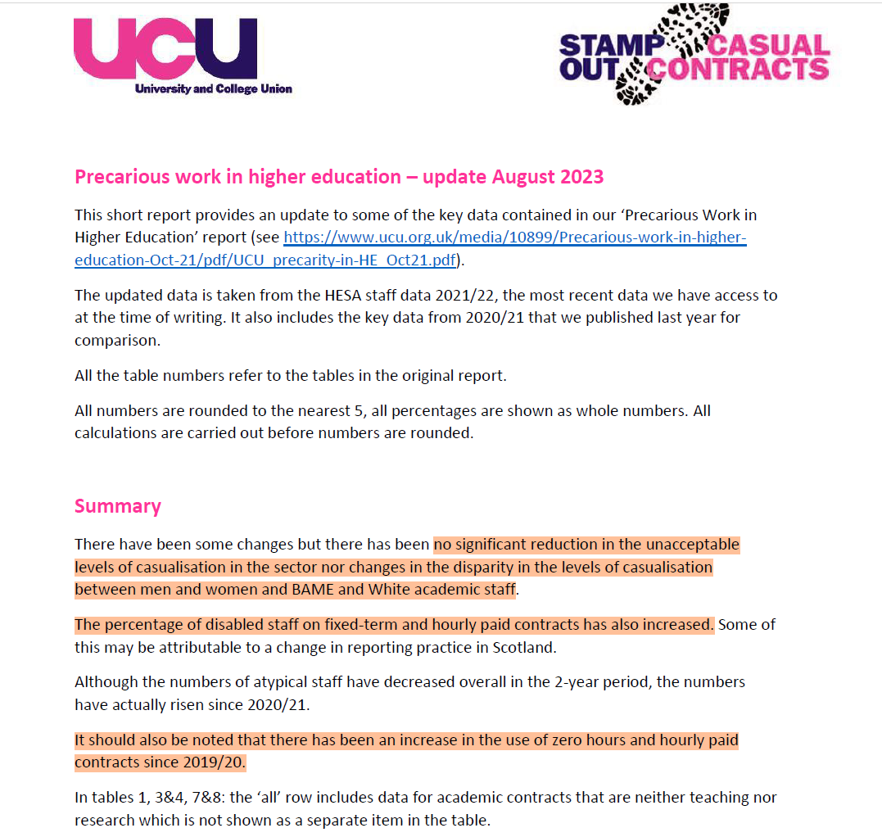
Updated 2023

Slide 5
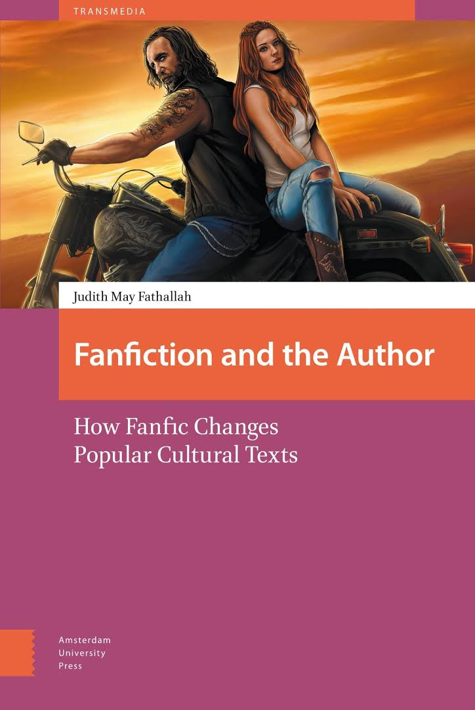
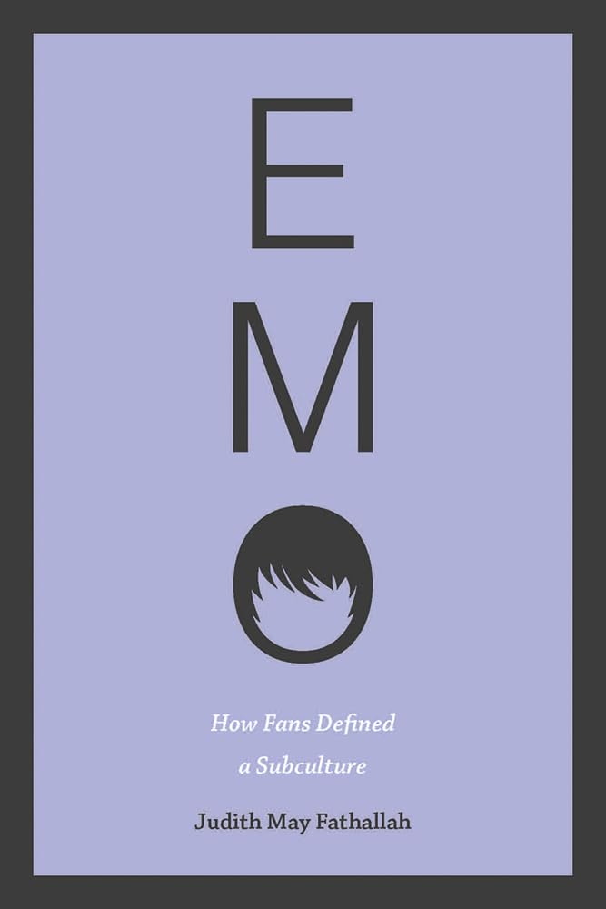
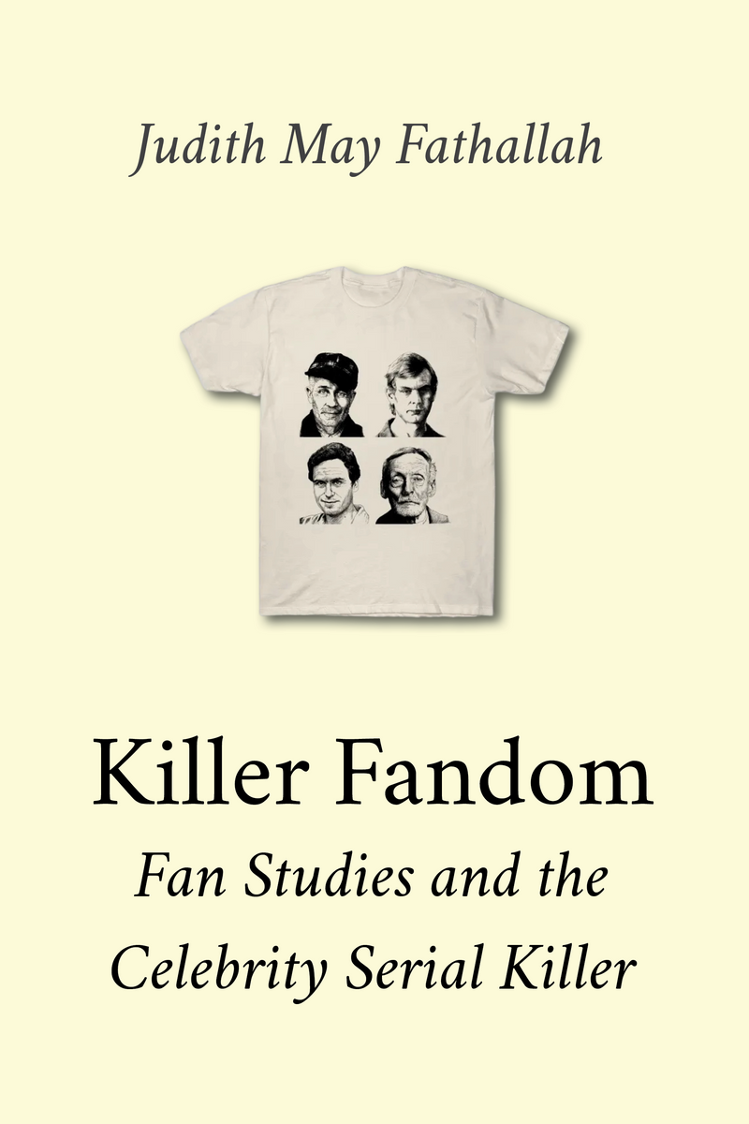
My journey with book publishing
2017, Amsterdam University Press, made OA by Knowledge Unlatched
2020, Iowa University Press, no OA edition
2023, mediastudies.press, Diamond OA

Slide 6
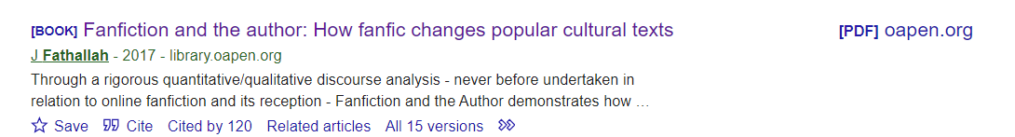

Why I chose OA, and mediastudies.press
Work with the Open Book Collective: ethical imperative of OA
Citation advantage is real
Now 135 (13 Sep)
Now 21 (13 Sep)

Slide 7
Press/student/broader interest in my work on killer fandom (Book launch, New Books Network, talk at Millersville University…)
The implicit contract of prestige publishing is broken anyway: there is no reward for publishing with “big names”.
https://blogs.lse.ac.uk/impactofsocialsciences/2024/05/20/the-ref-consultation-shows-the-need-for-a-more-plural-perspective-on-oa-books/
Innovative publisher, high production values meeting OBC membership standards, more likely to accept an unusual pitch

Slide 8
In conclusion
There are varied, high quality, sustainable options for OA book publishing without BPCs
If we believe in a transition to Open Access, we need to exercise our power of choice regarding whom we choose to publish with
The citation advantage and openness of our work is probably more personally beneficial anyway than the “prestige” of legacy publishers, which don’t result in permanent contracts anyway
Authors should work with librarians to ensure library budgets are going to support the right publishers and the OA future we believe in.

