Slide 1

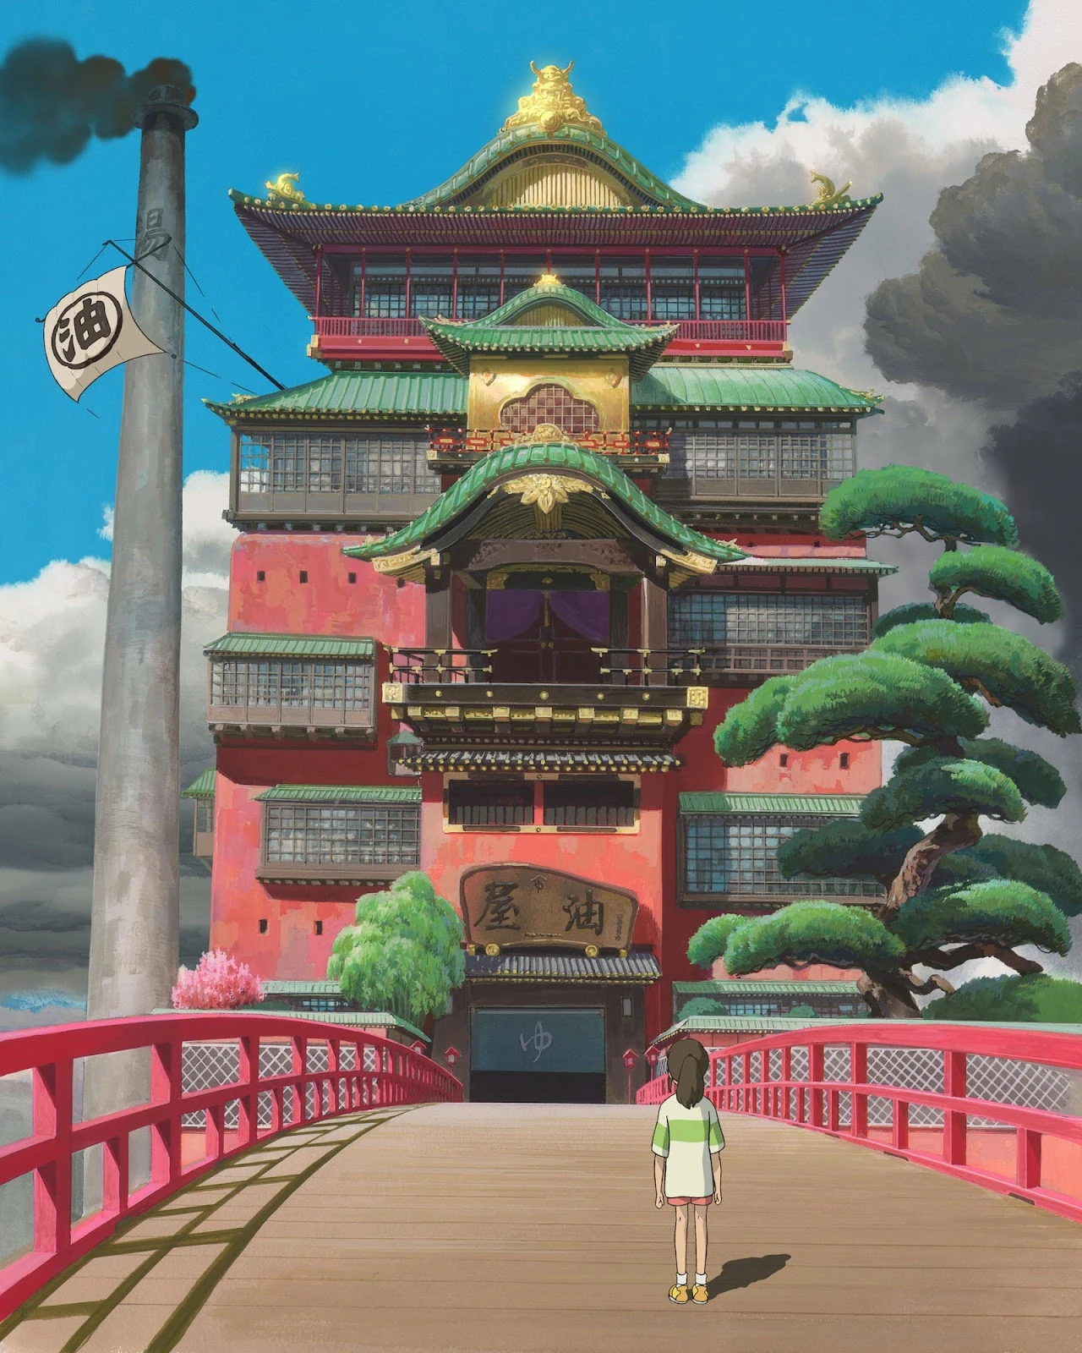



The Women of the Bathhouse: The Intersections of Women’s Labour in Studio Ghibli’s Spirited Away (Miyazaki, 2001)
Zoe Crombie, Lancaster University
z.crombie@lancaster.ac.uk

Slide 2
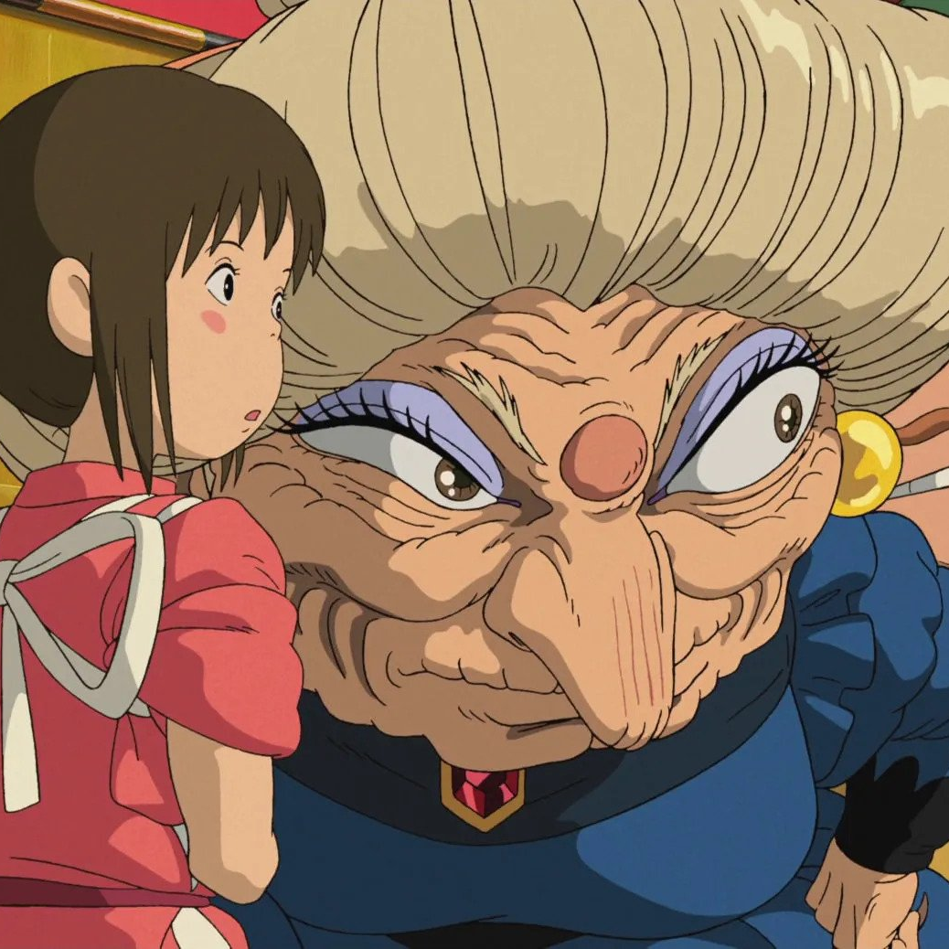
Agenda
Studio Ghibli’s background
Spirited Away
The Bathhouse
Chihiro/Sen and Yubaba
Kaonashi and ideology
Ghibli and ‘women’s work’
Conclusions

Slide 3
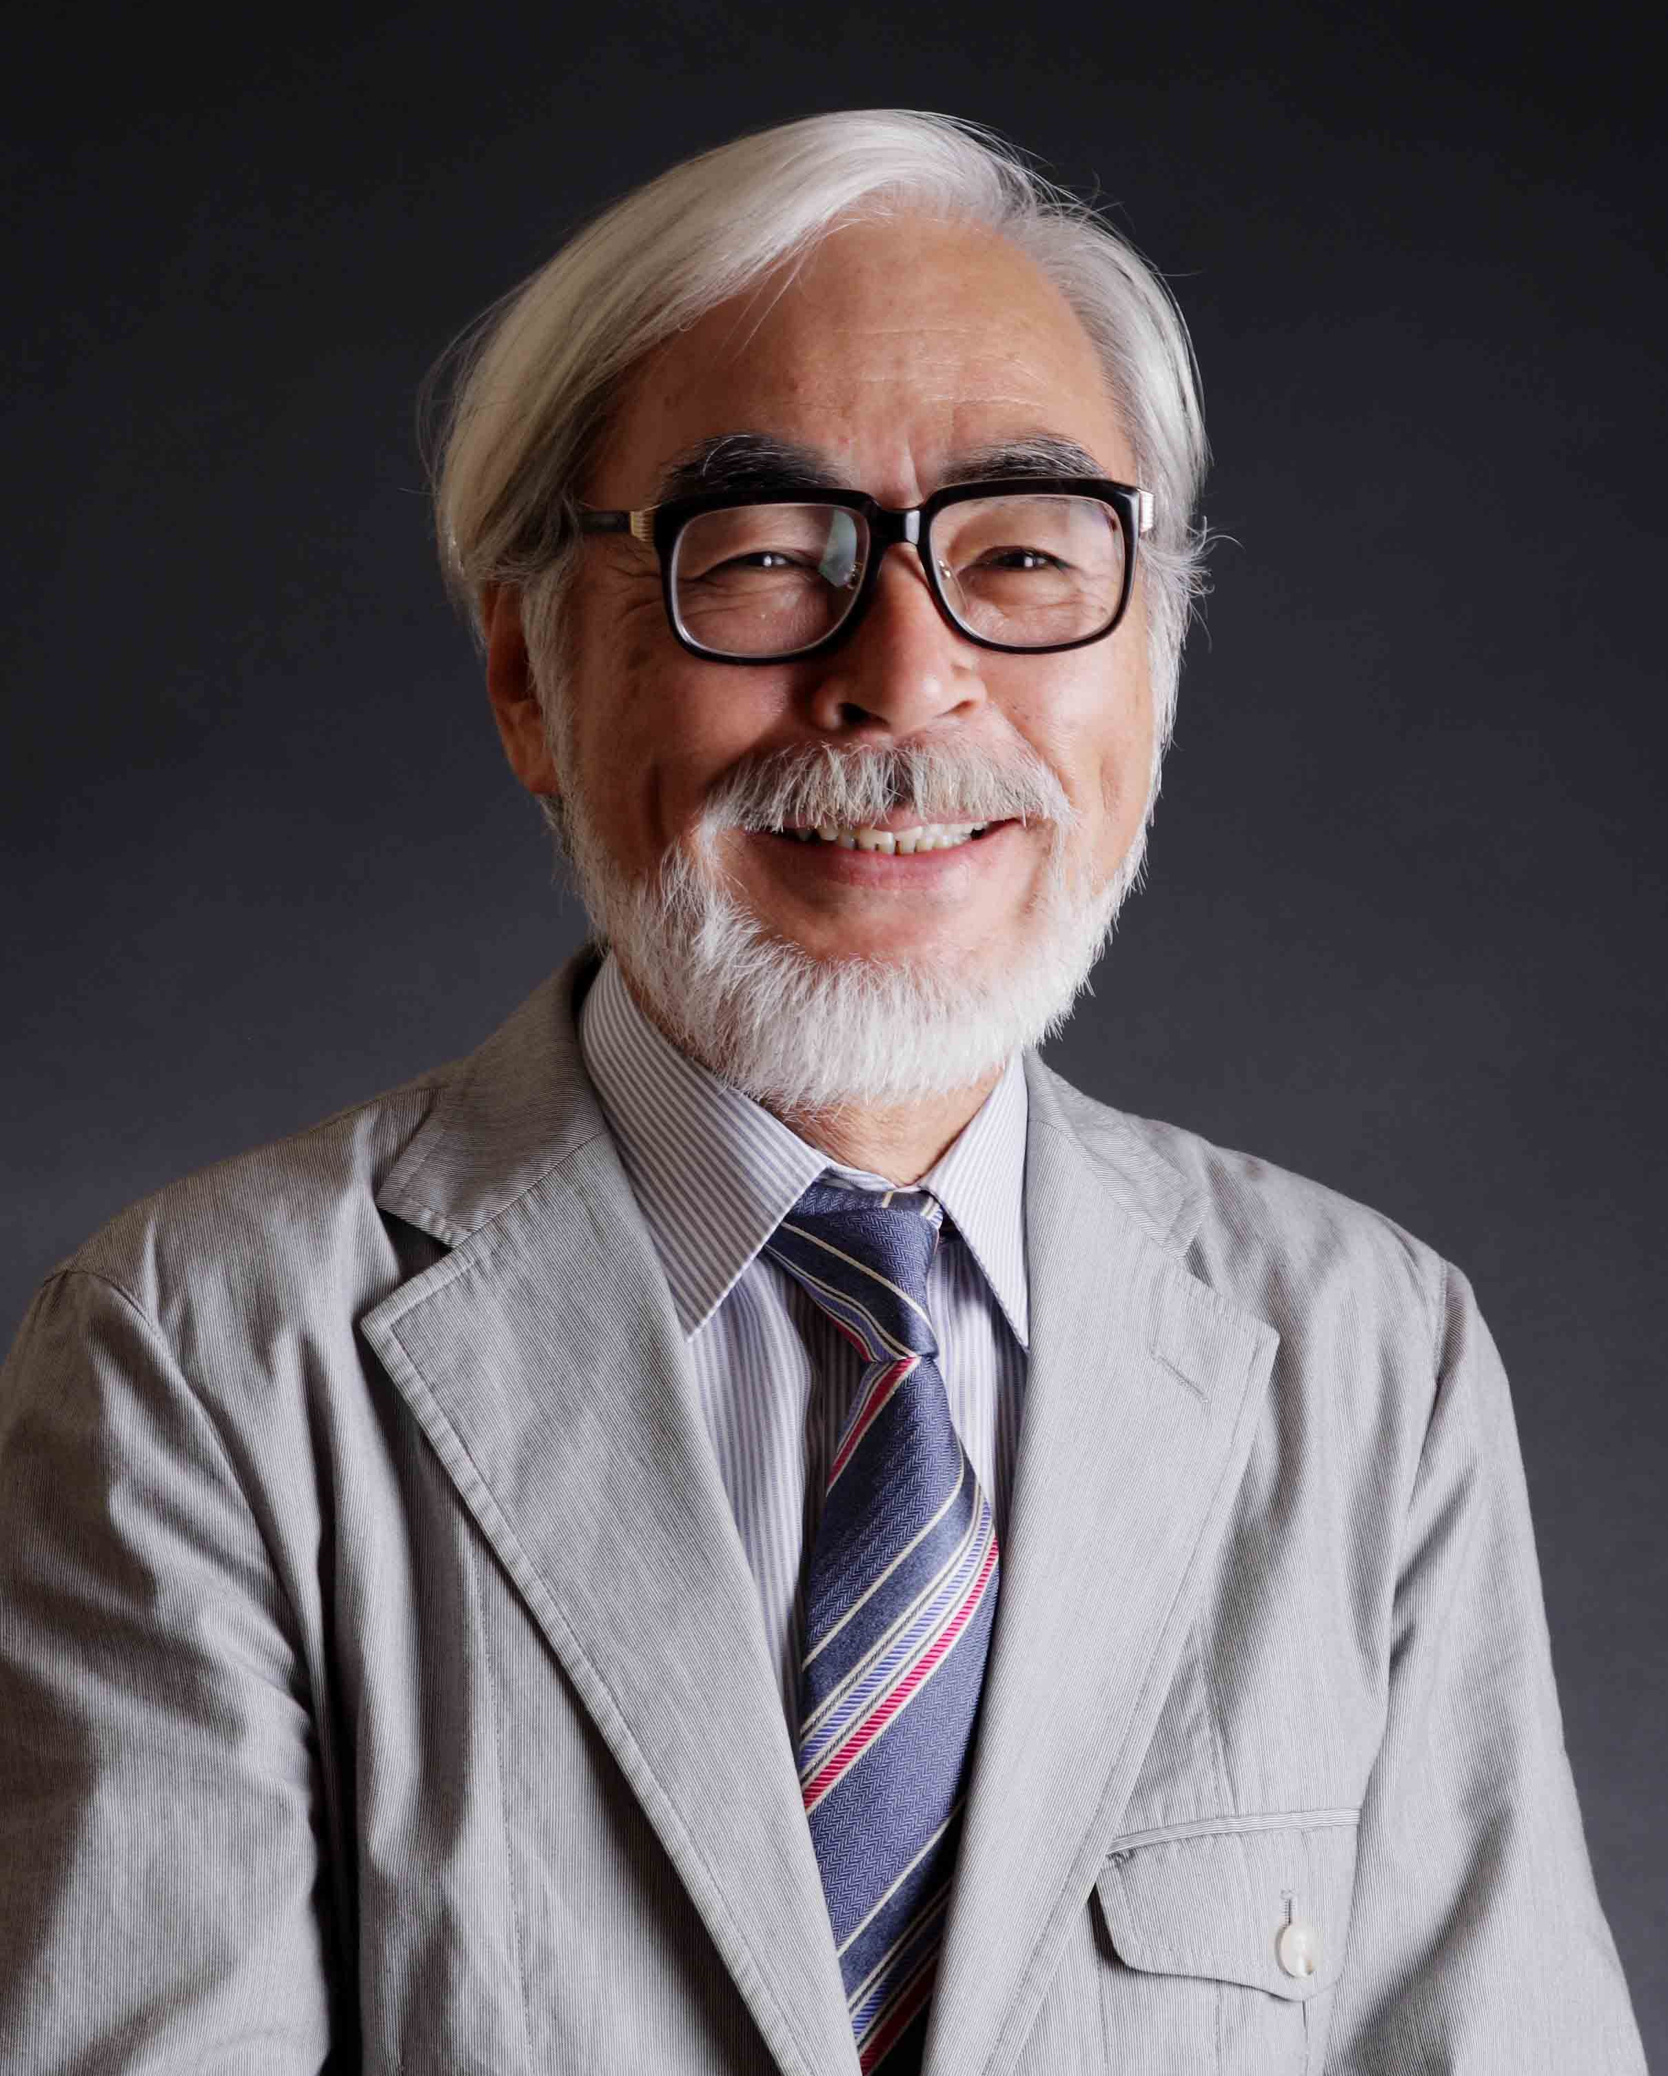
Studio Ghibli and Hayao Miyazaki
Studio Ghibli founded in 1985 by directors Hayao Miyazaki and Isao Takahata and producer Toshio Suzuki
Miyazaki has become known for featuring self-determining female leads in the majority of his films
Both the empowerment and the disenfranchisement of these characters is often tied to their performance of labour

Slide 4
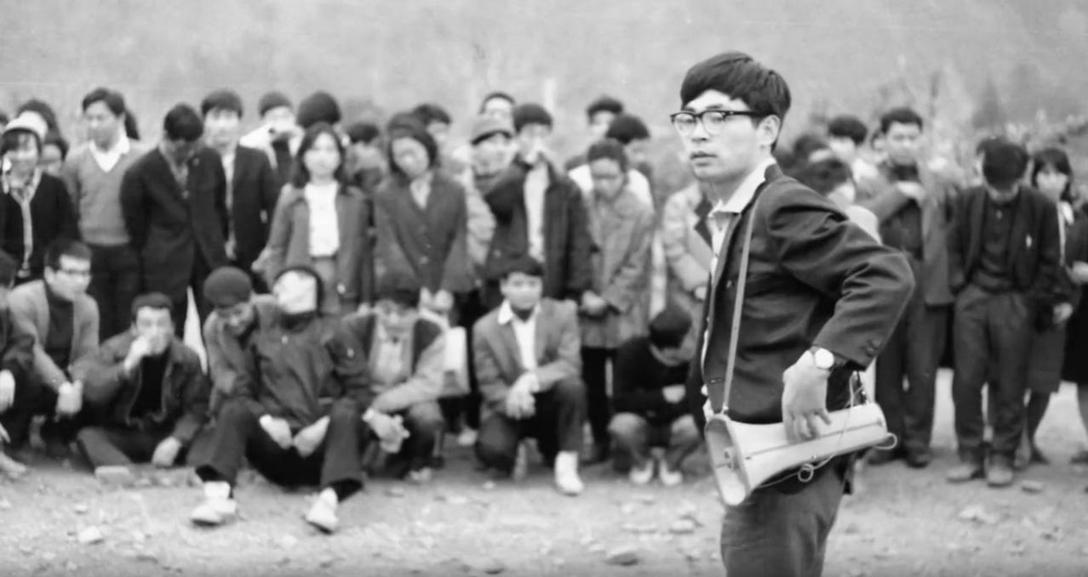
Ghibli and Labour
Hayao Miyazaki at the Toei Labour union

Slide 5
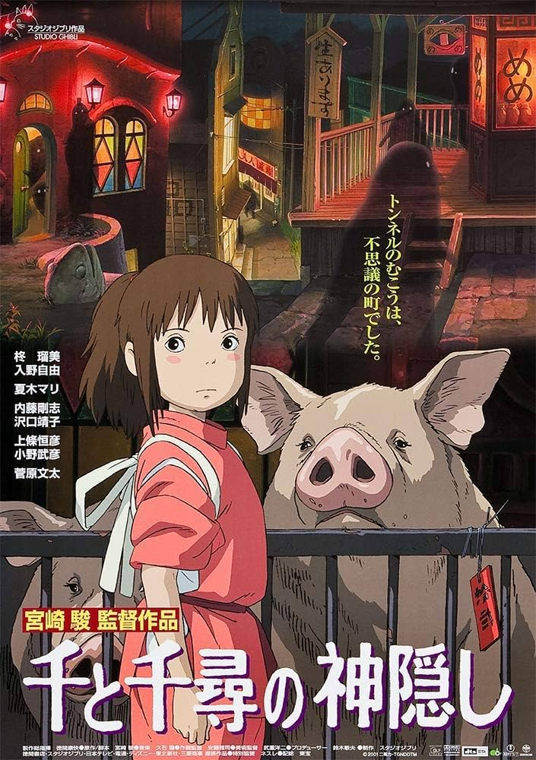
Spirited Away
Released in 2001, Spirited Away was the first anime film to achieve serious international acclaim beyond niche groups
The film follows Chihiro, a girl who ventures into the spirit world who must save her parents
A richly polysemous text
‘A nightmare of capitalist Japan’ (Suzuki, 2009)

Slide 6
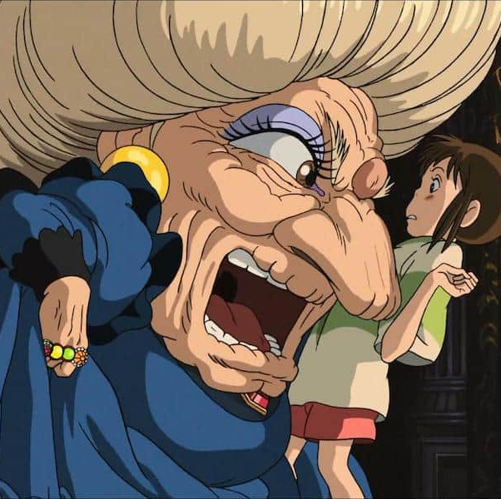
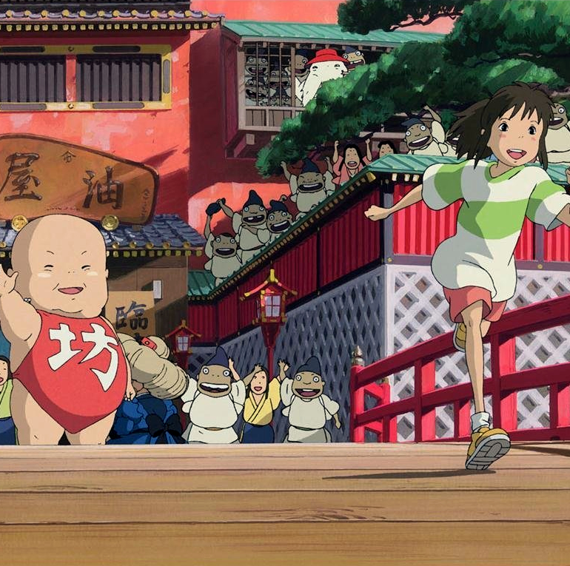
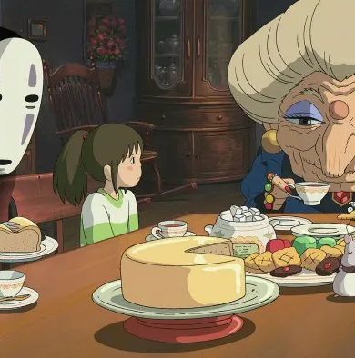
Category C: The content is not explicitly political, but in some way becomes so through the criticism practised on it through its form
Comolli and Narboni, ‘Cinema/Ideology/Criticism’, p. 32

Slide 7
The Bathhouse
An imposing location she is forced into
Women all sleep on the same floor
Starts from the bottom (the boiler room) and works her way to cleaning the floors of the bath facilities
Male presenting and voiced characters work primarily on the upper floors

Slide 8
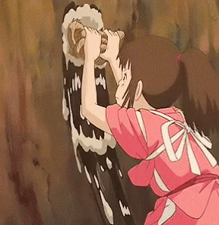
Chihiro/Sen’s Lost Identity
As a female child, Chihiro’s labour and point of view is disrespected twofold
She is at the bottom of the bathhouse’s hierarchy
With the removal of a kanji, her name is turned to ‘Sen’ – a reading commonly used for the number 1000
Her apparent worth is determined monetarily, and it isn’t high
Proves herself on her own terms

Slide 9
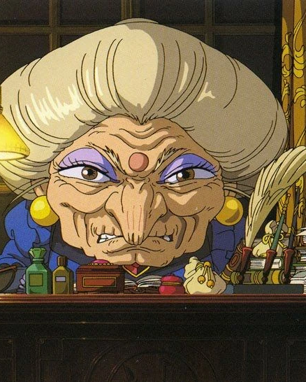
Yubaba as Feminist Critique
Yubaba is the antagonist of the story
While a woman runs the bathhouse, the system still favours men
Her ‘weakness’ is her love for her baby – an identification of femininity she keeps hidden to maintain a more intimidating, masculinized image
A postfeminist figure, defined partially as ‘a focus on individualism’ by women (Gill, 2007, p. 149)

Slide 10
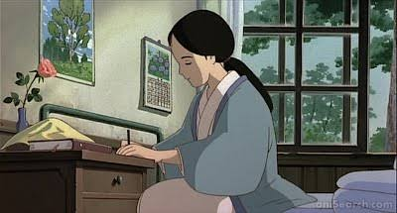
‘Good Wife, Wise Mother’
This phrase emerged in the latter part of the Meiji period to describe the ideal woman of Japanese society
Though initially used to promote women’s education, the phrase came to imply a ‘separate and inferior’ role that placed women in the home (Fujimura-Fanselow, 1991)
This attitude, and the subsequent devaluing of women’s labour in Japan, continues to some extent today (Soble, 2015)

Slide 11
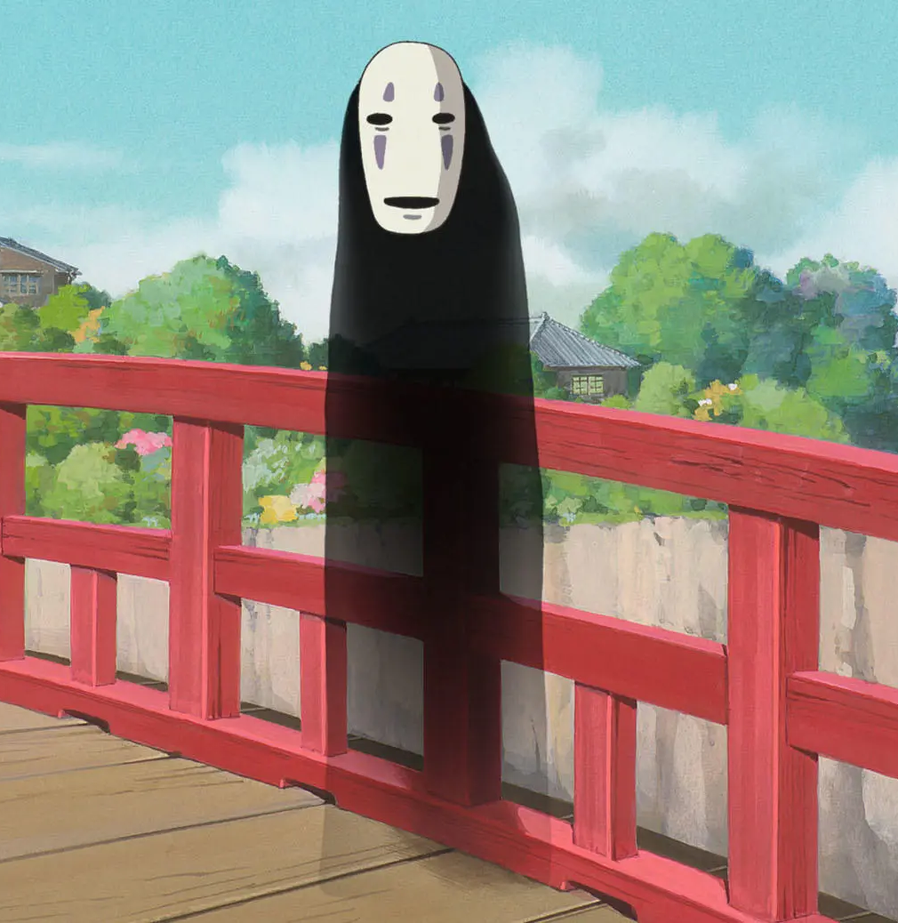
Kaonashi (No-Face)
A mysterious spirit who becomes attached to Chihiro
Appears to absorb and mirror the behaviour of those around them
The character functions as a blank slate for the capitalist, patriarchal ideologies of the bathhouse to be projected upon

Slide 12
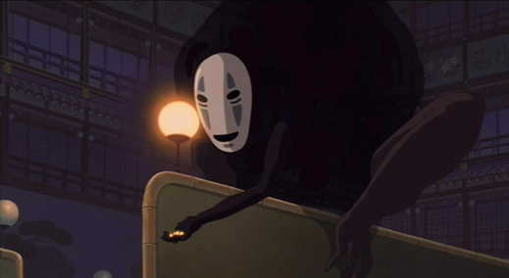

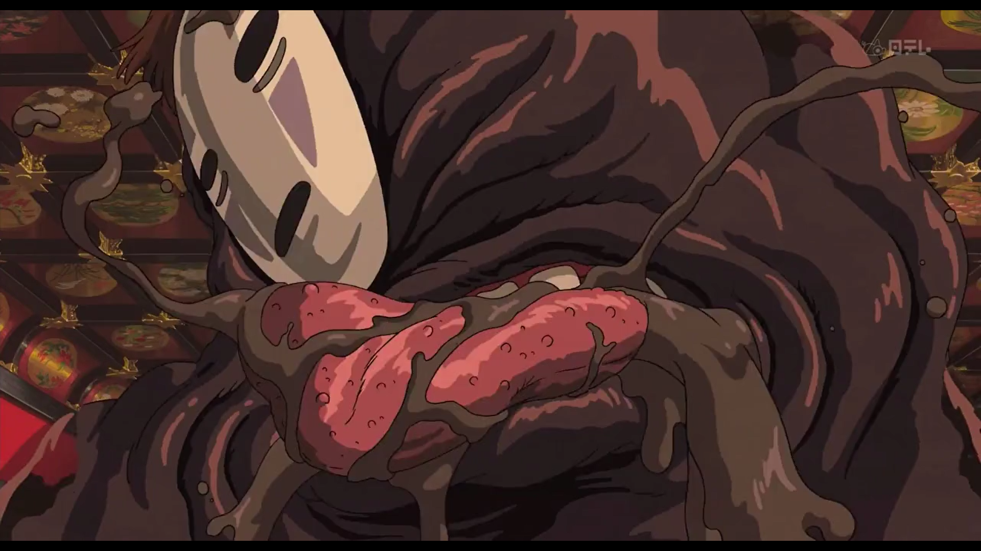
Kaonashi’s Corruption
First, he witnesses a spirit’s greed and tempts him with gold, swallowing him whole to use his voice
He then grows more gluttonous, consuming relentlessly to impress Chihiro and becoming ‘a signifier of excess’ (Napier, 2006, p. 294)
Finally, he is saved by Chihiro through the use of an emetic, which purges and purifies the greed and influence from him physically and spiritually

Slide 13
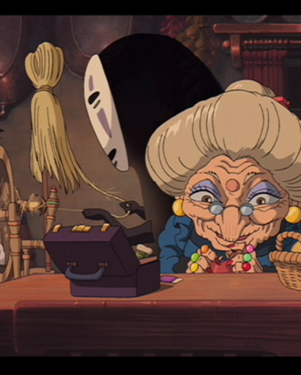
Zeniba and moderate consumption
Kaonashi ends the story living with Zeniba, the identical twin sister of Yubaba
They are shown performing domestic labour followed by enjoying a more moderate amount of homemade food
This suggests a more sustainable model of consumption spearheaded by two female characters in a domestic sphere
Women’s exploitation under capitalism is rejected, and their life at home is not dependent on men

Slide 14
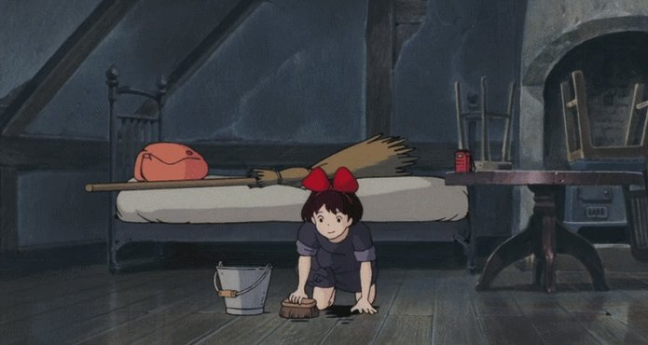
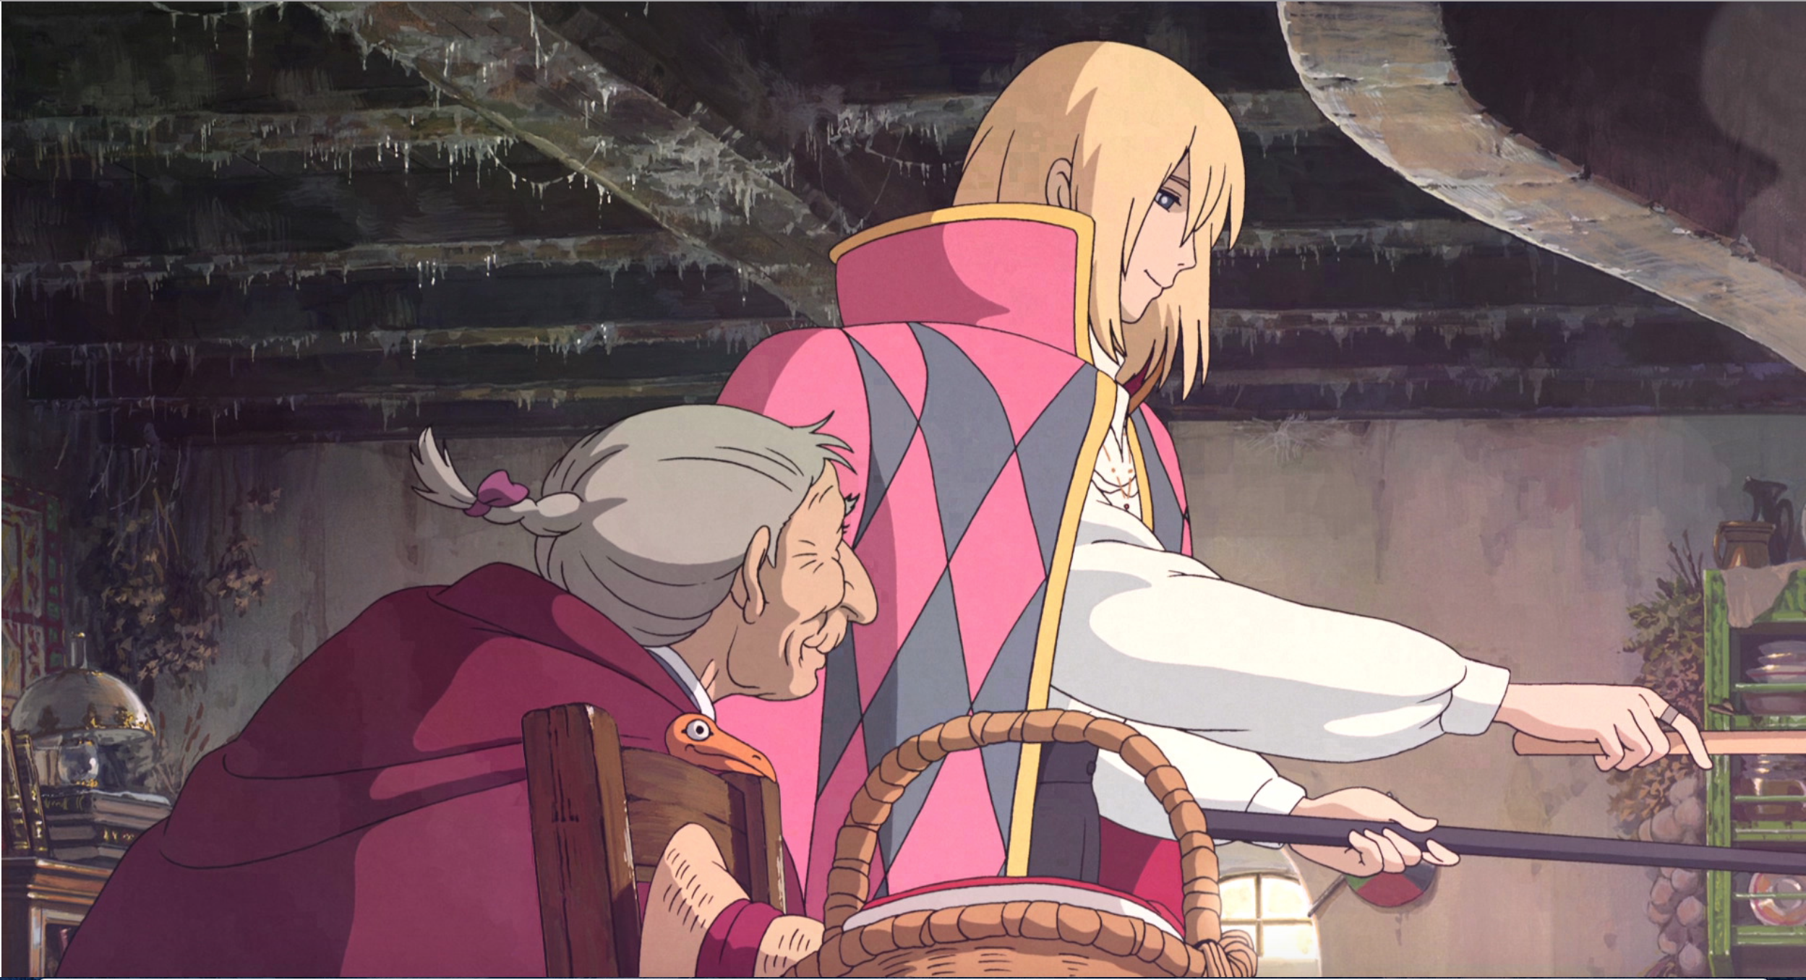
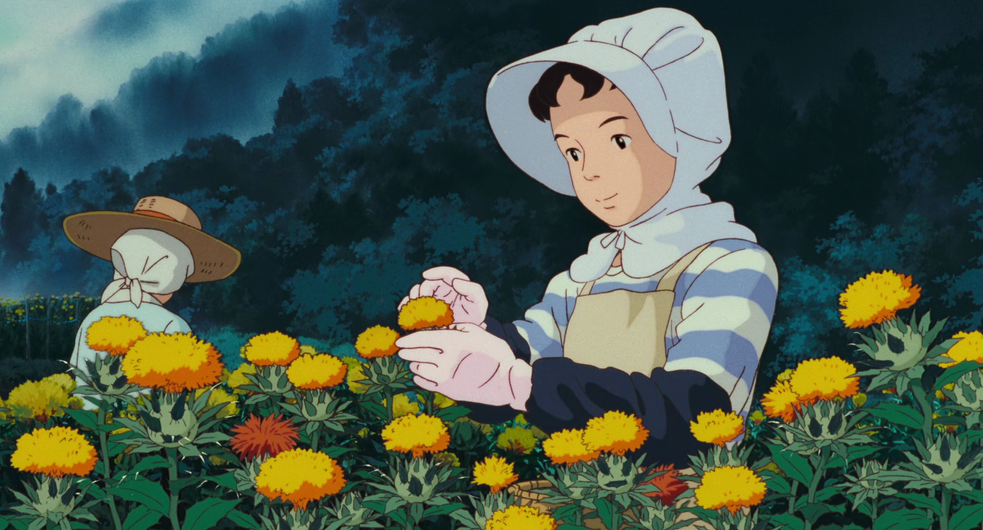
Ghibli and ‘Women’s Work’
Only Yesterday (Takahata, 1991)
Kiki’s Delivery Service (Miyazaki, 1989)
Howl’s Moving Castle (Miyazaki, 2004)

Slide 15
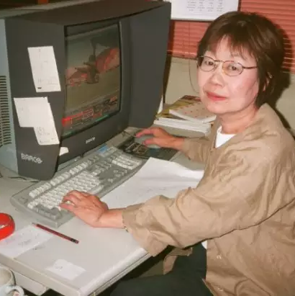
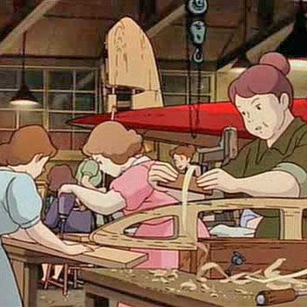
Women Working at Ghibli
Michiyo Yasuda (1939-2016) was one of the most prominent voices of Ghibli
Rayna Denison identifies a trilogy of women’s films, with Porco Rosso (bottom right) being worked on by contracted female crew (2023)
Denison also identifies provisions for female staff at the studio, including a creche
However, a female director has never helmed a film for the studio

Slide 16
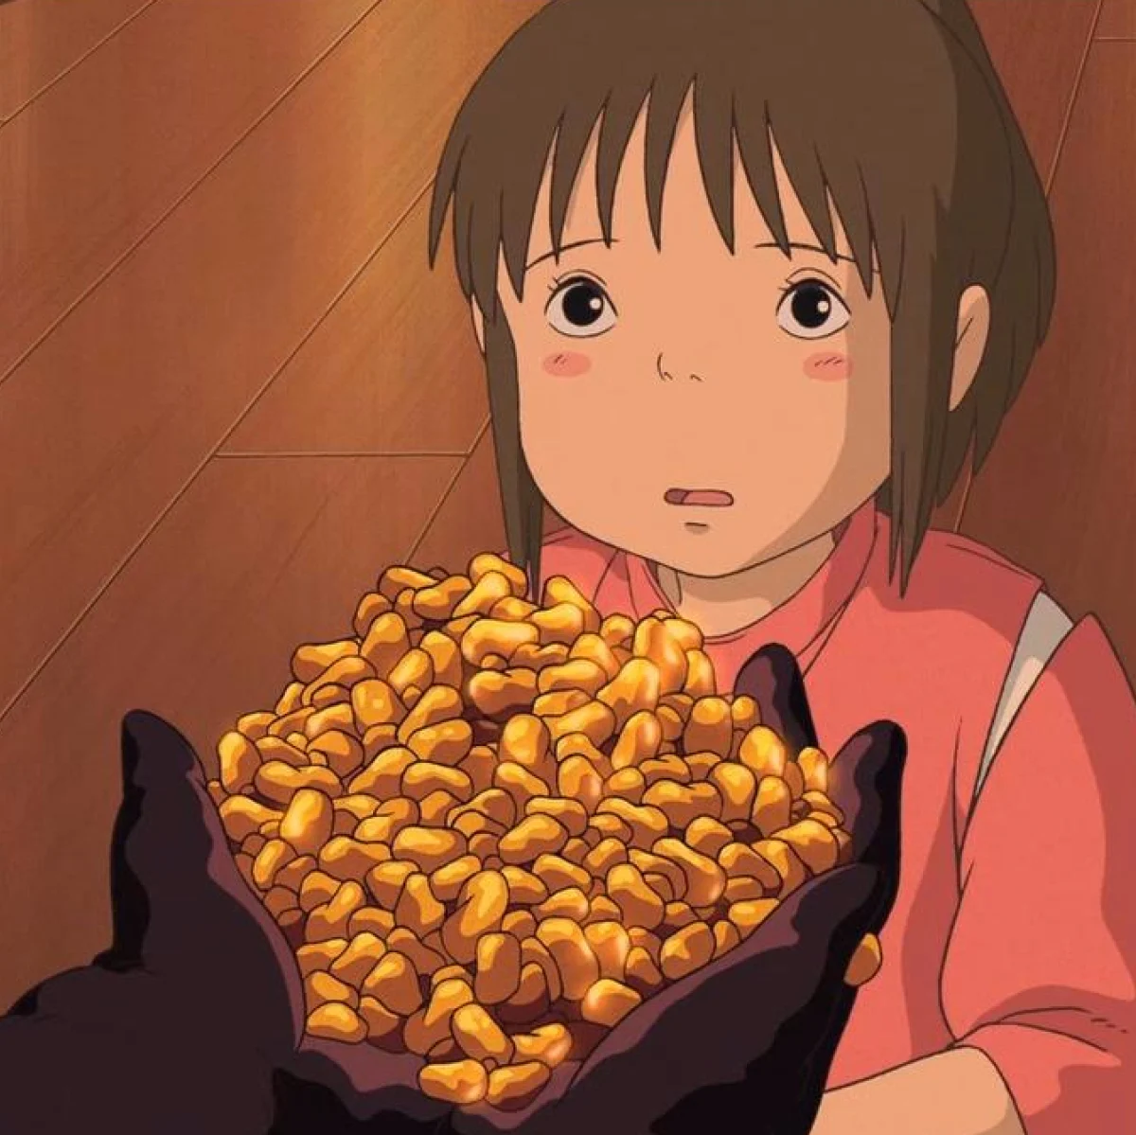
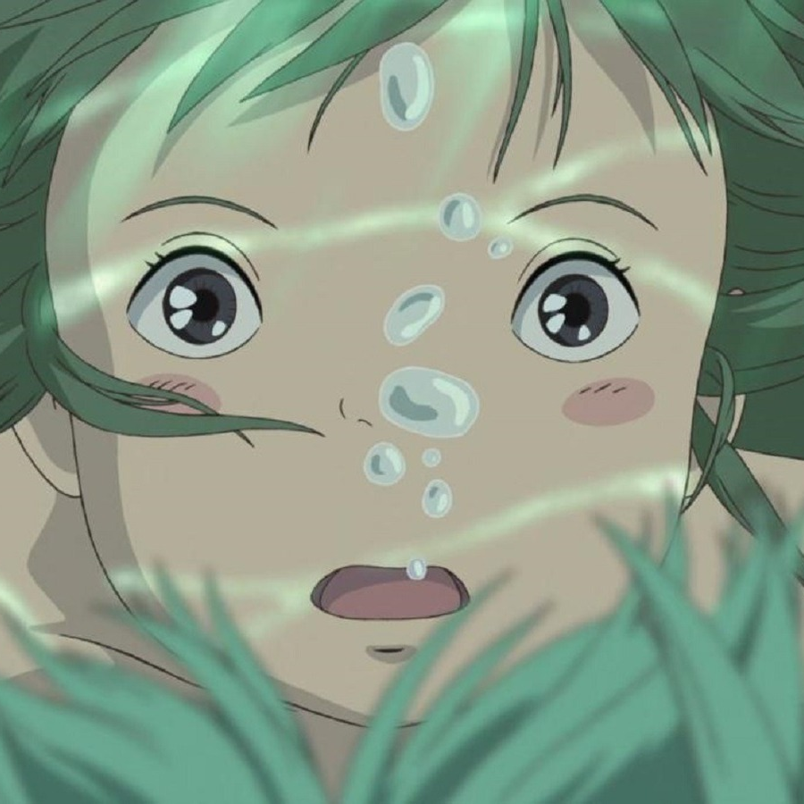
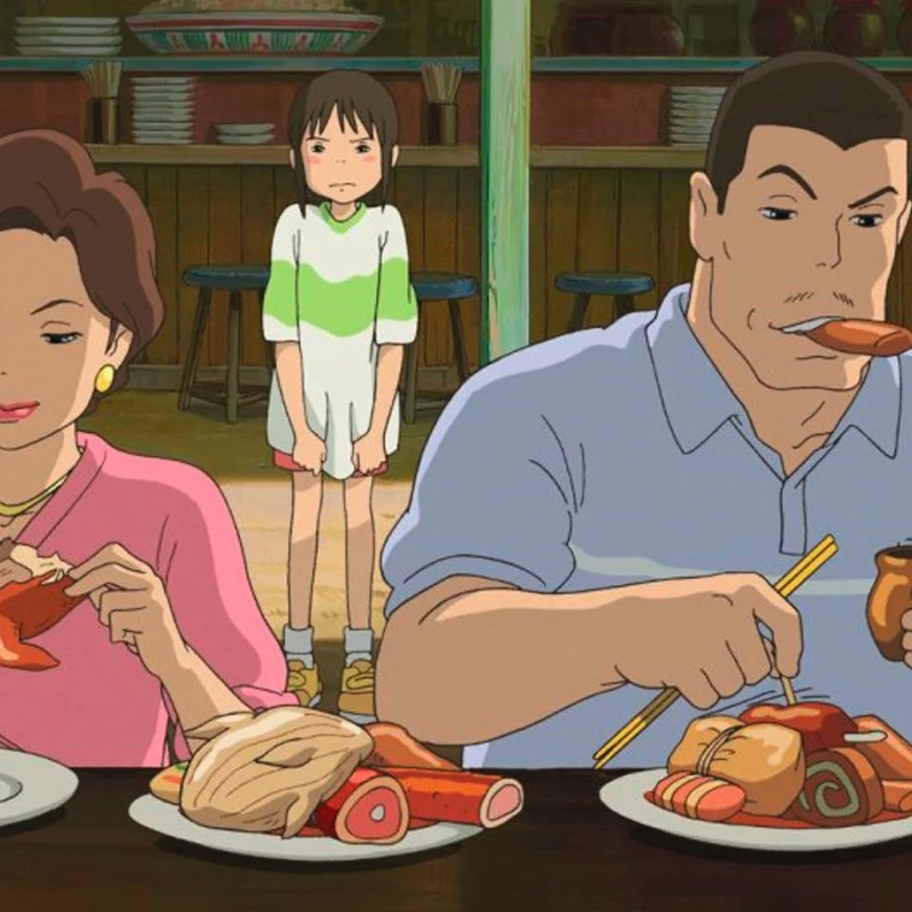
Conclusions
Women’s labour in Spirited Away is shown to be exploited under capitalism
Characters like Yubaba and Kaonashi represent how individuals both control and are indoctrinated into these systems
The film, and many other Ghibli films, ultimately promote the value of ‘women’s work’ in opposition to large scale industrial labour practices
This is reflected to an extent at the studio – but they still have some way to go!

Slide 17
Bibliography
Animation Obsessive, 2021. ‘Hayao Miyazaki, Union Man’, Animation Obsessive
Comolli, J., and Narboni, P., 1969. ‘Cinema/Ideology/Criticism’, Cahiers du Cinema, 216
Denison, R., 2023. ‘Ghibli’s Worlds of Women: From Women’s Films to the Women Who Shaped the Permanent Studio Ghibli’, Studio Ghibli: An Industrial History, London: Palgrave Macmillan
Gill, R., 2007. ‘Postfeminist Media Culture: Elements of a sensibility’, European Journal of Cultural Studies, 10, 2
Fujimura-Fanselow, K., 1991. ‘The Japanese Ideology of ‘Good Wives and Wise Mothers’: Trends in Contemporary Research’, Gender & History, 3, 3
Miyazaki, H., 1989. Kiki’s Delivery Service, Japan: Studio Ghibli
Miyazaki, H., 1992. Porco Rosso, Japan: Studio Ghibli
Miyazaki, H., 2001. Spirited Away, Japan: Studio Ghibli
Miyazaki, H., 2004. Howl’s Moving Castle, Japan: Studio Ghibli
Napier, S., 2006. ‘Matter out of Place: Carnival, Containment, and Cultural Recovery in Miyazaki's "Spirited Away”’, The Journal of Japanese Studies, 32, 2
Soble, J., 2015. ‘To Rescue Economy, Japan Turns to Supermom’, The New York Times
Suzuki, A., 2009. ’ A nightmare of capitalist Japan: Spirited Away’, Jump Cut: A Review of Contemporary Media, 51
Takahata, I., 1991. Only Yesterday, Japan: Studio Ghibli

