Slide 1



NNUF Access Fund #186
Fast non-destructive characterisation of nuclear fuel pellets via hyperspectral imaging
A.J. Parker¹, R.D. Dunphy², P. Murray², R. Wilbraham¹, and J. Zabalza*²
¹Lancaster University, Lancaster, LA1 4BE
²University of Strathclyde, Glasgow, G1 1XQ
^{*Proposal Submitted by}

Slide 2
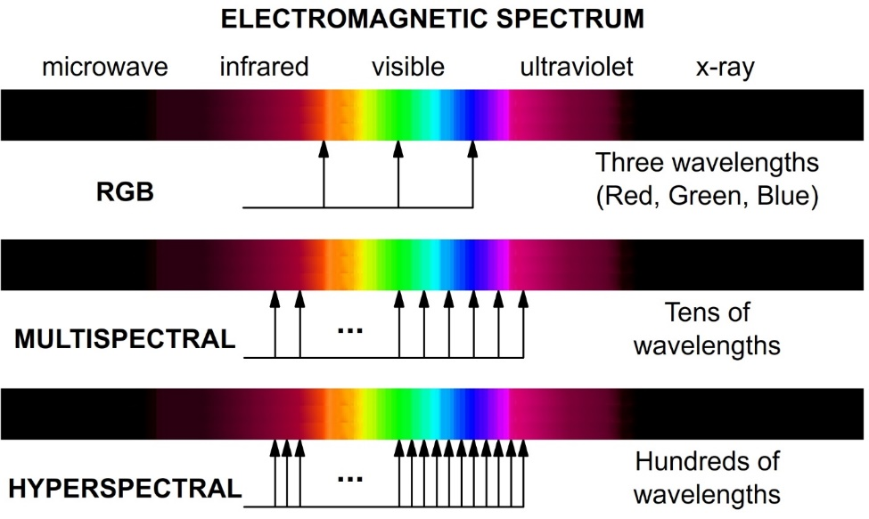
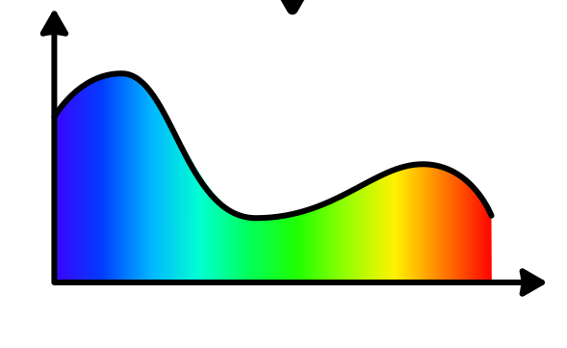
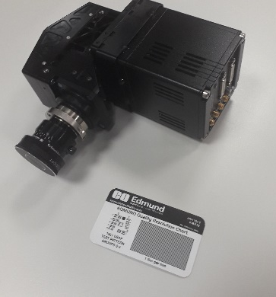
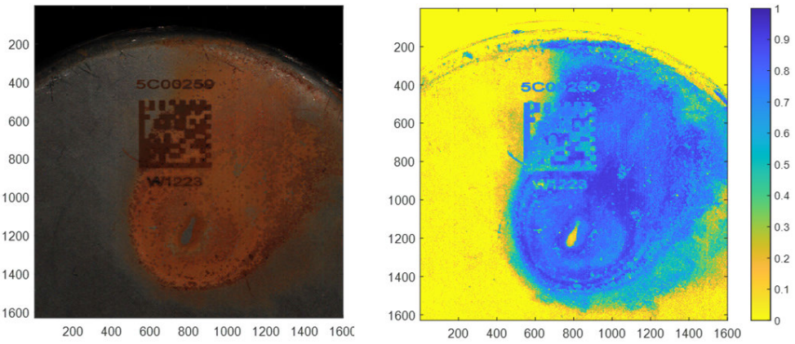
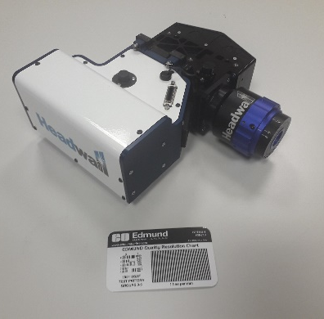
Hyperspectral Imaging Overview
Via University of Strathclyde's Hyperspectral Imaging Centre
Infrared
Intensity
λ
Spectrum
y
Ultraviolet
x
Example – identifying corrosion on nuclear packages
HSI for NNUF
VNIR
400-1000 nm
SWIR
1000-2500 nm
J. Zabalza, et al, IEEE Sensors Journal, Vol 23, No. 21 2023

Slide 3
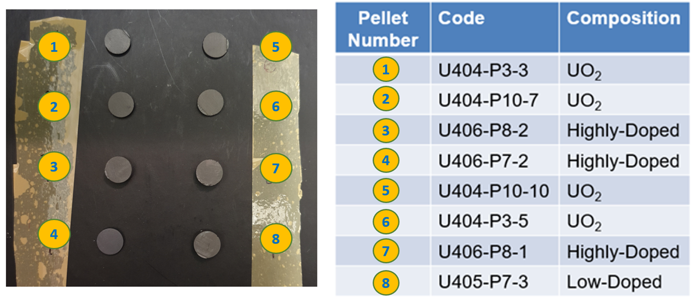
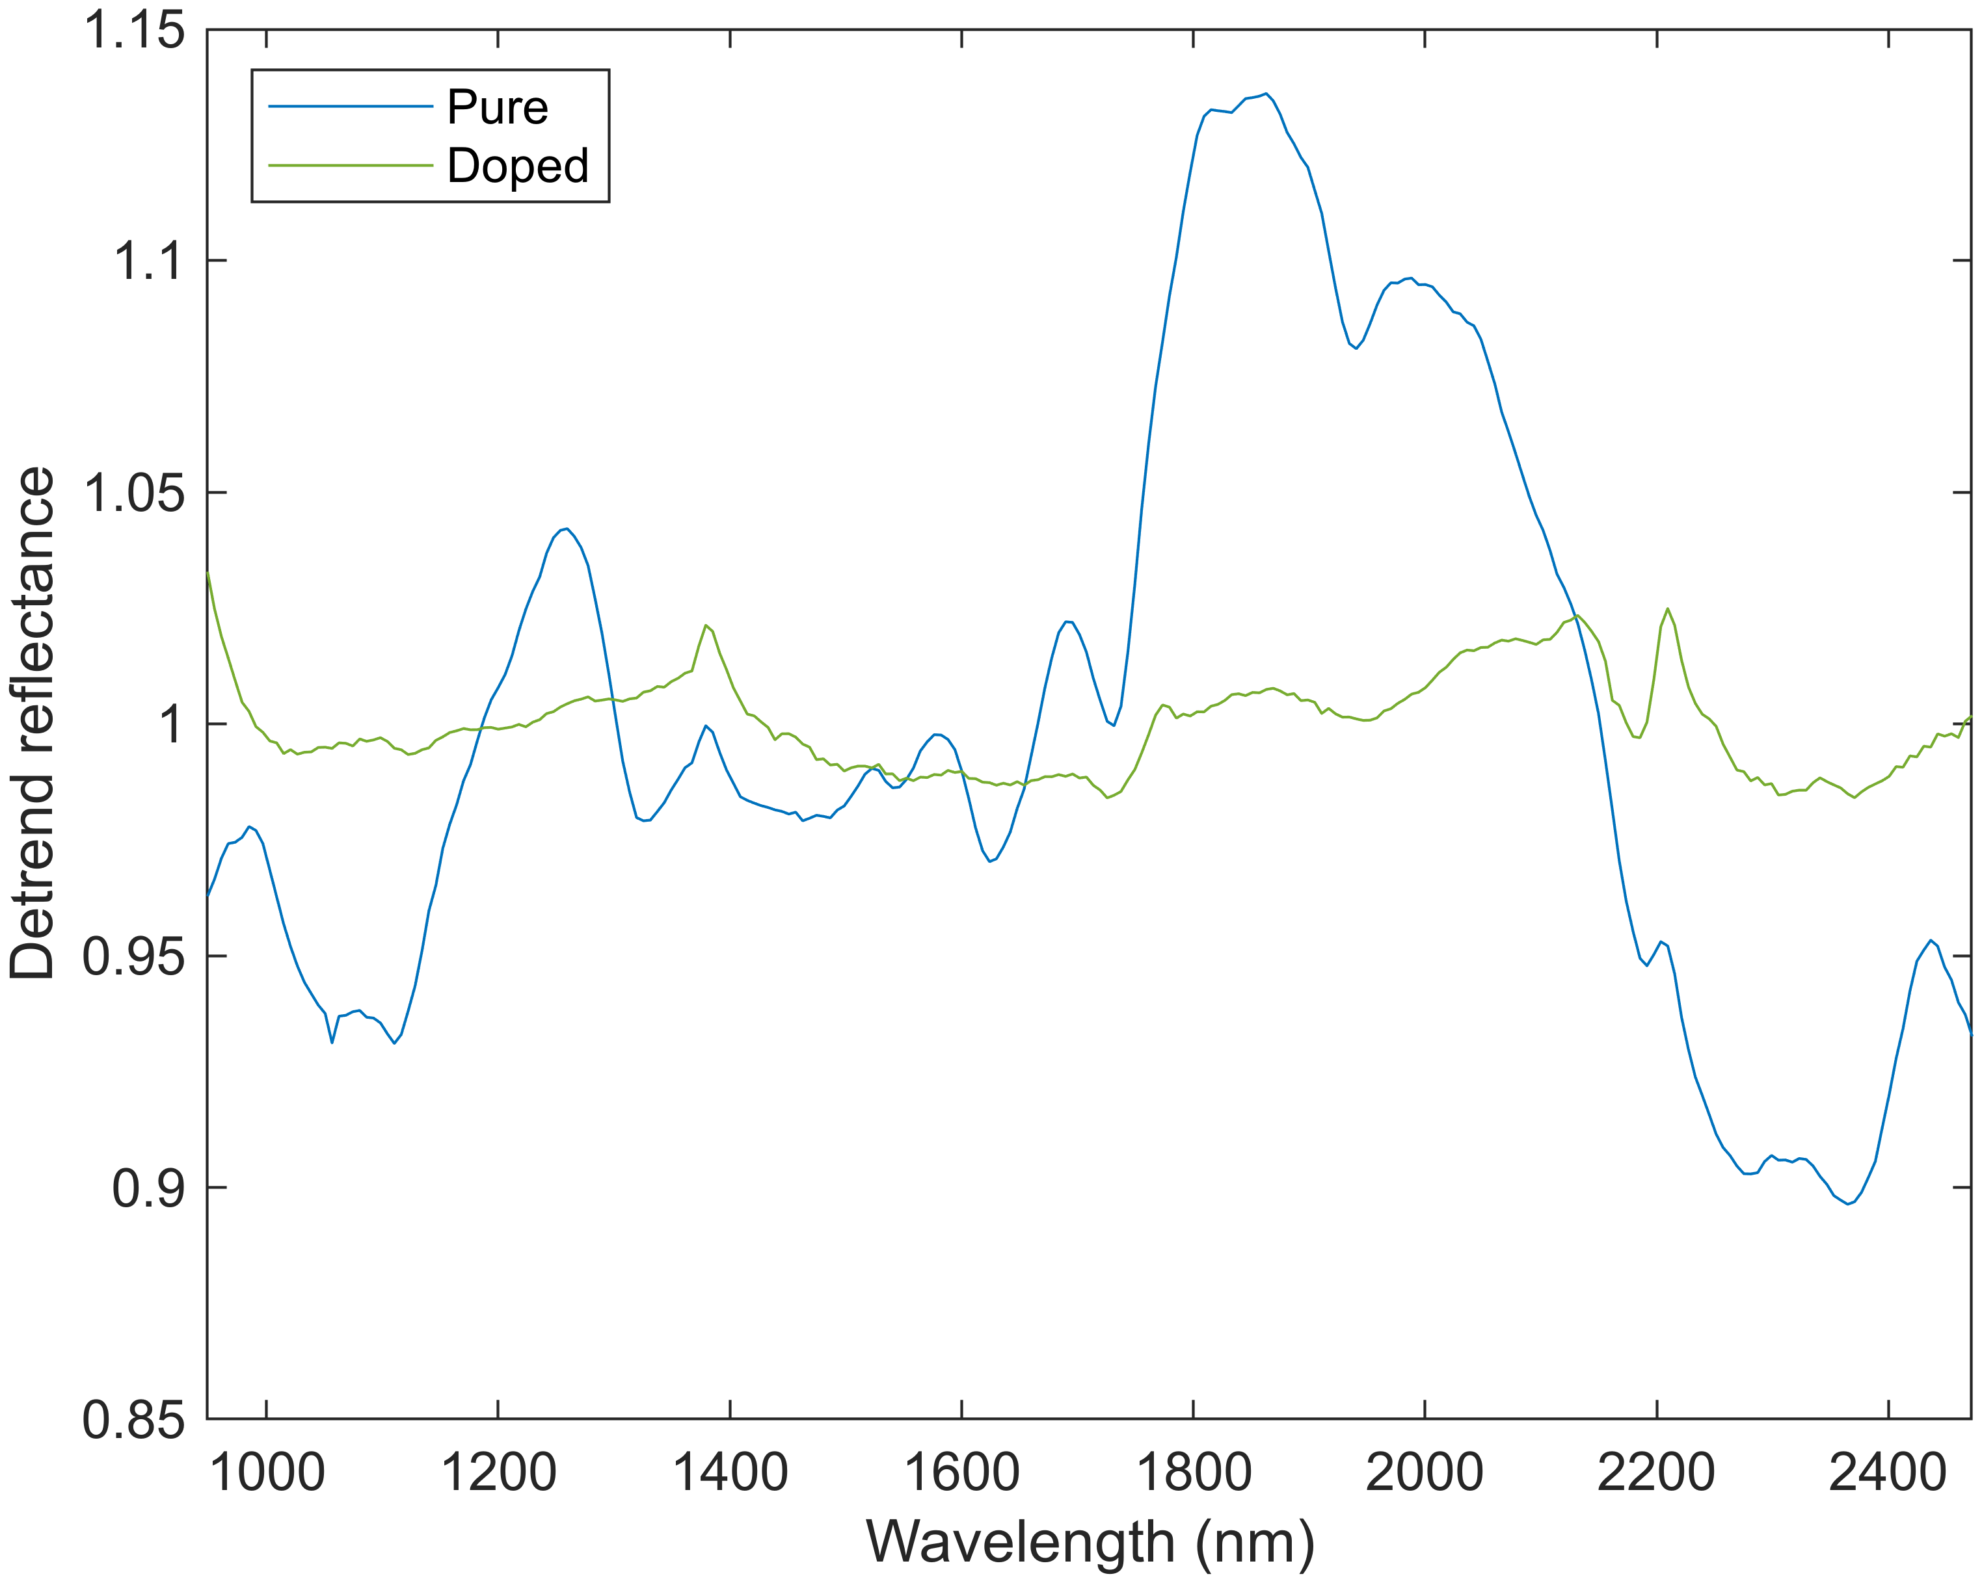
Background I
EPSRC funded project, Autonomous Inspection for Responsive and Sustainable Nuclear Fuel Manufacture.
Preliminary measurements of UO₂ SIMFuel pellet slices* in UTGARD inventory
Photo of SIMFuel pellet slices
SIMFuel source no. and type
SWIR spectra of SIMFuel by type
* Z. Hiezl, D. I. Hambley, C. Padovani, and W. E. Lee, “Processing and microstructural characterisation of a UO2-based ceramic for disposal studies on spent AGR fuel,” Journal of Nuclear Materials, vol. 456, pp. 74–84, 2015, doi: 10.1016/j.jnucmat.2014.09.002.

Slide 4
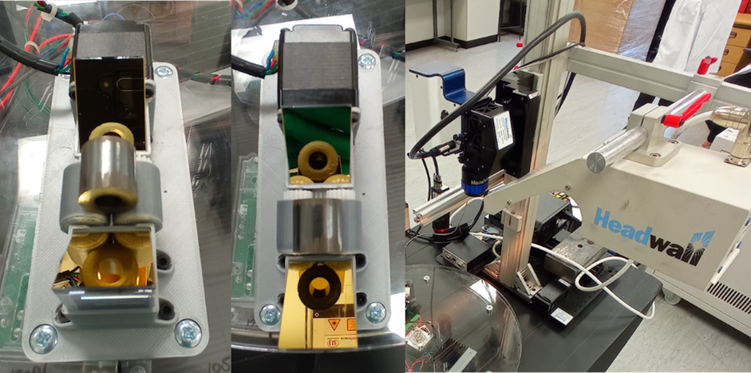
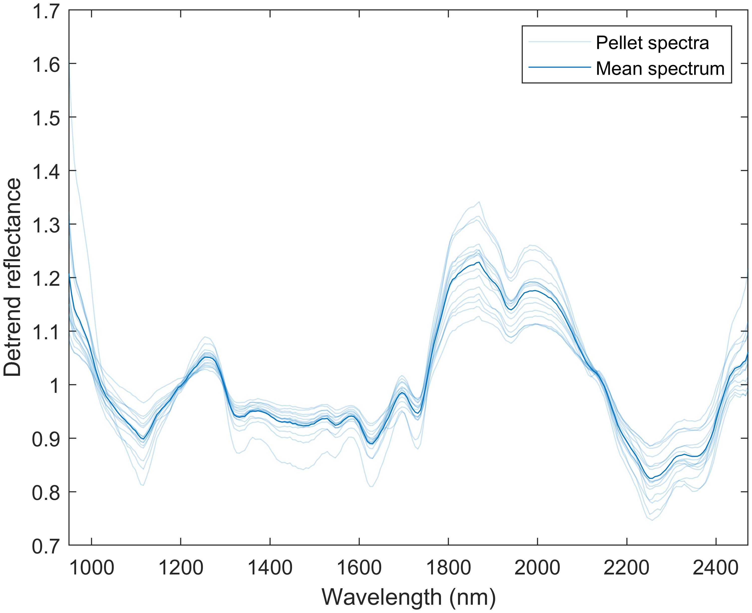
Background II
Continuation of testing on x8 pure UO₂ AGR design and NNL Preston
Observed same SWIR response for pure UO₂ as initial undoped SIMFuel
Photo of AGR fuel pellets and SWIR camera setup
SWIR spectra of pure UO₂ AGR pellets

Slide 5
NNUF Access Fund & Industrial Relevance
Seeing a clear distinction being fresh fuel and spent fuel
Change in response likely due to presence of fission products
We wanted to know which fission products (if any) was causing this..
SWIR spectra of SIMFuel by type
SWIR spectra of pure UO₂ AGR pellets

Slide 6

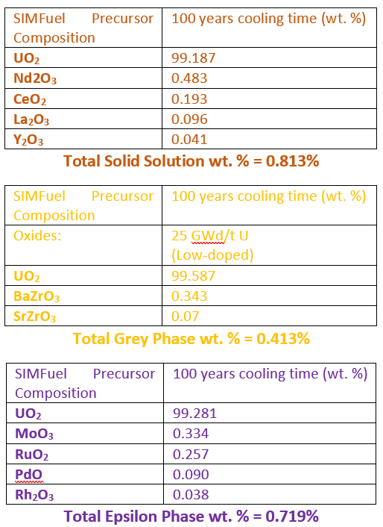
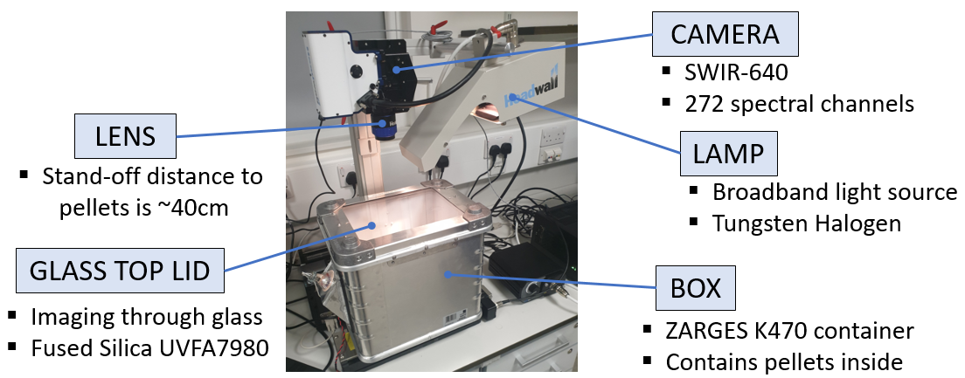
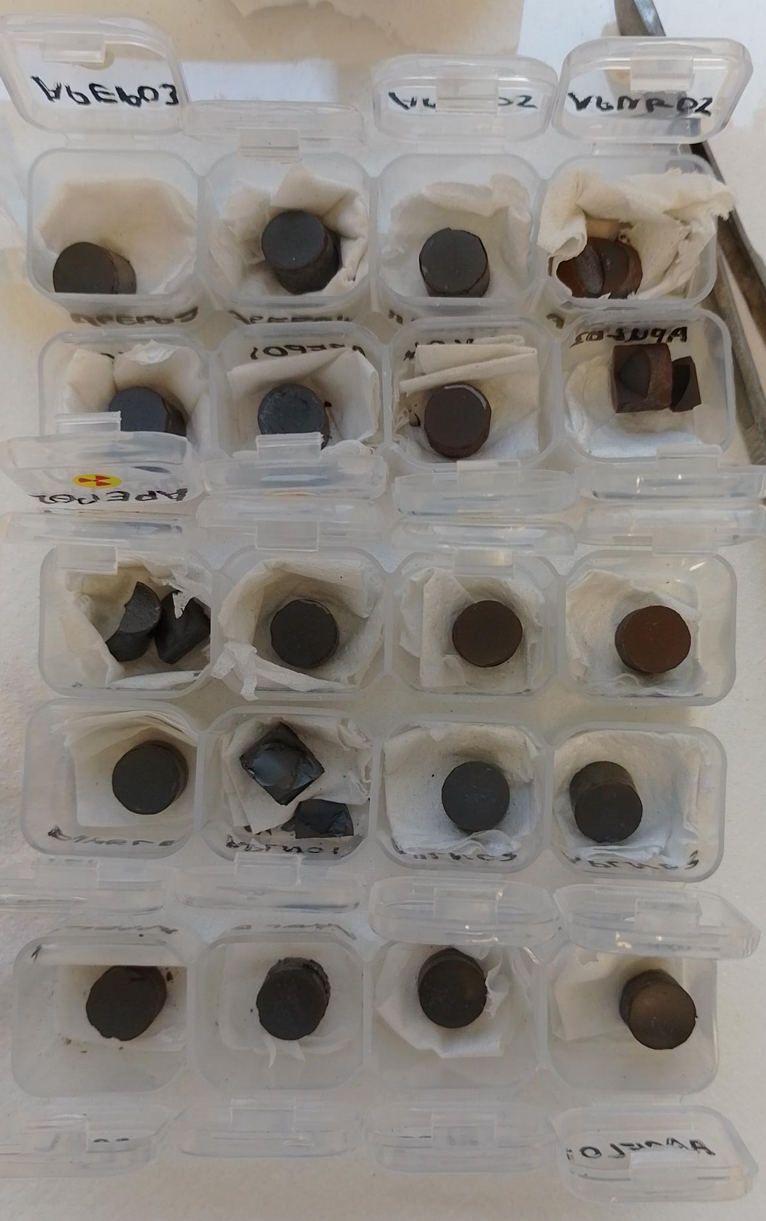
Pellet Preparation
UTGARD and ADRIANNA laboratories at Lancaster
Spark plasma sintering to produce UO₂ pellets – Split SIMFuel
Raman and SEM results also provided via NNUF

Slide 7
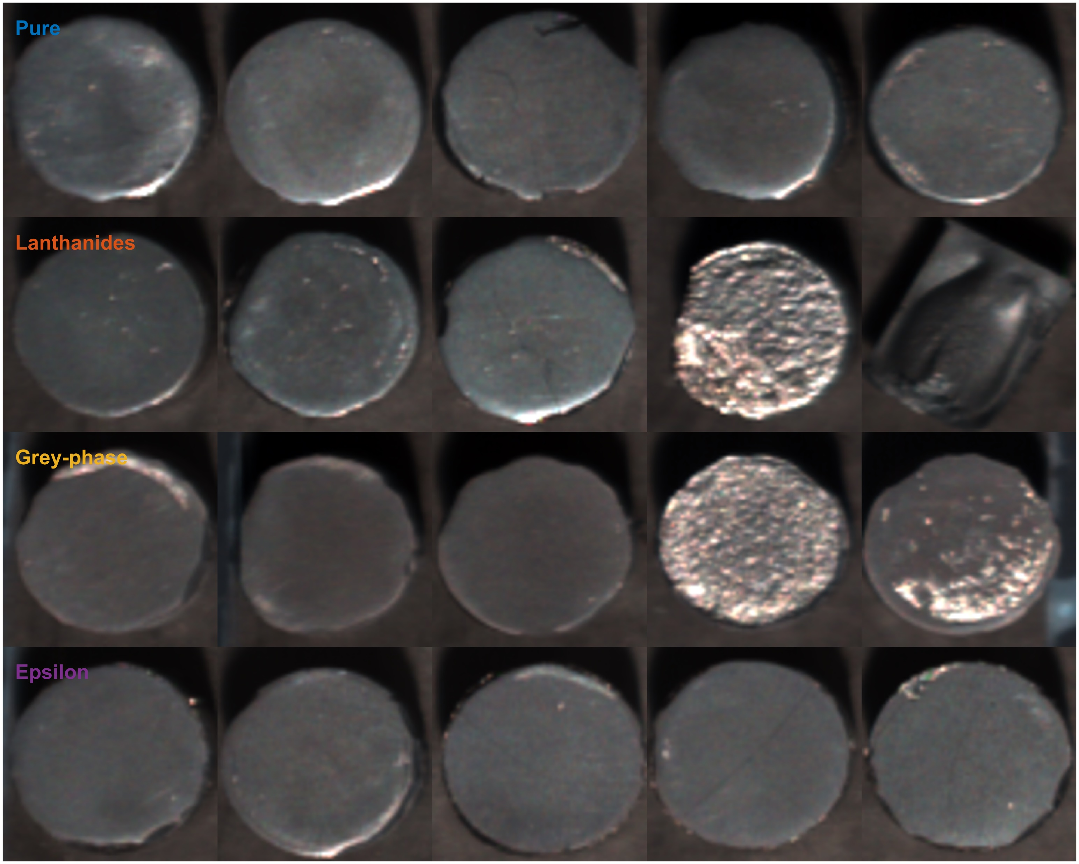
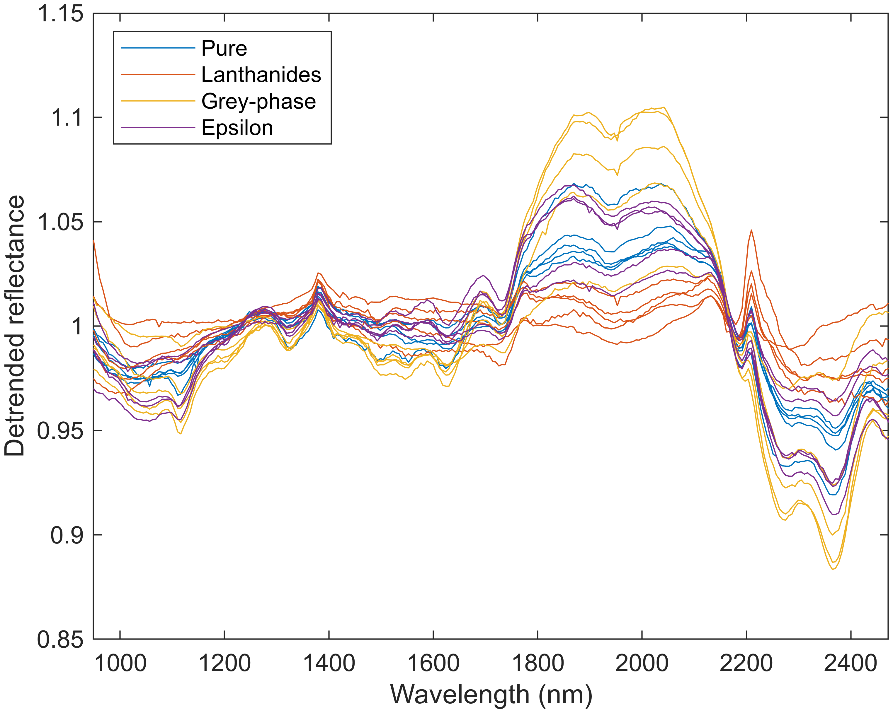
Results I
False colour image of the Split SIMFuel pellet surfaces arrangement by dopant group
SWIR spectra for all Split SIMFuel pellets by dopant group

Slide 8
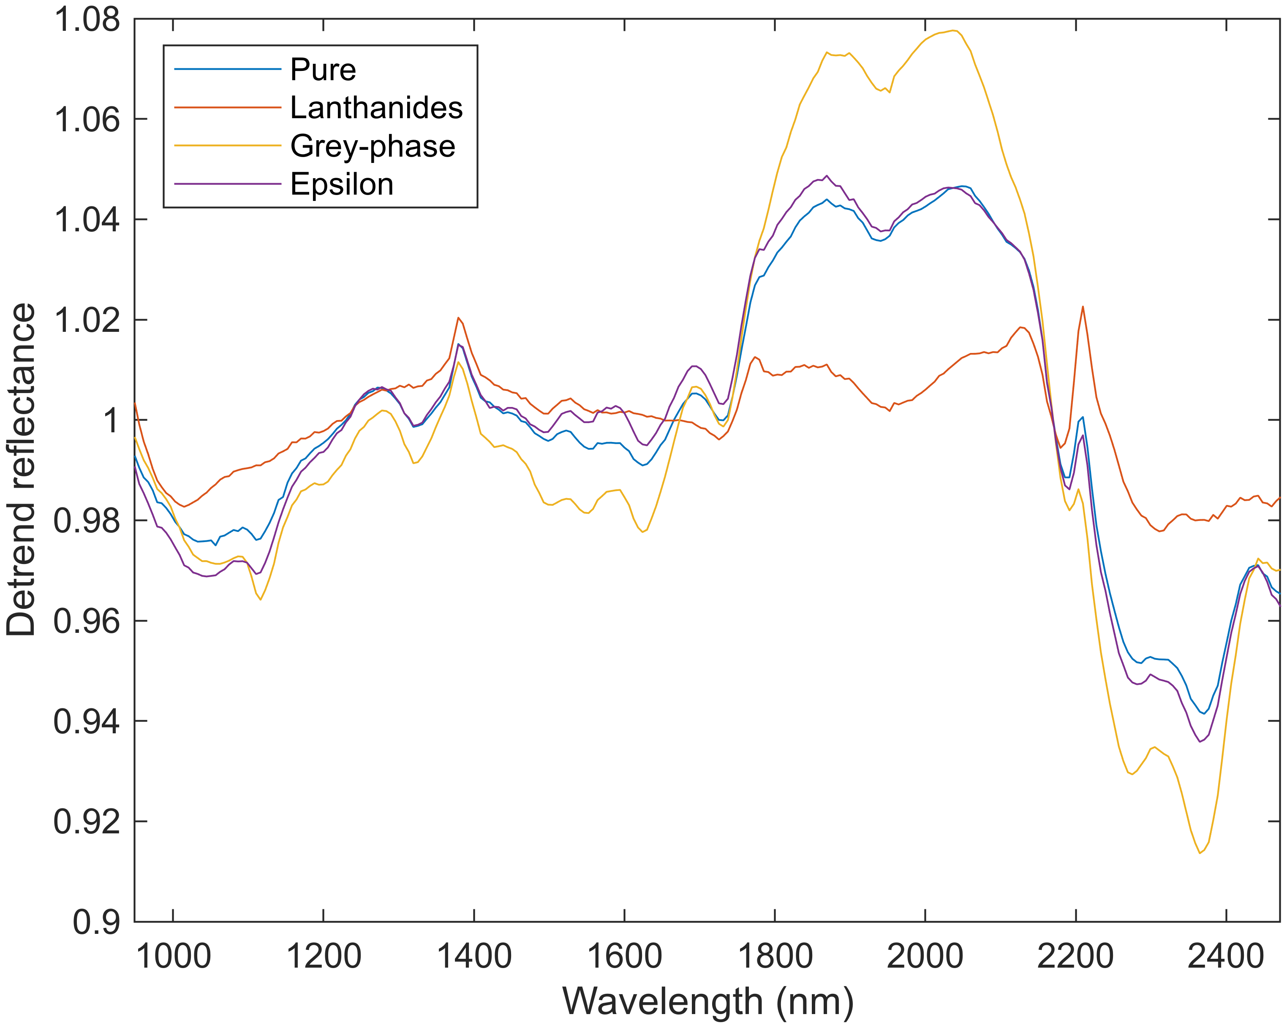
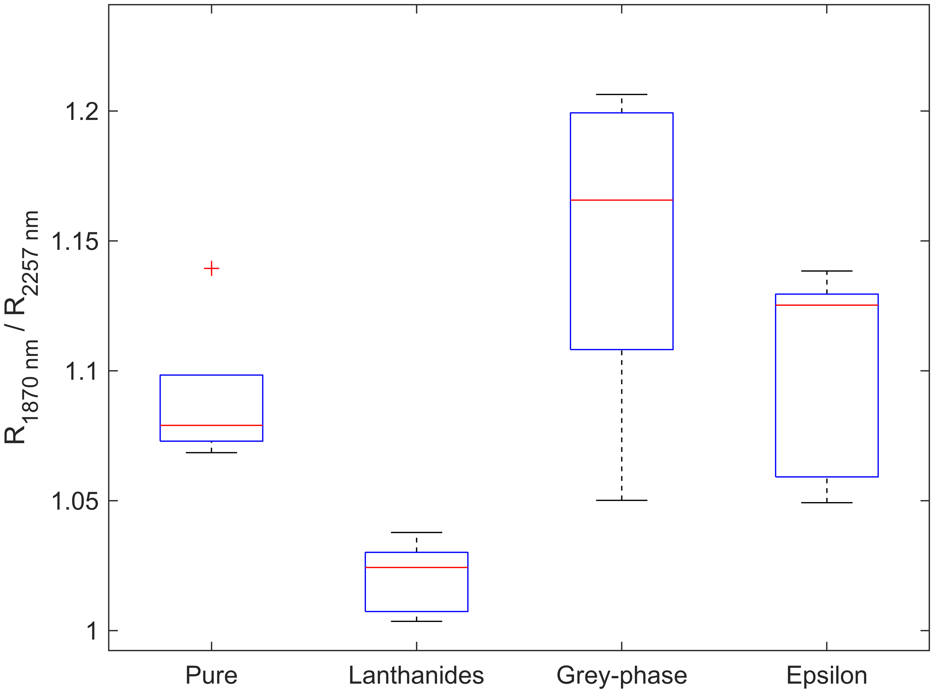
Results II
Mean SWIR spectra for Split SIMFuel pellets by dopant group
Index of the two main features for Split SIMFuel pellets by dopant group

Slide 9
Overall Dataset
Dataset of 3 pellet groups
Response across the groups is clear, consistent, and repeatable
SIMFuel, pure and doped UO₂
AGR fuel pellets, pure UO₂
NNUF
Split SIMFuel, pure and doped UO₂
Split SIMFuel indexed comparison

Slide 10





Conclusions, Ongoing work, and Thanks
Dataset of 3 pellet groups, response is clear, consistent, and repeatable
Appears that the presence of Lanthanide causes significant spectral response change
Short communication in preparation
Full analysis of Raman and SEM is ongoing to understand spectral features (peaks and absorptions bands
THANKS to …

