Slide 1

Empathy in curriculum design
Newton, R. and Doherty, M. (2023), "Beyond the Survey: Service Design Approaches to Inclusive Programme Review", International Journal of Management and Applied Research, Vol. 10, No. 2, pp. 199-215. https://doi.org/10.18646/2056.102.23-016
Notes:
Curriculum transformation projects have become a current theme for many universities who are trying to innovate and future proof their education proposition. Yet, curriculum remains a somewhat abstract concept unless we consciously consider all human actors involved in the education. In our paper, we will bring up the debate about humanness and people centricity essential for curriculum design with examples from business and legal studies.
The Secret Life of Students 2024 | Wonkhe
https://wonkhe.com/events/the-secret-life-of-students-2024/?utm_medium=email&utm_campaign=Wonkhe%20Monday%20Briefing%20-%208%20January&utm_content=Wonkhe%20Monday%20Briefing%20-%208%20January+CID_abc52eab1e281d4f1640b15c0c08e4dc&utm_source=Email%20marketing%20software&utm_term=Secret%20Life%20of%20Students

Slide 2

Discover your students
So you think you know me?
Challenge your assumptions and co-create personas as boundary objects
Develop trust and genuine interest
Approach students as human beings

Slide 3
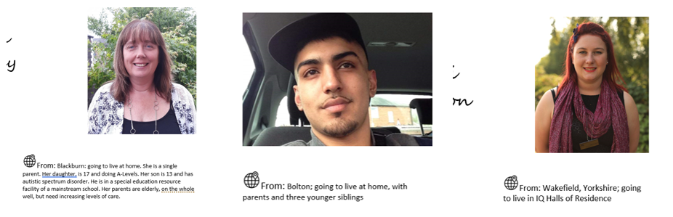
User personas in the law curriculum design

Slide 4
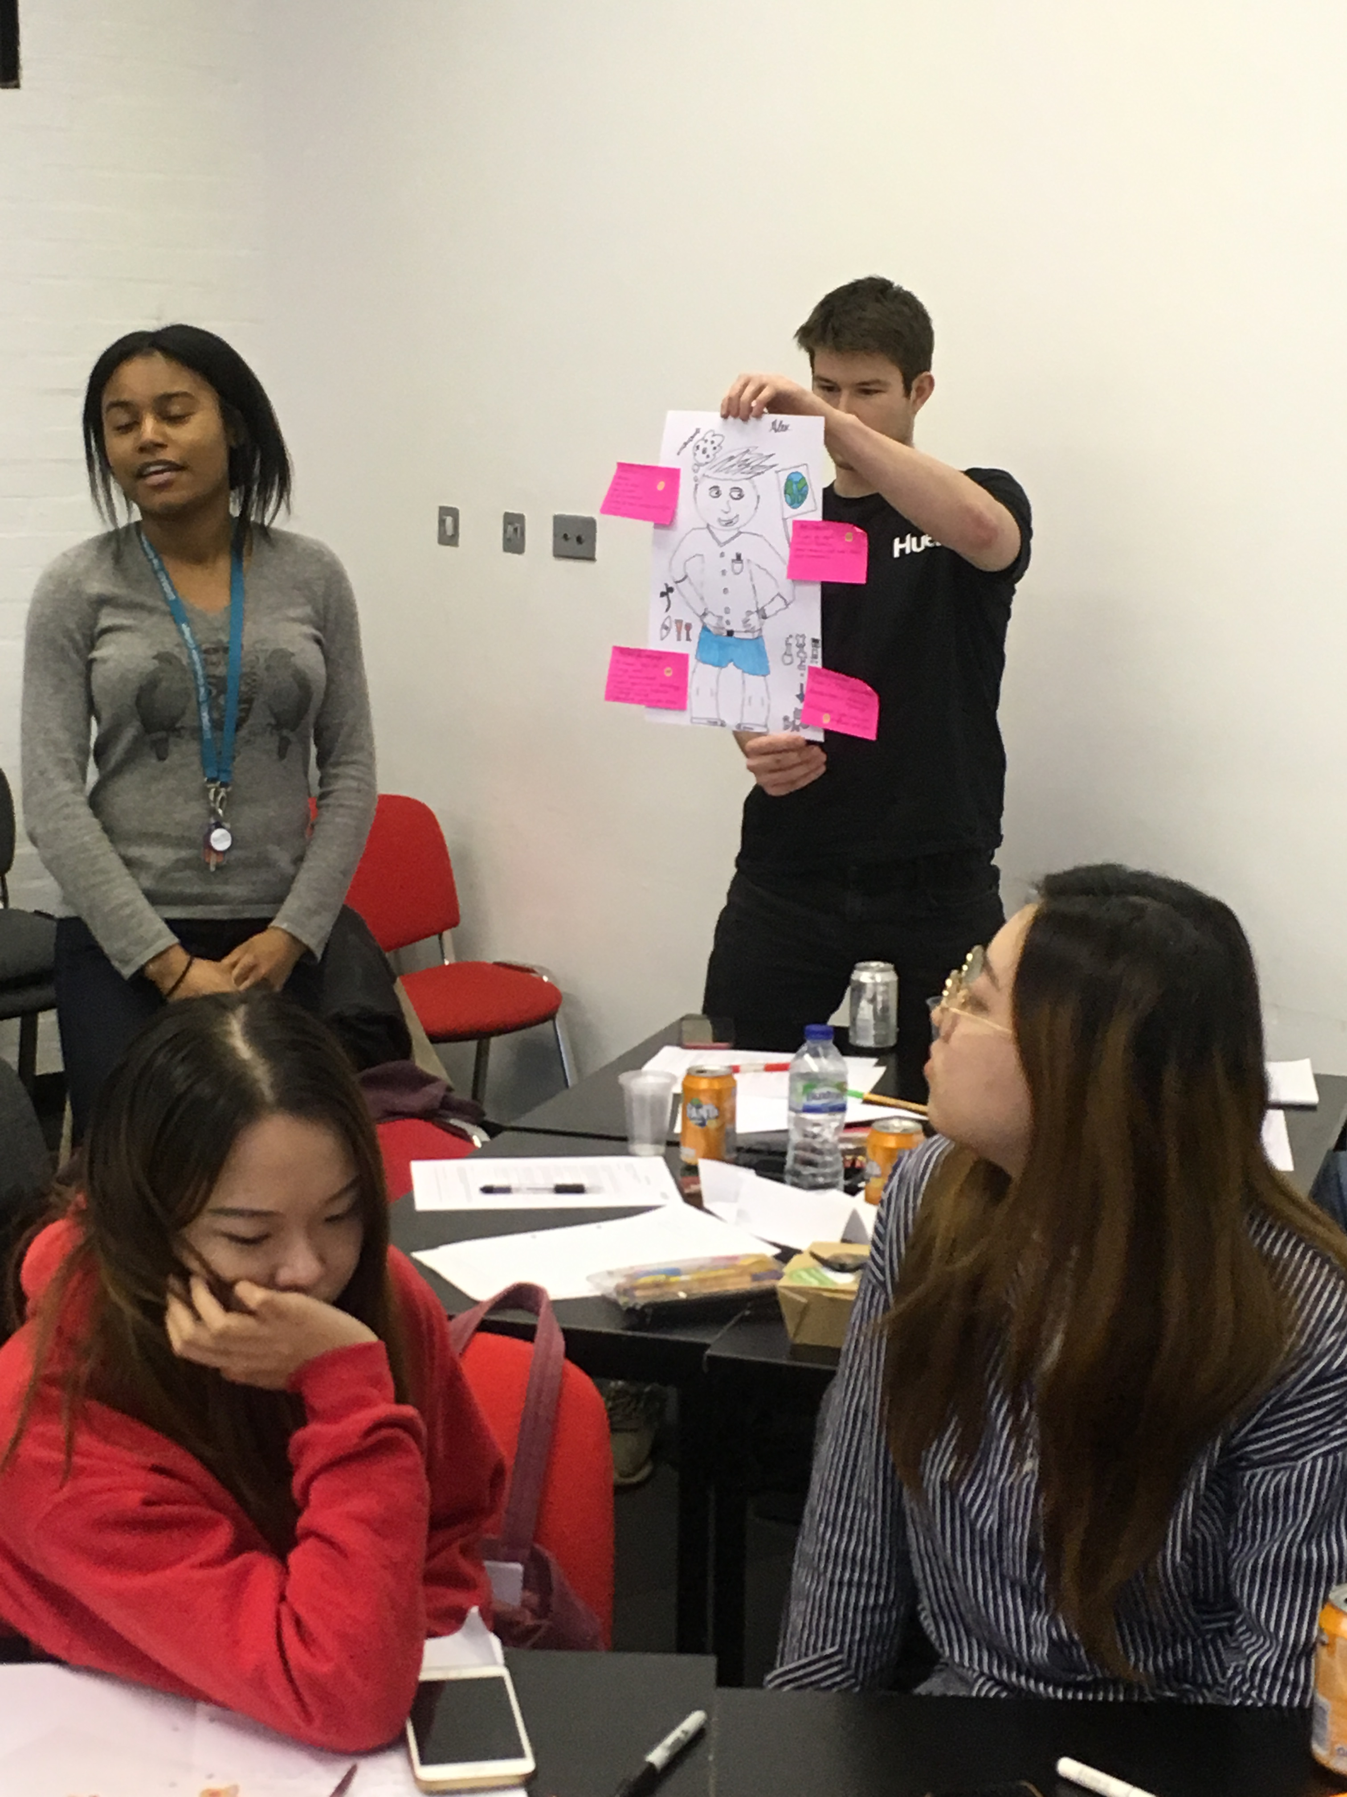
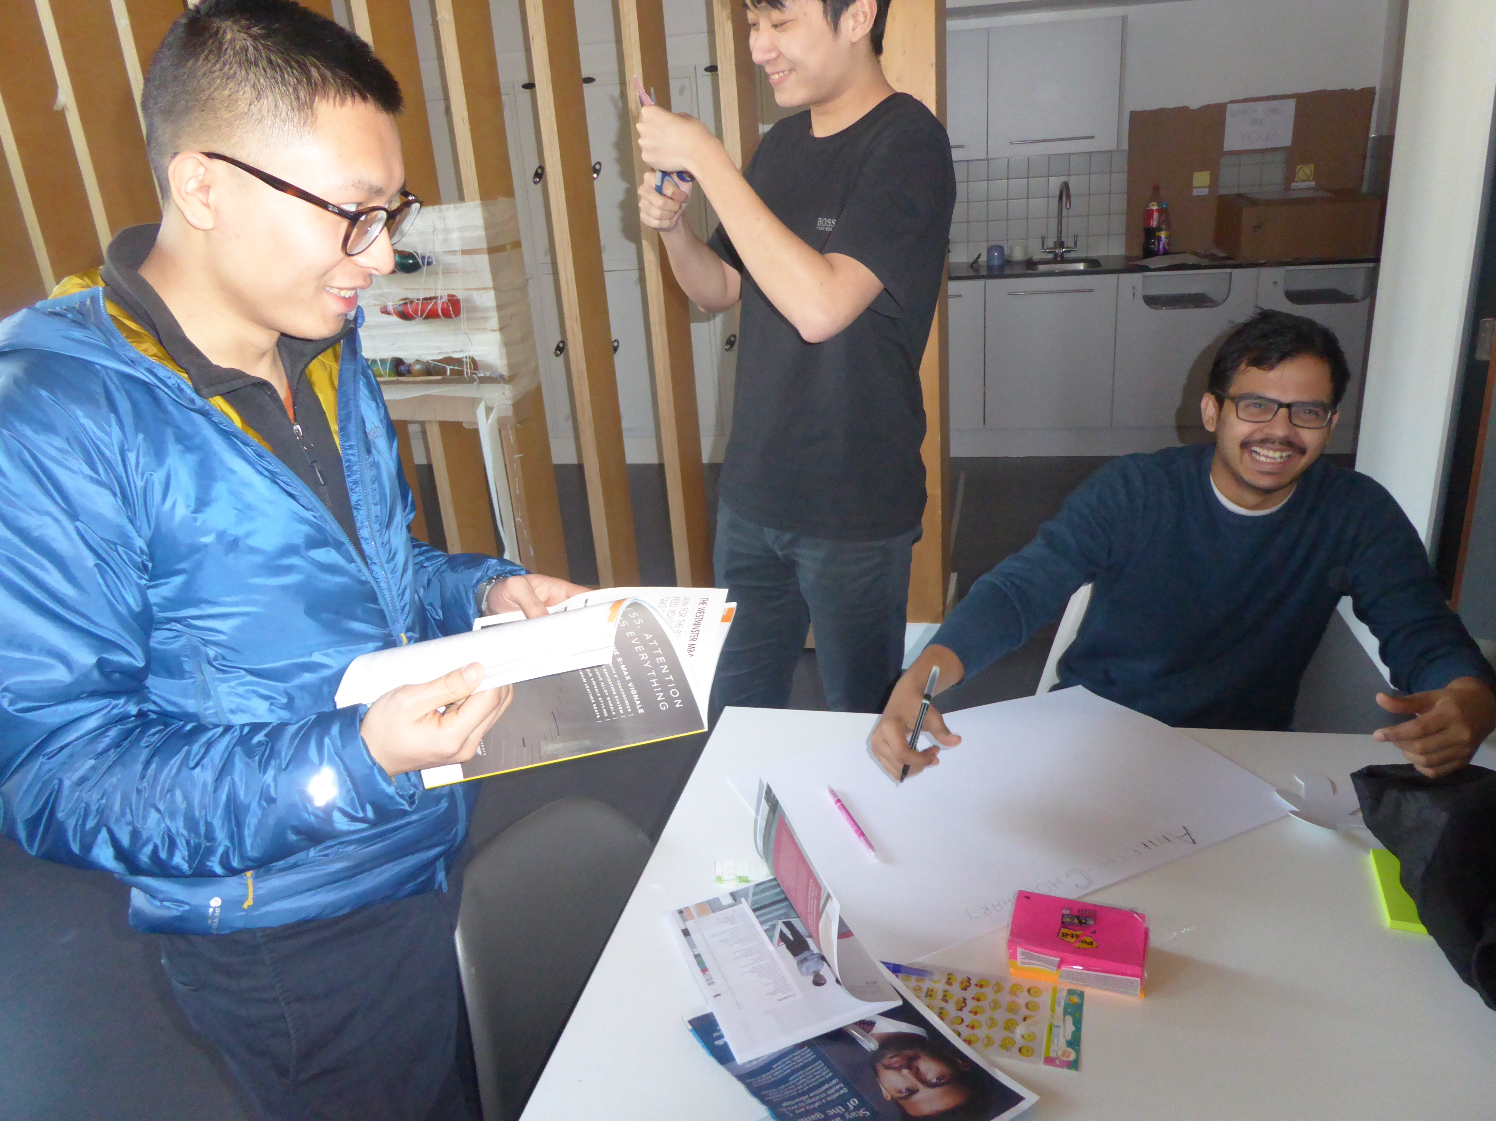
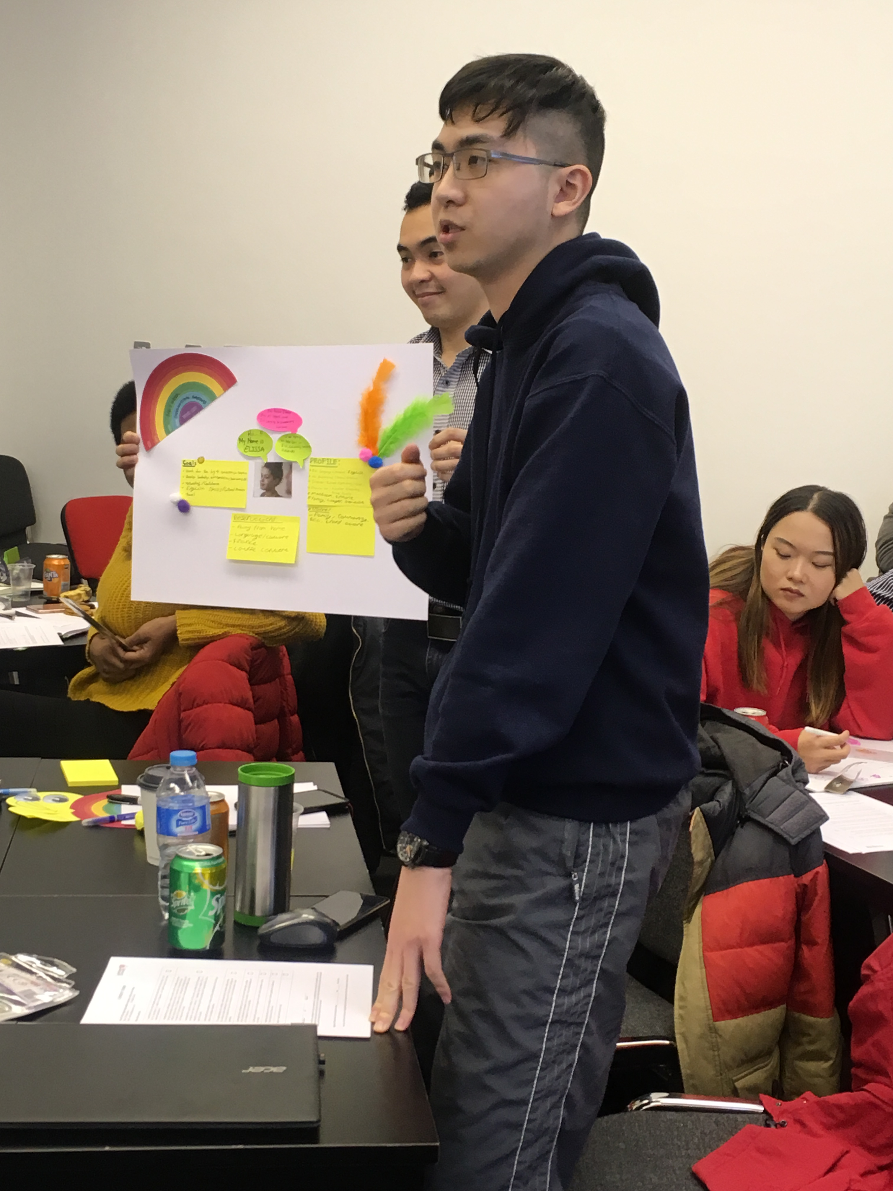
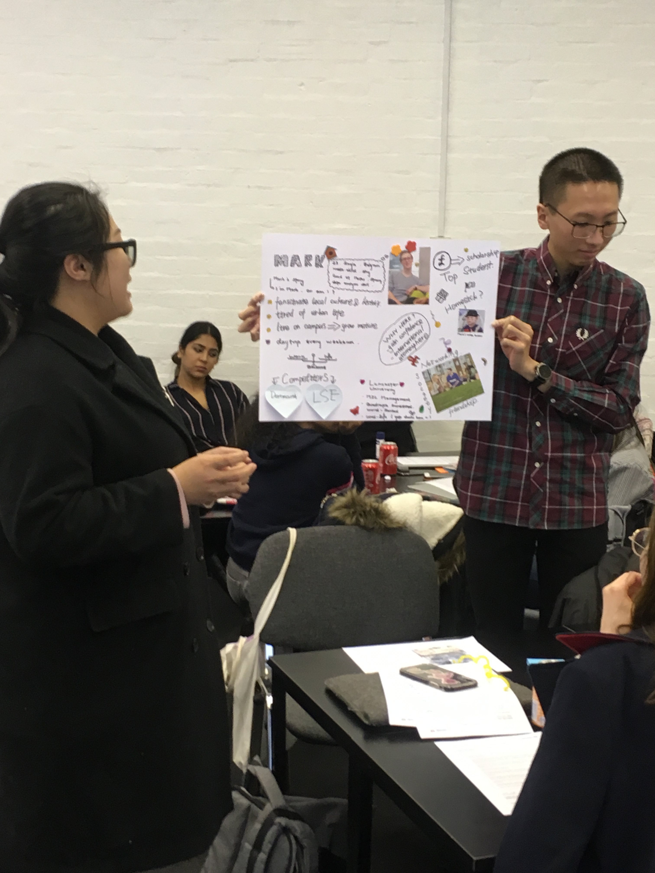
Co-created personas in management curriculum
What are students on this programme like?
Where are they from?
Why are they here?
What do we know about their family/friends/hobbies?
What are their career aspirations?
What are their fears and frustrations?
What makes them happy?
Notes:
Boundary object

Slide 5
About us
Professor Radka Newton
Professor Michael Doherty
Radka’s personal experience of being an international student contributed to her professional calling to ensure that as educators we create challenging yet attainable education environments. As a continuous improvement and service excellence scholar, she has grown a significant expertise in combining executive coaching, organisation change practice and service design. Radka is a Personal Chair in Management Education and Innovation and a co-founder of the Service Design in Education network.
Michael is Professor of Law, and Associate Head of the Law School, at Lancaster University. He is co-author of Public Law (3rd edn, Routledge 2023). He is active in legal education scholarship, co-created the Connecting Legal Education online community, and is a former Chair of the Association of Law Teachers. Michael’s work in legal and service design encompasses education, cultural studies and disciplinarity. He the founding editor-in-chief of Legal Design Journal.
We are co-editors of the upcoming anthology
Transforming Higher Education with Human-Centered design
(Autumn 2024)
The IJMAR article is based on the Inclusive Programme Review method.

