Slide 1
Co-designing community resilience to Online Child Sexual Victimisation (OCSV)
Lead Investigators: Professor Corinne May-Chahal (Lancaster University)
Professor Adam Crawford (University of Leeds & University of York)
Researchers: Dr Christine A Weirich (University of Leeds)
Dr Larissa Engelmann (University of Leeds)
Notes:
My name is Larissa Engelmann and I will be presenting emerging findings from one of our problem-based studies, exploring online child sexual victimisation, or OCSV, in Blackpool, a town in the northwest of England. By OCSV, we refer to any form of victimisation due to online child sexual abuse or exploitation, such as that related to online grooming, or the sharing of self-generated child sexual abuse material between children of the same age. We are just over half way through the project and this presentation will focus on emerging findings from interviews and focus groups conducted between October 2022 and August 2023.
The purpose of this project is to develop a quality standards tool co-produced with the community to effectively respond to and prevent OCSV. The project is led by Professor Corinne May-Chahal and Professor Adam Crawford and supported by Dr Christine Weirich and myself.
This presentation will include information about risks and behaviours associated with child sexual abuse and exploitation. Hence, what I discuss may be upsetting or distressing. If at any point you would like to leave please do so. I’ll also be available afterwards if you want to talk about anything that was discussed.

Slide 2
What do we know so far?
Online and offline facilitated child sexual abuse increasingly blurred (May-Chahal & Kelly, 2020)
Significant overlap among types of online Violence against Children (WHO, 2022)
Ambiguity in relation to self-generated imagery (Skidmore, Aitkenhead & Muir, 2022)
Police lack understanding of risks associated with online abuse and exploitation (HMIC, 2015)
There is a need for child-led instead of offender-led responses (Skidmore, Aitkenhead & Muir, 2022)
"Evidence about the success of prevention programmes for online child sexual exploitation and abuse (OCSEA) is not yet available“ (WHO, 2022)
Notes:
The research literature on this topic is scarce and tends to focus on perpetrators rather than prevention and response mechanisms for children. However, what we do know about OCSV is that:
Much sexual abuse is now mediated through technology. This can significantly harm children and young people beyond the initial abuse or contact offence.
Scholars argue that there is significant overlap among different types of online Violence against Children (WHO, 2022). Online child sexual abuse is therefore often accompanied by other forms of criminal exploitation, which can further complicate the response and support for children and young people.
A significant issue in the age of social media and children’s access to phones and tablets, is the lack of understanding of and responses to youth self-generated imagery (Skidmore, Aitkenhead & Muir, 2022). When a child decides to take photos and videos and uploads them or shares them with friends, they and their friends are committing a crime. Current legislation is not well-placed to address this problem, and there is a lack of knowledge about how to prevent children from sharing such material with each other.
An inspection by Her Majesty’s Inspectorate of Constabulary in 2015 stated that the Police lack understanding of risks associated with online abuse and exploitation (HMIC, 2015). This can lead to missed opportunities when trying to prevent this form of abuse or exploitation or when trying to catch it early and prevent it from escalating.
Therefore, to support the early identification and prevention of OCSV, there is a growing interest in child-led instead of offender-led responses (Skidmore, Aitkenhead & Muir, 2022), in combination with a stronger focus on parents’ roles and responsibilities in keeping children safe online.
Nevertheless, a recent report by the World Health Organisation in 2022 found that the "Evidence about the success of prevention programmes for online child sexual exploitation and abuse (OCSEA) is not yet available“ (WHO, 2022).

Slide 3
Aims and Objectives
Taking a place-based approach, to analyse how OCSV is currently understood and responded to by police, public and third sector partners, parents and children.​
Identify how the police can best work in partnership with others to respond to and prevent OCSV. ​
To produce a locality-based OCSA quality standards tool that can be applied nationally with scope to develop in an international context.
Notes:
This project seeks to address some of the gaps identified within the literature by firstly, taking a place-based approach, to analyse how OCSV is currently understood and responded to by key stakeholders such as police, parents and children. Secondly, we are exploring how the police can best work in partnership with others to anticipate, respond to and prevent OCSV. The information gathered through this process, will help us to produce a locality-based Online Child Sexual Abuse quality standards tool that can be applied nationally and internationally.

Slide 4
OCSV Project – What is the project?
Understand
Listen
(Consultation)
Develop
(Co Production)
Test
Interviews with:
Practitioners
Police
Community Organisations
Health
Case File Analysis
Focus Groups with:
Practitioners
Police
Parents
Community Organisations
Young People
Visioning Day (November 2023)
Task force to finalise following visioning day
Toolkit developed
Pilot takes place in Blackpool
(approx. 6 months)
Notes:
The first stage of data collection involved a rapid evidence review through interviews with local service providers, such as safeguarding leads, youth workers, social workers and police officers. Stage 1 will soon be complemented by a case file analysis of police and social work case files, to enable us to get a better idea of the scope and nature of the problem of OCSV.
Stage 2 involves focus groups with key stakeholders including School Safeguarding Officers, Police Officers, Social Workers, parents, children and young people. These are ongoing. Within this stage, we are also consulting children between the ages of 7 and 16 on their views on the topic of OCSV.
The final stage of this project will involve a co-production day where key stakeholders will come together to decide on the quality standards they want to implement in Blackpool to address and prevent OCSV. This day will be followed by a 6-month piloting phase in which the quality standards tool will be implemented and evaluated.

Slide 5
Notes:
Whilst this is a problem-based project focusing on OCSV, we recognise the localized nature of how problems manifest and are responded to. With established connections in Blackpool from the lead investigator, and an already established child criminal and sexual exploitation team, we decided that this would be the context for this study.

Slide 6
Context: Blackpool
George Clooney once ate fish and chips on the seafront
After London, Blackpool is the 2nd most visited place in England
Large transient Population (42.9% in 2021 census)
High concentration of deprivation
Significantly higher number of children in care compared to national and regional average (JSNA Blackpool, 2023)
The 2020/21 sexual offence crime rate in Blackpool is 80% higher than the overall regional rate (2.54 per 1,000) (JSNA Blackpool, 2023)
39% of sexual offences in Blackpool involved children (similar to regional rate at 40%) (JSNA Blackpool, 2023)
Dedicated co-production team and child sexual and criminal exploitation team
Notes:
Blackpool is a town on the west coast of England with a population of roughly 141,000 people.
Blackpool is known as a domestic Holiday destination particularly for families with children because of local attractions such as roller coasters, arcades and the beach. Indeed, it is so attractive that George Clooney has visited before. Hence, after London, Blackpool is the 2nd most visited place in England with a large transient population at 43% in 2021. This means that Blackpool has a large population who do not normally reside in the area.
Blackpool has high levels of deprivation and high levels of need. There is a significantly higher number of children in care compared to the national and regional average in the UK. Furthermore, the 2020/21 sexual offence crime rate in Blackpool is 80% higher than the overall regional rate and 39% of sexual offences in Blackpool involved children.
Given this context, Blackpool is dedicated to improving the lives of individuals in their care and has developed a dedicated multi-agency team led by Children’s Social Care, Police and Health whose primary function is to support children and young people who are at risk of or victims of child criminal exploitation and/or child sexual exploitation. This is called the Awaken Team. Additionally, Blackpool council is dedicated to co-producing responses to local problems, which is highlighted by their co-production team which actively employs people with lived experience.

Slide 7
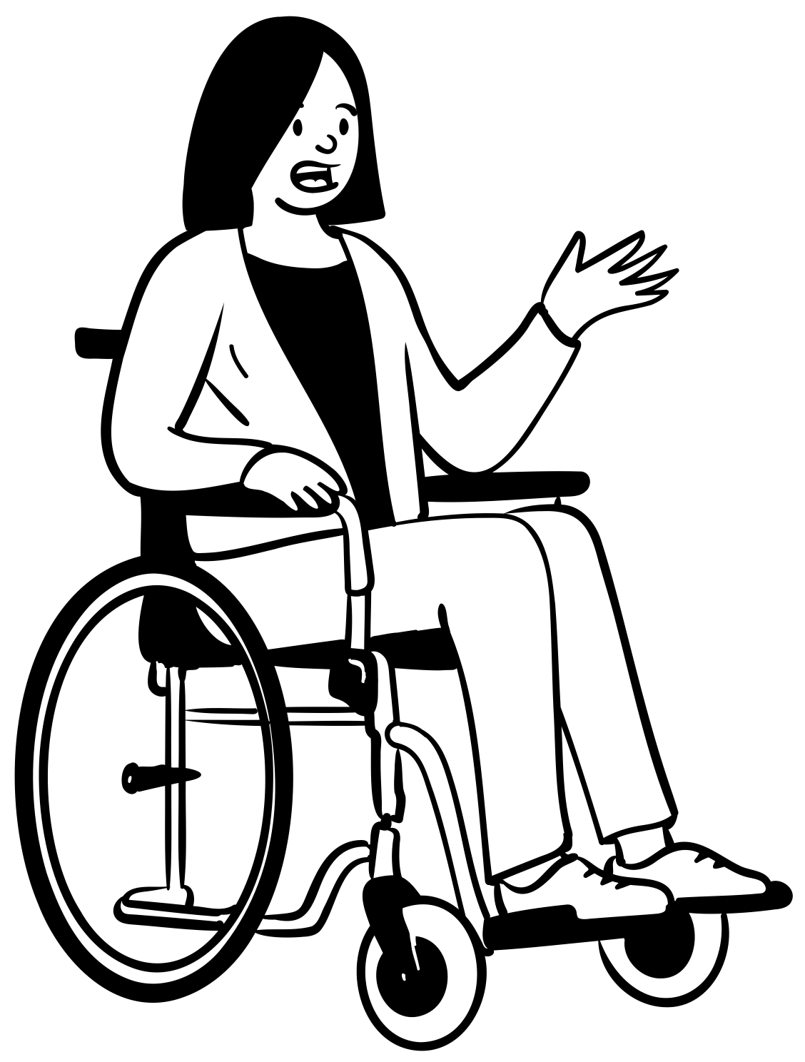
How is OCSV understood and responded to? (Police)
Lancashire Online Child Abuse Investigation Team (OCAIT) [Regional]
Active prosecution of referred local cases through National Crime Agency
Cases often highlight other safeguarding issues
Awaken Team (local multi-agency team)
Largely contact offences and criminal exploitation but online sexual exploitation rising and often linked to criminal exploitation
Struggles with the criminalisation of under 18-year-olds in the response to OCSV
For me, I would prefer us to deal with the worst of the worst and your Early Intervention Teams to take that active role in identifying what that child needs, identifying what the parents might need, liaising with Children’s Social Care. Also, just in case there is an issue within that cohort, that classroom within the school, going into that school and doing that education or at least coordinating that within the community. […]Because ultimately it starts somewhere, doesn’t it? It starts with that family, it starts with that community, it just normally ends with us. (OCAIT)
Notes:
The two statutory services available in Blackpool to respond to online child sexual abuse are the regional Online Child Abuse Investigation Team, or OCAIT, and the local Awaken Team. Although the OCAI team is dedicated to cases of online abuse and exploitation they are not solely focused on sexual abuse and they are a regional team rather than local. In comparison to OCAIT, the Awaken Team largely respond to contact offences. Therefore, there is no dedicated online child sexual abuse team based in Blackpool.
Nevertheless, the Awaken team have argued that they have been responding to an increasing number of cases which involve an online aspect, which reflects findings in the literature on this topic. Similarly, they have also witnessed an increased overlap of criminal and sexual exploitation with one often leading to or including the other. They also tend to include a number of related safeguarding issues, such as a chaotic home lives or school exclusions.
Whilst these teams are skilled in responding to this problem, they feel increasingly overwhelmed with the number of cases referred to them. Furthermore, the regional and national policing team would like to see more local community responses which can support victims and particularly young people who may be both victims and perpetrators of this crime. OCAIT discussed the pressure they feel as assumed experts in this area to have to respond to a large number of cases which may benefit from earlier and more local intervention for example from schools and community organisations. As this quotes highlights:
For me, I would prefer us to deal with the worst of the worst and your Early Intervention Teams to take that active role in identifying what that child needs, identifying what the parents might need, liaising with Children’s Social Care. Also, just in case there is an issue within that cohort, that classroom within the school, going in to that school and doing that education or at least coordinating that within the community […] Because ultimately it starts somewhere, doesn’t it? It starts with that family, it starts with that community, it just normally ends with us.

Slide 8
How is OCSV understood and responded to? (Youth Organisations)
But it’s hard, […] we can do sessions but they kind of turn off. “Yeah, we know all this, we’ve done this in school,” so we need to get to the bottom of why, if they’ve done all this, what is the bit that’s making them choose not to take that advice? It’s 21st century risk taking behaviour, it’s the same as hanging round the shops, stuff that everyone’s done forever, they are choosing to ignore that advice because it’s advice given by adults quite often.(Lead of local youth club)
“The problem is what’s above that [safeguarding procedures] …they don’t trust the services above us and how they will deal with that information or whatever the consequence might be because that is out of our control and it’s out of their control. ... We can’t solve the issue for them, we could be part of the education of solving that issue but once it’s been told and said the police get involved, the Social Care get involved and it’s back to those people they don’t really trust in dealing with that situation.” (Local youth worker)
Notes:
On the other hand, local youth and community organisations struggle to respond to OCSV, not only because of the scale of the problem, but also because of a perceived lack of knowledge of ‘what works’ in the online space to give children the skills, knowledge and risk awareness to stay safe online. As this lead of a local youth organization stated:
But it’s hard, […] we can do sessions but they kind of turn off. “Yeah, we know all this, we’ve done this in school,” so we need to get to the bottom of why, if they’ve done all this, what is the bit that’s making them choose not to take that advice? It’s 21st century risk taking behaviour, it’s the same as hanging round the shops, stuff that everyone’s done forever, they are choosing to ignore that advice because it’s advice given by adults quite often.(Lead of local youth club)
Local organisations have also discussed the ways in which they try to prevent problems of OCSV from escalating and supporting children to come forward. The uncertainty of what might happen when children come forward, particularly when they may have uploaded or shared pictures or videos that have been self-generated, is considered a barrier to the reporting of cases of exploitation and abuse particularly in a locality where trust in public services amongst many children is low due to experiences within their community and family. As this youth worker has highlighted:
“The problem is what’s above [ the safeguarding procedures] …they don’t trust the services above us and how they will deal with that information or whatever the consequence might be because that is out of our control and it’s out of their control. ... We can’t solve the issue for them, we could be part of the education of solving that issue but once it’s been told and said the police get involved, the Social Care get involved and it’s back to those people they don’t really trust in dealing with that situation.” (Local youth worker)

Slide 9
Service concerns and gaps
Key Challenges from service provider perspective
Consistency in reporting and handling cases of OCSV (particularly ‘low level’)
Questions around responsibility and support (who should and does intervene in what and why)
Lack of clear guidance and support to identify and address OCSV early
Young person’s agency and stake in online world
Notes:
A key concern from service providers is the lack of flagging and joining up of data sets and therefore the true scale and nature of OCSV in Blackpool is unknown. In relation to cases that are handled locally by schools, parents or youth organisations, practitioners feel that there is a lack of consistency in how cases are responded to, which means it is hard to manage expectations for everyone involved. In turn, children may feel uneasy about coming forward if they do not know what to expect.
Another important challenge raised is the role of the young person’s agency and the fact that risk taking behaviour and exploring their sexuality is going to be a part of a young person’s life. To engage in this behaviour safely, practitioners and parents need more knowledge about what works to support young people to identify abuse and exploitation, recognise the long-term impact it can have and increase their confidence to talk to someone about problems if they feel something is wrong.
Another concern relates to who should take responsibility of the response to OCSV. Whilst individuals such as parents and schools have been named as central stakeholders in this regard, with a perceived lack of skill and knowledge they often do not feel ready or able to take this on, certainly not by themselves. The lack of clarity around who is and should be responsible at different stages of a child’s life highlights the need for a more coordinated and whole systems approach.
This will require more support and training particularly for schools, parents and youth organisations to align their responses and communicate clear messages with children throughout their life.

Slide 10
Parent experiences and concerns
So if my daughter came up and said, “Oh such-and-such has asked me to do this,” or “Such, I’m doing this,” I’d be like, what do I do? Who do I talk to? Or anything. Because kids get taught it at school, but they don’t ask parents to go in and say, “Do you know what will happen if they did this?” or “Do you need help with this?” (Parent, mother of two children)
My children don’t go to other people’s houses because I don’t trust anybody! No, honestly, they don’t, they go to next-door-but-one who very much parents like I do. I know her children and they don’t have devices and things like that. I’m not saying it’s bad for your child to have a device because one of my children does have a device but I agree as well, I think anybody with a device from any age is at risk from seeing anything online. (Parent, mother of two children)
Notes:
Parents discussed at length the lack of support they feel they have to adequately and effectively keep their children safe online. Some parents argued that they are dependent on themselves to figure out how to do this and they often feel overwhelmed by the amount of information available to them online. There is also a recognition that due to the lower levels of educational attainment amongst parents in Blackpool and the need for both parents to work, many parents will struggle to do their own research to identify ‘what works’ to keep their child safe. As one of the parents argued:
So if my daughter came up and said, “Oh such-and-such has asked me to do this,” or “Such, I’m doing this,” I’d be like, what do I do? Who do I talk to? Or anything. Because kids get taught it at school, but they don’t ask parents to go in and say, “Do you know what will happen if they did this?” or “Do you need help with this?” (Parent, mother of two children)
This highlights the need for reliable and effective community wide approaches to preventing and responding to OCSV, not only supporting local services.
Parents also discussed the problem of children meeting up and sharing risk taking behaviour with each other. Many parents discussed instances where their child was talking to friends who engaged in risk taking behaviour online putting them and their own child at risk. For some parents this has resulted in trying to limit the interaction with other children, particularly when they do not know what the parents of their childs friends have put in place to address this problem. As this parent states:
My children don’t go to other people’s houses because I don’t trust anybody! No, honestly, they don’t, they go to next-door-but-one who very much parents like I do. I know her children and they don’t have devices and things like that. I’m not saying it’s bad for your child to have a device because one of my children does have a device but I agree as well, I think anybody with a device from any age is at risk from seeing anything online. (Parent, mother of two children)

Slide 11
Summary and next steps
Safeguarding procedures and support are in place to varying different levels
There is a lack of feedback loops between services to align responses across sectors (i.e., schools, youth services, parents/guardians)
Need for consistency across services around messaging and knowledge
Desire to address the problem and established partnerships are a significant place-based asset
Next steps
Case file analysis, interviews and children’s workshops will help to better understand the scale of the problem
Co-production event to agree on Quality Standards and Piloting phase
Notes:
In summary, there are dedicated and informal local responses and safeguards in place to respond to and prevent OCSV in Blackpool. The effectiveness of these responses is not yet well understood and responses tend to vary by stakeholder group such as school, social work, youth club, police or the Awaken team. Interviewees would like more feedback loops across services to better understand what children have already learnt and what they are learning about OCSV, how to link up responses and supplement work that is already ongoing with children and to spot changes in children’s behaviour early.
Hence, any form of best practice guidance and quality standards tool will have to identify ways to streamline responses and knowledge about this problem locally and improve feedback and communication between stakeholders to increase consistency in the response to and prevention of OCSV. Even though local stakeholders do not always feel responsible for the prevention of OCSV, there is a clear desire to keep children safe and where possible within resource and capacity constraints to work together to do this. This will be helpful when bringing stakeholders together for the visioning day and discussing specific quality standards that may help address this problem locally.
The upcoming case file analysis will go some way in identifying which cases come to the attention of authorities, how and what outcome they lead to, whereas the children’s workshops will enable us to include the voice of children in this response. This will have a particular focus on not only what they know but also what they would like to see when something goes wrong.
The visioning day in November is where we will use what we have learned so far to steer the conversation and help local stakeholders to come up with and agree on quality standards that will be piloted in Blackpool.We are hopeful that with the information we have gathered so far and what we will continue to gather over the next few months, we are able to develop a tool that will be the first of its kind and will go some way in starting to address OCSV for children in Blackpool and provide a platform for further developments nationally and internationally.
Thank you for listening to my presentation and I look forward to your questions.

Slide 12
Thank you
If you have any questions or comments please get in touch.
Larissa Engelmann
l.Engelmann@leeds.ac.uk
Twitter: @larissa_engelm

Slide 13
References
Internet Watch Foundation (2022) Annual Report 2022. https://annualreport2022.iwf.org.uk/
HMIC (2015) Online and on the edge: Real risks in a virtual world. An inspection into how forces deal with the online sexual exploitation of children.
JSNA Blackpool (2022)
May-Chahal, C. and Kelly, E., 2020. Online child sexual victimisation. Policy Press.
Rudolph, J.I., Walsh, K., Shanley, D.C. and Zimmer-Gembeck, M.J., 2022. Child sexual abuse prevention: parental discussion, protective practices and attitudes. Journal of interpersonal violence, 37(23-24), pp.NP22375-NP22400.
Skidmore, M., Aitkenhead, E. and Muir, R., 2022. Turning the tide against online child sexual abuse.
Police Foundation (2022) Turning the tide on online child sexual abuse.
World Health Organization, 2022. What works to prevent violence against children online?.

Slide 14
Current Service Provision and trends
Healthy Relationships (Offline)
Online Safety
When they’re talking to people on, I don’t know, Roblox and Fortnite …, it feels like an unstoppable tide if I’m honest. …because … parents and carers don’t understand it, also it’s a huge amount of work and negotiation to check with young people because that is their space and it’s been their space, especially since COVID they had to take ownership of that space. That was the only place they could be with their friends, so now they don’t want to let anyone into that space because they’re having conversations with their friends, which is fine and they need some of that space. (Lead of local youth club)

Slide 15
Challenges in responding to OCSV
Feedback-loops
Responsibility
Consistency
Young person’s agency
I know they say prevention is better than cure but I’m not sure how to prevent a world that no one else can see into. (Lead of Local Youth Worker)

Slide 16
(ii) Identify how the police can best work with others to anticipate, respond to and prevent OCSV
Consistent messaging (WHO, 2022 – repeated exposure and greater intensity – single exposure unlikely to be successful)
Whole system response and expansive referral systems
They are pretty savvy and they can run us round the block on social media and TikTok and Snapchat and whatever but there’s a lack of, they don’t need to understand this actually but they don’t understand their own vulnerability within those spaces. But equally, we don’t want them to feel vulnerable in those spaces, so it’s a really tough one. (Lead of Local Youth Organisation)
The world has changed, we haven’t caught up with how to best support them in that space I don’t think. Like I say, we have those one-to-one conversations but are we doing enough? Probably not. Are parents able to keep it up with it? Absolutely not. I don’t know what the answer is and like I said, we’ve tried that, we’ve tried the classroom type group delivery and the older ones especially are just like, “Oh, we’ve done this, we know it. (Lead of local youth organisation)

Slide 17
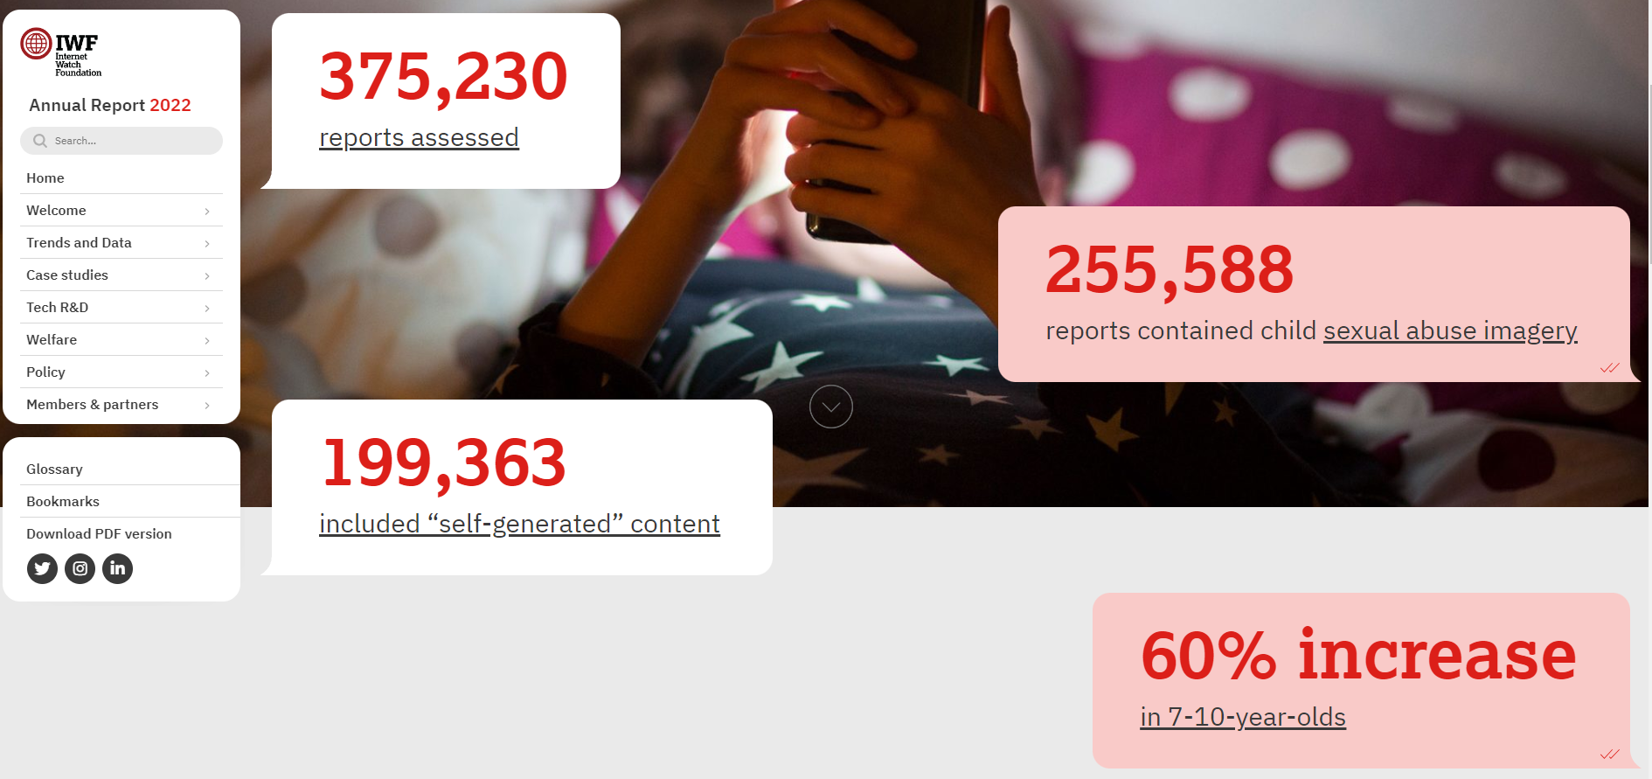
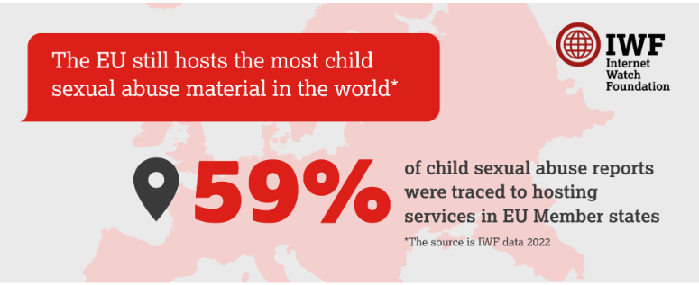
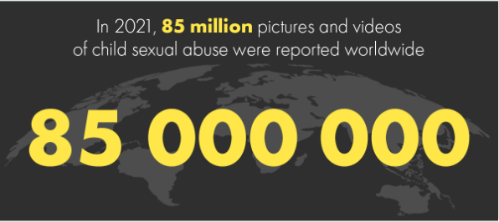
Why this and why now?
ECPAT
Notes:
I doubt I have to say much about why this is an important topic to explore, but as you can imagine over the last 10-15 years online child sexual abuse and exploitation has increased dramatically. Whilst some of this may be due to higher rates of detection with a stronger emphasis on identifying this material online, there are some trends that suggest that the volume of abuse and exploitation is increasing in intensity, scope and reach. As you can see here, a recent report by the Internet Watch Foundation based in the UK found that there has been a 60% increase in sexual abuse imagery of 7-10 year olds. Additionally, a significant number of images and videos tend to be self-generated, this means a child or young person took these images themselves and often uploaded them themselves, likely under pressure from peers or strangers online and offline.
Within this

