Slide 1
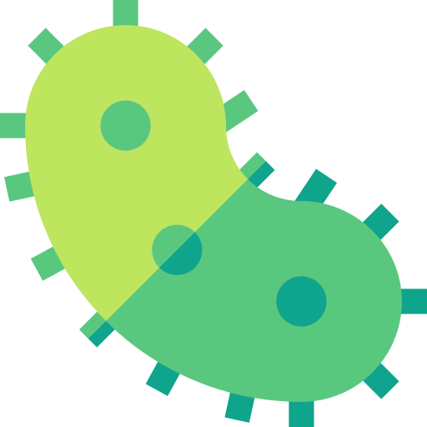
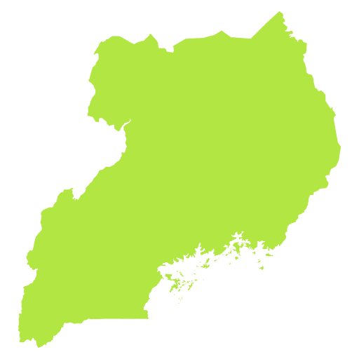
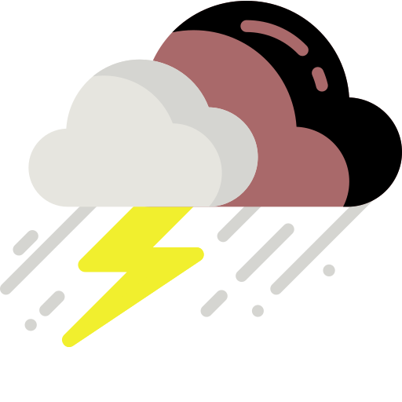
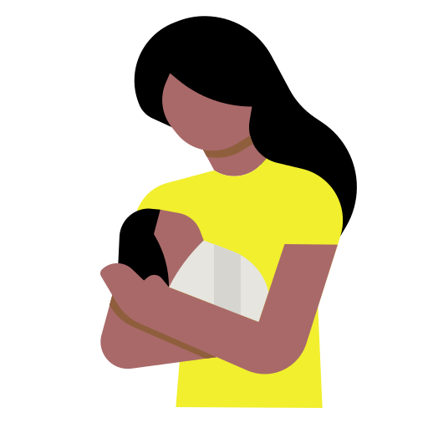
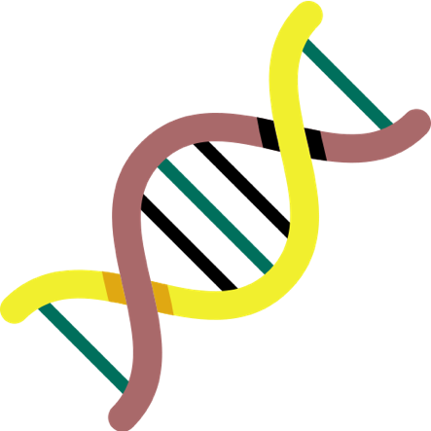
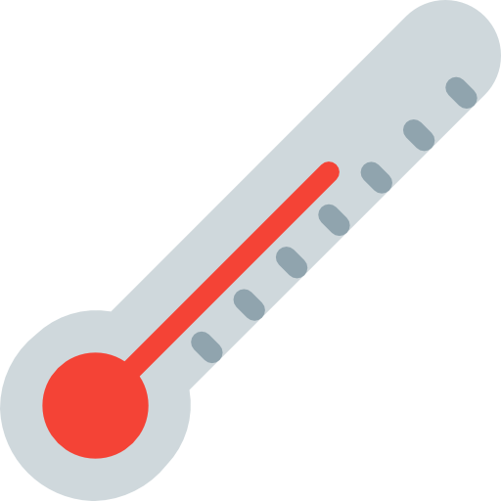
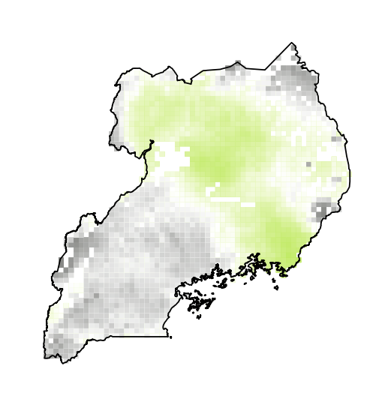
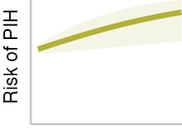
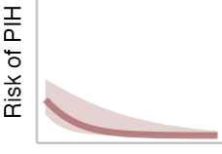
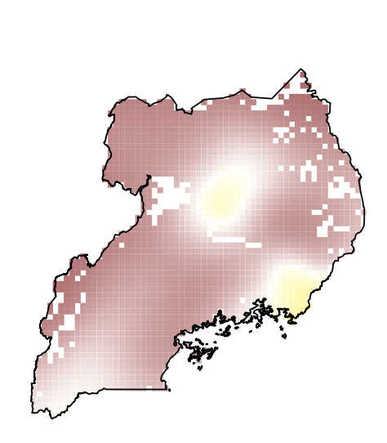
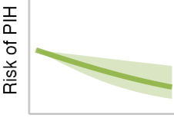
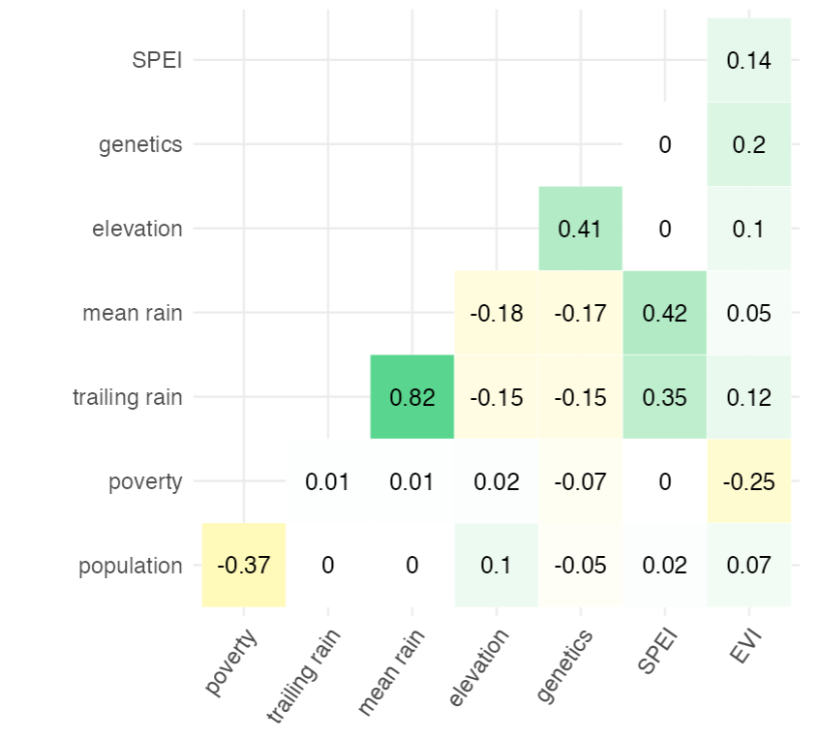
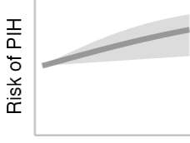
POST INFECTIOUS (PIH) vs NON-POST INFECTIOUS (NPIH) hydrocephalus
Lucinda Hadley, Claudio Fronterre, Misaki Sasanami
50% of hydrocephalus cases are preceded by neonatal infection (PIH) while the rest are non-postinfectious (NPIH). | The absence of infection in mothers indicates that infants with PIH are exposed within the first days of life. | Based on observed seasonality of PIH, we seek areas of increased relative risk (RR) of PIH to NPIH. | We find a significant association with rainfall, elevation, poverty and and an exciting new angle: genetics.
Hydrocephalus is the most common indicator for brain surgery in children [1]
Rates of PIH in sub-Saharan Africa are between 2-4 times higher than in the USA and UK [1]
A link has been discovered between the bacteria P.th… and PIH [2]
Non-post infectious hydrocephalus (NPIH) cases can be considered a “control” for PIH.
Motivation + impact:
Identify risk factors for PIH
Predict patient risk of PIH at point of care
More efficient use of expensive treatments
Identify areas to soil test for bacteria
Maps
Probability of an observed hydrocephalus case being post-infectious.
Yellow highlighted areas where excess RR remains after controlling for the variables in our model
0.75
0.5
0.25
Significant Variables
rainfall
Rolling mean (14 days)
Extreme events (SPEI)
Genetic admixture
Poverty
Elevation
Vegetation (EVI)
[1] Li, J., Shen, L., & Qian, K. (2023). Global, regional, and national incidence and mortality of neonatal sepsis and other neonatal infections, 1990–2019. Frontiers in Public Health, 11, 1139832.
[2] Paulson, J. N., Williams, B. L., Hehnly, C., Mishra, N., Sinnar, S. A., Zhang, L., ... & Schiff, S. J. (2020). The bacterial and viral complexity of postinfectious hydrocephalus in Uganda. Science translational medicine, 12(563).
[3] Images: Flaticon.com'. This poster has been designed using images from Flaticon.com by contributors: Freepik, Victoruler, photo3idea_studio

