Slide 1



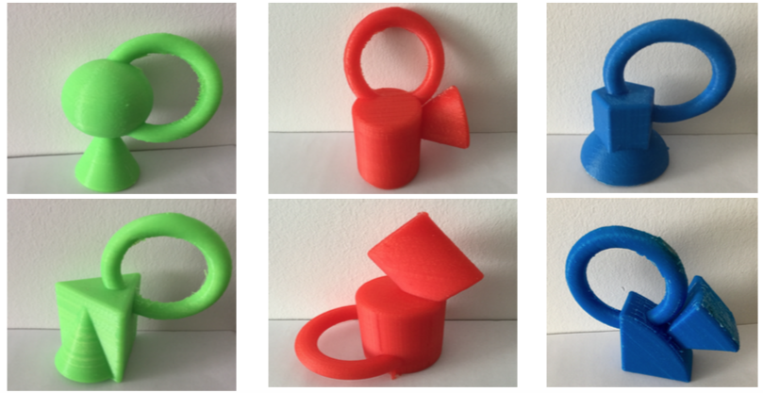
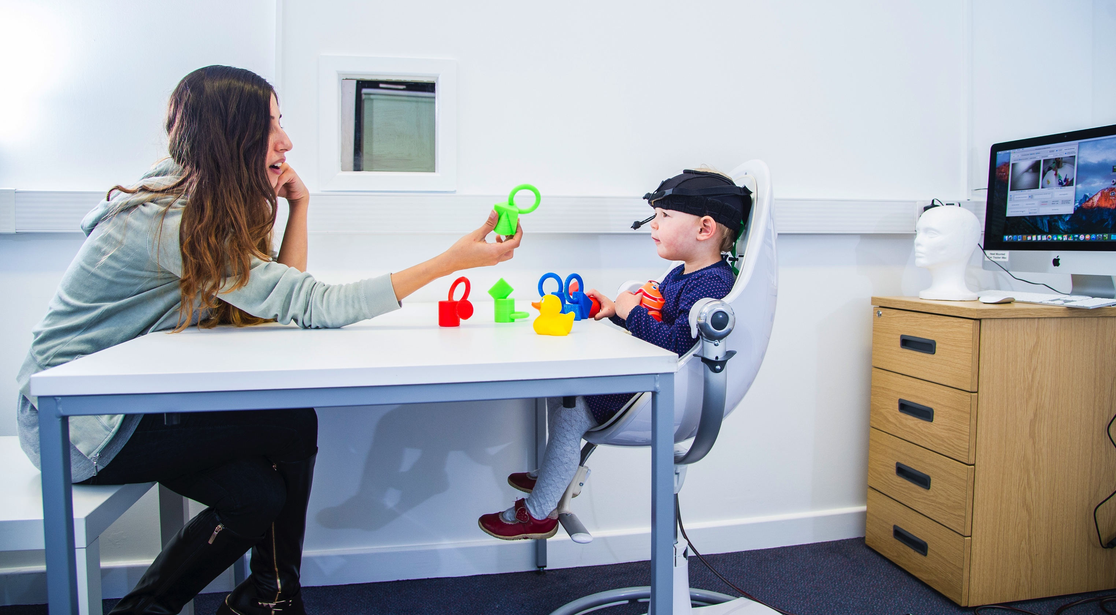
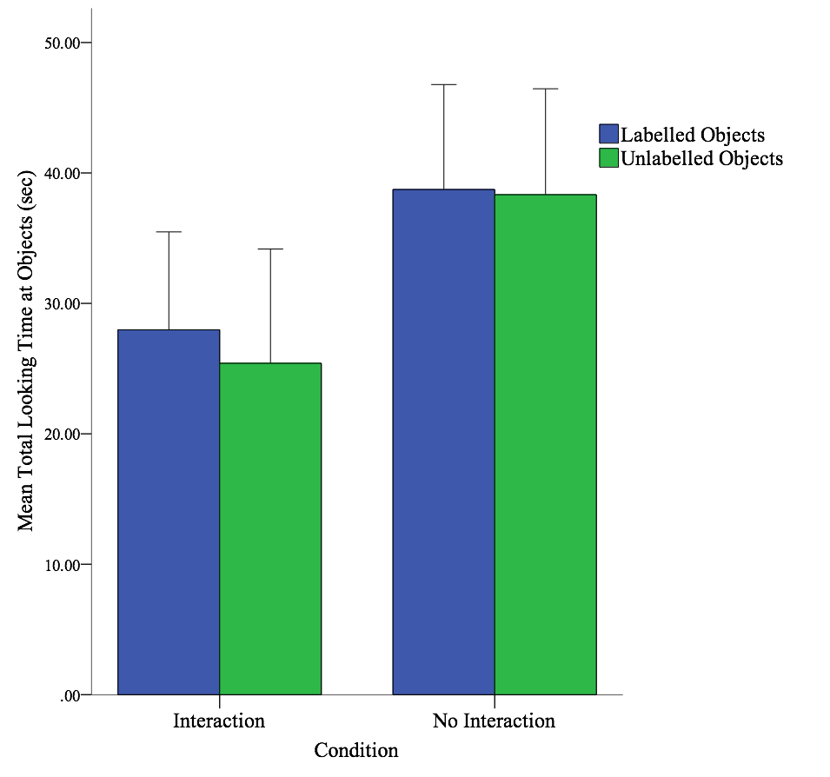
The effect of labelling on infants’ object exploration.
Marina Loucaides¹, Katherine Twomey², Gert Westermann¹
¹Department of Psychology, Lancaster University, Lancaster, UK
²Division of Human Communication, Development and Hearing, University of Manchester, UK
Introduction
Method
Conclusions
The way in which infants explore objects in a dynamically complex everyday environment has been relatively little studied. Here we investigated how infants’ object exploration is affected by the presence or absence of labels, and whether infants were allowed to handle the objects. The present study aimed to explore how children explore novel objects and how they learn labels for novel objects. Handling and no handling the novel objects and their vocabulary scores were examined as factors that can influence this exploration.
Participants: 24 two year-old children
Equipment: Head-mounted Eye-tracker
Questionnaire: A vocabulary inventory (UK-CDI; Alcock, Meints, & Rowland, 2017) was completed by the parent.
Stimuli: Novel words: Habble, Mapoo, Zeebee (Pereira, Smith, & Yu, 2014)
Mixed-subjects design: a handling group and a no handling group that each experienced a labelling and a unlabelling condition.
Each object was seen for 30s.
Five-minute break (Horst & Samuelson, 2008).
Testing: The experimenter tested label-object mappings by presenting three objects on a tray (e.g., Which one’s the blicket?).
A main effect was found between the looking times of handling and no handling conditions. The looking time during the no handling condition was significantly higher compared to the handling condition.
Label and non-label events did not show different total looking times in either handling or no handling conditions.
In both handling conditions, the looking times to the objects and to the experimenter’s face and the number of switches between objects and other areas of interest were not predicted by labelling condition and productive vocabulary scores.
Children’s productive vocabulary scores, looking time at labelled objects and switches during looking time at labelled objects were not found to predict retention of novel words in either condition.
Background
Young children are intrinsically motivated and curious (Twomey & Westermann, 2015) and learn from their surroundings by collecting information during their everyday activities (Yu, Smith, Christensen, & Pereira, 2007).
The everyday visual world offers many potential referents through a dynamically complex environment (Pereira, Smith, & Yu, 2014) which is subject to their everyday activities (Kretch, Franchack, & Adolph, 2014).
Investigating the unconstrained and dynamic explorations closer to their real-life events is important (Franchack, Kretch, Soska, & Adolph, 2011).
How children interact with objects is a significant component of learning word-object associations (Samuelson, Kucker, & Spencer, 2017); however this has yet to be studied in detail.
Hypotheses:
We expect that looking at labelled objects will be longer compared to the unlabeled objects.
We expect that handling the objects will show less looking towards the objects?
We expect that looking at the objects, switching eye gaze during labelling and vocabulary scores will be associated with correct retention of the novel words.
*
Results
Handling Condition: The effect of labelling
Looking times to the objects were not predicted by labelling or productive vocabulary scores, F(2, 21) = .82, p = .46.
Looking times to the experiment’s face were not predicted by labelling or productive vocabulary scores, F(2, 21) = .47, p = .63.
For the number of switches between areas of interest were not predicted by labelling or productive vocabulary scores, F(2, 21) = 2.58, p = .10.
Acknowledgements
This study is part of Marina’s PhD thesis at the University of Lancaster. Thanks to the Leverhulme Trust for funding this PhD project and the help and support from supervisors and colleagues.
No Handling Condition: The effect of labelling
Looking times to the objects were not predicted by labelling or productive vocabulary scores, F(2, 21) = .33, p = .72.
Looking times to the experiment’s face were not predicted by labelling or productive vocabulary scores, F(2, 21) = 2.44, p = .11
Number of switches between areas of interest were not predicted by labelling or productive vocabulary scores F(2, 21) = 1.55, p = .24.
Contact Information
Marina Loucaides: marinqa.loucaides@lancaster.ac.uk
Katherine E. Twomey: katherine.twomey@manchester.ac.uk
Gert Westermann: g.westermann@lancaster.ac.uk
References
Alcock, K. J., Meints, K., & Rowland, C. F. (2017). UK-CDI Words and Gestures - Preliminary norms and manual. Retrieved from http://lucid.ac.uk/ukcdi
Franchak, J. M., Kretch, K. S., Soska, K. C., & Adolph, K. E. (2011). Head-mounted eye tracking: a new method to describe infant looking. Child Dev, 82(6), 1738-1750. doi:10.1111/j.1467-8624.2011.01670.x
Horst, J. S., & Samuelson, L. K. (2008). Fast Mapping but Poor Retention by 24-Month-Old Infants. Infancy, 13(2), 128-157. doi:10.1080/15250000701795598
Kretch, K. S., Franchak, J. M., & Adolph, K. E. (2014). Crawling and walking infants see the world differently. Child Dev, 85(4), 1503-1518. doi:10.1111/cdev.12206
Pereira, A. F., Smith, L. B., & Yu, C. (2014). A bottom-up view of toddler word learning. Psychon Bull Rev, 21(1), 178-185. doi:10.3758/s13423-013-0466-4
Samuelson, L. K., Kucker, S. C., & Spencer, J. P. (2017). Moving Word Learning to a Novel Space: A Dynamic Systems View of Referent Selection and Retention. Cognitive Science. https://doi.org/http://doi 10.1075/is.17.1.05two
Twomey, K. E., & Westermann, G. (2015, August). A neural network model of curiosity-driven infant categorization. In 2015 Joint IEEE International Conference on Development and Learning and Epigenetic Robotics (ICDL-EpiRob) (pp. 1-6). IEEE.
Yu, C., Smith, L. B., Christensen, M., & Pereira, A. (2007). Two views of the world: Active vision in real-world interaction. In Proceedings of the 29th Annual Meeting of the Cognitive Science Society. Mahwah, NJ: Erlbaum.
There was a significant main effect for looking time during handling and no handling the objects, F(1,22) = 4.80, p = .04, , η² = .18.
No significant effect of labelling for looking time when the objects were labelled or unlabelled, F(1,22) = .58, p = .45, , η² = .03.
There was no interaction between labelling condition and handling conditions, , F(1,22) = .31, p = .58, , η² = .01.
Retention of novel words
Handling condition: Retention of novel words was not predicted by looking time at labelled objects, productive vocabulary and switches were not able to predict retention, F(3,8) = .81, p = .52.
No handling condition: Retention of novel words was not predicted by looking time at labelled objects, productive vocabulary and switches were not able to predict retention, F(3,8) = 1.78, p = .23.

