Slide 1



Modeling and Characterization of Novel Deepwater Marine Risers
LUPGRC 2017
Amaechi Chiemela Victor
Date: 6th May, 2017
Year: 2nd Year PhD Student
Department: Engineering Department
Supervisor: Prof. Jianqiao Ye
Research Sponsors:
1. NDDC (Niger Delta Development Commission), Nigeria.
2. Engineering Department, Lancaster University, Lancaster, UK.
Notes:
LANCASTER UNIVERSITY POWERPOINT TEMPLATES
These PowerPoint templates are for use by all Lancaster University staff. Please see below for further information regarding the use of these templates. Should you have any further queries, please contact the marketing team via marketing-services@lancaster.ac.uk
Template slide 3: Insert a new slide
If you need to insert a new slide, from the ‘home’ toolbar, click on ‘new slide’ and select from the templates the style you require from the dropdown box.
Template slide 4: Typing new text and copying text from another document
New text should be typed over the text in the appropriate template. Copy and pasting text from another document will result in changing the style of the typography and layout. This is unavoidable as it is part of the Microsoft software. We appreciate that in sometimes you will need to copy text from another document into this template. Once you have pasted the existing text into the template, you will need to change the formatting so that they typefaces, sizes, colour, line spacing and alignment are consistent with the rest of the template.
Template slide 5: Inserting images
There are three choices of templates with images already inserted. Please use the template with the relevant image size and positioning. To insert an image, please go to ‘insert’ then ‘picture’ and find your image, highlight it and ‘insert’. Resize the image and position as per the example template.
Template slide 6: Text boxes
If a text box is deleted, either insert a new slide (using the appropriate template) or go to another slide and copy a text box. To select a text box for copying, please click on the outer edge of the text box so that the line goes solid (not dashed). Right click your mouse and select ‘copy’, then go back and ‘paste’ it into the slide where the text box is missing which should paste into the correct position on the slide.
Template slide 7: Other information
Typefaces, sizes and colours
All copy is Calibri.
Slide title copy throughout:
Size: 36 point
Colour Lancaster University red: (RGB) R: 181 G: 18 B: 27 (recent colours on PowerPoint)
Small copy on first and last slide:
Size: 16 point
Colour grey: (RGB) R: 102 G: 102 B: 102 (recent colours on PowerPoint)
Sub-headings:
Size: 24 point – italics
Colour grey: (RGB) R: 102 G: 102 B: 102 (recent colours on PowerPoint)
Bullets copy and body copy:
Size: 24 point (see below for a further option)
Colour grey: (RGB) R: 102 G: 102 B: 102 (recent colours on PowerPoint)
It isn’t advisable to have too much text on a slide, however on rare occasions it may be necessary, therefore there is a slide using 20 point bullet pointed text.
Line spacing and alignment
Single line spacing (apart from the main headings which is ‘exactly 35 point’)
All text is aligned left
Slide title options
There are two options for titles on the slides – one line or two lines for longer titles. Ideally, the one line title should be used, however on rare occasions a two line title maybe needed.

Slide 2
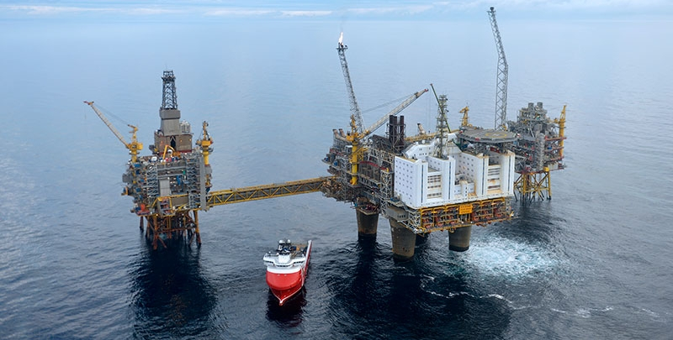
Outline
Outline
Risers Overview
Brief Discussion
Current Work (Update)
Riser Configurations
Catenary Equation
Loads on Risers
Orcaflex Model
Analysis / Discussion
Works Done
Next Steps
Conclusion

Slide 3
Brief on Research
Oil and Gas Industry
The scope of the research work
The research output and update
The timelines to meet & any challenges
The expected output on next steps
Considerations on present research
Present Results of research
Understand the result interpretation.
Onshore
Mainstream
Offshore
Flexible Risers
Mooring lines
Risers
Rigid Risers
Platforms
Pipelines, etc.
Hybrid Risers
Composite Risers

Slide 4
Current Work (Update)
Following your advise, I have started working on Steel, using Steel Catenary Risers.
Had to run some simulation on Orcaflex and try to interpret it.
This also made me to also look at Pipe-laying operations, as they also have similar behaviour in installation from an offshore vessel.
I have run an Orcaflex model of the riser on Orcaflex.
Will develop it and incorporate the vessel motion generated from ANSYS Aqwa.
Had to study more on Ocean conditions, as I was wrongly using the wrong wave spectrum for deepwater conditions.
Currently am studying the analytical behaviour of the Catenary Risers.
I have also extended the design from the Hydrodynamic model on Charles Hull, by modelling risers on it.

Slide 5
Riser Configurations
Free Hanging Catenary
Lazy Wave
Steep Wave
Tethered Lazy Wave / Reverse Pliant Wave
Lazy-S
Steep-S
Pliant Wave

Slide 6
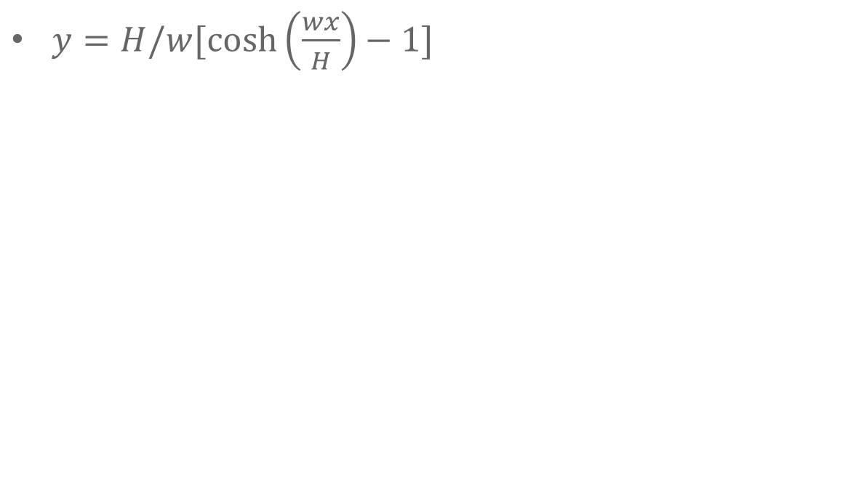
Catenary Equation
$y=H/w[\cosh\left(\frac{wx}{H}\right)−1]$
H
ds
Y
H
X
Catenary Line

Slide 7
Loads on Risers
Mean Water level
Wave forces
Vessel
Top Connection
Weight, (W_{r}) of Composite riser
Current forces
Internal and external fluid pressure
Buoyancy
Z
Bottom connection
Y
Foundation casing
X

Slide 8
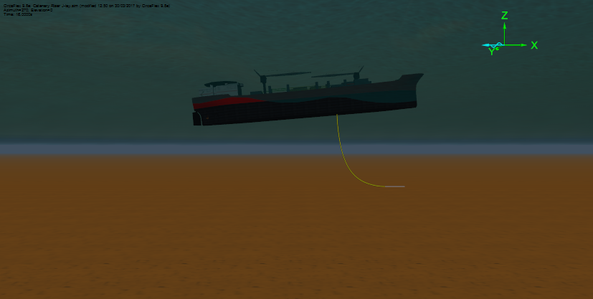
Orcaflex Model Update

Slide 9
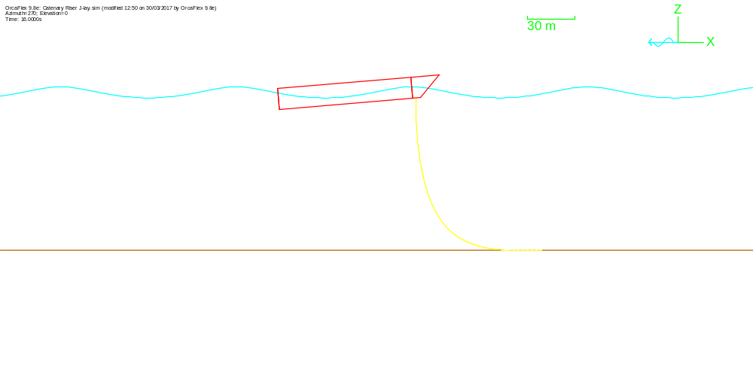
Wire Frame Orcaflex Model

Slide 10
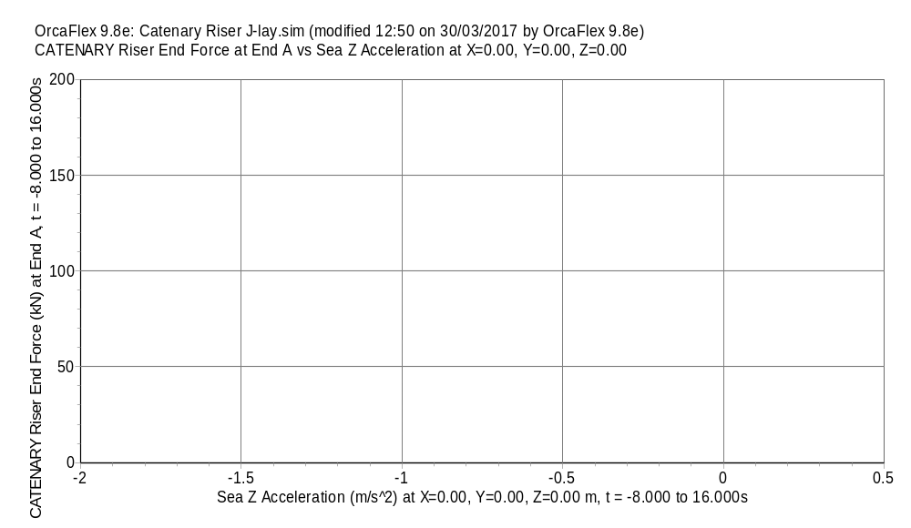
Results

Slide 11
Result presentation
Full Results for CATENARY Riser at time 16.000s
OrcaFlex 9.8e: Catenary Riser J-lay.sim (modified 12:50 on 30/03/2017 by OrcaFlex 9.8e)
End A
Total Force (kN) | 70.3767908787898
End Tension (kN) | 70.3380480487908
End Shear Force (kN) | 2.33488566805939
Total Moment (kN.m) | 0
End Bend Moment (kN.m) | 0
End Torque (kN.m) | 0
End Curvature (rad/m) | 0
End Ez-angle (deg) | 17.9584990101339
End Force Azimuth (deg) | 180
End Force Declination (deg) | 174.988982552242
End Force Ez-angle (deg) | 19.8597458115726
End Force Exy-angle (deg) | 360
End B
Total Force (kN) | 27.0148404990448
End Tension (kN) | 26.9885153675545
End Shear Force (kN) | 1.19232774190126
Total Moment (kN.m) | 0
End Bend Moment (kN.m) | 0
End Torque (kN.m) | 0
End Curvature (rad/m) | 0
End Ez-angle (deg) | 0.385102490526068
End Force Azimuth (deg) | 360
End Force Declination (deg) | 87.0852676763911
End Force Ez-angle (deg) | 2.91473232360894
End Force Exy-angle (deg) | 180

Slide 12
Components for Ends A and B
End A components
 |  | End Axes |  |  | Global Axes
Load | Magnitude | Ex | Ey | Ez | GX | GY | GZ
Force (kN) | 70.3767908787898 | 23.9083224495571 | -6.75075250311921E-16 | 66.1912744404043 | -6.14722267644048 | -6.75075250311921E-16 | -70.1078051843243
Moment (kN.m) | 0 | 0 | 0 | 0 | 0 | 0 | 0
End B components
 |  | End Axes |  |  | Global Axes
Load | Magnitude | Ex | Ey | Ez | GX | GY | GZ
Force (kN) | 27.0148404990448 | -1.37369752545878 | -5.09554184790562E-15 | 26.9798918140414 | 26.9798918140414 | -5.09554184790562E-15 | 1.37369752545878
Moment (kN.m) | 0 | 0 | 0 | 0 | 0 | 0 | 0

Slide 13
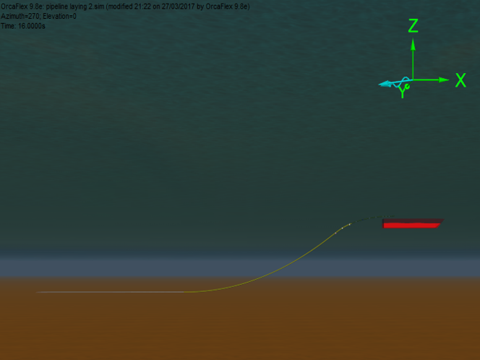
Pipe-Laying with Stinger

Slide 14
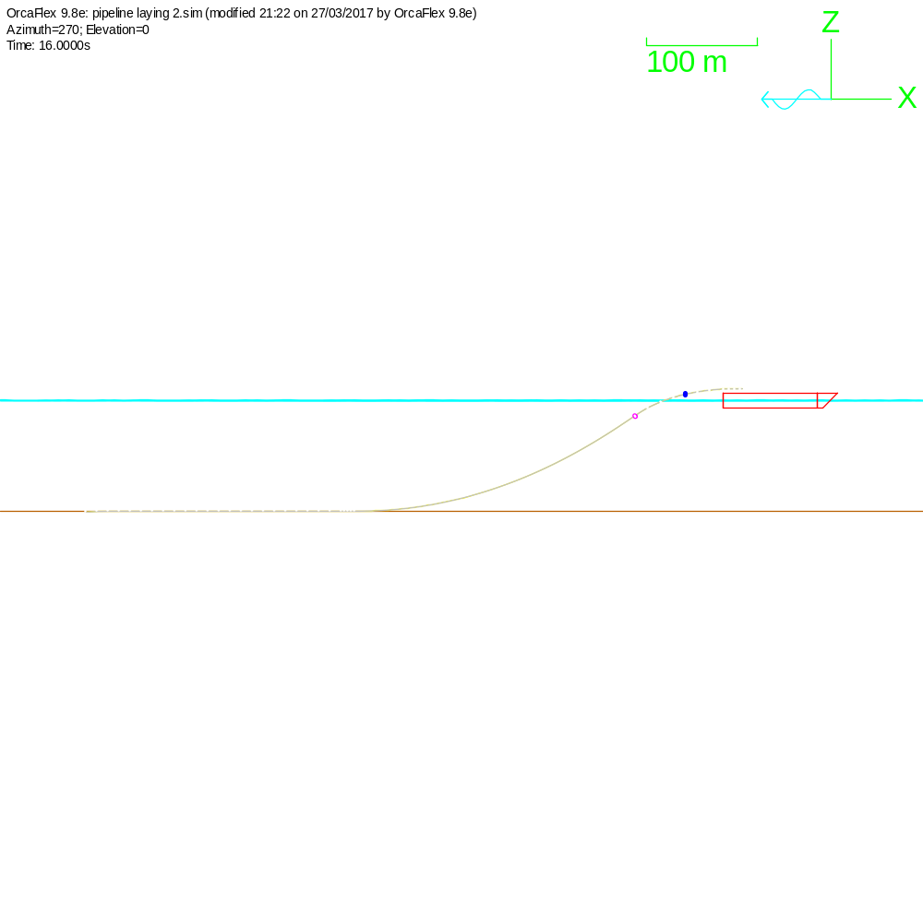
Wireframe of the Model

Slide 15
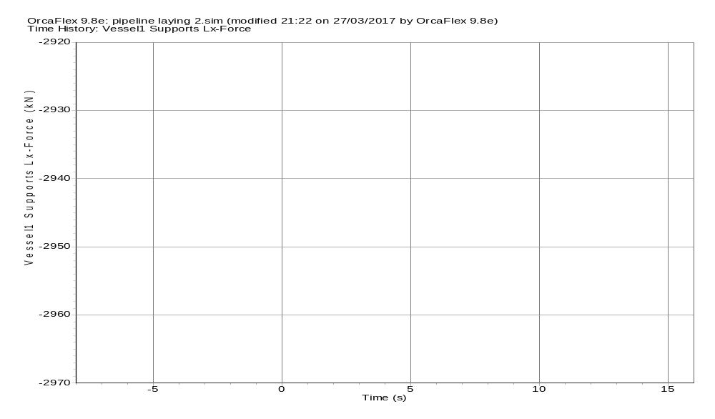
Result of simulation

Slide 16
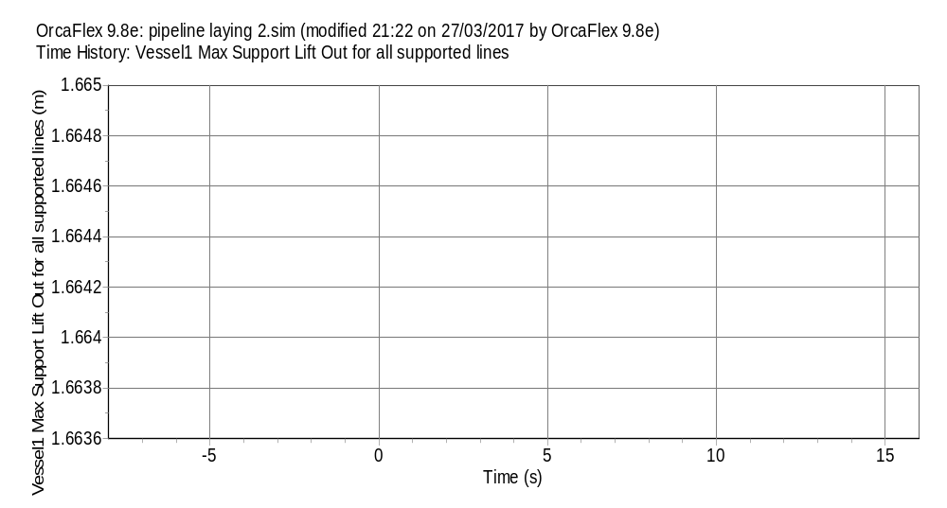
To see effect of vessel lift

Slide 17
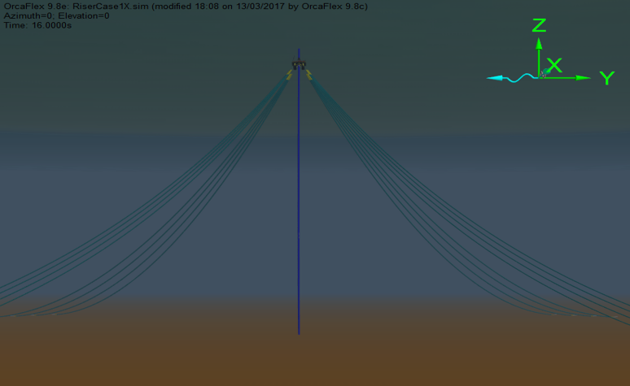
Riser Model on FPSO

Slide 18
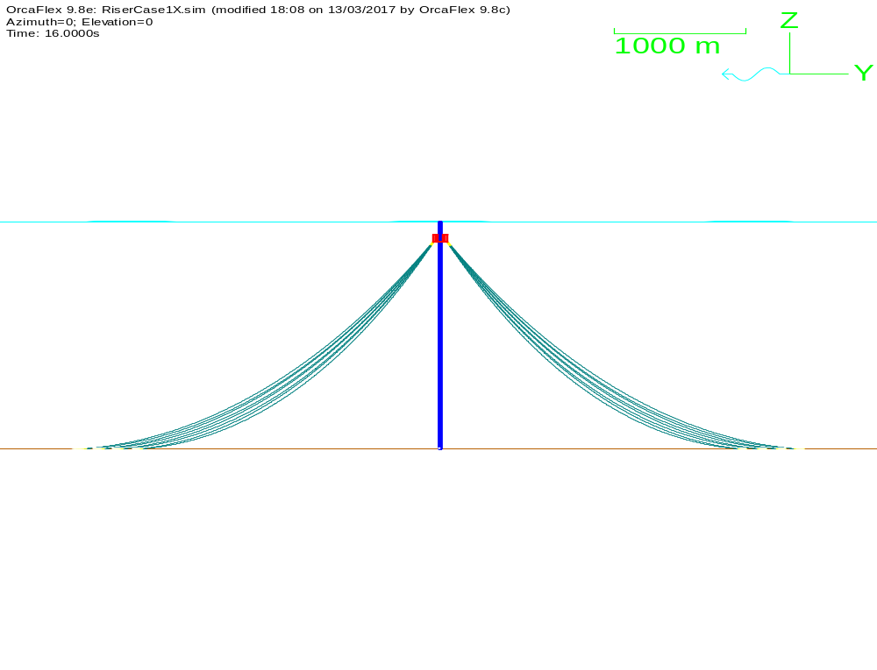
Wireframe of Riser Model

Slide 19
Result of Simulation
End A
Total Force (kN) | 3399.98021931812
End Tension (kN) | 3399.93447412388
End Shear Force (kN) | 17.6369900628376
Total Moment (kN.m) | 0
End Bend Moment (kN.m) | 0
End Torque (kN.m) | 0
End Curvature (rad/m) | 0
End Ez-angle (deg) | 167.426020680886
End Force Azimuth (deg) | 357.435550730998
End Force Declination (deg) | 167.238877475392
End Force Ez-angle (deg) | 167.238877475392
End Force Exy-angle (deg) | 357.435550730998
End B
Total Force (kN) | 4628.77727116632
End Tension (kN) | 4628.76577688492
End Shear Force (kN) | 10.3154643551501
Total Moment (kN.m) | 0
End Bend Moment (kN.m) | 0
End Torque (kN.m) | 0
End Curvature (rad/m) | 0
End Ez-angle (deg) | 171.930329857442
End Force Azimuth (deg) | 179.999999999747
End Force Declination (deg) | 172.058016506824
End Force Ez-angle (deg) | 172.058016506824
End Force Exy-angle (deg) | 179.999999999747

Slide 20
Components for Ends A and B
End A components
 |  | End Axes |  |  | Global Axes
Load | Magnitude | Ex | Ey | Ez | GX | GY | GZ
Force (kN) | 3399.98021931812 | 750.258525889106 | -33.6025750768122 | -3315.99886957661 | 750.258525889106 | -33.6025750768122 | -3315.99886957661
Moment (kN.m) | 0 | 0 | 0 | 0 | 0 | 0 | 0
End B components
 |  | End Axes |  |  | Global Axes
Load | Magnitude | Ex | Ey | Ez | GX | GY | GZ
Force (kN) | 4628.77727116632 | -639.559567651002 | 2.82519422727764E-9 | -4584.3802836907 | -639.559567651002 | 2.82519422727764E-9 | -4584.3802836907
Moment (kN.m) | 0 | 0 | 0 | 0 | 0 | 0 | 0

Slide 21
Update on Simulations
As regards the environmental load cases, I had to take a tutorial yesterday to understand more on the environmental loads.
The stiffness on my riser for the ANSYS Aqwa which I am using for the hydrodynamic analysis is from that from Orcaflex.
However, my initial design had very high stiffness with End Tensions as 3399.9 KN (End A) and 4628.77KN(End B).
Currently, am trying to run more simulations using different load cases.

Slide 22
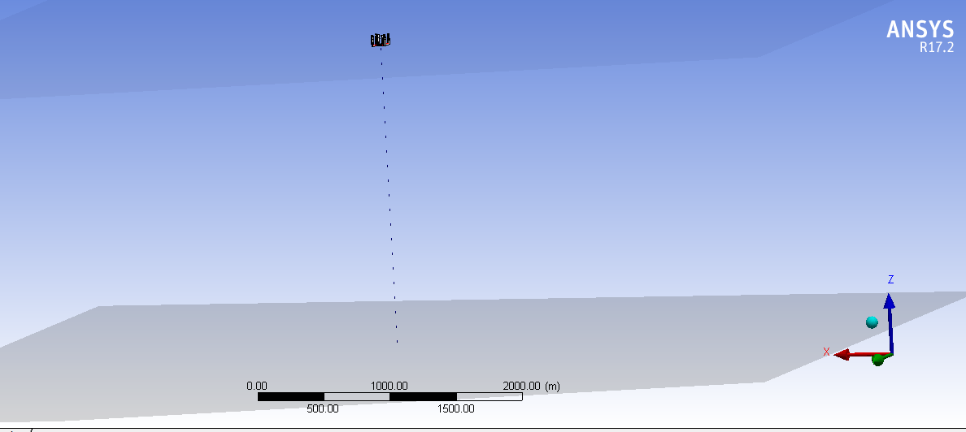
Update on ANSYS Aqwa Model

Slide 23
Next Steps
The Hydrodynamic Model is still being developed;
To do more simulations on the model;
To approach the analysis and expand the model;
To get good results on this work;
To tidy up the review paper and send;
Writing journal papers and more conferences
Riser Systems
Drilling Risers
Flexible Risers
Composite risers
Pull tube Risers
Steel Catenary Risers
Top-tensioned Risers
Riser towers
Conclusion
I understand the research work better now.
Am more comfortable with the numerical modelling.
I will keep on improving the models on the research, and running with different load cases.

Slide 24
Thank You

