Slide 1


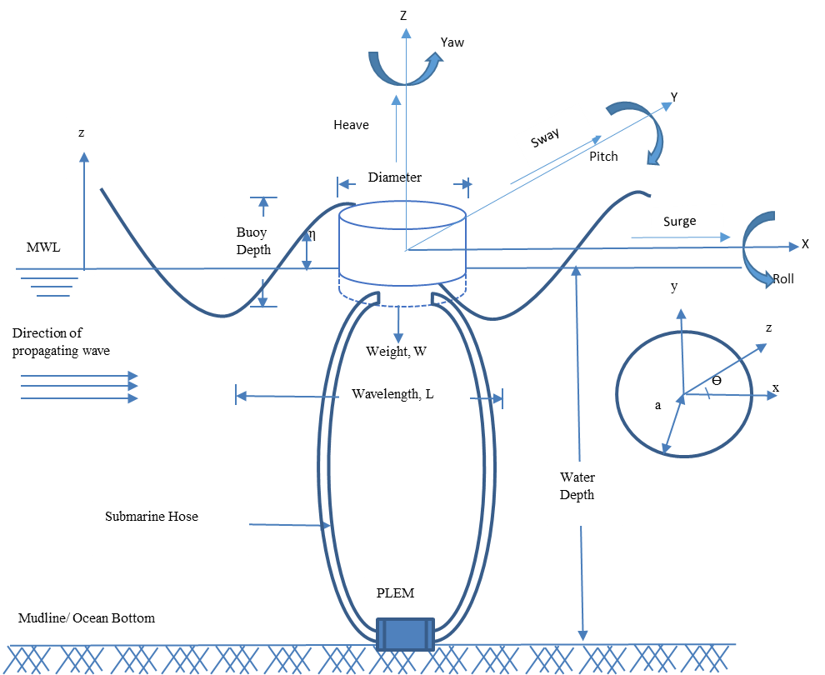
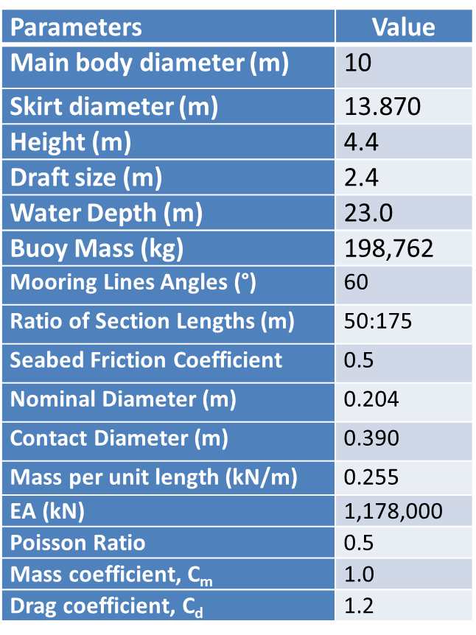
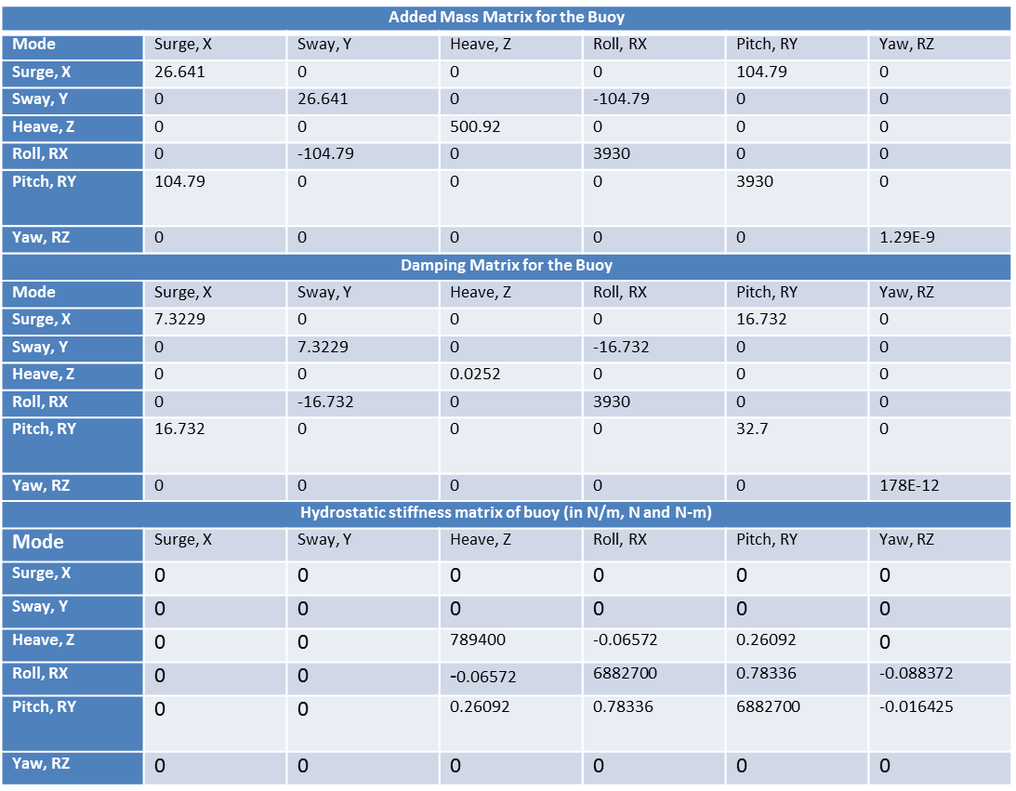
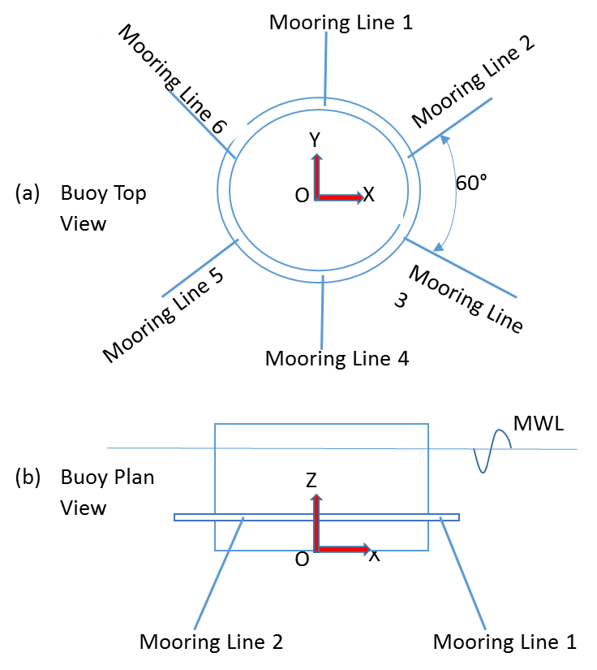
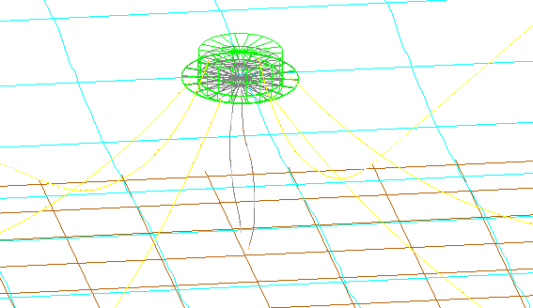
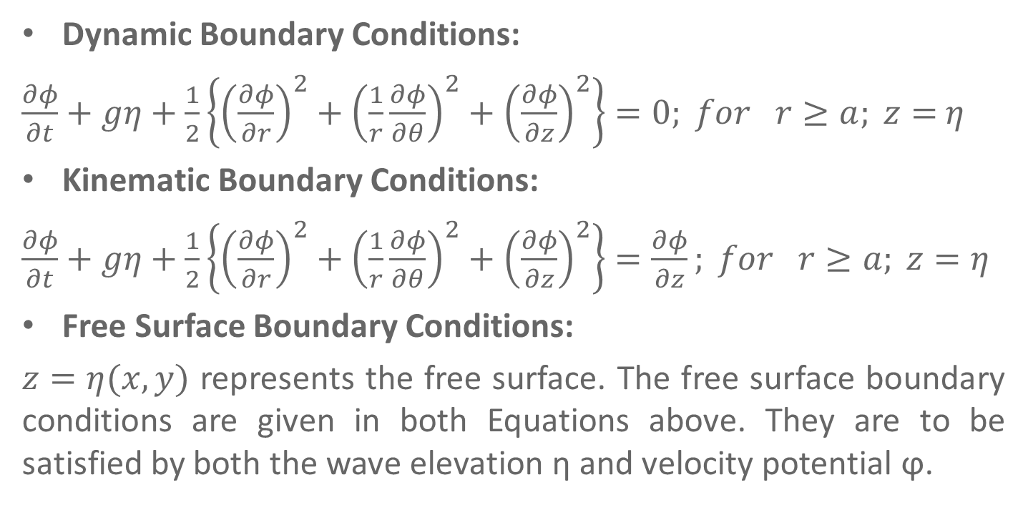
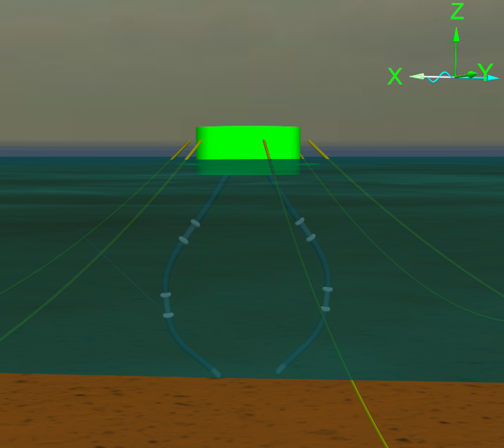
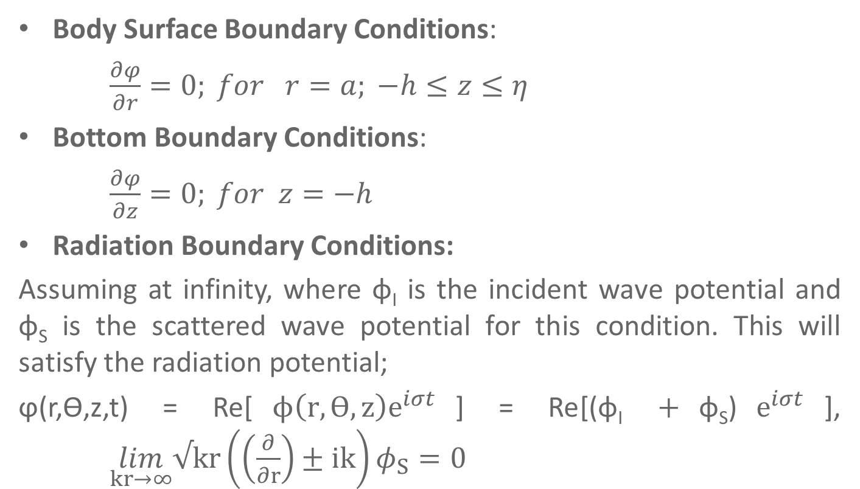
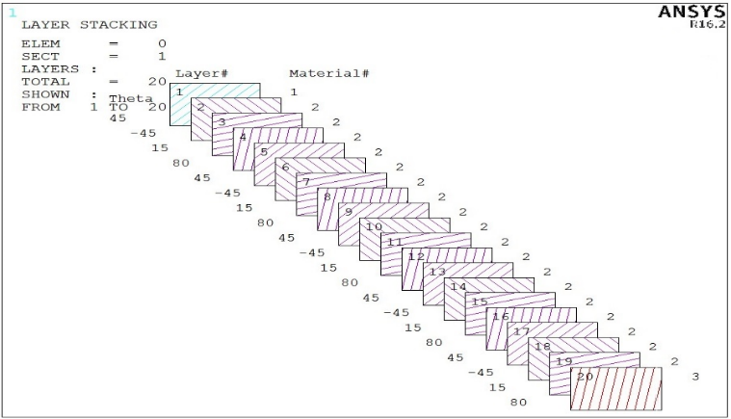
A Numerical Modeling Approach of Composite Riser Hoses
Amaechi Chiemela Victor
3rd Year PhD Student – Engineering Department
Supervisor: Prof. Jianqiao Ye
Email: c.amaechi@Lancaster.ac.uk
Introduction
Hydrodynamic strength analysis on Riser Hose
Composite material - a matrix and a reinforcement combination, which when combined gives properties superior to the properties of the individual components.
Risers are conduits to transfer materials from seafloor to production / drilling facilities atop the water's surface, & from facility to the seafloor.
The advantages of composite materials can be harnessed in the development of risers in deepwaters-Composite Risers.
Composite materials - have good corrosion resistance, light weight, etc.
Loads on a Composite Riser
Mean Water level
Hydrostatic stiffness, Added mass and Damping matrices
Wave forces
Vessel
Weight, (W_{r}) of Composite riser
Top Connection
Drilling Risers
Flexible Risers
Composite Risers
Pull tube Risers
Steel Catenary Risers
Top-tensioned Risers
Riser towers
Riser Systems
Current forces
Internal and external fluid pressure
Z
Buoyancy
Y
Bottom connection
X
Foundation casing
Application of Composite Riser
Boundary Conditions
Conclusion
Composite riser behave differently from Steel Risers, they were first deployed in deepwaters in 2002, and there are some challenges, e.g. lack of standards on Composite Risers. Composite materials offer a range of benefits that could improve riser technology. As regards the research, it is still on-going.
@ FST Christmas Poster Conference, 19th Dec. 2017.

