Slide 1


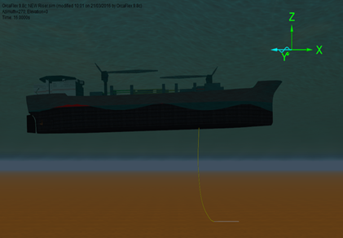
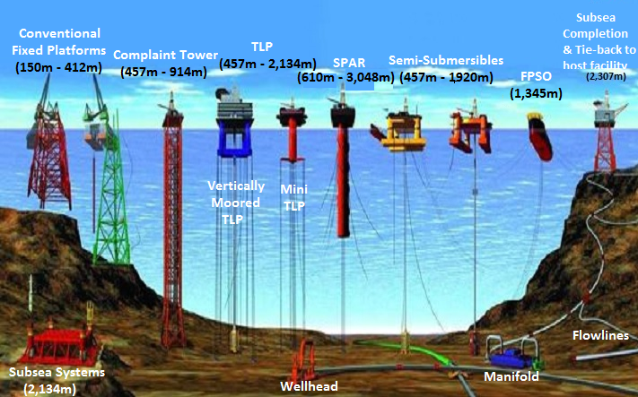
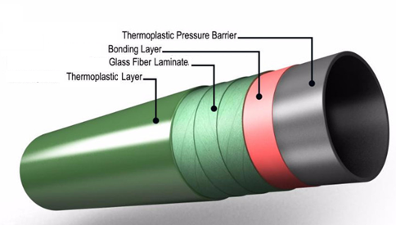
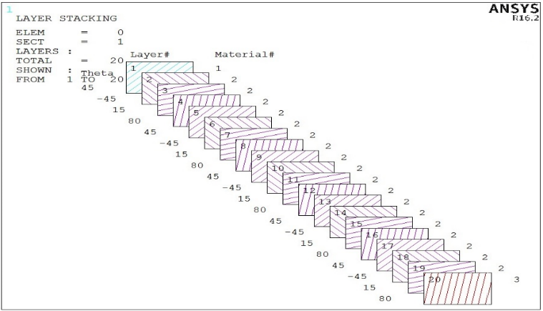
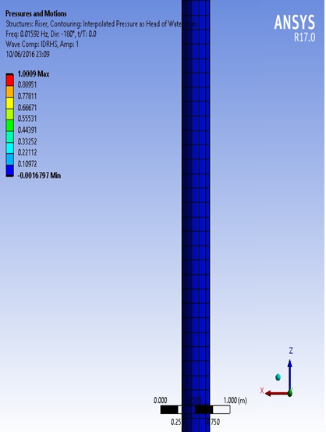
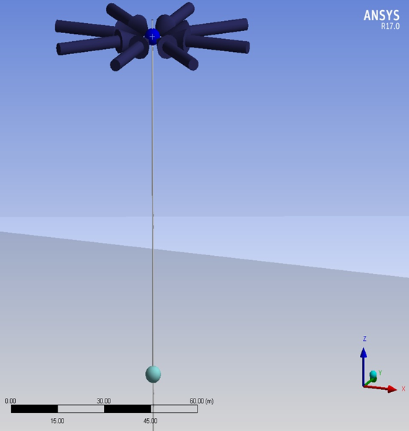
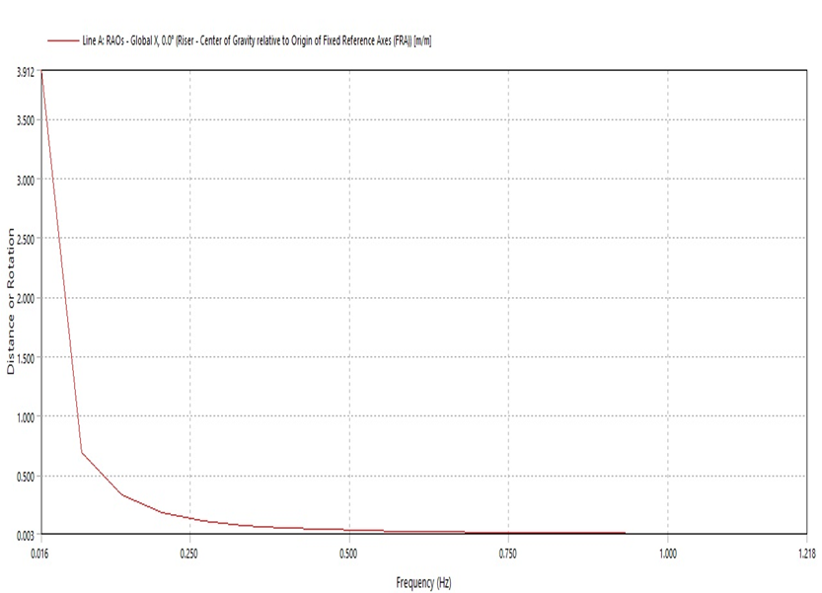
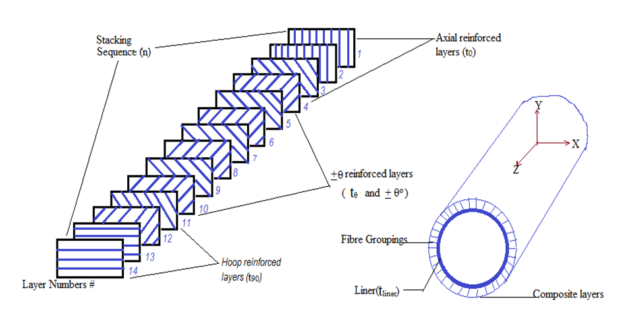
Characterization Behaviour of Novel Composite Deepwater Risers
Amaechi Chiemela Victor
2nd Year PhD Student – Engineering Department
Supervisor: Prof. Jianqiao Ye
Email: c.amaechi@Lancaster.ac.uk
Motivation
Riser Design using Orcaflex
Loads on Composite Riser
History on Offshore Deepwaters
Different types and sizes of pipes are used, like the drill pipes, risers and the horizontal pipes. The dimensions could be >= 30” (76cm) as they are large capacity pipelines.
Research works on composite risers stemmed from composite tubes, composite pires, steel pipes, and steel riser designs.
The earliest known oil wells were drilled in China in 347 AD or earlier. They had depths of up to about 800 feet (240 m); drilled using bits attached to bamboo poles.
The history of oil exploration dates to 1891 when the first oil well was drilled at Grand Lake St Mary’s, Ohio.
In 2003 in Gulf of Mexico, only 35% of production was from wells at depths of >300m. By 2015, it was 95%.
Current state of the art on composite riser is as an alternative to steel risers and not a replacement.
Composite Riser Technology can be fully deployed in Deep water regions- West Africa, Gulf of Mexico (GoM), North Sea, etc
Mean Water level
Wave forces
Vessel
Top Connection
Weight, (W_{r}) of Composite riser
Current forces
Internal and external fluid pressure
Z
Buoyancy
Y
Bottom connection
Why Choose Composite Risers?
X
Foundation casing
Drilling Risers
Flexible Risers
Composite Risers
Pull tube Risers
Steel Catenary Risers
Top-tensioned Risers
Riser towers
Riser Systems
Objectives
Composite Tube
Material Properties
Parametric of a Composite Riser Tube
To develop a model for composite risers,
To study the fatigue behaviour and characteristics of the riser and visualise the flow of oil/gas in pipes in deep sea,
To optimize the composite riser.
PROPERTY | Specific Gravity | Density (kg/m³) | Thermal conductivity (w/m-ºC) | Heat capacity (J/kg/ºC) | Poisson ratio V₁₂ | Young’s modulus (GPa)
Sea Water | 1.0 | 1,030 | 0.6 | 4,200 | 0.5 | 2.15
Steel | 7.8 | 7,850 | 50 | 480 | 0.30 | 200
Titanium | 4.43 | 4430 | 19 | 540 | 0.342 | 113.8
Aluminium | 2.78 | 2780 | 204.26 | 910 | 0.33 | 68.9
AS4-Epoxy | 1.53 | 1530 | ---- | ---- | 0.32 | ----
AS4-PEEK | 1.56 | 1561 | ---- | ---- | 0.28 | 66
P75/Epoxy | 1.78 | 1776 | ---- | ---- | 0.29 | ----
P75/PEEK | 1.77 | 1773 | ---- | ---- | 0.30 | 33
PEEK | 1.32 | 1300 | ---- | ---- | 0.40 | 5.15
Composite Riser | 1.68 | 1680 | 0.5 | 1,200 | 0.28 | ----
Composites Simulation of Riser Pipe
Hydrodynamic Loading
Composite material - a matrix and a reinforcement combination, which when combined gives properties superior to the properties of the individual components.
Risers are conduits to transfer materials from seafloor to production / drilling facilities atop the water's surface, & from facility to the seafloor.
The advantages of composite materials can be harnessed in the development of risers in deepwaters-Composite Risers.
Composite materials - have good corrosion resistance, light weight, etc.
References
Azar, J. (2006). Drilling Problems and Solutions. In R. F. Larry W. L., Petroleum Engineering Handbook; Volume II - Drilling Engineering (pp. 433-454). Texas:
Hatton, S., (2012). Carbon fibre- a riser system enabler: Offshore Engineer, p. 37,42-43.
Bai, Y., & Bai, Q. (2005). Subsea Pipelines and Risers; First Edition, 2013 Reprint;. Oxford, UK: Elsevier Ltd.
Sparks, C.P. (2007).Fundamentals of Marine Riser Mechanics. Pennwell, USA.
Fischer, F. J. (1995). Composite Production Risers for Deepwater Offshore Structures. Oil & Gas Science And Technology 50(1), 35
Conclusion
Composite riser behave differently from Steel Risers, they were first deployed in deepwaters in 2002, and there are some challenges, e.g. lack of standards on Composite Risers. Composite materials offer a range of benefits that could improve riser technology. As regards the research, it is still on-going.
Acknowledgment
I wish to acknowledge the support of my Supervisor Prof. Jianqiao Ye.
Also thanks to the staff and members of the Engineering Department.
Special thanks to Charles Odijie, Yakubu Tsado and Adeayo Sotayo.
@ FST Christmas Poster Conference, 20th Dec. 2016.

