Slide 1




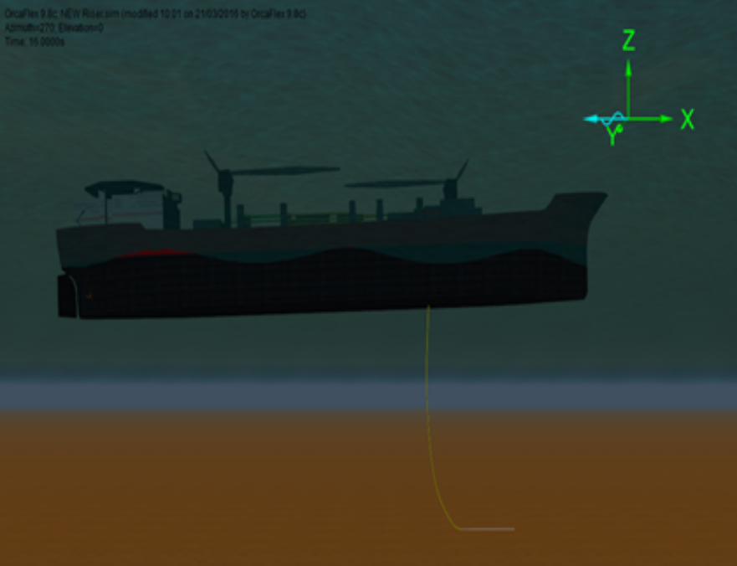
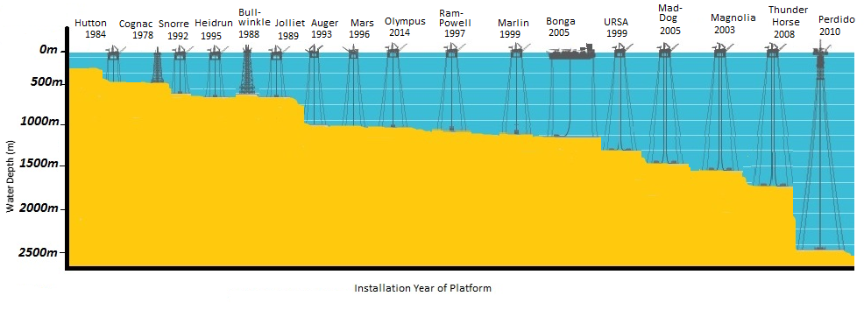
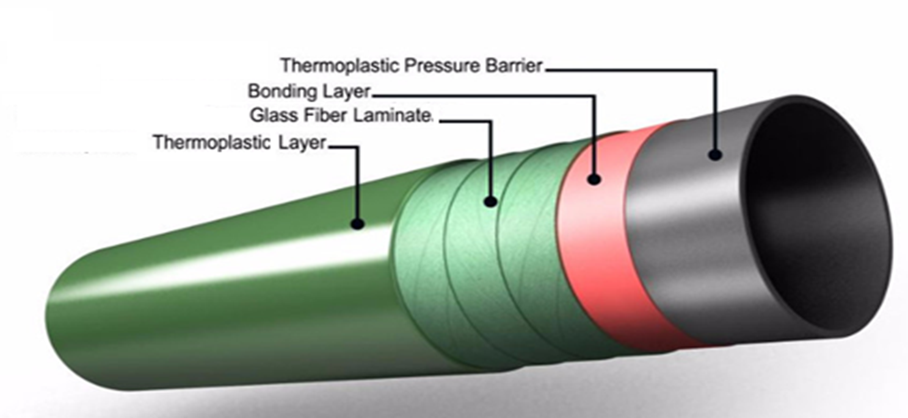
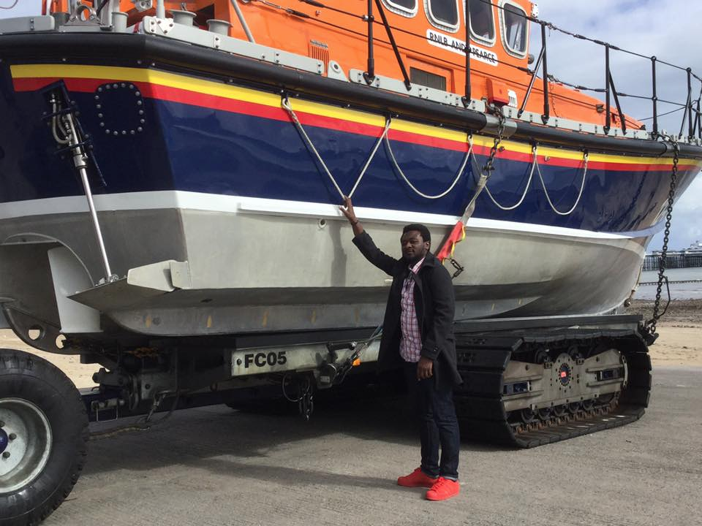
Composite risers – an offshore deepwater solution
Amaechi Chiemela Victor
Oil and Gas Industry
Offshore
Mainstream
Onshore
Flexible Risers
Mooring lines
Risers
Rigid Risers
Platforms
Pipelines, etc.
Hybrid Risers
Composite Risers
Mean Water level
Wave forces
Vessel
Top Connection
Weight, (W_{r}) of Composite riser
Current forces
Internal and external fluid pressure
Buoyancy
Z
Bottom connection
Y
X
Foundation casing

