Slide 1
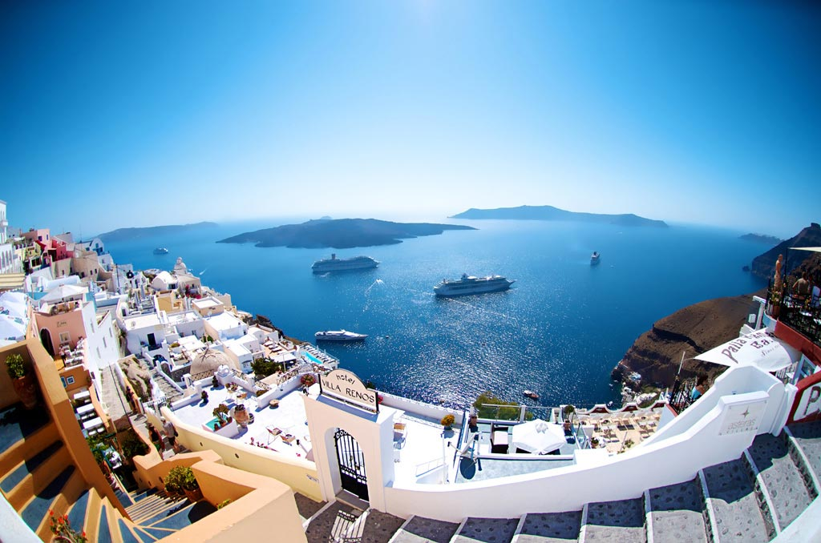
Simulation of passenger flows at a constrained cruise port:
Evidence from the island of Santorini
Michail Karpathiou, Fotios Katsigiannis
Lancaster University Management School
Department of Management Science
{m.karpathiou, f.katsigiannis}[at]lancaster.ac.uk

Slide 2
Agenda.
1. Problem definition
2. Motivation and objectives
3. Participating stakeholders
4. Conceptual model
5. Model overview
6. Model validation
7. Experimentation
8. Analysis and discussion
9. Future work

Slide 3
1. Problem definition – overview (1/4).
Mediterranean is the second market in the world (Cruise Lines International Association, 2018)
Market traffic demonstrates a robust growth (Porteconomics, 2016)
Cruise tourism has a big sustainability impact in small islands (Brida and Zapata, 2009; Brida et al. 2014)
Santorini is a small Greek island (76.19 km²) with rocky terrain and limited port infrastructure (no berth in the cruise terminal)

Slide 4
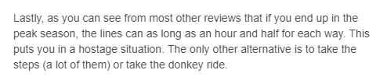


1. Problem definition – public testimonials (2/4).
Source: Tripadvisor, (Various Dates); Cruisecritic (Various Dates)

Slide 5
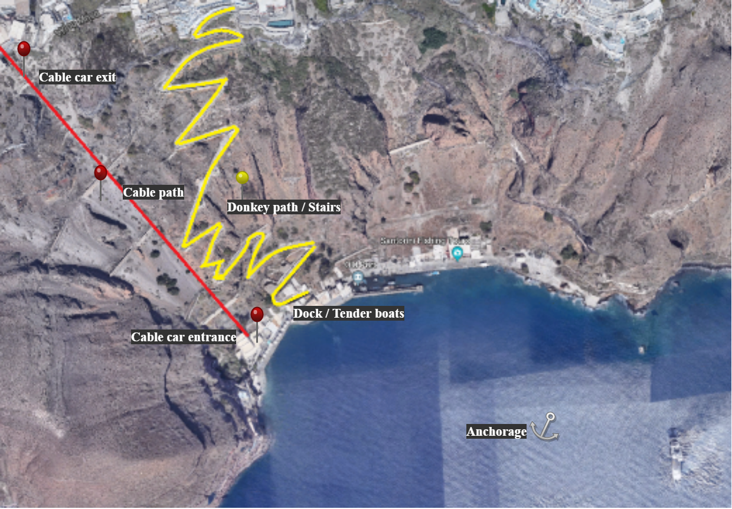
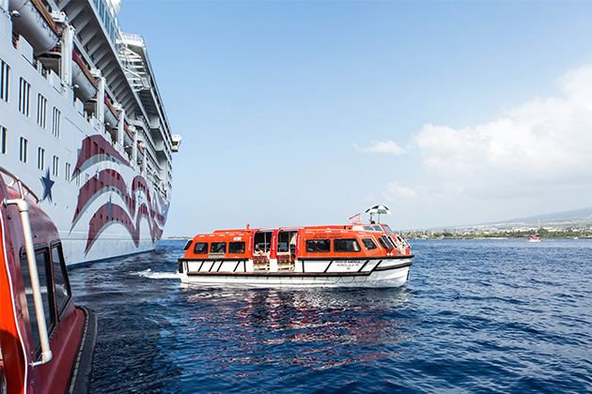
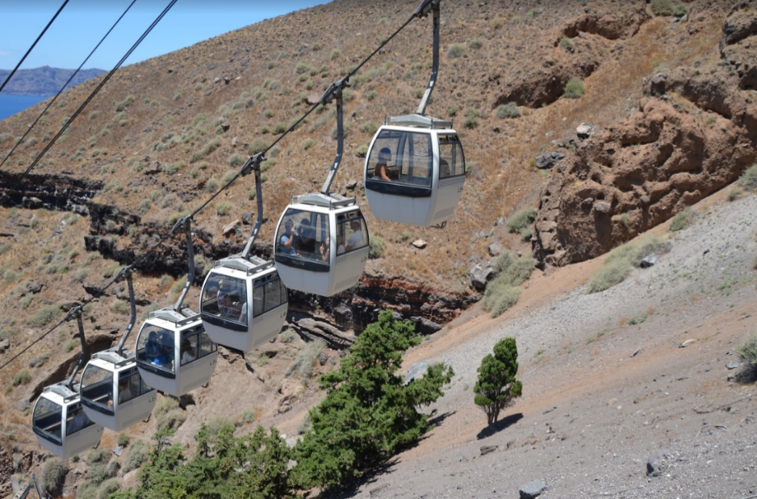
1. Problem definition – the port (3/4).

Slide 6
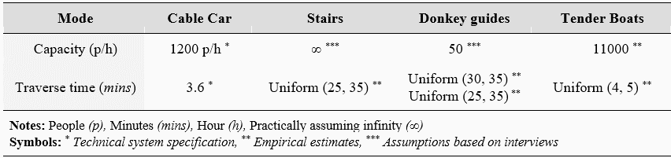
Problem definition –data (4/4).
Table 1: Model parameters
Source: Karpathiou and Katsigiannis (2018), Port authority officers (2018)

Slide 7
2. Motivation and objectives.
Justify an investment extending the existing cable system in order to relieve the existing bottleneck and mitigate the number of waiting passengers during the most congested days.
Propose ways for improving current passenger infrastructure in the port.
Analyse the impact of the potential enhancements on landside transport facilities to the reduction of the passenger queuing time at the port and the total system profitability.
Populate a model with data for a system having no historical observations
A similar model described by Dragović et. al (2014) provides decision aid on the expansion of Kotor harbour

Slide 8
3. Stakeholders.
Income
Island Authorities
Cruise Lines
Infrastructure
(dis)utility
Clientele
Services
Income
Services
Taxes
Taxes
(i)
Passengers
Facilities/ Services
Residents
Income
(i) : attractiveness of destination and passengers’ satisfaction
Source: Karpathiou and Katsigiannis (2018)

Slide 9
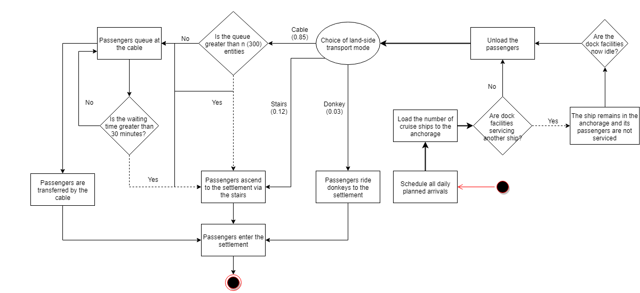
4. Conceptual model.
Observe: balking and reneging behaviors
Source: Karpathiou and Katsigiannis (2018)

Slide 10
5. Model Overview – assumptions (1/4).
The passengers of each ship remain in queue while the passengers of previous vessels are being transferred to the settlement
We do not consider the transfer time from the cruise ship to the dock as the tender boats act like a common denominator for all vessels calling at the port
Route selection probabilities are deterministic and are empirically defined
The preferences of passengers regarding waiting time were sourced from various online sources (e.g. tripadvisor.com)
Source: Karpathiou and Katsigiannis (2018)

Slide 11
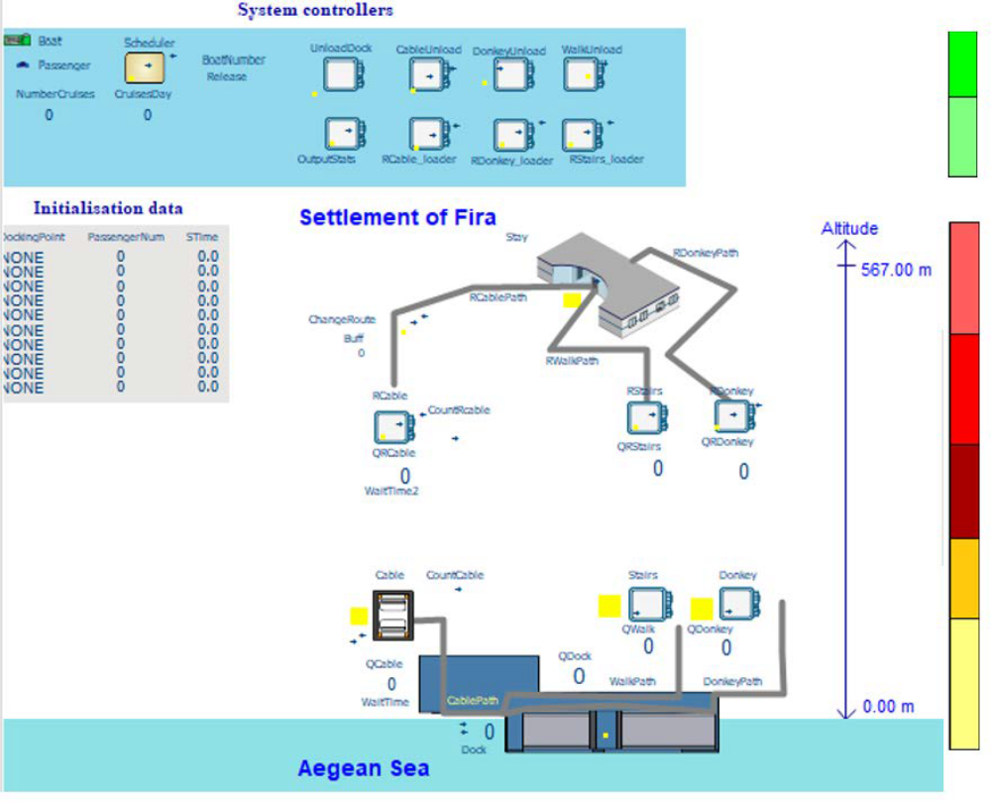
5. Model Overview – basic components (2/4).
Discrete Event Simulation
Terminating model
Witness Software
Parts:
Passengers, Boats
Machines:
Cable Car, Donkeys, Stairs
Paths:
Stay within the settlement, traverse time from port to cable and path
Source: Karpathiou and Katsigiannis (2018)

Slide 12
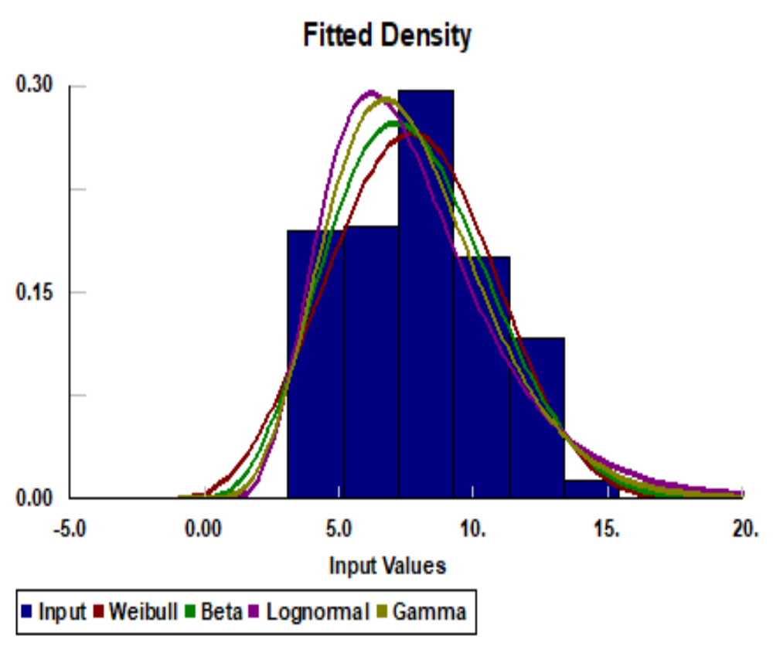
5. Model Overview – data (3/4).
Best distribution fitting attempts for vessel arrival rates:
Data obtained from Crew Center (2018) for 2017 and 2018 include the scheduled cruise port calls and departure times that each ship is expected to make for the months of March till November.
Enriched the data set in [1] with estimates regarding the ship capacity.
The distribution fitting process did not result in any statistically significant results
Source: Karpathiou and Katsigiannis (2018)

Slide 13
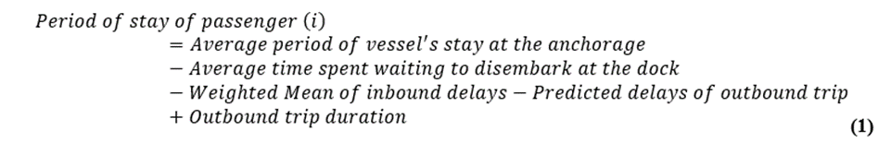
5. Model Overview – queuing time as a constraint (3/4).
The stay of the cruise ships in the anchorage varies from 8.7 to 9.04 hours, the time that the passengers spend in the settlement is calculated via the following expression*:
Logical definition of period of stay → constrained by delays and estimates on outbound delays
*This expression is modified according to the specificities of each route (traverse time, capacity and modelling approach)

Slide 14
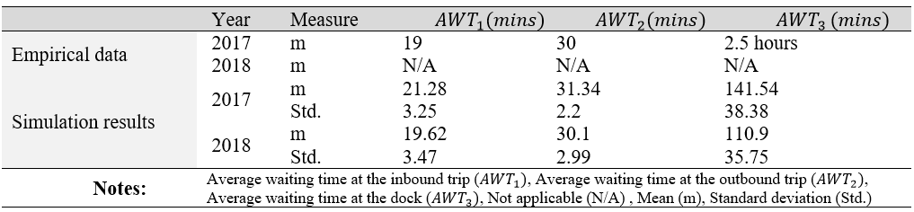
6. Model Validation.
During the information sourcing process, we identified that the crucial problems of the port are:
    The mean waiting times at the queues both at the inbound and outbound trips (Objective 1); and
    The spilled demand caused by passengers who change their preference due to large cable queues (Objective 2).
Table 2: Empirical waiting times and model output based on the most congested days (7) per year
Source: Karpathiou and Katsigiannis (2018)

Slide 15
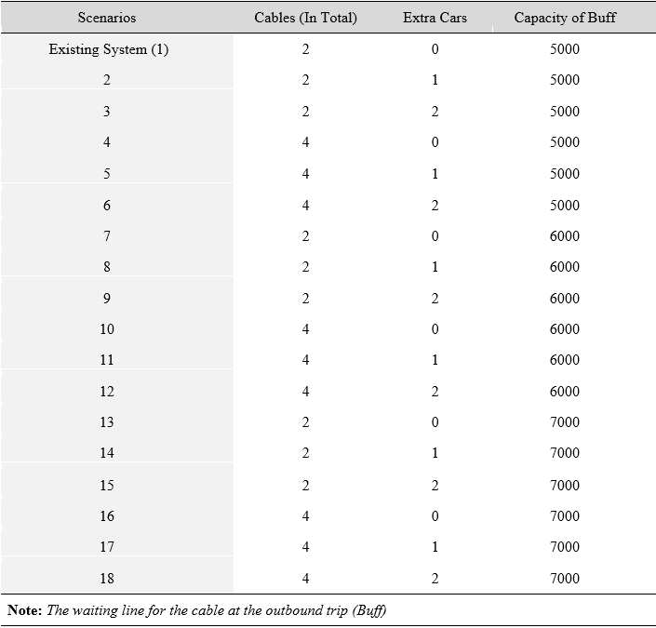
7. Experimentation – Experiments (1/3).
Table 3: Scenario design
What-if scenarios examining different capacity expansion alternatives and combinations
Each scenario is applied to the 7 most congested days of each year
Source: Karpathiou and Katsigiannis (2018)

Slide 16
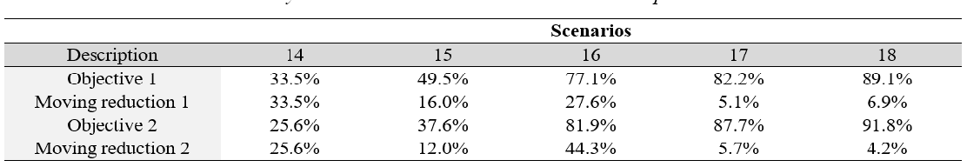
7. Experimentation – Experiment analysis (2/3).
Table 4: Relative percentage improvement to the existing system (Objective 1, 2) and between the scenarios ( Moving reduction 1,2)
Notes: Objective 1: Mean waiting times, Objective 2: Average spilled demand

Slide 17
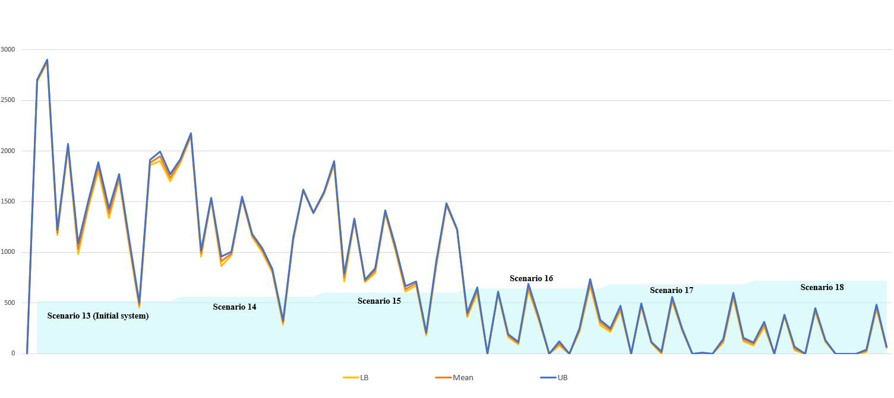
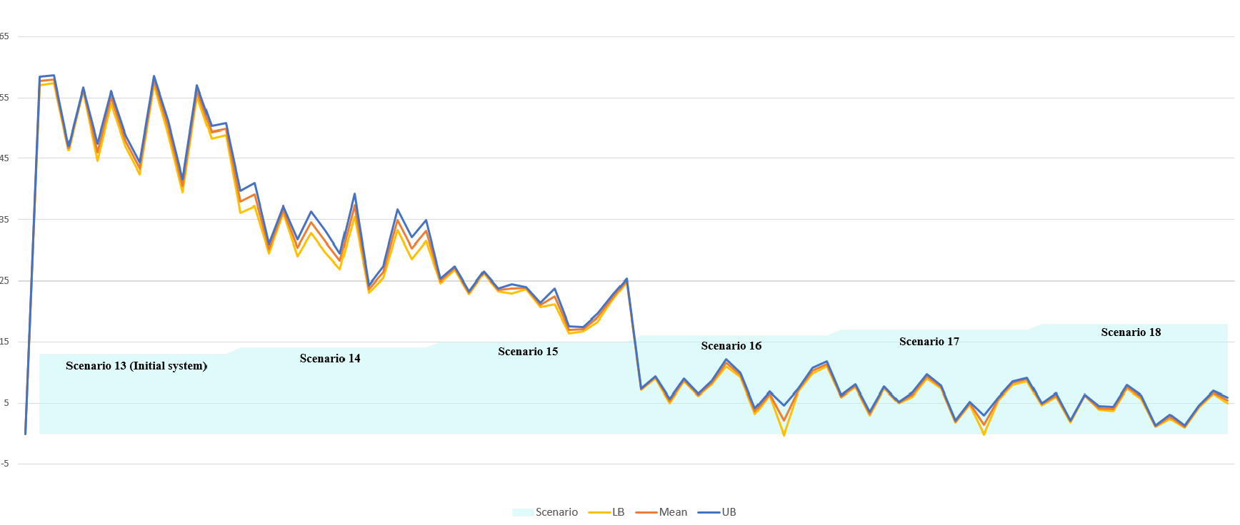
7. Experimentation – Experiment analysis (3/3).
Average Spilled Demand and 99% CI
Mean Waiting Times at Queues and 99% CI
8.232.5€ *
8810.4€ *
9231.9€ *
2572.6€ *
3780.8€ *
Source: Karpathiou and Katsigiannis (2018)
*savings in comparison to the existing system

Slide 18
8. Conclusions – future work.
The added value of this work stems from its originality towards the problem nature, as it populates the focal system with data which can be used later for quantitative comparisons;
The model can be used to simulate increased cruise ship arrivals and provide what-if scenarios on in-settlement congestion and further capacity enhancement scenarios;
The proposed methodology may be used for improving similar problematic situations in ports with analogous traffic behaviour;
Obtain observations on days with similar congestion to the ones that we tackled and then re-validate the proposed model; and
Model individual walking behaviours (Daamen, 2004) and passenger preferences based on passenger demographics.

Slide 19



Slide 20
References (1/2).
Bellos, I., 2018. Santorini authorities rationing cruise passenger visits to island [WWW Document]. Kathimerini. URL http://www.ekathimerini.com/224901/article/ekathimerini/business/santorini-authorities-rationing-cruise-passenger-visits-to-island
Brida, J.G., Chiappa, G.D., Meleddu, M., Pulina, M., 2014. A Comparison of Residents’ Perceptions in Two Cruise Ports in the Mediterranean Sea. Int. J. Tourism Res. 16, 180–190. https://doi.org/10.1002/jtr.1915
Brida, J.G., Zapata, S., 2009. Cruise tourism: economic, socio-cultural and environmental impacts. International Journal of Leisure and Tourism Marketing 1, 205–226. https://doi.org/10.1504/IJLTM.2010.029585
Crew center [WWW Document], n.d. . Cruise port schedules. URL http://crew-center.com/cruise-ships-port-schedules-2018
Cruise Lines International Association, 2017. Cruise Industry outlook.

Slide 21
References (2/2).
Daamen, W., 2004. Modelling passenger flows in public transport facilities.
Dragović, B., Škurić, M., Kofjač, D., 2014. A proposed simulation-based operational policy for cruise ships in the port of Kotor. Maritime Policy & Management 41, 560–588. https://doi.org/10.1080/03088839.2013.865850
Karpathiou, M., Katsigiannis, F., 2018. Simulation of passenger flows at a constrained cruise port: Evidence from the island of Santorini (Project). Lancaster University Management School.
Port authority officers, 2018. Unofficial Interview and Discussion.
Porteconomics, 2016. Mediterranean cruise ports: traffic growth continues.
Various, 2003-2015. Empirical estimates on service times. Cruisecritic.
Various, 2007-2018. Tripadvisor [WWW Document]. Fira cable car reviews. URL http://www.ekathimerini.com/224901/article/ekathimerini/business/santorini-authorities-rationing-cruise-passenger-visits-to-island (accessed 4.7.18).

Slide 22
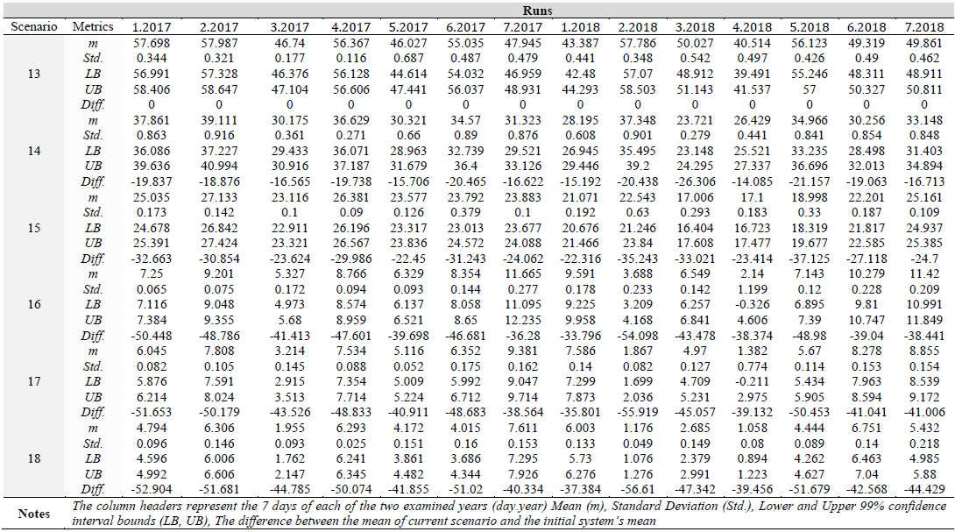
Appendix.
Table A1: Scenario metrics on AWT
Existing System

Slide 23
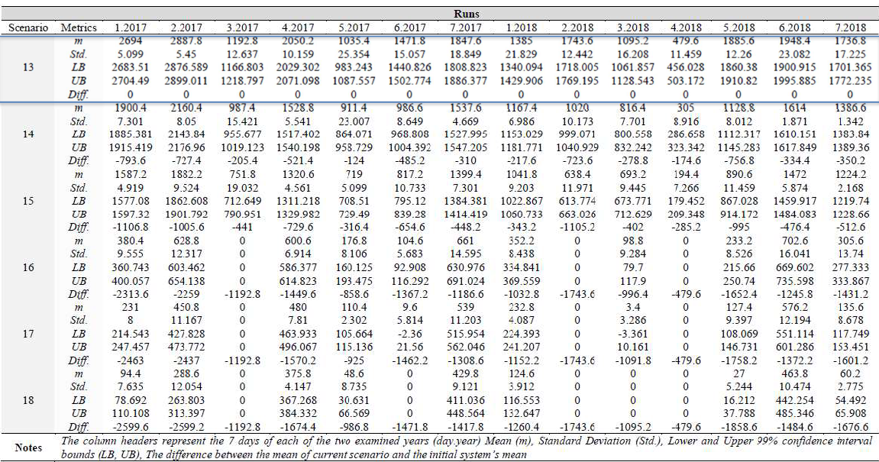
Appendix.
Table A2: Scenario metrics on spilled demand objective

Slide 24
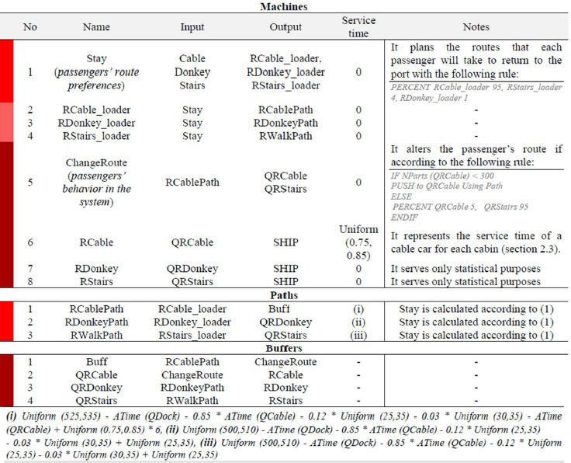
Appendix.
Table A3: Modelling components of the outbound phase

