Slide 1


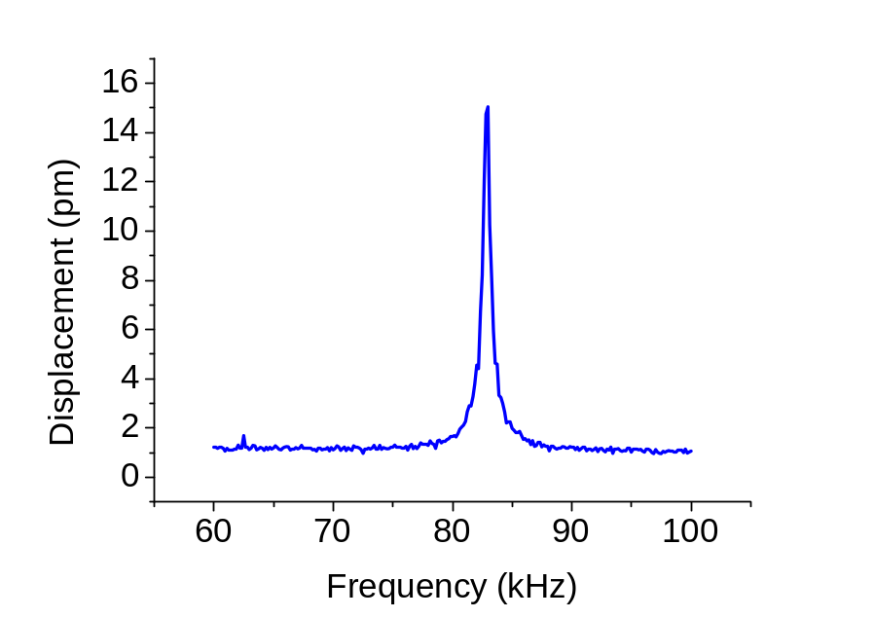
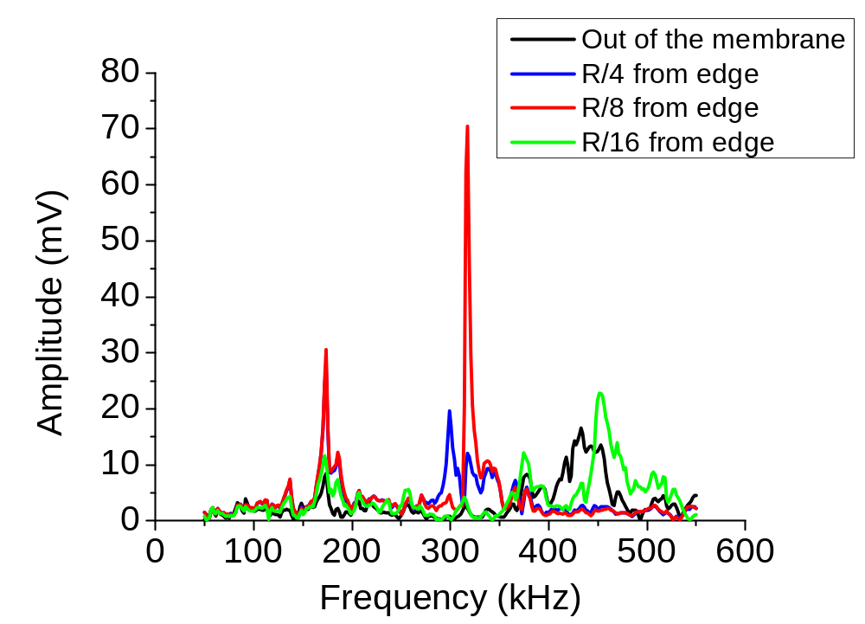
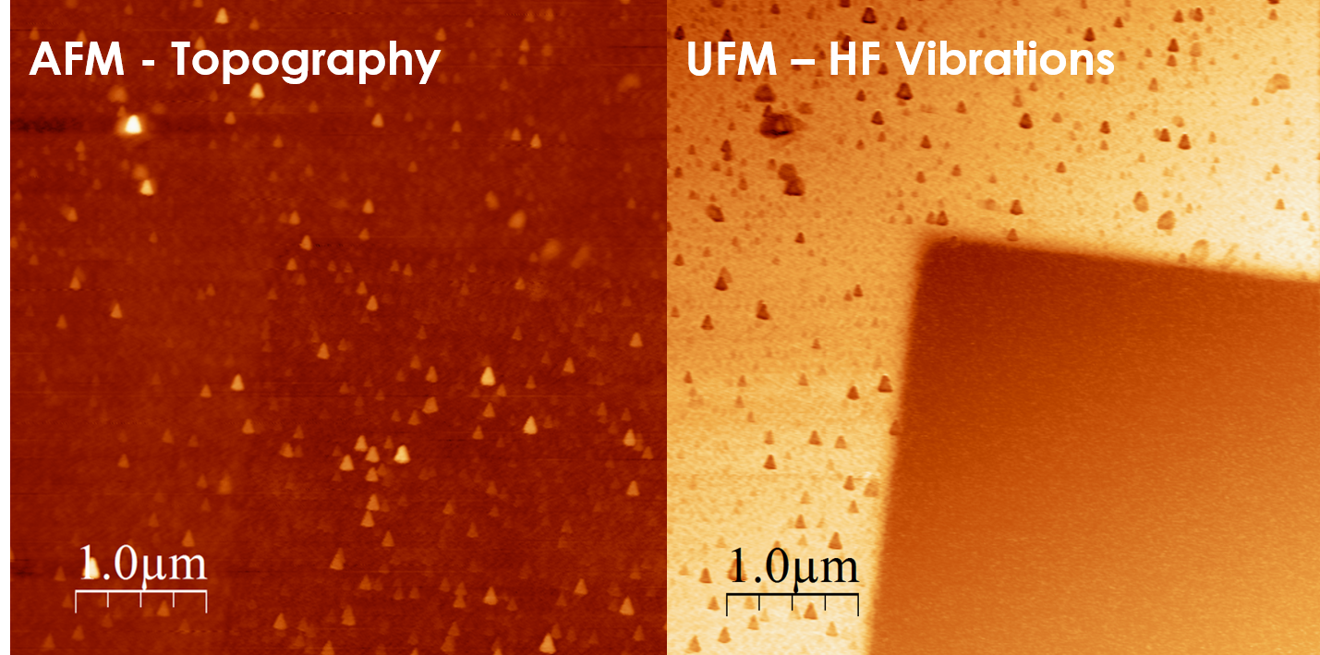
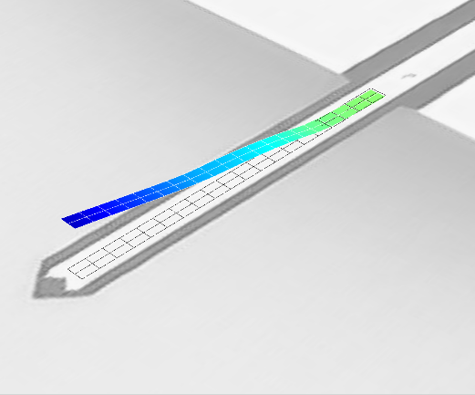
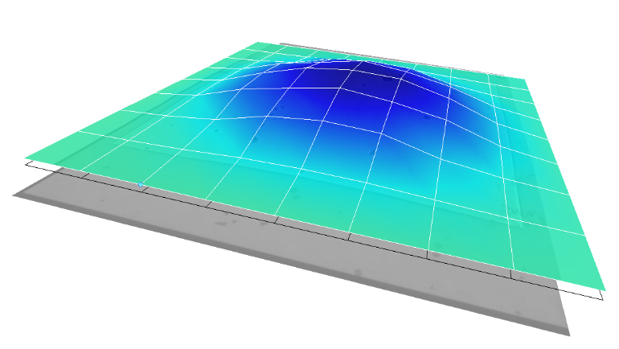
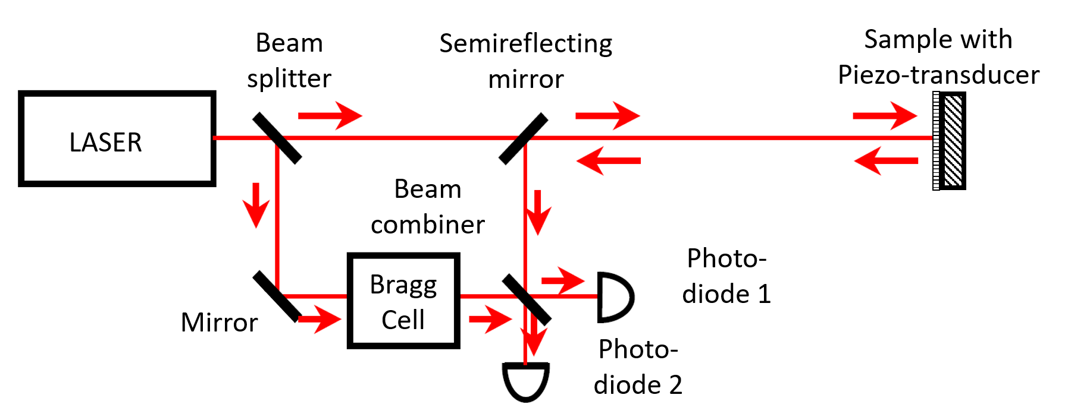
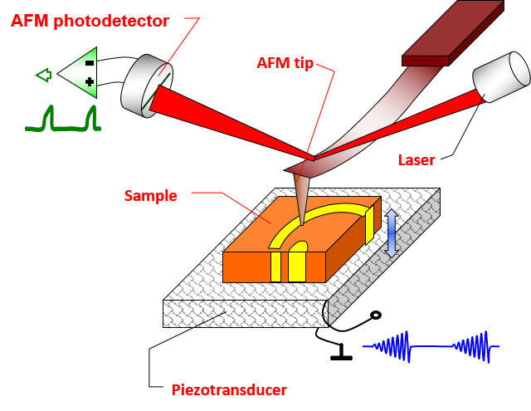
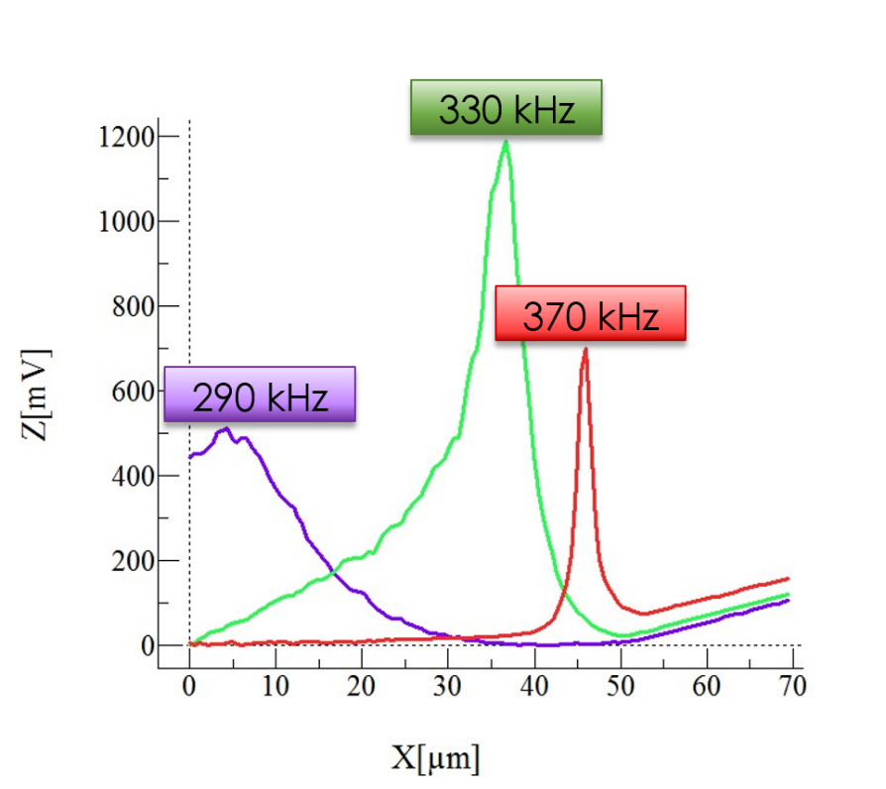
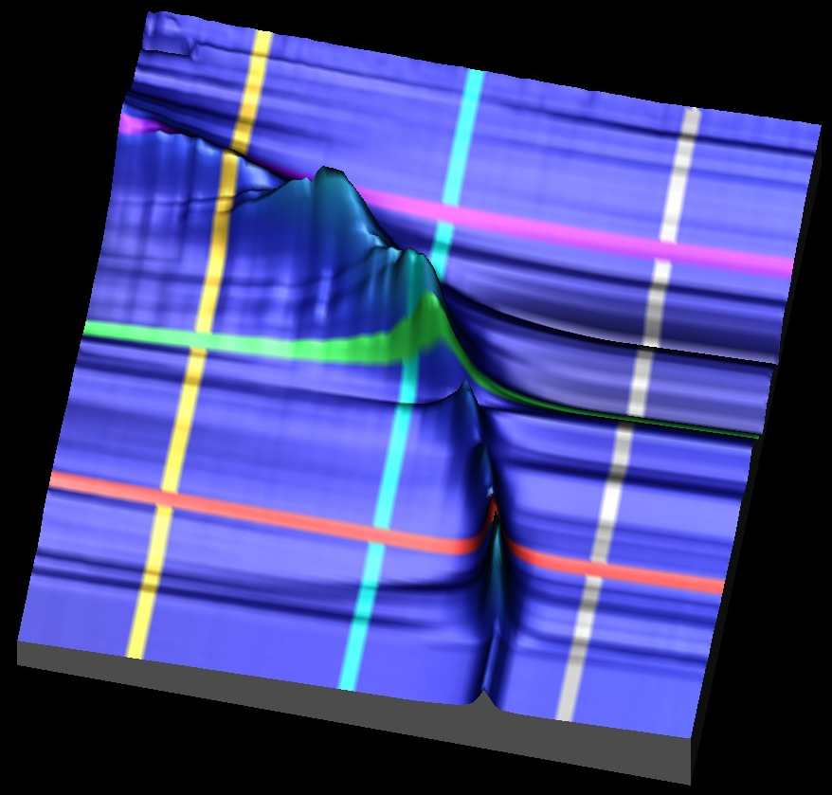
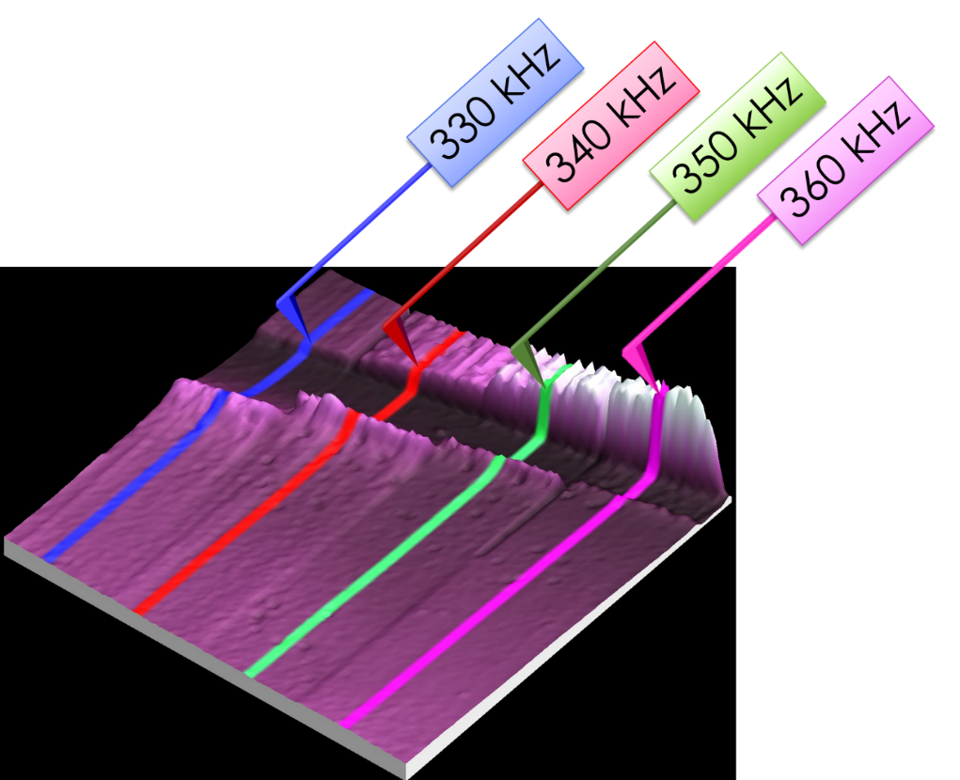
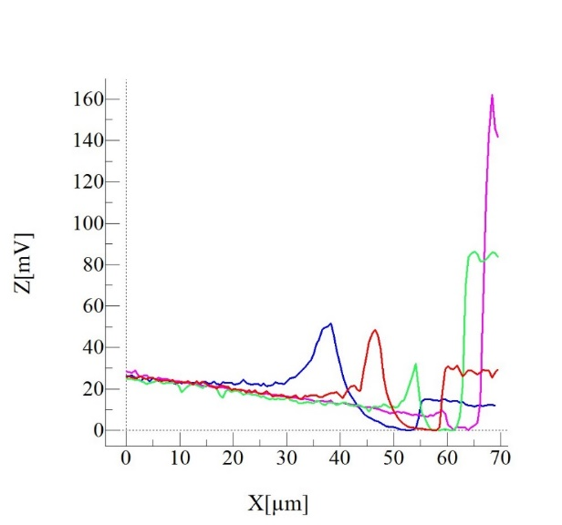
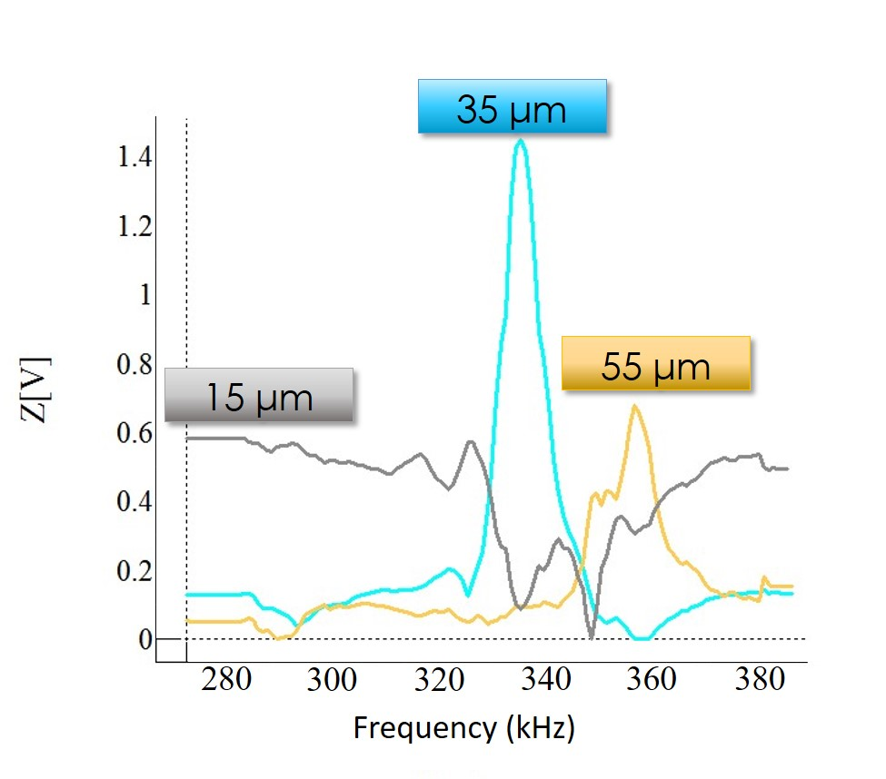


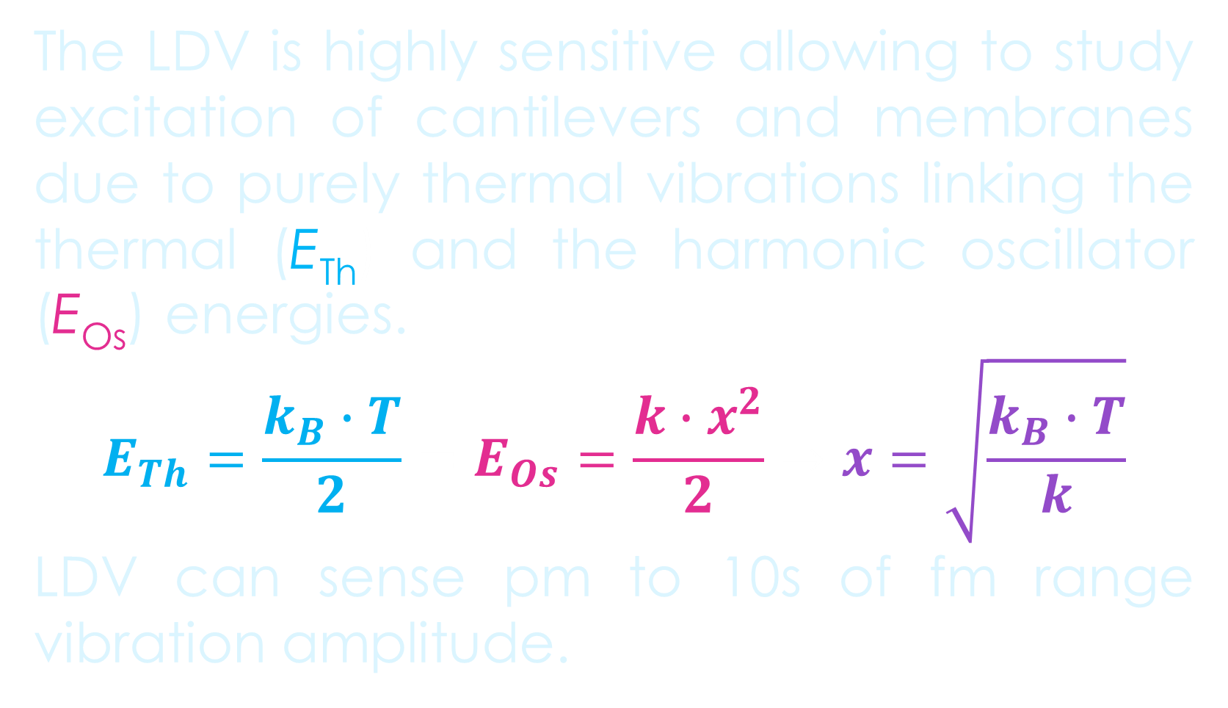
Mapping vibrational modes of Si₃N₄ membrane - Ultrasonic Force Microscopies vs Laser Doppler Vibrometry
The development of new micro and nano-electromechanical systems (MEMS and NEMS), requires matching characterization techniques enabling nanoscale spatial resolution coupled with the frequency response up to GHz range. While optical methods, such as interferometry and Laser Doppler Vibrometry (LDV), can map dynamic behavior of MEMS and NEMS based on suspended membranes at high frequencies, their spatial resolution linked to light wavelength limits it the micrometre length scale.
Here we show that ultrasonic SPM techniques that can easily achieve nm length scale spatial resolution, can be used to explore the high frequency vibrations of nanoscale thin MEMS membranes. Using both linear and nonlinear mechanisms for the excitation and detection of such vibrations the detected frequencies can be extended from kHz to GHz range.
Probing MEMS with Laser Doppler Vibrometry (LDV)
SPM detection of vibrations with nm spatial resolution
In SPM we excite a HF vibration of the NEMS device via piezo- or electrical drive, and then probe them with a cantilever tip in nm point contact with sample, identifying the resonance frequencies of membrane + cantilever system. The ultrasonic vibration can be detected via Force Modulation Microscopy (FMM) linearly (above)[1]
The LDV is highly sensitive allowing to study excitation of cantilevers and membranes due to purely thermal vibrations linking the thermal (E_{Th}) and the harmonic oscillator (E_{Os}) energies.
$$E_{Th}=\frac{k_{B}∙T}{2}=E_{Os}=\frac{k∙x^{2}}{2}→x=\sqrt{\frac{k_{B}∙T}{k}}$$
LDV can sense pm to 10s of fm range vibration amplitude.
…or nonlinearly – using Ultrasonic Force Microscopy (UFM) principle. UFM uses “mechanical diode” principle of rectifying high frequency vibrations to easily detectable cantilever displacement [2]. UFM can detect subsurface features, like the edge of a tensioned SiN_{x} membrane (right), not seen in AFM topography (left).
16.02 nm
Three modes of detecting vibrations in AFM
31.93 nm
1. FMM
2. UFM
3. M-UFM
The ultra-high frequency (UHF) LDV coupled with the piezo-excitation of vibrations maps the spatial distribution of the oscillation modes in the NEMS devices.
$$a_{s}cos\left(ω_{s}t\right)$$
$$a_{s}cos\left(ω_{s}t\right)+a_{t}cos\left(ω_{t}t\right)$$
Marta San Juan Mucientes and Oleg Kolosov
Physics Department, Lancaster University, LA1 4YB, UK
m.sanjuanmucientes@Lancaster.ac.uk
$$a_{s}^{2}\frac{1}{2}\left[1+\cos\left(2ω_{s}t\right)\right]{+a_{t}^{2}\frac{1}{2}\left[1+\cos\left(2ω_{t}t\right)\right]}{− a}_{s}a_{t}\left[cos\left(\left(ω_{s}−ω_{s}\right)t\right)+cos\left(\left(ω_{s}+ω_{s}\right)t\right)\right]$$
FMM detects vibrations directly localizing the resonance peak
UFM images show the membrane edge, but not the vibration modes.
Modulation UFM (M-UFM) allows to study the special distribution of the vibrational modes as well as subsurface structure of the sample.
SPM with ultrasonic excitation
Probing the frequency response of nano-membrane
CONCLUSIONS:
SPMs and LDV allow measuring the vibration of sub-nm MEMS amplitudes , with um (LDV) and nm (SPM) lateral resolution.
The SPM measurements of vibrations are in a good correlation with LDV data.
The optimal SPM tip position for the observation of vibrational modes is not in membrane center, but close to its edge.
SPM can use the detection of vibrations excited by MEMS/NEMS support
  FMM – direct excitation and detection
  UFM – nonlinear vibrations “rectification”
  or excited by the membrane tip - M-UFM
FMM directly probes vibrational modes of membrane + cantilever system excited as a whole. The mode amplitude and frequency depends on the position of the tip and the excitation frequency.
M-UFM measurements excite the vibration locally at the tip point, show how the distribution of the vibrational modes along the membrane depend of the excitation frequency.
FMM Profiles
M-UFM Profiles
References:
[1] M.T. Cuberes et al., Journal of Physics D-Applied Physics, 33 (2000) 2347-2355.
[2] O. Kolosov, et al., NSTI-Nanotech 2012, CRC PRESS-TAYLOR & FRANCIS GROUP, Santa Clara, USA, 2012, pp. 282-285.
Acknowledgements:
Lancaster University.

