Slide 1


GOOD CITIZENS OR DEVIOUSLY COUNTERPRODUCTIVE? A META-ANALYSIS OF EMOTIONAL INTELLIGENCE
Chao Miao, Wilkes University, chao.miao@wilkes.edu
Ronald H. Humphrey, Lancaster University, UK r.humphrey@lancaster.ac.uk
Shanshan Qian, Towson University
sqian@towson.edu

Slide 2

Organizational Citizenship Behavior (OCB)
Helping others out, volunteering
Discretionary—don’t have to do it

Slide 3
New emphasis on EI related behaviors
Organ (1988, p. 4)
Organ (1997, p. 95)
“OCB represents individual behavior that is discretionary, not directly or explicitly recognized by the formal reward system, and in the aggregate promotes the efficient and effective functioning of the organization.”
stated that OCB is “performance that supports the social and psychological environment in which task performance takes place.”

Slide 4

Discussion: What organizational citizenship behaviors have you witnessed at work?
Also, how does organizational citizenship behavior contribute to workplace performance?

Slide 5
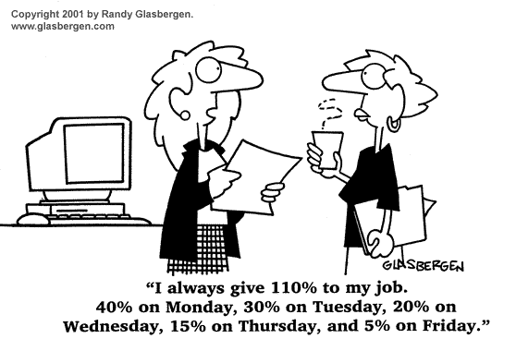
OCB and Performance
A meta-analysis has provided compelling evidence that OCB improves both organizational and individual outcomes (Podsakoff, Whiting, Podsakoff, & Blume, 2009). With regard to organizational performance, OCB improves productivity, efficiency, customer satisfaction, and reduces costs and unit-level turnover.

Slide 6
Performing citizenship behaviors aids employees in obtaining rewards and higher performance evaluations, and reduces their turnover intentions, actual turnover, and absenteeism. With regard to task performance the meta-analysis found a substantial relationship between task performance and citizenship behavior directed towards individuals (corrected correlation of .47) and towards the organization (corrected correlation of .54).

Slide 7
Counterproductive Work Behavior (CWB) also has important effects on organizations.
As defined by Spector and Fox (2002, p. 271), “CWB is behavior intended to hurt the organization or other members of the organization.” CWB may consist of a variety of different counterproductive behaviors, including physical or verbal aggression against other organizational members, sabotage of equipment or physical facilities, theft, and purposely doing work poorly or slowly (Bennett & Robinson, 2000).
Discussion: What counterproductive behaviors have you witnessed?

Slide 8
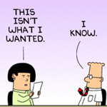
Discussion
What counterproductive behaviors have you witnessed?

Slide 9
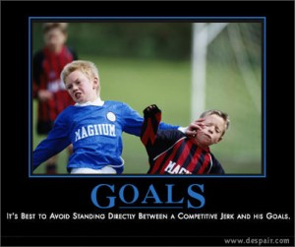

Slide 10


Slide 11
Two Main Purposes
It is essential to understand whether EI is positively associated with the performance of OCB, and negatively related to CWB, and the overall size of these relationships.
It is vital to know the relative importance of EI as a predictor when examining other personality traits, such as the Big Five, general self-efficacy, and cognitive intelligence.

Slide 12

EI and Empathy
EI scholars also posit that empathy is key to EI and include empathy subscales in their EI measures. Goleman and his colleagues avow that empathy is “the fundamental competence of social awareness” and “the sine qua non of all social effectiveness in working life” (Goleman, Boyatzis, & McKee, 2002: 50).

Slide 13
EI, Empathy, and Prosocial behavior
Borman and his colleagues (Borman, Penner, Allen, & Motowidlo, 2001) tested dispositional predictors of OCB, including measures of the Big Five, and they found that other-oriented empathy had the highest zero-order correlation with OCB. A considerable body of research has examined empathy’s effects on prosocial behavior, testing what has become called the empathy-altruism hypothesis (Batson, Eklund, Chermok, Hoyt, & Ortiz 2007). The empathy-altruism hypthesis has been confirmed by meta-analytic summaries of the research using both surveys and lab studies (Eisenberg & Miller, 1987). Studies have shown that EI scales predict empathy (Kellett, Humphrey, & Sleeth, 2002; 2006).

Slide 14

EI improves effective helping
EI may also increase OCB because it improves the quality and effectiveness of helping behaviors. Kolb and Boyatzis (1970) classified helpers into 3 categories: effective helpers, ineffective helpers, and nonhelpers. People high on EI might be both more motivated to help and have greater ability to do so because of their keen understanding of human nature.

Slide 15
EI reduces counterproductive work behaviors
EI may reduce CWB in particular because it helps employees cope with the negative feelings and frustrations that normal work problems often create. Regulation of emotions, both with regard to oneself and others, is a key part of EI. As the stressor–emotion model of CWB (Spector & Fox, 2002) depicts, these negative emotions are a key cause of CWB. People high on EI should be able to handle typical problems without undue negative emotions, in contrast, employees low on EI may not be able to handle the stress and act out in counterproductive ways as a result.

Slide 16
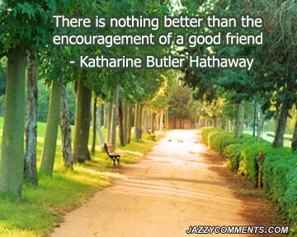

Slide 17
The Big Five Model of Personality
Neuroticism—Emotional Stability
Extraverts—Introverts
Openness
Agreeableness
Conscientiousness

Slide 18
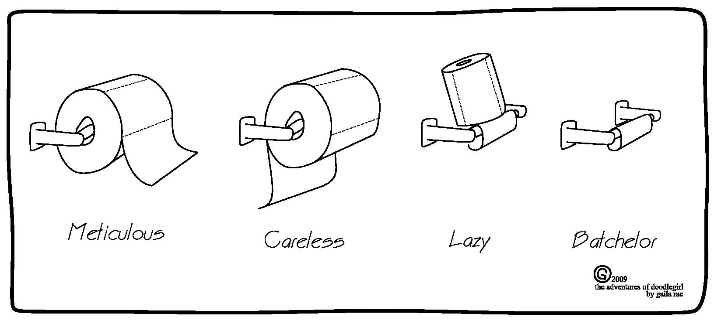
Measure of Conscientiousness

Slide 19
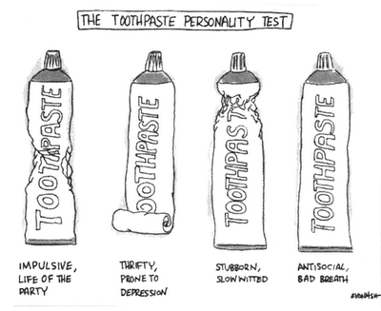

Slide 20

IQ vs. EI
How important is IQ to doing organizational citizenship behaviors?
How important is it to counterproductive work behaviors?

Slide 21

Emotional Intelligence and Organizational Citizenship Behaviors
68 studies
16,368 employees
Corrected correlation: .52

Slide 22


Emotional Intelligence and Counterproductive Work Behavior
17 Studies
3,914 employees
Corrected correlation: -.34

Slide 23

What about when we included the other variables?
Stream 1 ability EI ranks fifth out of nine predictors in its relative importance in predicting OCB in model 2.
Stream 2 self-reports EI ranks first out of nine predictors in its relative importance in predicting OCB.
Stream 3 mixed competency EI met the criterion of a large relative importance and ranks first out of nine predictors in its relative importance.
Stream 3 mixed competency EI contributed 53.2% of the explained variance with a R² contribution of .33.

Slide 24
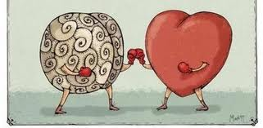
Emotional Intelligence and CWB Relative Importance
Streams 1, 2, 3 EI ranked sixth, first, and first out of nine predictors in its relative importance respectively.

Slide 25



