Slide 1


Modality and Ideology in Newspaper Editorials
The case of The Guardian and Al-Ahram Weekly
Noha Abdel Kader, Lancaster University

Slide 2
Modality plays a role in reflecting underlying ideologies
Examples in two editorials dealing with the hotly debated issue of the political rise of Islamist groups in the aftermath of the January 25 Egyptian revolution.
Editorialists reflect different modal expressions, revealing the type and degree of their commitment to the content of the expressed message as well as their ideologies.

Slide 3
How editorialist modalities are approached
First:
Choices in two newspaper editorials taken from the Guardian and Al-Ahram Weekly will be viewed to establish that the writers’ choices of different types and degrees of modality, reflect their ideological positions.
Second:
Systematic analysis of modality using Halliday’s (2004) functional approach
Other approaches categorising modality:
Coates (1983); Perkins (1983); Palmer (1990) and Papafragou (2000).

Slide 4
Halliday’s (2004) functional approach
Analyses the relation between modality type
epistemic
deontic
and degree:
low
Median
High
as markers of ideology.

Slide 5
Modality defined
A term used in syntactic and semantic analysis referring to expressions of necessity, obligation or desirability
Generally describes unrealised states and unreal conditions using language to encode them in forms such as:
possibly
perhaps
Modality is normally conveyed by modal verbs
could be, should be, ought to be

Slide 6
Types of modality: Epistemic
Commitment to the truth of the proposition: i.e. the speaker’s confidence in the truth of the proposition expressed
Reflection of the certainty and the authority of these propositions.

Slide 7
Types of modality: Deontic
The system of duty and attitude to the degree of obligation, which the speaker does not expect to be disputed.
Associated with power and formality
Directives (warnings, requests, advice, suggestions…etc.)

Slide 8
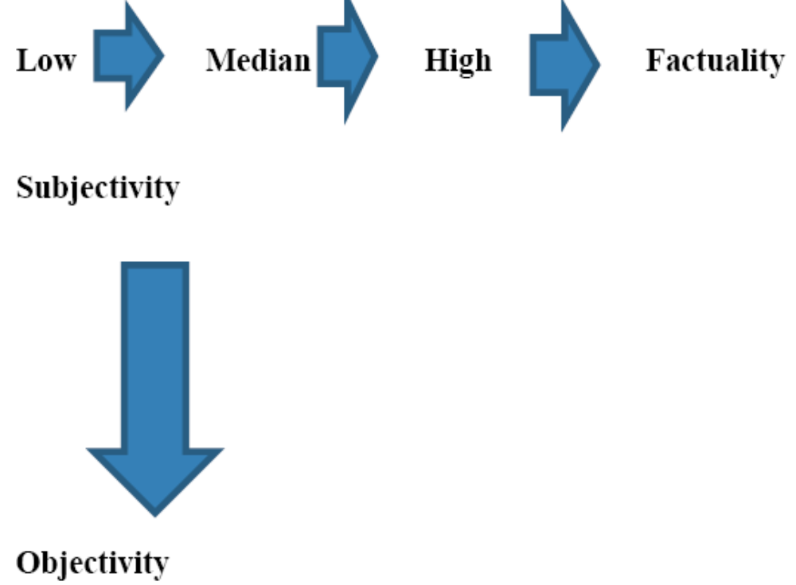
Modality: Degree
(LOW) Possibility - probability - logical necessity – prediction - factuality (HIGH)
The Scales of Epistemic Modality (Degrees of Certainty) ( Badran 2002: 144)

Slide 9
Modality: Degree
(LOW) Permission - volition - duty - obligation insistence - command (HIGH)
The Scales of deontic Modality (Degrees of Certainty) ( Badran 2002: 144)

Slide 10
Linguistic forms realising modality
Epistemic: may, might, could (low) Should (median) Must, will (high) Is (factuality) | Deontic: may, can (low) should (median) must, will (high) leave (command)

Slide 11
Idiomatic expressions and modality meanings
Be to (for orders, fixed events…etc.)
Be going to (firm predictions based on evidence at time of speaking)
Had better (desirable or advisable actions)
Have got to (obligations from outside)

Slide 12
Ideology
a systematic body of ideas organised from a particular point of view (Hodge and Kress 1993)
“Ideology is most effective when its workings are least visible”( Fairclough 1989: 85).

Slide 13
Establishing a Link between Modality and Ideology
Speakers’ engagement is reflected in different types and degrees of modality; their stance or attitude, e.g. assertive or tentative; how committed or how detached they are and other crucial aspects of interpersonal meaning.
Through these less visible workings of ideology, modality plays a significant role.
Modality serves as a linguistic instrument to which language users can resort in order to reflect or obscure their views of reality in accordance with their ideologies.

Slide 14
Modality in Editorials
The editorial is the voice of the paper’s opinions
Editorials have an ideological significance, rationalised by the newspapers through their claim to rely on "expert" voices to properly contextualise and explain the news.
Editorials are not merely texts with implicit meanings, but are part of “the continuous oppression and struggle to gain power through knowledge” (Matheson, 2005).

Slide 15
Editorial Language
Includes:
Emotive vocabulary
Authority
Generic statements (to show authority, the editorial claims total knowledge)
Argumentative
1st person pronouns – we
Personal, subjective view

Slide 16
Editorials: The right to assess
Stance, appraisal and assessment are all about relative positions
Who is in a position to appraise?

Slide 17
Interpersonal meaning
Modality is concerned with assertion, assertiveness, tentativeness, and other crucial aspects of interpersonal meaning (as opposed to ideational or content meanings)
forms a part of the tenor of discourse

Slide 18
The Guardian Editorial Analysed
Epistemic Modality
Epistemic low-value modality examples
A Muslim Brotherhood win would resonate far beyond Egypt
Does the Brotherhood intend to apply Islamic law? That is where it begins to retreat into generalities
the Brotherhood has also been a bit more cagey…

Slide 19
The Editorial modality:
Hinting at the Brotherhood’s possible affinities to other Islamist groups all around the Arab world as well as expressing possibility of having unknown intentions such as applying Sharai ( Islamic law)

Slide 20
The Guardian Editorial Analysed
Epistemic Median-Value Modality Examples
…the Brotherhood should soon have a fairly free hand to tackle many of the country's domestic problems as it sees fit…
…Or what they should do in office.

Slide 21
The Editorial modality:
Asserting with a fairly high degree the firm grip that the brotherhood will have on the political life in Egypt and questioning its real intentions

Slide 22
The Guardian Editorial Analysed
Epistemic High-Value Modality Examples
And what the movement does in power will have…
will be in Islamist hands”.
will depend on…

Slide 23
The Editorial modality:
The impact of the Brotherhood’s winning over other Islamist groups in the region, as well as hinting at attempts to extend control and dominance to the major institutions in Egypt

Slide 24
Al- Ahram weekly editorial analysed
Deontic modality
Deontic low-value modality examples
it is much more important to ask what they intend to do…
it wishes to “renegotiate” the peace treaty with Israel…
Deontic median-value modality examples
[the Brotherhood] is deeply and emotionally opposed to the blockade on Gaza.
Israel is deeply resistant…
Deontic high-value examples:
…their [the Brotherhood’s leaders] overriding duty to the Egyptian people as politics and governing.
The Brotherhood has also effectively told its cousins in Hamas that their cause will have to wait.

Slide 25
The Editorial modality:
Deontic low-value modality :
The Brotherhood’s desire to renegotiate the peace treaty with Israel is presented as a less forceful wish
Deontic median-value modality :
The stance of the Brotherhood concerning the Palestinian case is asserted as a profound and emotional opposition; insinuations as to the historical ties between the Brotherhood and Hamas
Deontic high-value modality:
Indicating the Brotherhood’s rearrangement of priorities after becoming a ruling party.

Slide 26
Al –Ahram weekly editorial analysed
Epistemic modality
Epistemic low-value modality examples
Regarding religion… the future seems less clear.
It seems that instead of the nation being the source of political authority, the Sharia is becoming the source…
Insisting on the Islamist political project…can take a toll not only on society, but also on religion itself.

Slide 27
The editorial modality
Questioning the validity of using Islam in political and social life.
The harmful effects not only on society but on religion resulting from using Sharia as the main source of legitimacy.

Slide 28
Al –Ahram weekly editorial analysed
Epistemic median-value modality examples
…which is likely to be highly divisive and ultimately explosive.
Some people may claim that their opponents are too ignorant

Slide 29
The editorial modality
The devastating effect of imposing religion on society
How taking religion as a social criterion can be politically exploited to discredit opponents on the grounds of ignorance in matters related to faith.

Slide 30
Al –Ahram weekly editorial analysed
Epistemic high-value modality Examples
These are the areas of conflict that will have grave repercussions for religion
The new political reality that will emerge, will be one dictated by the nation as a whole

Slide 31
The editorial modality
the serious impact of using Islam as a reference in political matters
the possibility that the Brotherhood might attempt to create an autocratic regime which will entail resistance

Slide 32
Al –Ahram weekly editorial
Deontic modality
Deontic low-value modality examples
Populist politicians may posture to their heart's content
…in the hands of scholars who were expected to rise above political interests…

Slide 33
The Editorial modality:
The misuse of Sharia in politics by Islamists
the refutation of claims made by the Brotherhood and other Islamist groups that using religion in politics could be traced back to the origins of Islam

Slide 34
Al –Ahram weekly editorial
Deontic median- value examples
What they [Islamists] should do instead is to focus on promoting the freedom and dignity of the people
rival Islamist factions are challenging each other about what should be done in the name of Islam

Slide 35
The Editorial modality
The implication is that by entering the field of policy, the Brotherhood has been busy with political conflicts instead of serving their voters.
Explaining possible consequences of mixing religion with politics

Slide 36
Al –Ahram weekly editorial
Deontic high-value modality examples
The pretense is that there is an Islamic identity that we need to protect…
Islamists have no right to pretend that their economic policies…are the only ones acceptable …
Then the admission is that the Sharia is something extraneous to society that must be forced …

Slide 37
The Editorial modality:
Asserting that Islamists are protecting Islam as an urgent pretext for political gains.
Asserting that Islamists' policies are not to be considered the only rightful version- implying attempts to dominate society

Slide 38
Summing Up
The British editorial is most assertive with respect to :
The strong predictions that are made as to the major role that the Brotherhood will play in Egypt, especially with respect to Egyptian foreign policies
Global impact that Islamists' rise to power might have on its relations with other countries
With low and median degrees of certainty there are :
Hints at a possible change in the Brotherhood’s doctrine from being originally a charitable movement to an ambitious party that is lured by the world of politics.
The insinuation that the Brotherhood might apply Islamic law and that this can represent a threat to freedom and democracy.
The stance of the Brotherhood concerning the blockade on the Palestinians and the reaction of Israel to any tampering with the peace agreement.

Slide 39
The Egyptian writer appears most certain about
Islamists’ insistence on solely imposing what according to them is the true version of faith.
The alienating and divisive consequences of applying religion to politics.
Less certain with the following
That Islamists use religion as a means to an ends either by using it as a weapon to discredit their opponents or for shifting the battle from the political arena to the religious.
The writer specifies that Islamists need to serve the voters who brought them to power more than anything else

Slide 40
The Two Editorials Compared
The Guardian with a readership generally on the mainstream left of British political opinions embraces liberal views geared towards the implementation of democracy and freedom of thought.
The write is more assertive with propositions that reveal the firm grip that the Brotherhood may have on political life, as well as its covert desire to implement Sharia, both of which may represent a threat to diversity and pluralism of political thought.
The Egyptian national newspaper generally appeals more to the so-called elite readers like government officials and university professors; a stratum of society that shares its fears as to the freedom of opinion in Egypt under Islamists.

Slide 41
The Two Editorials Compared
A distinction between ‘us’ and ‘them’ groups for the purposes of advancing and confirming in-group ideologies and agendas.
This is achieved in both the Egyptian and the British editorials by comparing the paper’s ideology with the opposing ideology, which is presented as deviant and unsupportive of the in-group.

Slide 42
References
Coates, J. (1983) The Semantics of Modal Auxiliaries, London and Canberra: Croom Helm.
Fairclough, N. (1989) Language and Power, Harlow: Longman.
Halliday, M.A.K. (2004) An Introduction to Functional Grammar. (3rd ed.) London: Arnold.
Hodge, R. and Kress, G. (1993) Language as Ideology, London: Routledge.
Matheson, D. (2005) Media discourses. Analysing Media Texts. Maidenhead: Open University press.
Palmer, F. R. (1990) Modality and the English Modals, London and New York: Longman.
Papafragou, A. (2000) Modality: Issues in the Semantics-Pragmatics Inteiface Oxford: ELSEVIER.
Perkins, M. R. (1983) Modal Expressions in English, London: Frances Pinter Publishers.

