Slide 1
The Uncover Progress Proposal: Reflections on an Internship Focused on Creating an Access Project for Black British Students
Emmanuel Adeyemi-Abere & Eleanor Dove
Notes:
Introduction

Slide 2
Contents
History of the project within the WP team
UP Project Proposal
Reflections
Next Steps

Slide 3

History of the Project
Research led, 2020 – 2021 team of student researchers created resources
2022 – 2023 collaborated with Groundswell and another team of student researchers
2022- 2023 – applied for funding to run the internship

Slide 4

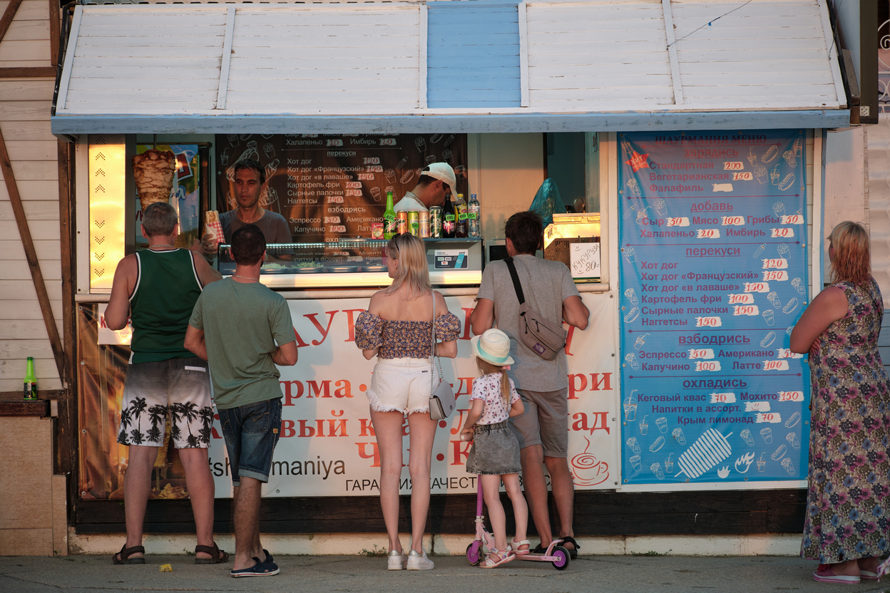


Project Proposal
The Uncover Progress (UP) Program
1
2
3
4
Beyond the Brochure Conference Day
Immersion Weekend
Mentoring
In-School Sessions
Notes:
As you can see from this visual aid, our program offers a multi-tiered and holistic approach to supporting this student group. We implore that Lancaster University commits to this program consisting of: a conference day, immersion weekend, mentoring scheme and delivery of in-school sessions. I will now explain what each activity precludes.

Slide 5
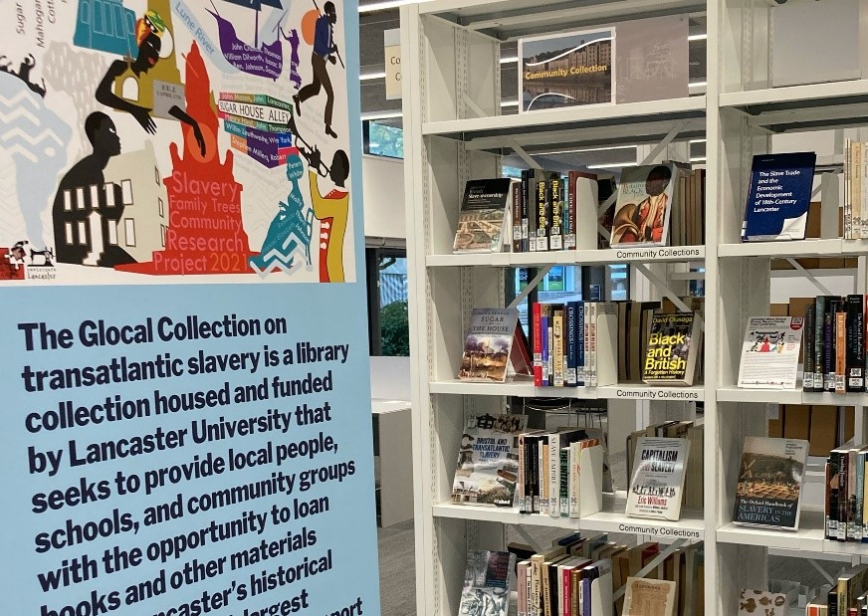
Building a Black British Experience
Students are not statistics, but stories not fully told
Categorisation as omission and oversimplification
What does being Black and British mean personally?
What does being Black and British mean at Lancaster?

Slide 6
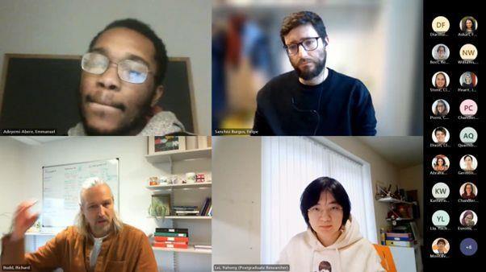

A Seat At The Table
Hybrid Placement in Widening Participation Team’s Office
Discussions with the Race Equality Charter Committee
Engagement across institution from Academic Lecturers, EDI Groups & Senior Management
Networking with Outreach Teams at other Institutions

Slide 7
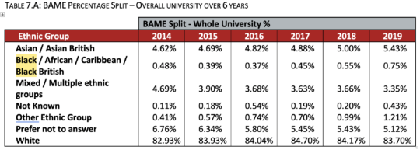
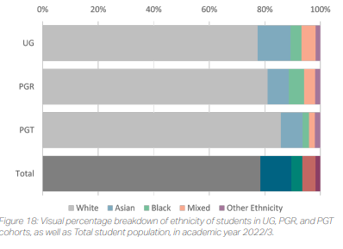
Where’s the Pipeline?
Internship designated UP to be a primarily pre-entry phase project
What will happen to those Black British students upon arrival?
Many EDI Annual Reports reveal problems that affect Black (British) contingent of BAME community at the University disproportionately
University as transient environment
Students from focus groups will not be immediate beneficiaries of the contributions to this project!

Slide 8


Actions Are Much More Than Words
Finances and Opportunity Costs
Projects tied into the goals from the Access & Participation Plan
How does the institution want to sincerely engage with the Black British community in the south?
Complications of communication and action in our own networks

Slide 9
Thank you for attending, any questions?

