Slide 1


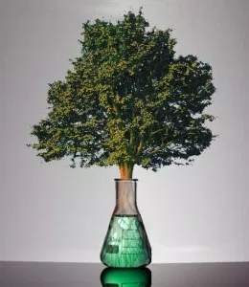
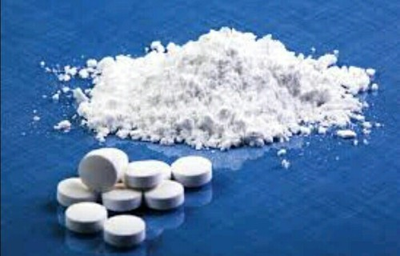
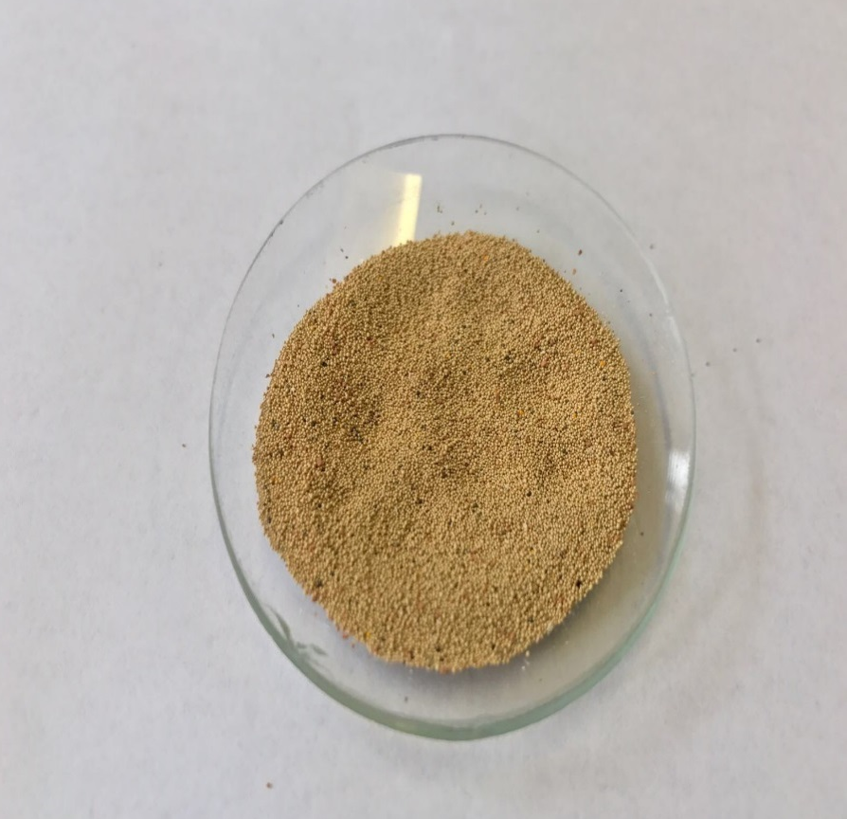
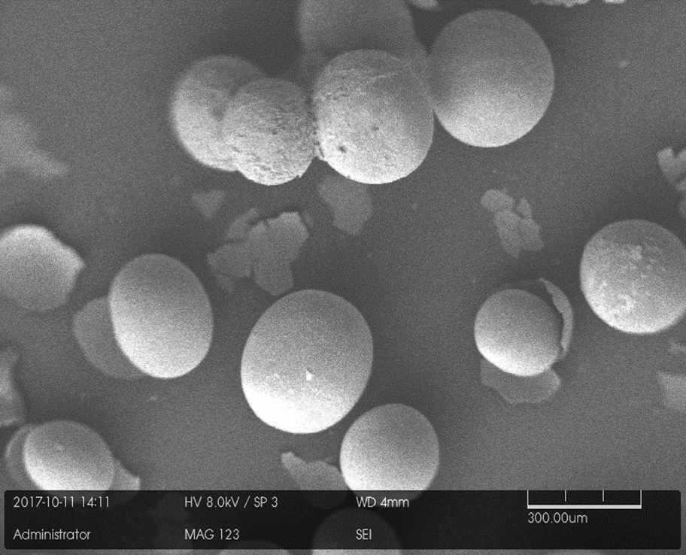
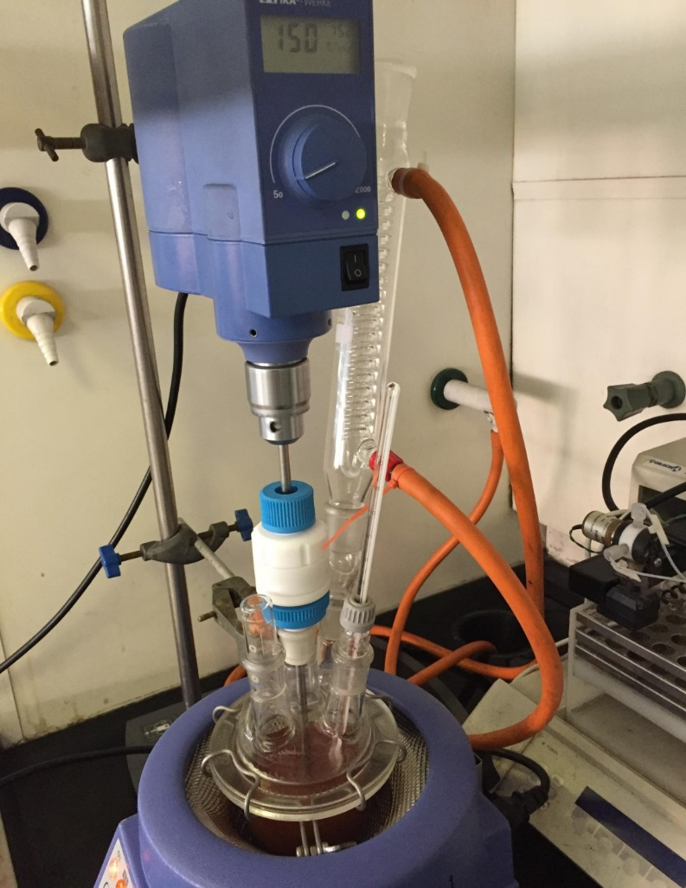
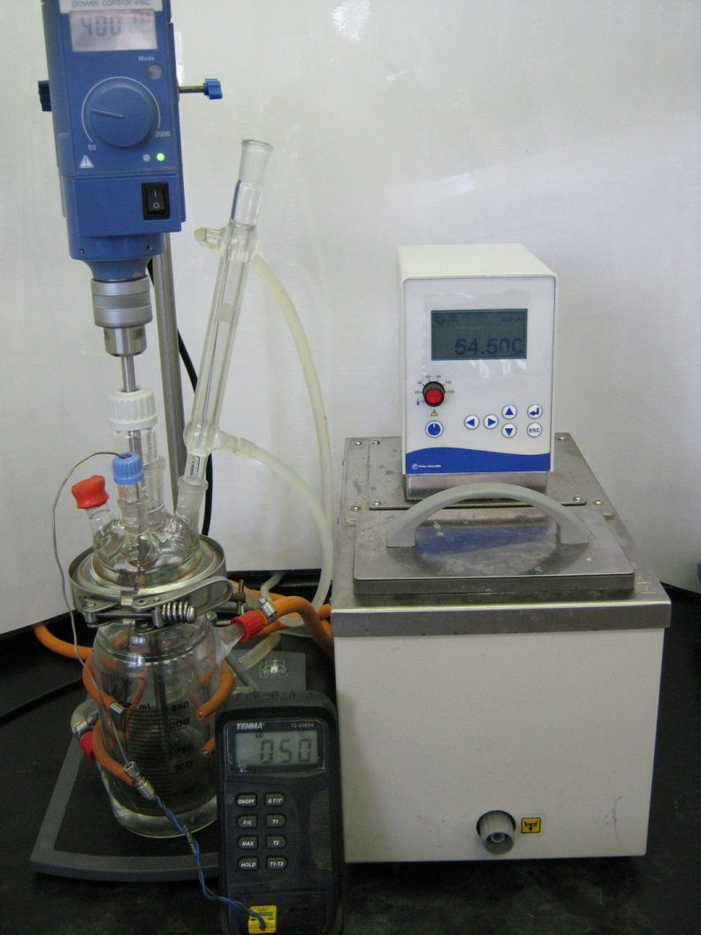
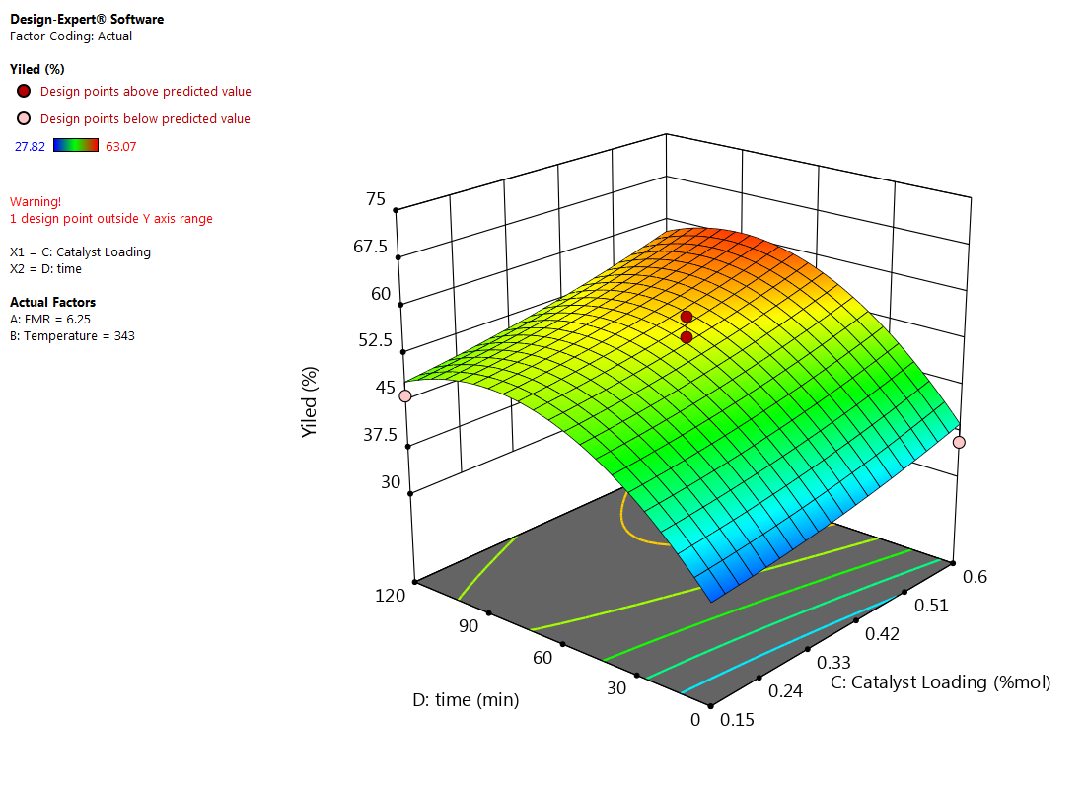
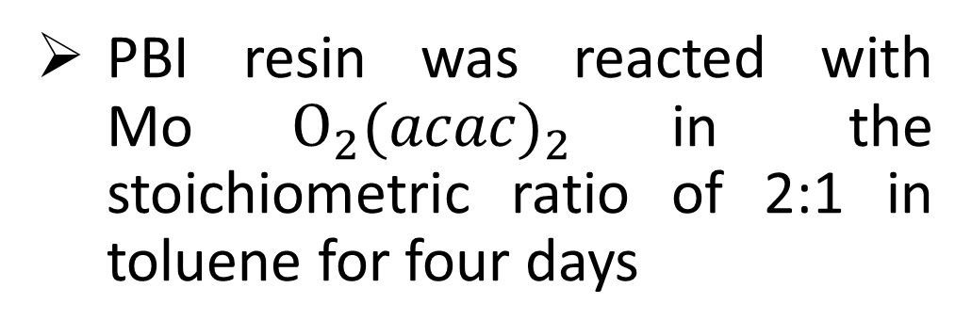
Greener and efficient epoxidation process for the synthesis of a commercially important epoxide
School of
Engineering
Prepared by
Md Masud Rana Bhuiyan
Supervised by
Dr Basu Saha & Dr Xiaodong Wang
Motivation
Greener and efficient process
Reduce manufacturing cost by reducing waste product and makes the process environmentally friendly
Important raw materials
Epoxides can be transformed into plasticizers, perfumes, food additives pharmaceutical drugs etc.
Powerful anticancer drug
1,2-epoxy-5-hexene is used for the synthesis of a powerful anticancer drug
1. Aim
3. Results
To synthesise 1,2-epoxy-5-hexane using polymer supported Mo catalyst and evaluate the catalytic efficiency in batch epoxidation reaction
Catalyst preparation and characterisation
2. Methodology
Catalyst preparation and characterisation
Batch epoxidation reaction
Gas chromatographic analysis
Optimise Process
Build a Model
Y= f(x₁,x₂,..)
Image of PBI.Mo catalyst
SEM image of PBI.Mo catalyst
FTIR of PBI.Mo catalyst
Optimisation study
PBI resin was reacted with Mo$O_{2}{(acac)}_{2}$in the stoichiometric ratio of 2:1 in toluene for four days
Batch epoxidation of alkenes with TBHP in the presence of PBI.Mo catalyst was conducted in a 0.25 L jacketed four neck glass reactor.
3-D graph showing the effect of reaction time and catalyst loading on epoxide yield
The numerical optimisation technique concluded that the maximum yield that can be reached is 64.2% at feed molar ratio of 2.76:1, reaction temperature 348 K, 0.56 mol% catalyst loading and reaction time of 76 min.
1,2-epoxy-5-hexene
Applied design of experiments technique to optimise reaction parameters
4. Conclusions
References
PBI.Mo Catalyst has been successfully prepared for the epoxidation of 1,5-hexadiene
Characterisation of PBI.Mo catalyst confirms the presence of Mo(VI) metal centre in the polymer resin
The optimisation result has been validated experimentally resulting in epoxide yield of 62.03%, which shows the adequacy of the predicted optimum conditions with 3.5% relative error from the experimental results
Aboelazayem, O., Gadalla, M. and Saha, B. (2018) Biodiesel production from waste cooking oil via supercritical methanol: Optimisation and reactor simulation, Renewable Energy, 124, pp. 144-154. DOI: 0.1016/j.renene.2017.06.076.
Ambroziak, K., Saha, B., Mbeleck, R. and Sherrington, D. C. (2007) Epoxidation of Limonene by Tert-butyl Hydroperoxide Catalyzed by Polybenzimidazole-supported Mo(VI) Complex, (Vi), pp. 598–603.
Mohammed, M. L., Mbeleck, R., Patel, D., Niyogi, D., Sherrington, D. C. and Saha, B. (2015a) Greener and efficient epoxidation of 4-vinyl-1-cyclohexene with polystyrene 2-(aminomethyl)pyridine supported Mo(VI) catalyst in batch and continuous reactors, Chemical Engineering Research and Design, 94 (August), pp. 194–203. DOI:10.1016/j.cherd.2014.08.001.
Sherrington, D. C. (1998) Preparation, structure and morphology of polymer supports, Chemical Communications, 81 (21), pp. 2275–2286. DOI:10.1039/a803757d.

