Slide 1





Choosing Open Access for Books: An Author's Perspective
Dr. Judith Fathallah, Lancaster University, Coventry University, Open Book Collective www.openbookcollective.org
judith@openbookcollective.org

Slide 2
My argument
In discussions of transition to an equitable, sustainable future for OA publishing, author choices are often neglected
We as the authors of academic works and textbooks have a role to play and a degree of agency in our publishing choices
Legacy publishing strategies no longer produce the rewards they did for earlier academic cohorts
Authors should be working with librarians to enable the transition both in their publishing choices and in their choice of the works they choose to request and assign.

Slide 3
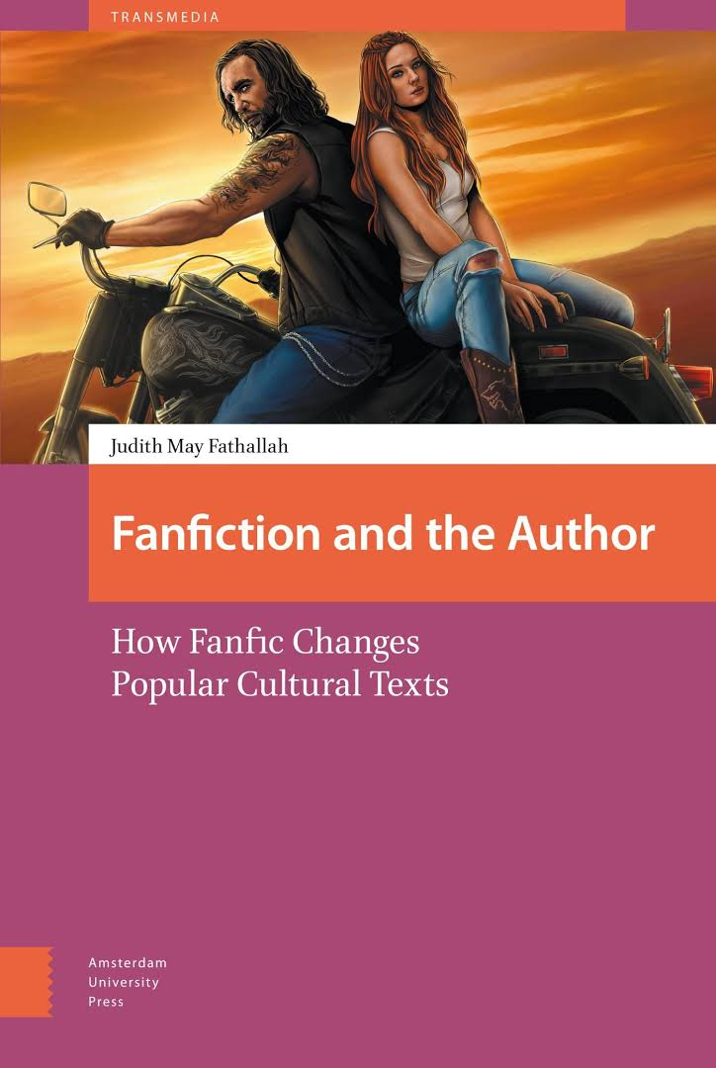


My journey with book publishing
2017, Amsterdam University Press, made OA by Knowledge Unlatched
2020, Iowa University Press, no OA edition
2023, mediastudies.press, Diamond OA

Slide 4
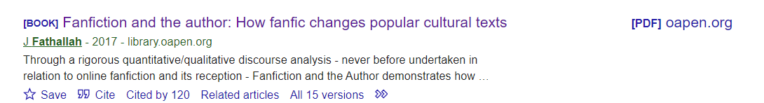

Why I chose OA, and mediastudies.press
Work with the Open Book Collective: ethical imperative of OA
Citation advantage is real

Slide 5
Press/student interest in my work on killer fandom (radio interview, New Books Network, talk at Millersville University…)
The implicit contract of prestige publishing is broken anyway: there is no reward for publishing with “big names”:
https://blogs.lse.ac.uk/impactofsocialsciences/2024/05/20/the-ref-consultation-shows-the-need-for-a-more-plural-perspective-on-oa-books/
Innovative publisher, high production values meeting OBC membership standards, more likely to accept an unusual pitch
Much more personal relationship with Press Director/guidance of my project – a scholar-led press in my area

Slide 6

The Open Book Collective s a UK-based charity with an international membership.
We enable knowledge institutions, including scholarly libraries, to fund small and medium scholar-led OA presses and OA infrastructure providers by subscribing to individual Supporter Programmes and collective Packages
This reduces reliance on inequitable and unsustainable BPCs.
www.openbookcollective.org

Slide 7
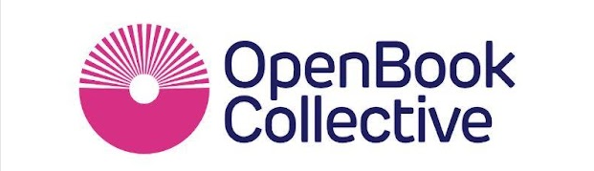



The Open Book Collective and Collective Development Fund
Dr. Judith Fathallah
Email: judith@openbookcollective.org
Copim’s ‘Open Book Futures’ project is funded by

Slide 8

Raise new revenue streams for OA publishers & SPs
Support a model of OA book publishing not reliant on BPCs
Make it easier for librarians to subscribe to OA membership schemes
Build a new community of publishers, service providers, librarians
Aims
Open infrastructure
Charity
Community led
Supporting bibliodiversity
Ethos

Slide 9
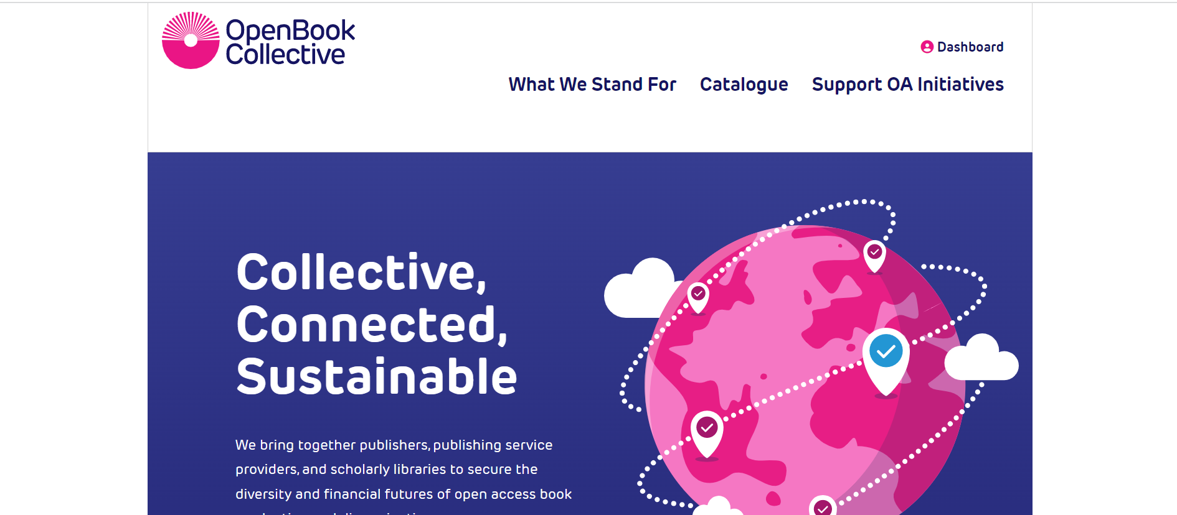







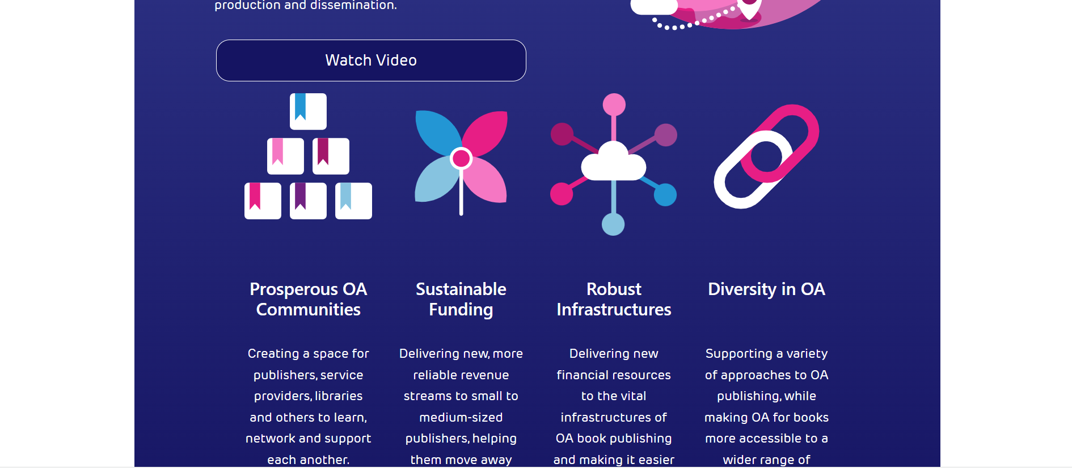






Slide 10
For publishers/service providers
Workflow
OBC manages invoicing, contracting, payment flows, making offering membership programmes possible for even small publishers
Outreach
OBC undertakes outreach work on their behalf, to global community of potential supporters
Reducing BPCs
A new income stream for publishers, helping them transition away from BPCs
Sustainable OA infrastructures
Via new income streams for service providers

Slide 11
For libraries / institutions
Aggregation Acting as a membership package aggregator & discovery portal
Relevance
Quick & consistent information about values / priorities / subject focus of initiatives (including full book catalogue)
Due diligence Expert scrutiny of peer review practices, governance procedures, business models
Workflow
One procurement process, integration with third party payment arrangements

Slide 12
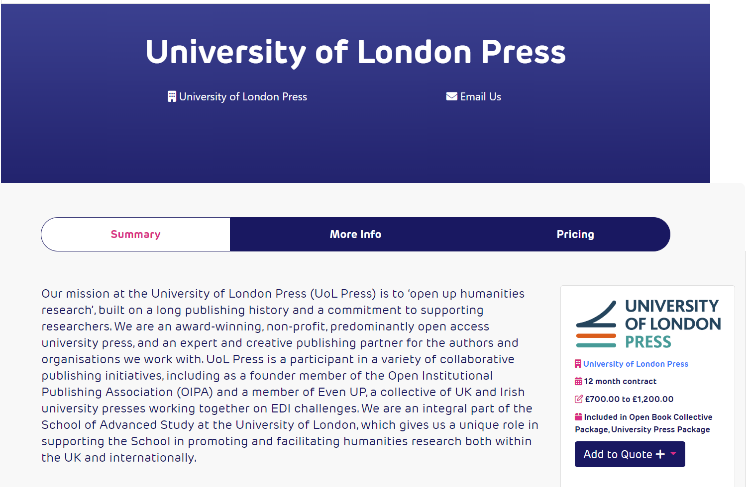
Some examples of publisher choices

Slide 13
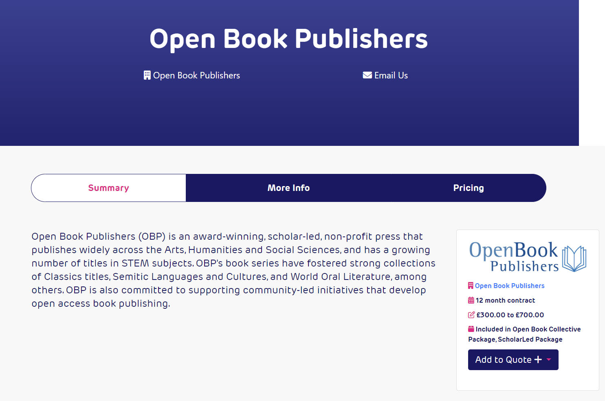
https://www.openbookpublishers.com/textbooks

Slide 14


Slide 15
In conclusion
There are varied, high quality, sustainable options for OA book publishing without BPCs
If we believe in a transition to Open Access, we need to exercise our power of choice regarding whom we choose to publish with
The citation advantage and openness of our work is probably more personally beneficial anyway than the “prestige” of legacy publishers, which don’t result in permanent contracts anyway
Authors should work with librarians to ensure library budgets are going to support the right publishers and the OA future we believe in.

