Slide 1
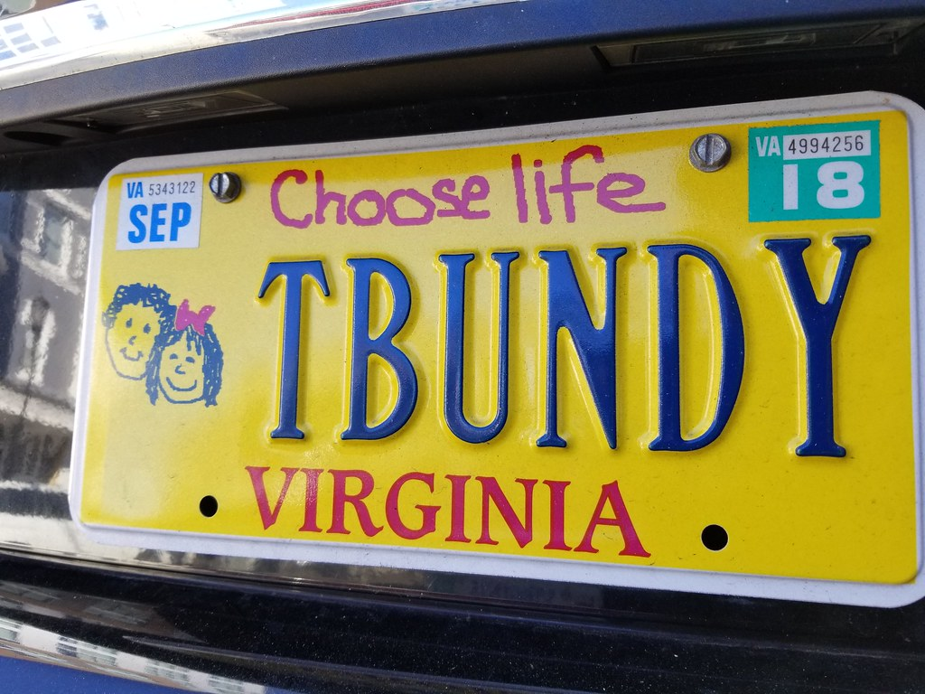
“Dark” Fandom as Play: Fan Studies and the Celebrity Serial Killer
Dr. Judith Fathallah
Lancaster university and Coventry university
Judith.Fathallah@coventry.ac.uk
j.Fathallah@lancaster.ac.uk
"Ted Bundy?" by Gamma Man is licensed under CC BY 2.0.

Slide 2
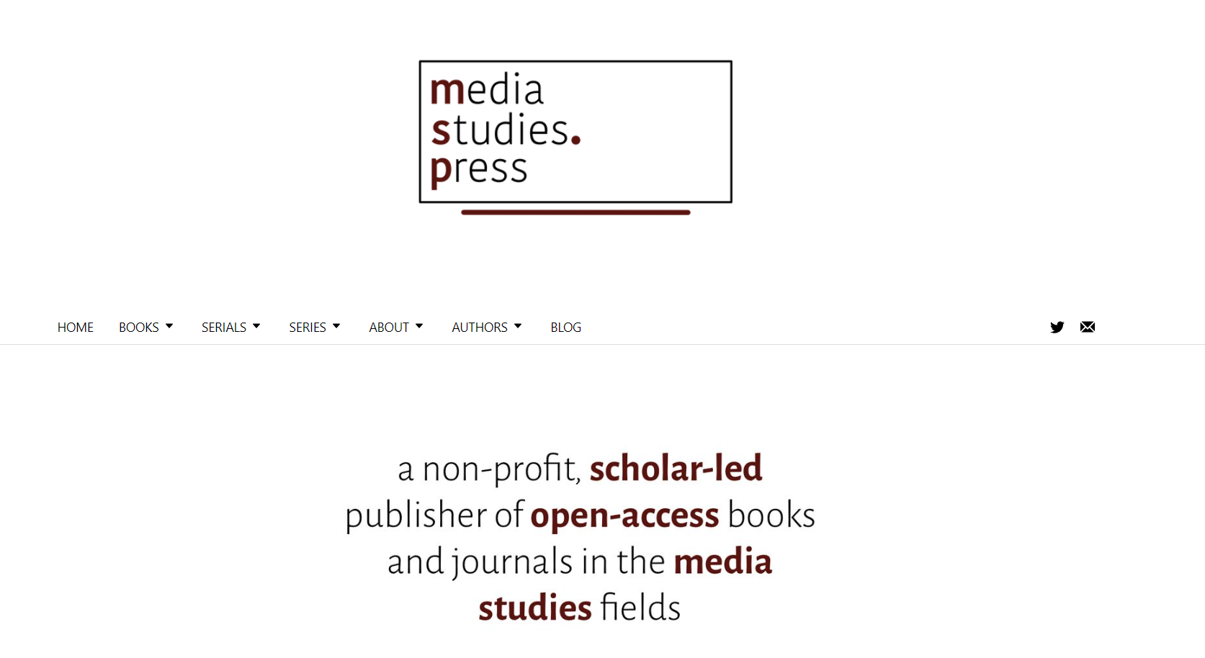

Killer Fandom: Fan Studies and the Celebrity Serial Killer (October 2023)
https://www.mediastudies.press/

Slide 3
The need to address serial killer fandom
* Fan studies evolved from a place of resisting pathologization
* The category “fan” has now been sufficiently mainstreamed (and sufficiently commercialized) that we can no longer avoid the more ‘difficult’ areas of fandom, such as fandom of school shooters and serial killers.
* In Killer Fandom, I apply four of the primary lenses from fan studies to serial killer fandom (textual poaching/convergence culture, affective community, (sub)cultural capital and digital play).
* Serial killer fandom as pastiche, parody and “coloring inside the lines” (Booth 2015, 2016)

Slide 4
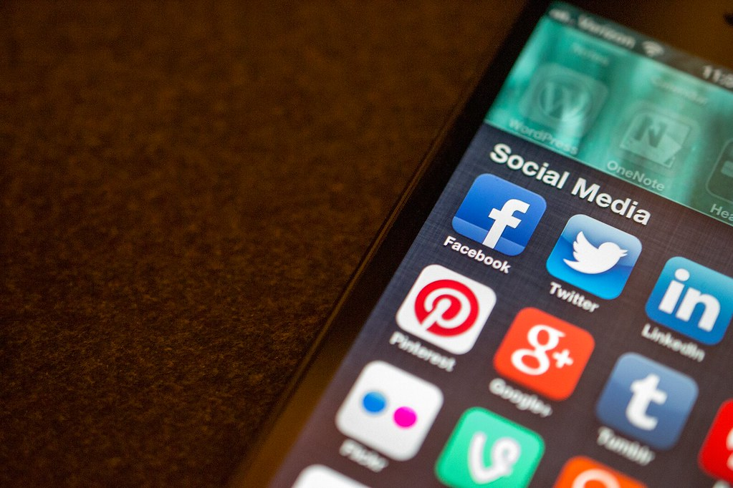
What is a “philosophy of playfulness”? . . . The contemporary media scene is complex, and rapidly becoming dependent on a culture of ludism. Today’s media field is fun, playful, and exuberant. More so than at any other time, the media we use in our everyday lives have been personalized, individualized, and made pleasurable to use. We play with our media; it is malleable in our hands (Booth 2016, 8).
"Social Media apps" by Jason A. Howie is licensed under CC BY 2.0.

Slide 5

Sociocultural parody/‘ambivalent’ internet
“in this mode of parody, parodic discourse has an effect of unsettling ‘established normative systems’ in order to subvert traditional structures and create alternative cultural meanings” (Booth 2015, 123). Pornographic parody highlights “what is always pornographic about mainstream culture” (128), exposing the “undercurrent of sexuality within all mainstream texts by providing negotiated readings of mainstream media” (128).
* SK fandom exposes our perennial fascination with serial killers: the serial killer industry

Slide 6


TikTok and Tumblr as playful sites
Ethan Bresnick (2019): TikTok as virtual play structure
- imitation
- rise and fall format
- memes/replication of formats
- editing affordances
- dominance of humour/puns/roleplay

Slide 7

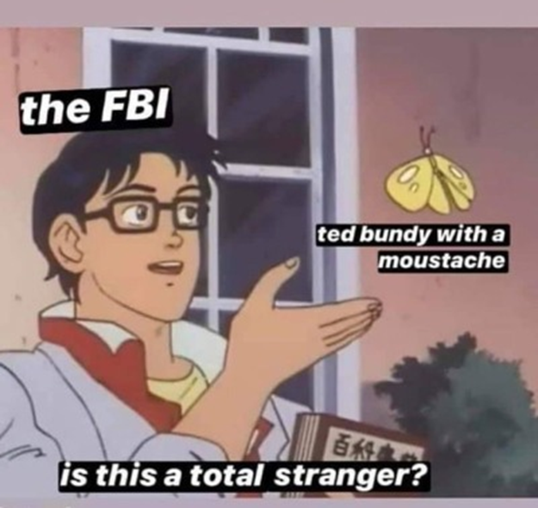
Satirising law enforcement – c.f. conservative function of true crime (Schmid 2005)
Notes:
Satirising law enforcement – conservative function of true crime

Slide 8

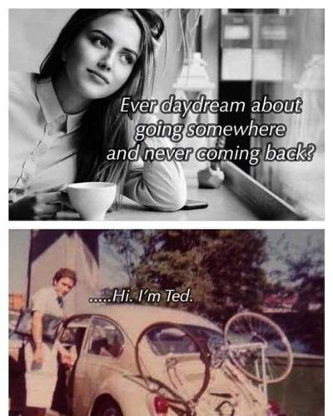
Anti small-r romance: c.f. Browder on true crime as ‘dystopian romance’ (2006)
Notes:
Mulvey – antiromance – women more likely to be consumers

Slide 9

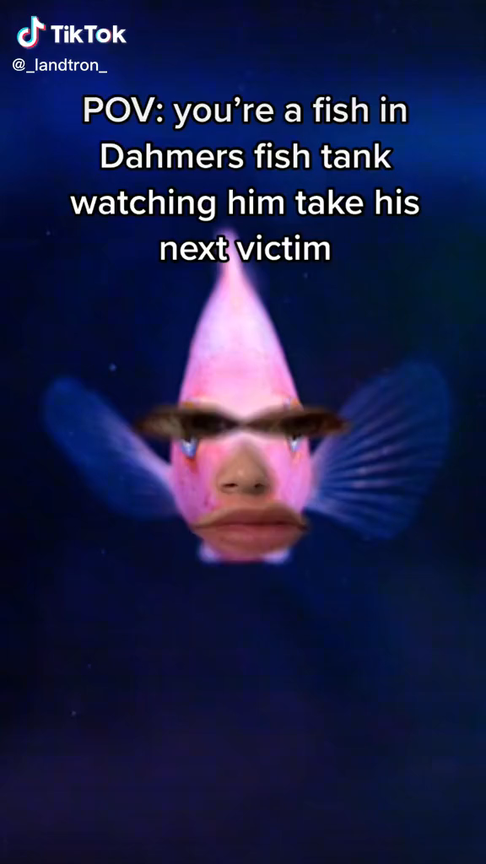
c
Large quantity of roleplay (varying degrees of absurdity) around the time of the Netflix ‘Monster’ series.

Slide 10
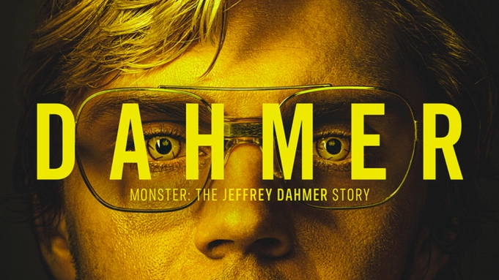
Throughout this study […] I have discovered that not only is serial killer fandom understandable in terms of frames common to all mediated fandom, but that, to a large extent, it is understandable in terms of the broader media culture. The fandom may be deliberately provocative or purposefully edgy – and the term “edge” is instructive here, because it does, by and large, operate at the “edge” of a discourse already predefined by the mainstream media without clearly opposing, contradicting, or subverting it. The serial killer industry is alive and well and streaming now on Netflix (Fathallah 2023)

Slide 11
References
Booth, Paul. 2015. Playing Fans: Negotiating Fandom and Media in the Digital Age. Iowa: University of Iowa Press. Kindle.
- 2016. Digital Fandom 2.0. New York: Peter Lang.
Bresnick, Ethan. 2019. “Intensified Play: Cinematic Study of TikTok Mobile App.” Unpublished manuscript, University of Southern California. https://www.researchgate.net/publication/335570557_Intensified_Play_Cinematic_study_of_TikTok_mobile_app
Browder, Laura. 2006. “Dystopian Romance: True Crime and the Female Reader.” Journal of
Popular Culture 39, no. 6: 928-953.
Fathallah, Judith. 2023. Killer Fandom: Fan Studies and the Celebrity Serial Killer. Mediastudies.press.
Schmid, David. 2005. Natural Born Celebrities: Serial Killers in American Culture. Chicago, IL: University of Chicago Press.

