Slide 1



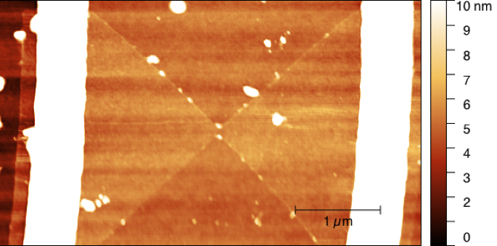
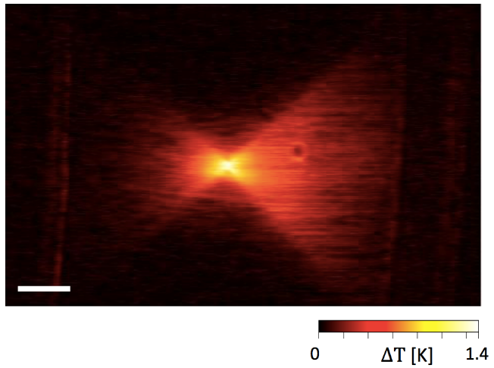
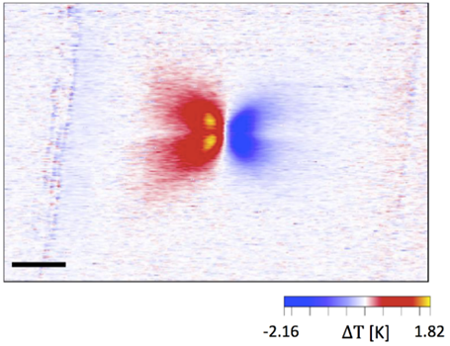
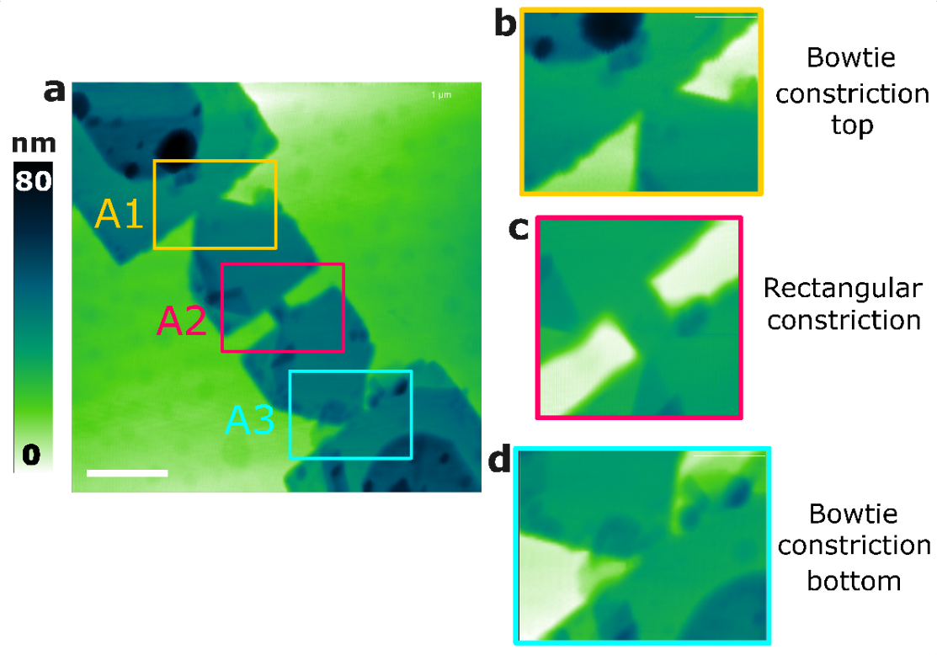


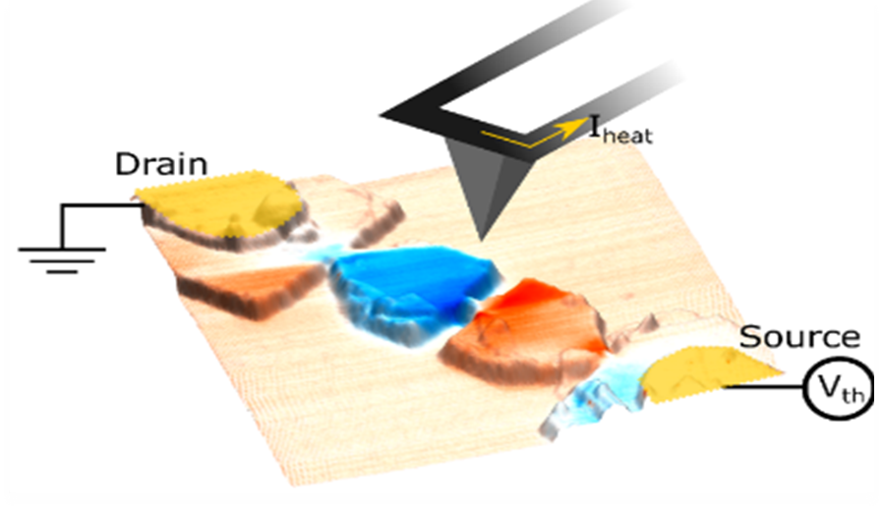
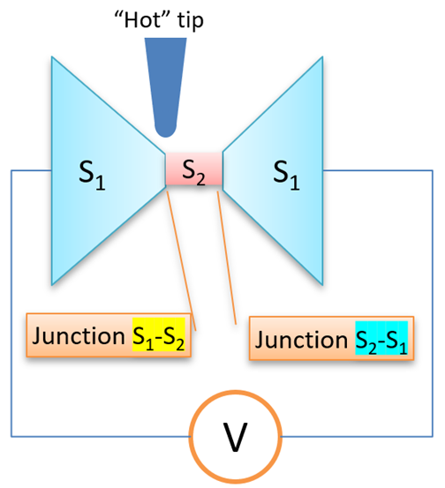
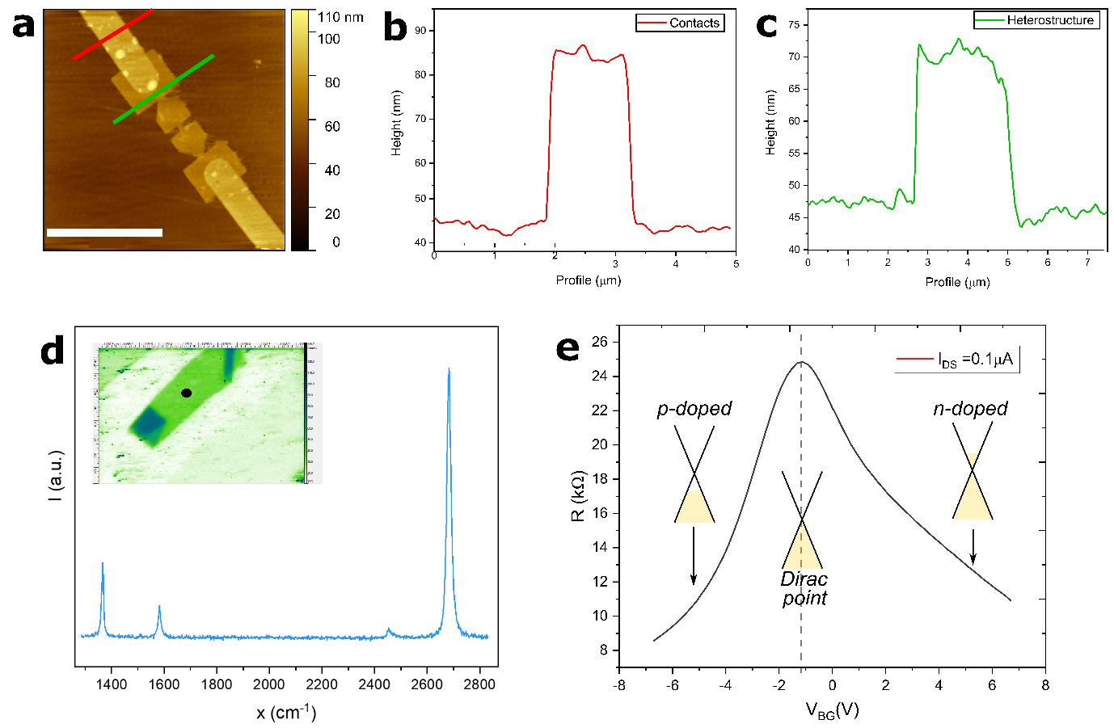
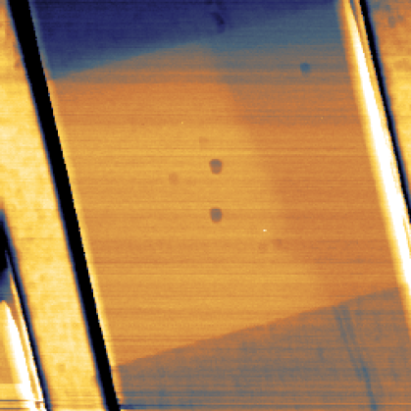
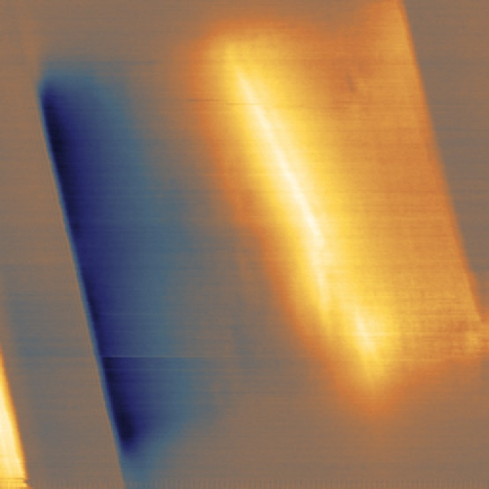
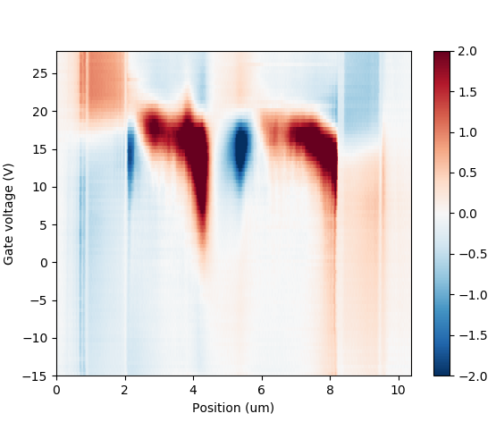
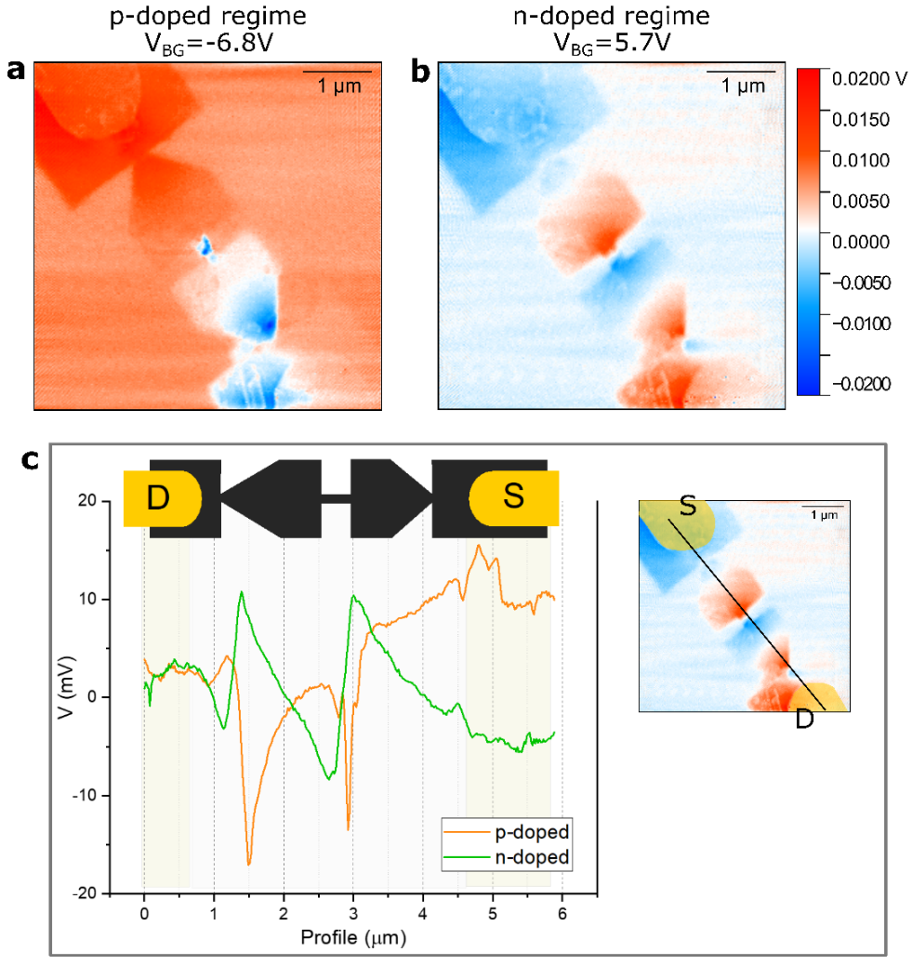
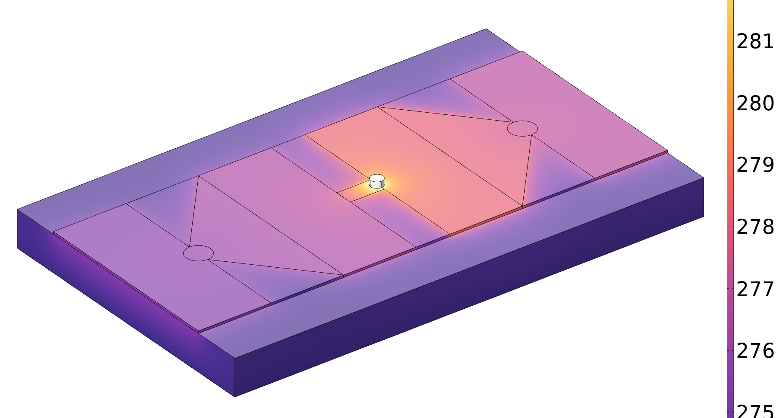
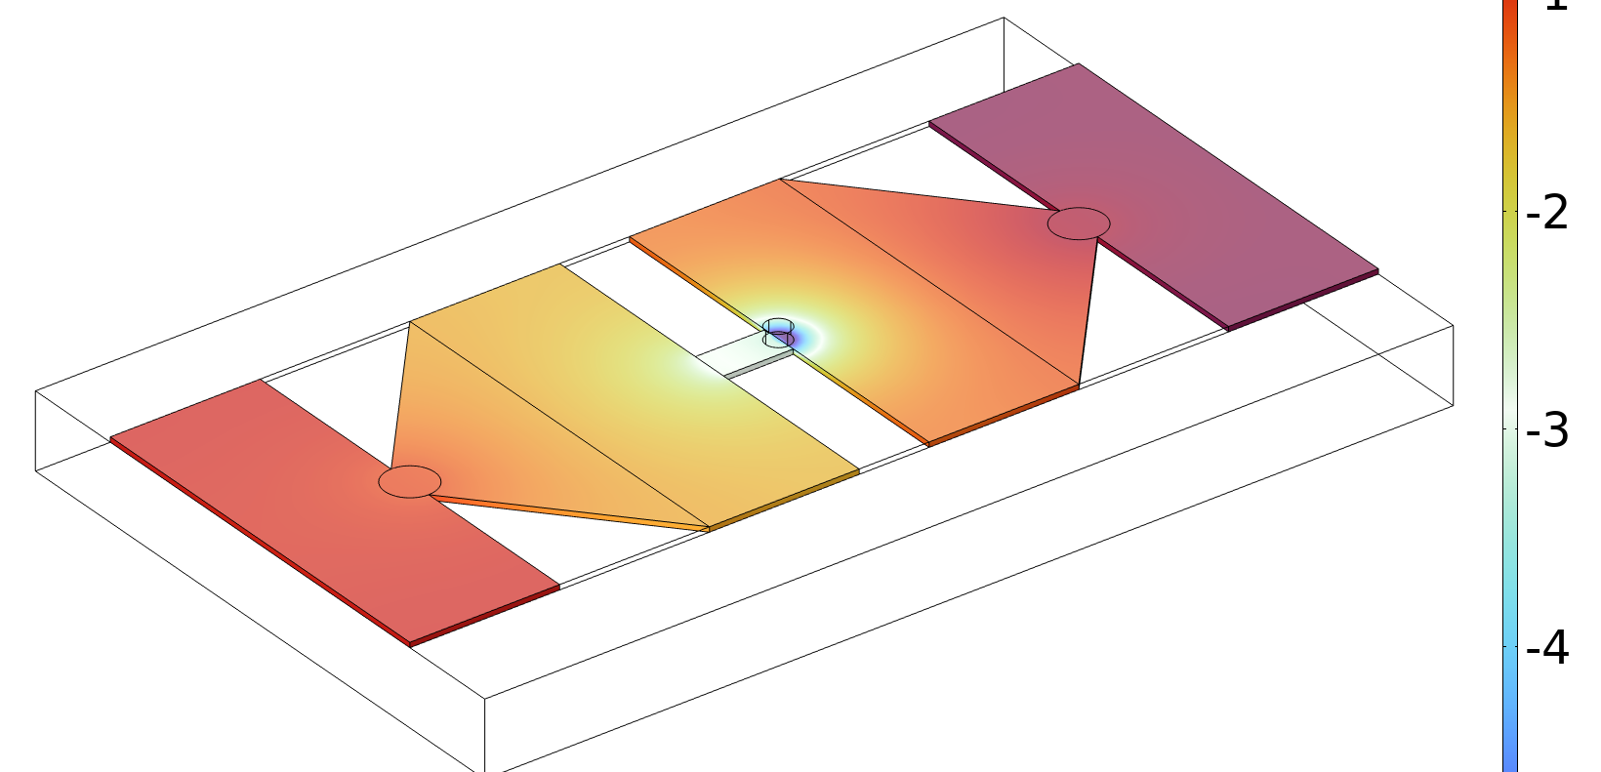
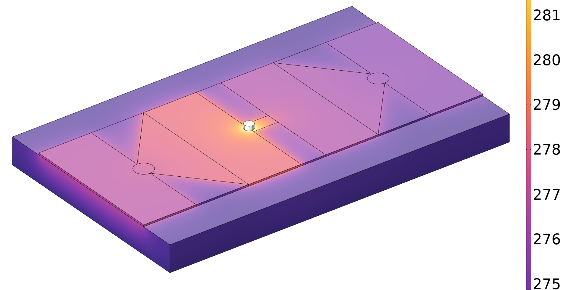
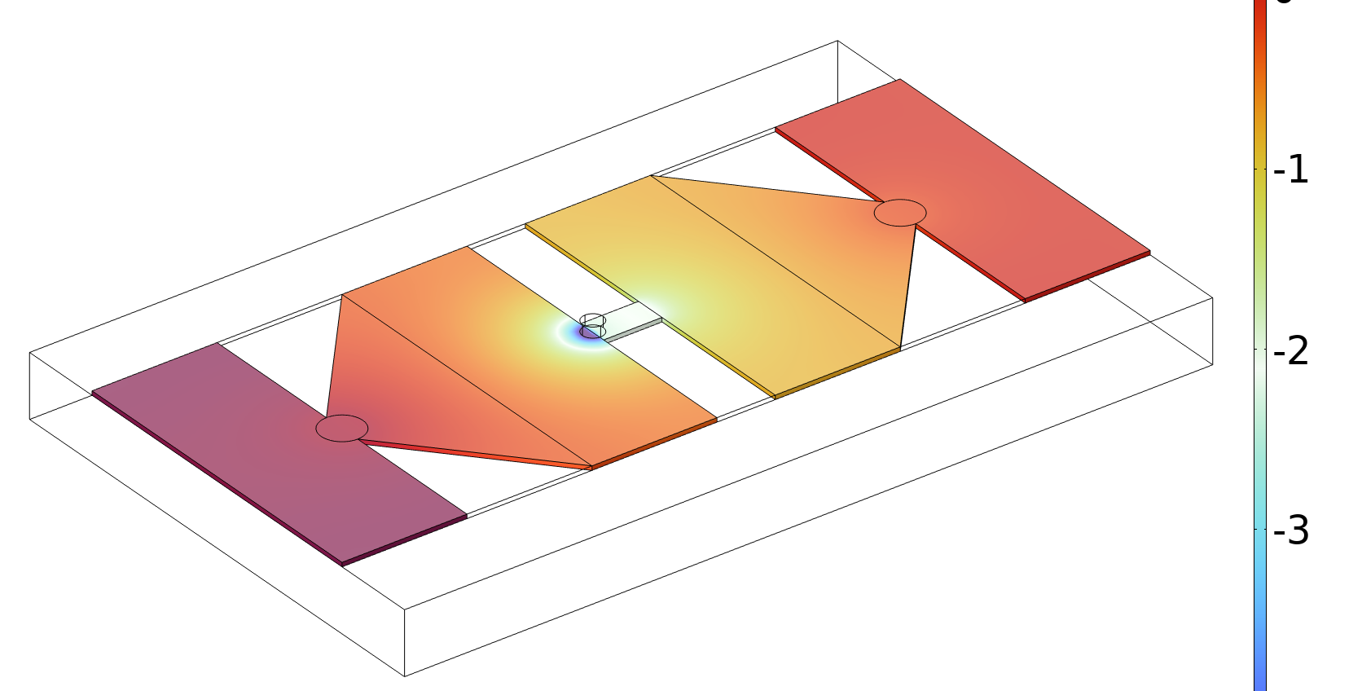
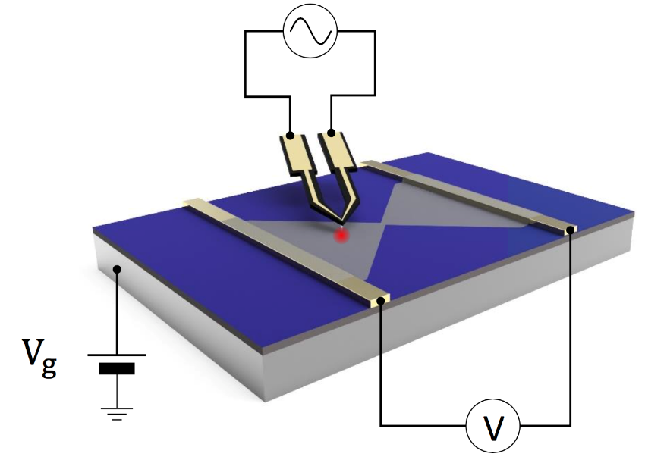
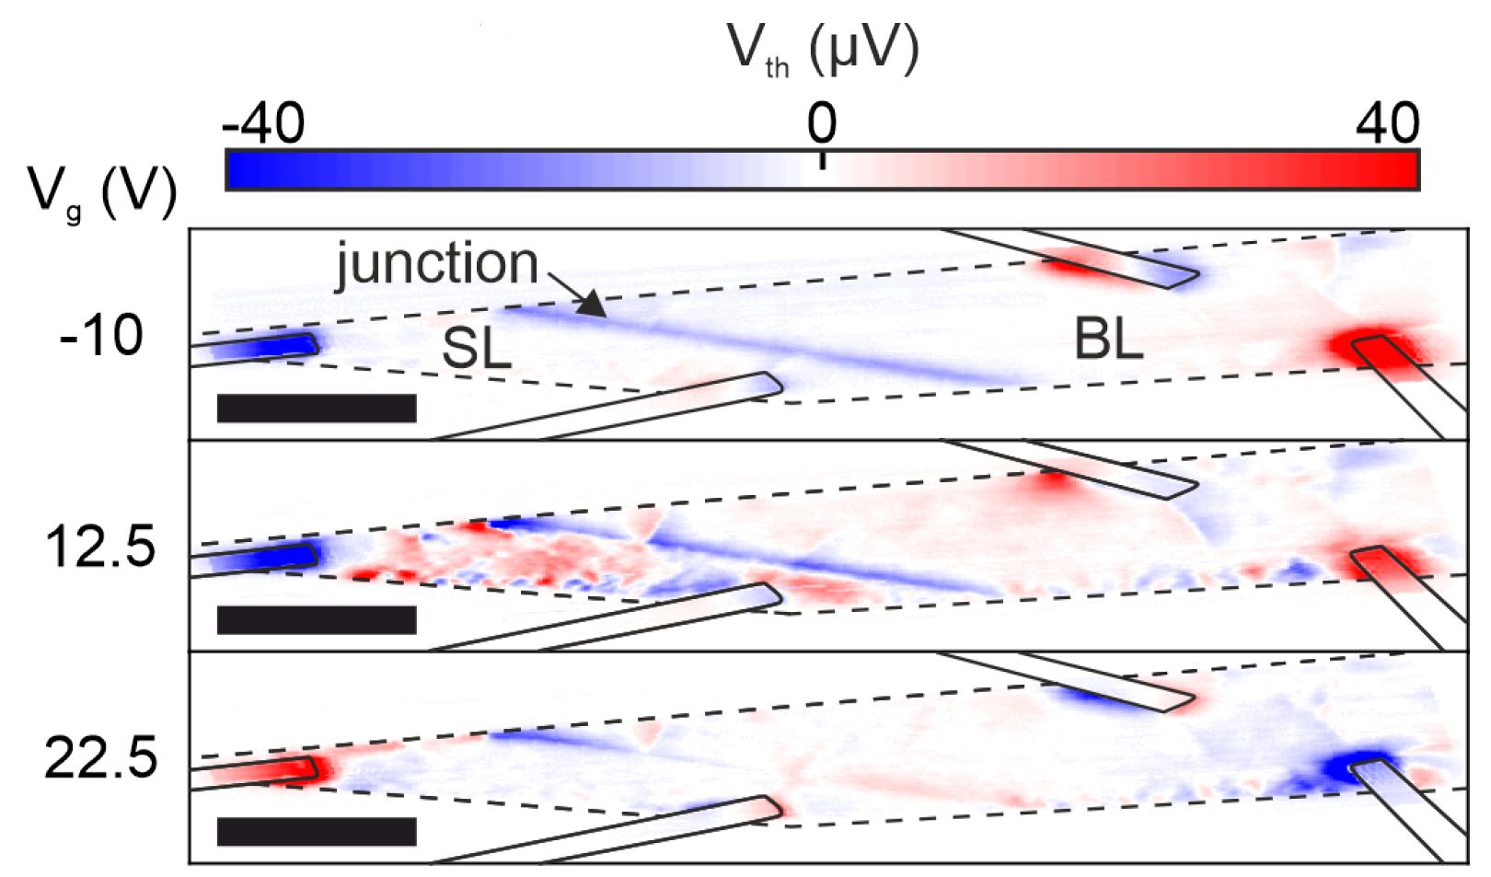
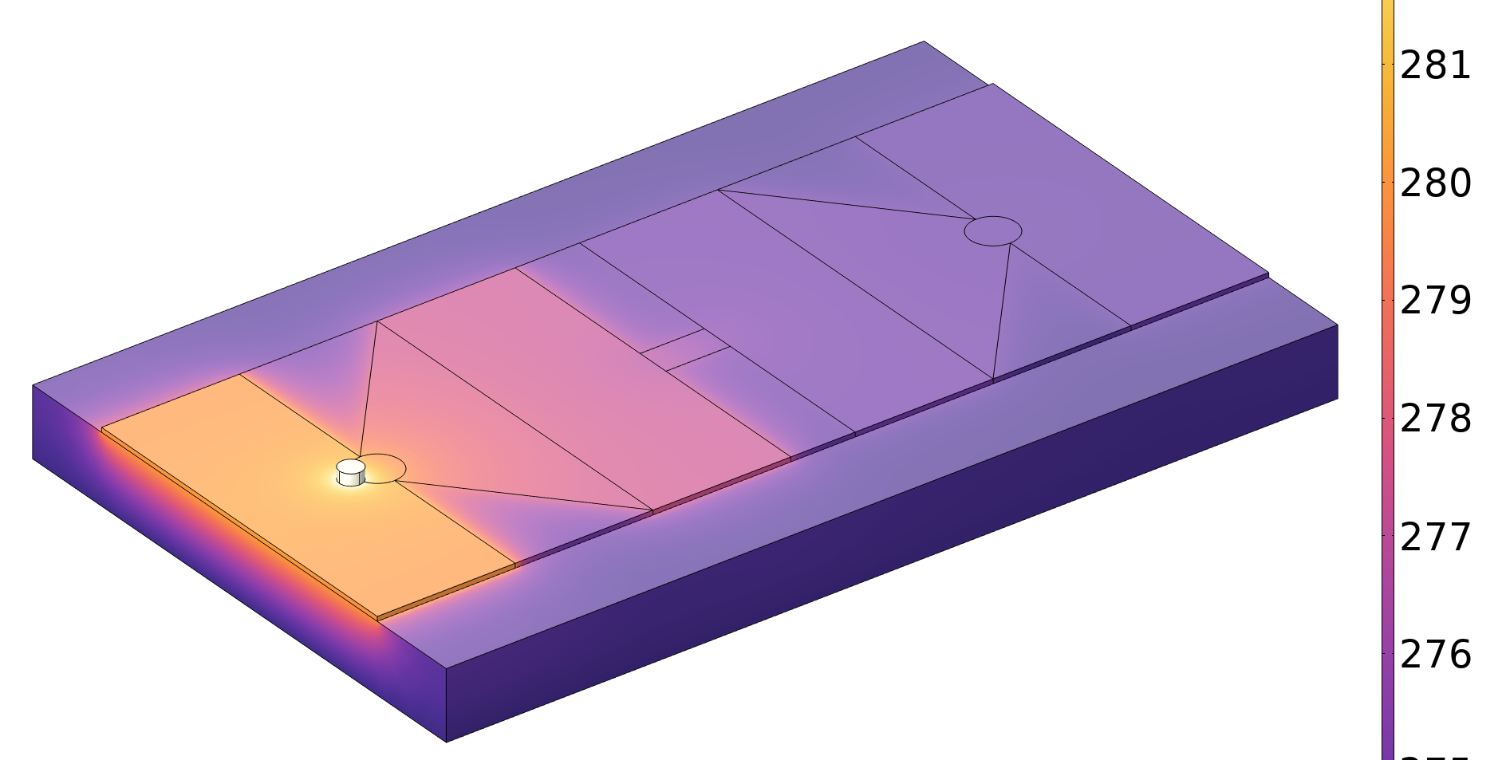
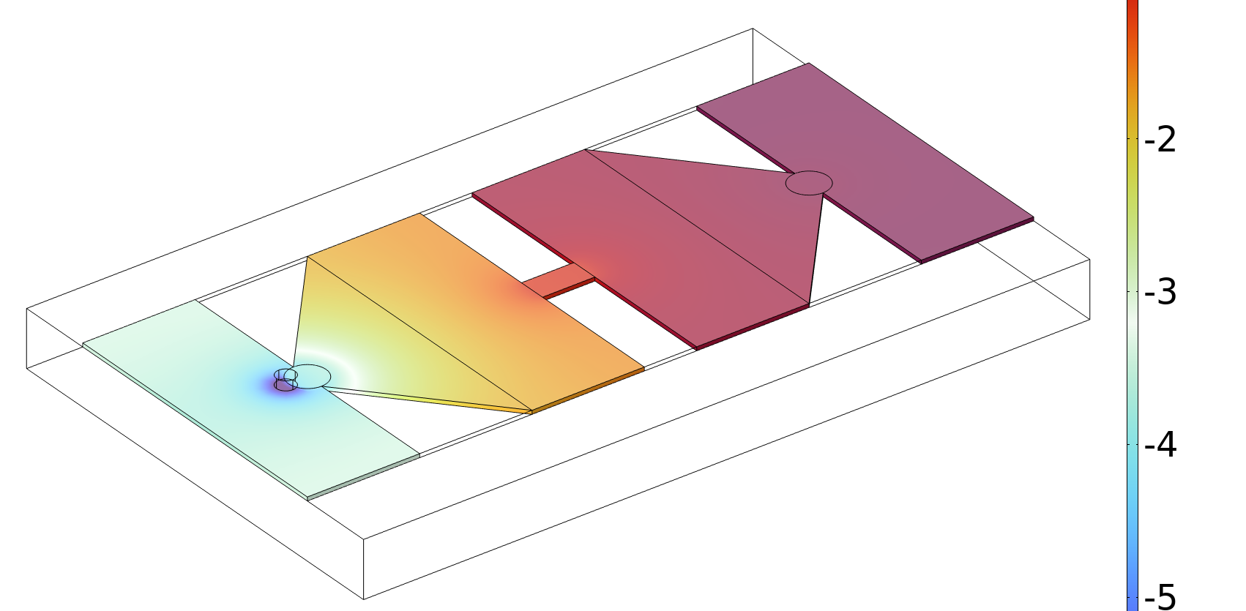
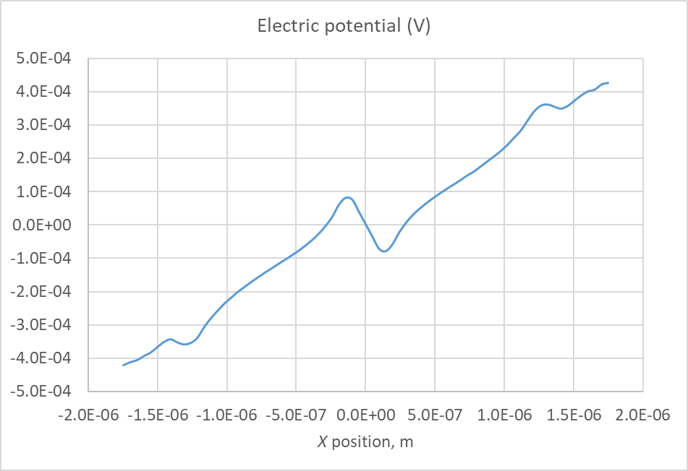
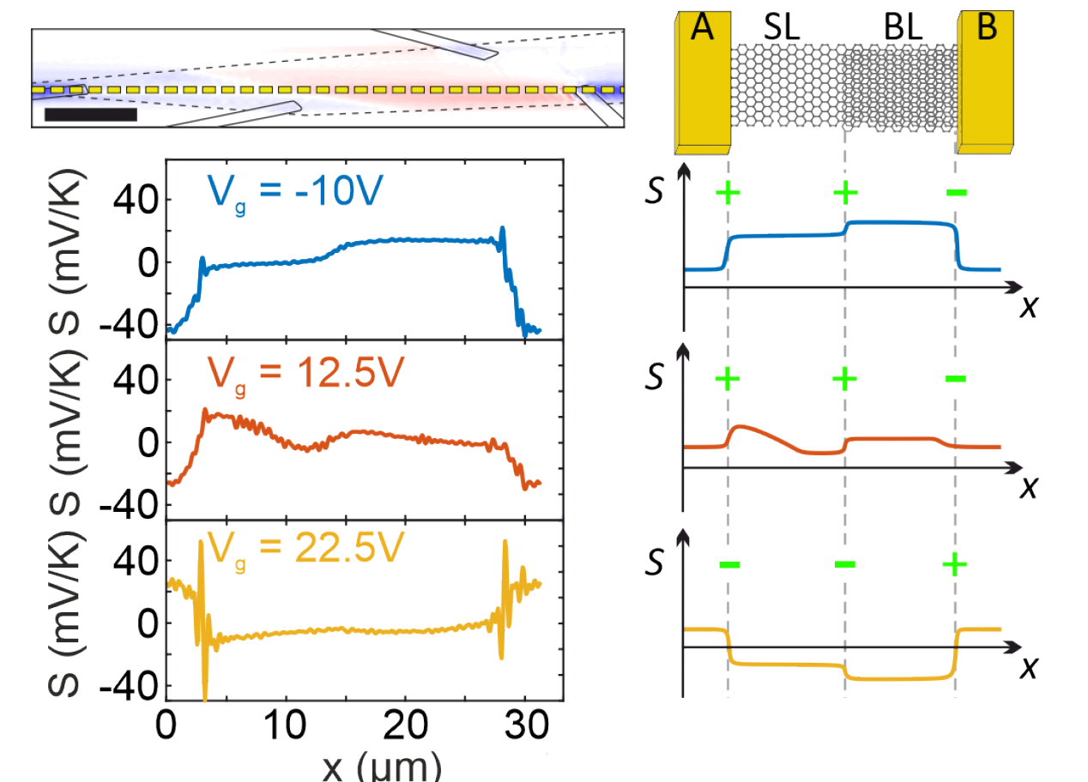
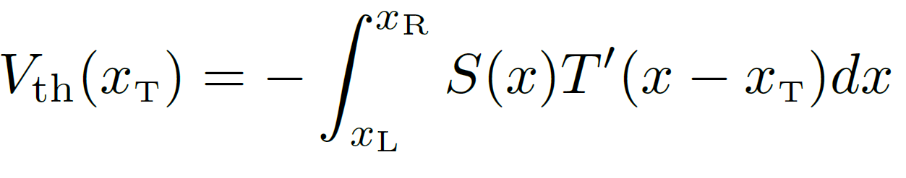
“Geometric thermoelectricity” (GTE) phenomenon. Encapsulated graphene: exploring nanoconstriction symmetry - carrier polarity parity.
Oleg Kolosov ¹, Eli G. Castanon^{1,2,3}, Matthew J. Hamer ³, Sergio Gonzalez ¹, Johanna Zultak ²,
Olga Kazakova ² and Roman Gorbachev ³.
¹ Department of Physics, Lancaster University, LA1 4YB, Lancaster, UK, ² National Physical Laboratory, Hampton Road, TW11 0LW, Teddington, UK, ³ National Graphene Institute, The University of Manchester, M13 9PL, Manchester, UK.
o.kolosov@Lancaster.ac.uk
“Geometrical thermoelectricity” (GTE) allows to tune a local Seebeck coefficient in a two-dimensional material (2DM) solely by changing device geometry [1], allowing to manufacture thermoelectric (TE) devices and heat management structures from a single material. The effect was initially observed in symmetrical nanoscale constrictions is linked with carriers mean-free path (MFP) modification in the nano-constriction. This study addresses several key questions of underlying physics of GTE – a) whether carrier polarity inversion results in the perfect inversion of the GTE effect, whether b) symmetry of the constriction effects the value and, possibly, sign of the GTE and c) whether electrodes and a substrate can be implicated in the origin of this effect.
GTE origin – nanoconstruction modifies local 2D material Seebeck coefficient
Interrogation symmetry: encapsulated variable geometry back-gated graphene nanosconstrictions
Vtip=0
Vin
hBN/Gr/hBN encapsulated device
Back gate
Au
hBN/ Gr/hBN
SiO₂/Si
Vbg
Topo
Joule heating
Peltier heating
Bow-tie graphene constriction in multifuctional SPM [1]
GTE most likely origin - dependence of carriers transmission and reflection in the constriction on the MFP (l₀) vs energy
The device has four symmetrical constriction geometries (i) triangular to flat, (ii) flat edge-long constriction - flat edge, and (iii) flat to triangular.
Topo
S=-$\frac{π^{2}k_{B}^{2}}{{3ε}_{F}e}\left[1+nU\frac{l\left(x\right)}{l_{0}}−\left(n−1\right)U\right]$ where $U={\left.\frac{d ln{l_{0}}}{d\ln{ε} }\right|}_{\left(ε=ε_{F}\right)}$
SiO₂/Si
SiO₂/Si
Key outstanding questions for the new GTE phenomena:
Will carrier polarity provide perfect inversion of the GTE effect?
GTE is observed in symmetrical junctions – will junction asymmetry affect GTE?
Can electrodes and substrate be the GTE culprit?
hBN/ Gr/hBN
hBN/ Gr/hBN
hBN/ Gr/hBN
SiO₂/Si
SiO₂/Si
Scanning Thermal Gate Microscopy (STGM) - probing nanoscale TE effect
Topo
Thermal
Electrical response Dirac p ~0V
Experiment and simulation - nanosconstriction symmetry – charge polarity parity preservation
Monolayer
Graphene
bilayer
STGM of GTE in the encapsulated structures “maps” local Seebeck coefficient. There is profound effects of the lateral heat transport in the 2D material (simulation) that providing a long range response.
Device irregularities do not affect carrier charge symmetry.
Joule heating
TE -STGM voltage
Gate dependence
STGM principle
STGM - deconvolution/ and quantification of local Seebeck coefficient.
Experimental STGM thermovoltage maps
FEA simulation
The encapsulation allowed to clarify that inversion of carrier polarity (~6 V backgate vs charge neutrality Dirac point < 1V) inverts the GTE response. Rectangular constriction reliably modifies the Seebeck coefficient to similar extent as high quality triangular junction. No effect of the electrodes is clearly observed, confirming the MFP origin of GTE.
CONCLUSIONS:
Introduced new “mixed physics” 2 electrical – 1 thermal 3-terminal device SPM based nanoprobe – scanning thermal gate microscopy (STGM) to explore nanoscale thermoelectric phenomena.
STGM maps thermal transport, Peltier and Seebeck effects.
Novel purely geometrical TE (GTE) phenomenon (no junction of dissimilar materials needed) in 2D materials were confirmed with clear link to the charge polarity, no link to electrodes.
GTE ffect does not directly depend on the orientation or symmetry of the junctions.
Lateral thermal transport plays significant role in the GTE effect.
References:
[1] Harzheim, A. et al, Nano Letters 2018, 18 (12), 7719-7725.
[2] Harzheim, A. et al, Advanced Functional Materials 2020, 30 (22), 2000574.
[3] Harzheim, A. et al, 2D Materials 2020, 7 (4), 041004.
Acknowledgements:
Lancaster University, EPSRC, EU Graphene Flagship Core 3..

