Slide 1





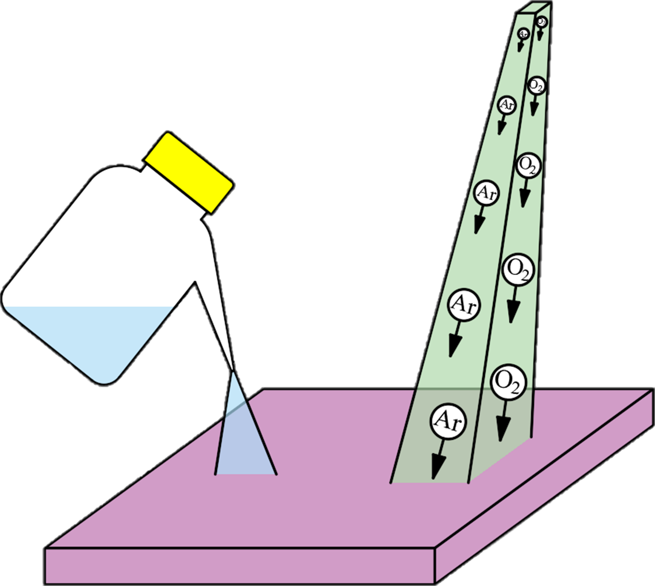
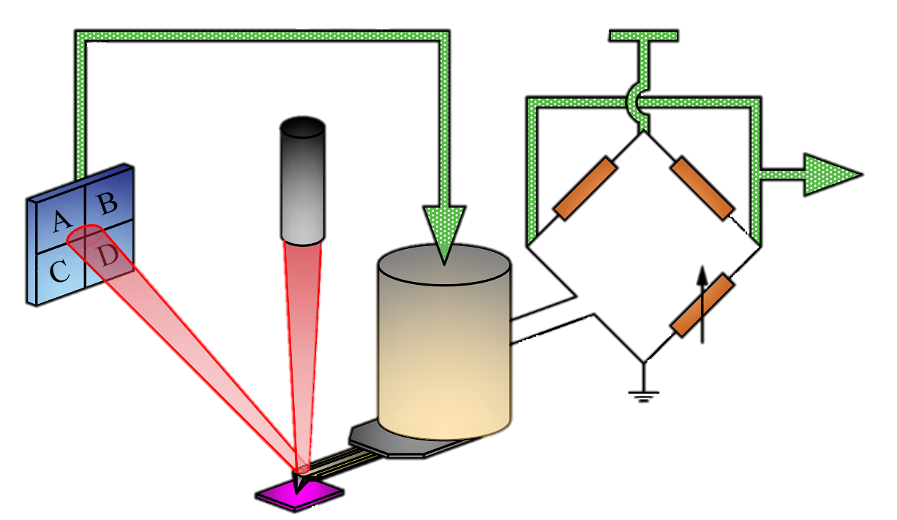
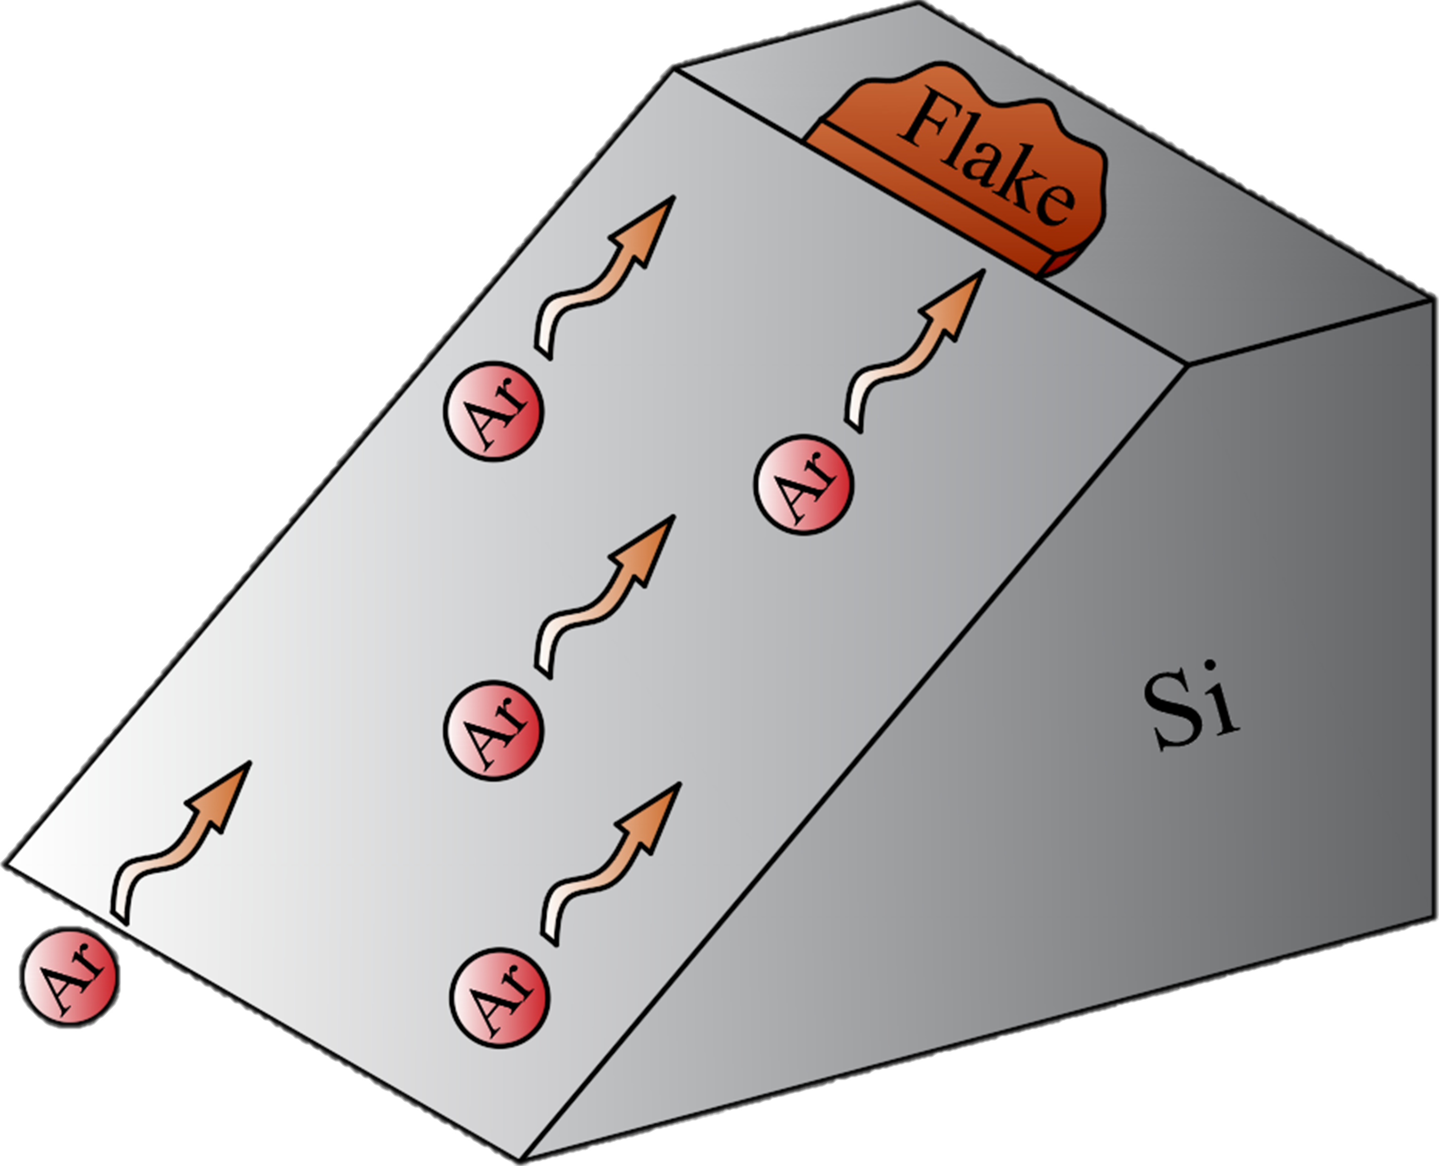
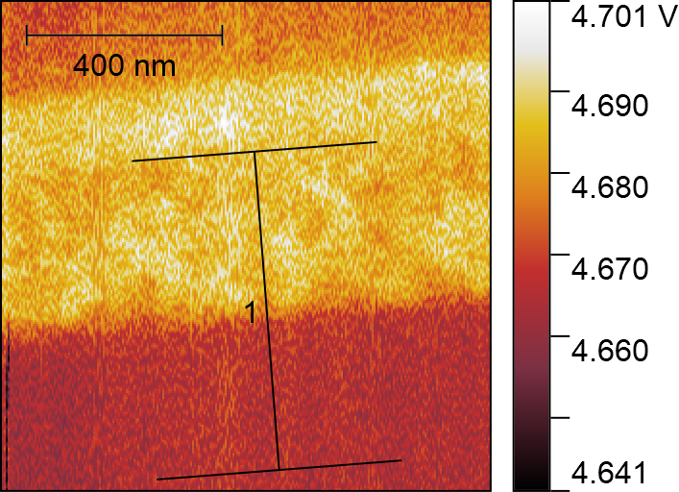
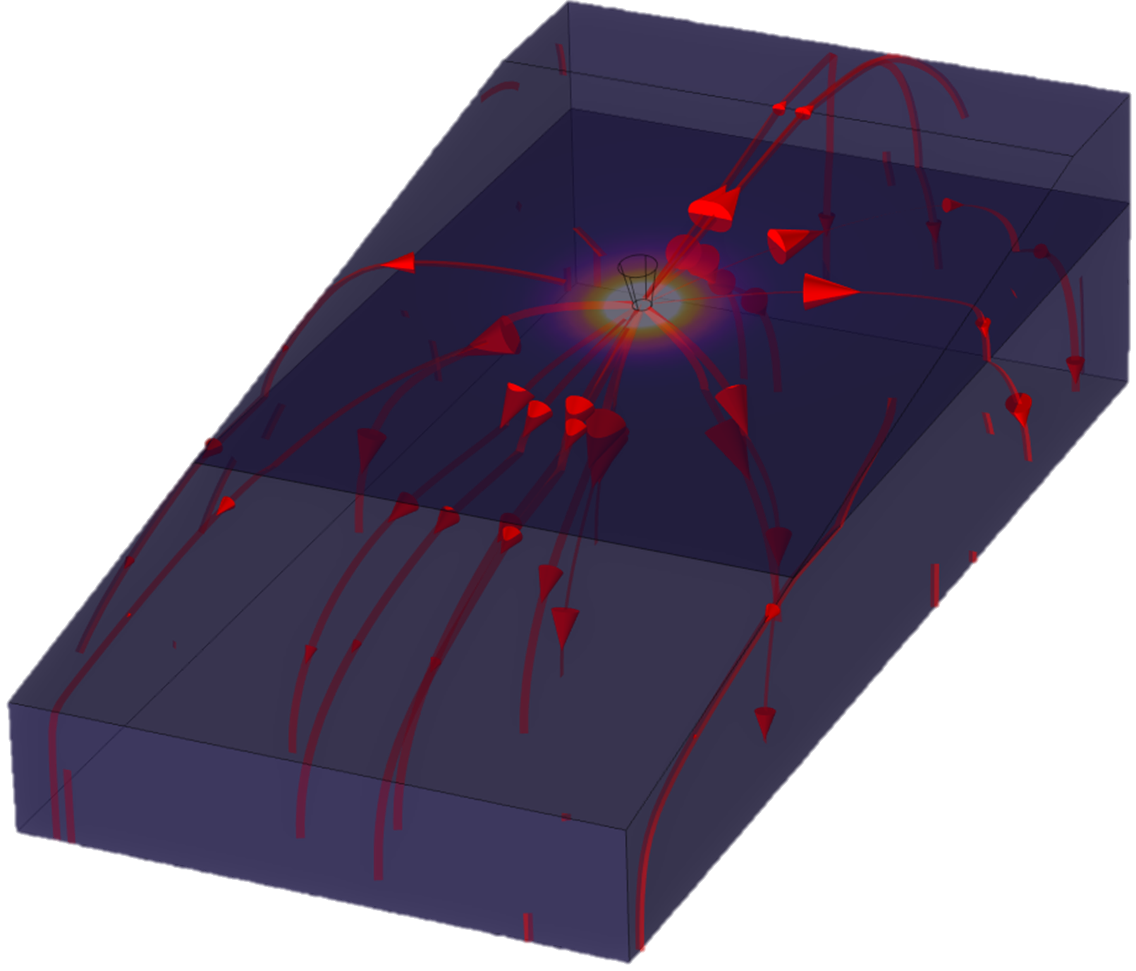



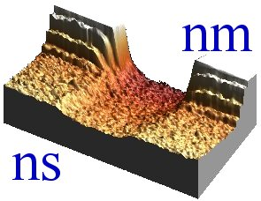
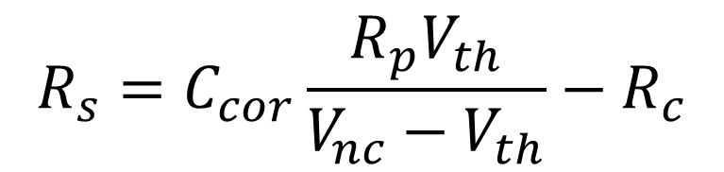
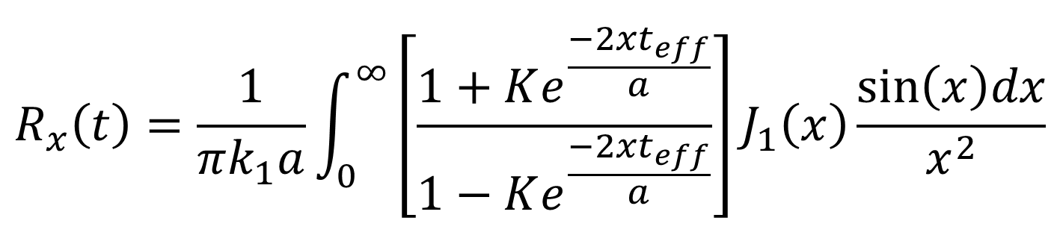

Measurements of Anisotropic Thermal Transport in γ-InSe via Quantitative Cross-Sectional Scanning Thermal Microscopy
Sergio Gonzalez-Munoz¹, Khushboo Agarwal¹, Eli G. Castanon², Zakhar R. Kudrynskyi³, Zakhar D. Kovalyuk⁴, Jean Spièce⁵, Olga L. Kazakova², Amalia Patane³ and Oleg V. Kolosov¹
¹Lancaster University, ²National Physical Laboratory, ³University of Nottingham, ⁴National Academy of Sciences of Ukraine, ⁵Université Catholique de Louvain
Keywords: Anisotropy, γ-InSe, nanoscale heat transport, wedge xSThM, thermal conductivity.
Summary:
We present a novel cross-sectional scanning thermal microscopy (xSThM) approach to study anisotropic heat transport in vdW γ-InSe together with its thermal resistances on the interfaces. We use beam exit cross-sectional polishing (BEXP) to shape the nanoflakes into low angle wedges with atomic scale surface flatness, followed by the xSThM in high vacuum (HV) conditions. By mapping continuously varying sample thickness, we eliminate the SThM tip-surface interfacial thermal resistance effect^{[4]}, hence, quantifying the γ-InSe – substrate heat transport. By comparing experimental results with a theoretical model^{[4]} and the finite element analysis (FEA) we can directly access the anisotropy of in-plane and cross-plane thermal conductivity of the vdW material (k_{ǁ}/k_{ꓕ}) and the thermal resistance (r_{int}) at the substrate interface.
Introduction:
Thermal transport in van der Waals (vdW) materials and their heterostructures can be tweaked, leaving an open platform for new TE applications^{[1]}. In particular, indium selenide (InSe) shows high TE potential due to advantageous electrical and thermal properties, increasing the TE efficiency^{[2]}. Here we quantify the thermal transport in γ-InSe nanolayers via x-section scanning thermal microscopy (xSThM), providing a key insight to its in-plane and cross-plane thermal conductivities as well as interfacial thermal resistance to the substrate^{[3,4]}.
Fabrication:
Samples: wedge γ-InSe flake on Si, wedge SiO₂ on Si (calibration). The fabrication procedure is depicted as follows:
Characterization:
HV-SThM (see scheme below) performed with an NT-MDT Smena microscope under high vacuum conditions (≈ 10⁻⁶ mbar) and ambient temperature (≈ 296 K).
SThM incorporates a resistive heater receiving constant power via a DC-AC Wheatstone bridge. The bridge output voltage is proportional to the probe temperature, which changes due to variations of the probe-sample heat flow. By moving the probe across the sample surface, a quantitative map of the sample heat transport is obtained.
Topographic feedback
V_{s}
1. Substrate cleaning: Solvent cleaning + O₂ plasma on surface.
2. Exfoliation: vdW flakes dry-exfoliated near to the substrate’s edge.
Laser
V_{out}
Wheatstone bridge
Bridge potential
Photodetector diode
Piezoelectric scanner
Variable resistance
3. BEXP: Cross-sectional wedge cut + polishing of substrate’s edge and flake.
Sample
Thermal probe
Results:
Al
15.936 K
Thickness (t) & thermal signal (V_{th} - top image) maps of the two samples are obtained. Profiles (bottom graph) are extracted from the images to provide the quantitative experimental data to compare with the theoretical model.
γ-InSe
The next equation is an isotropic fitting model for heat spreading^{[4]}. This can be transformed into anisotropic by changing $t→\overline{t}=t/{\sqrt{{k_{1,z}}/{k_{1,xy}}}}$and $k_{1}=\sqrt{k_{1,xy}k_{1,z}}$.
Si
15.733 K
γ-InSe
$$R_{x}\left(t\right)=\frac{1}{πk_{1}a}\int_{0}^{∞}{\left[\frac{1+Ke^{\frac{−2xt_{eff}}{a}}}{1−Ke^{\frac{−2xt_{eff}}{a}}}\right]J_{1}\left(x\right)\frac{\sin\left(x\right)dx}{x^{2}}}$$
r_{int} [Km²W⁻¹] | 9.6×10⁻¹¹
k_{1,xy} [Wm⁻¹K⁻¹] | 2.16 ± 0.35
k_{1,z} [Wm⁻¹K⁻¹] | 0.89 ± 0.09
The experimental data can be converted to thermal resistance with:
Si
Conclusions:
· Independently evaluate the γ-InSe and γ-InSe – substrate interfacial thermal resistance.
· Anisotropy in k of γ-InSe is reflected in the xSThM response vs. thickness and it is directly observed for the first time.
· Record lowest k in γ-InSe, beneficial for TE applications.
$$R_{s}=C_{cor}\frac{R_{p}V_{th}}{V_{nc}−V_{th}}−R_{c}$$
Acknowledgements: Authors are grateful to C. Evangeli, Y. Chen and A. Robson for insightful discussion on the SThM and BEXP measurements. The support of Graphene Flagship Core 3 project, EPSRC EP/V00767X/1 HiWiN project, UKRI Nexgenna project and Paul Instrument Fund (c/o The Royal Society) is fully appreciated.
References:
1. Kim, H. G. et al. Carbon. vol. 125. (2017).
2. Buckley, D. et al. Adv. Funct. Mater.. (2021).
3. Zhang, Y. et al. Adv. Funct. Mater.. vol. 30. (2019).
4. Spièce, J. et al. Nanoscale. vol. 13. (2021).

