Slide 1


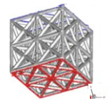
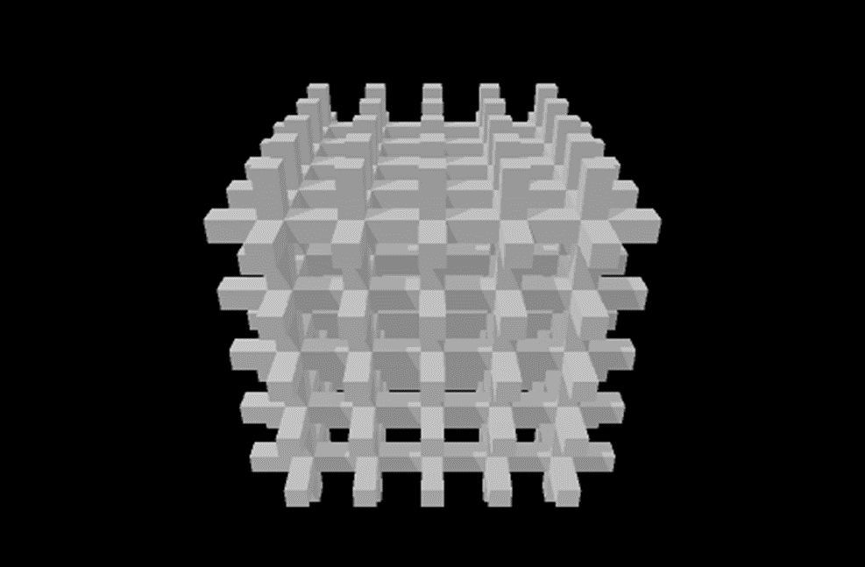
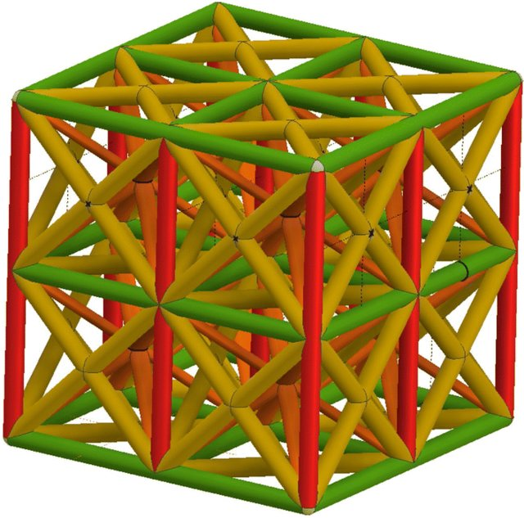
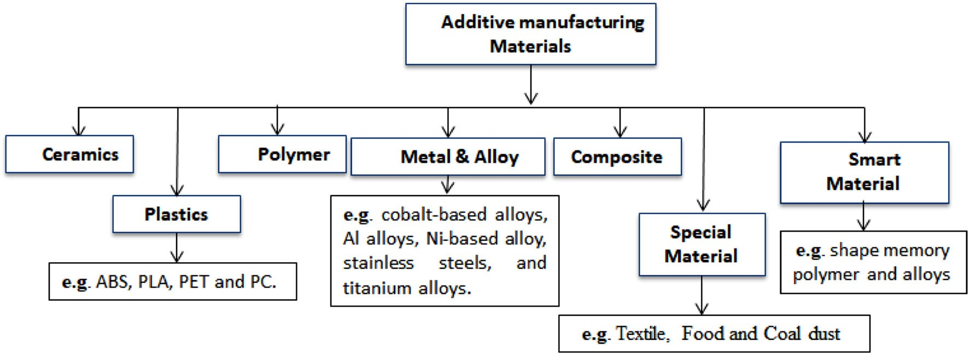
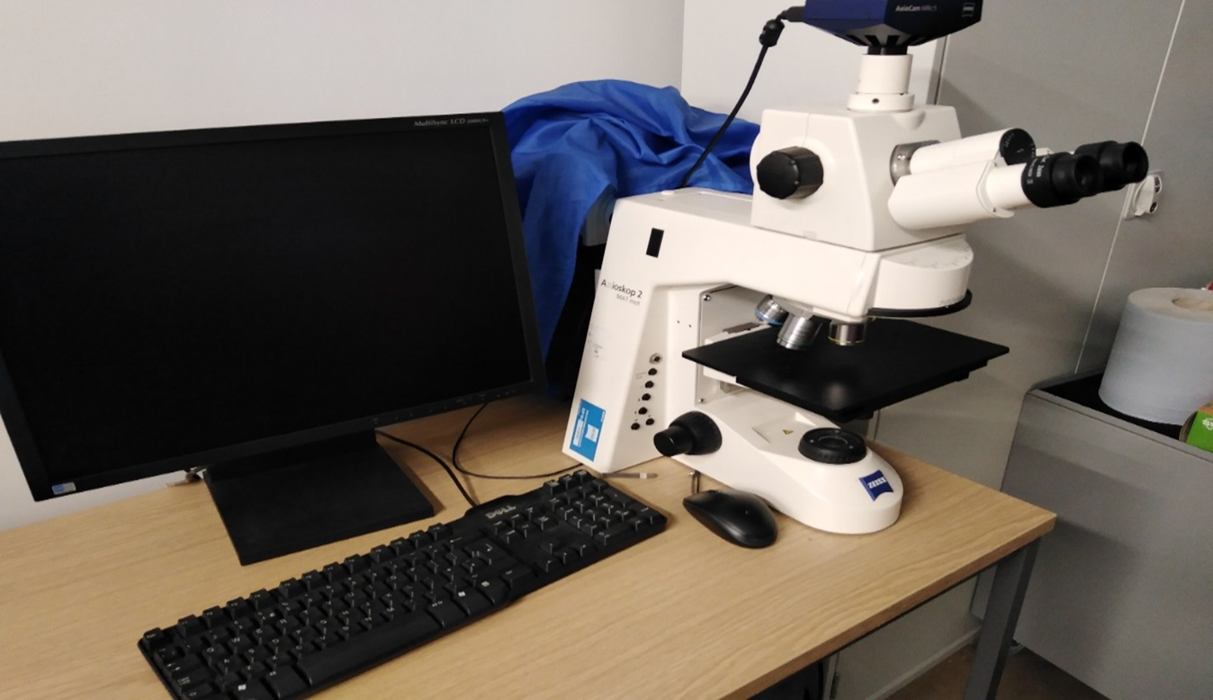
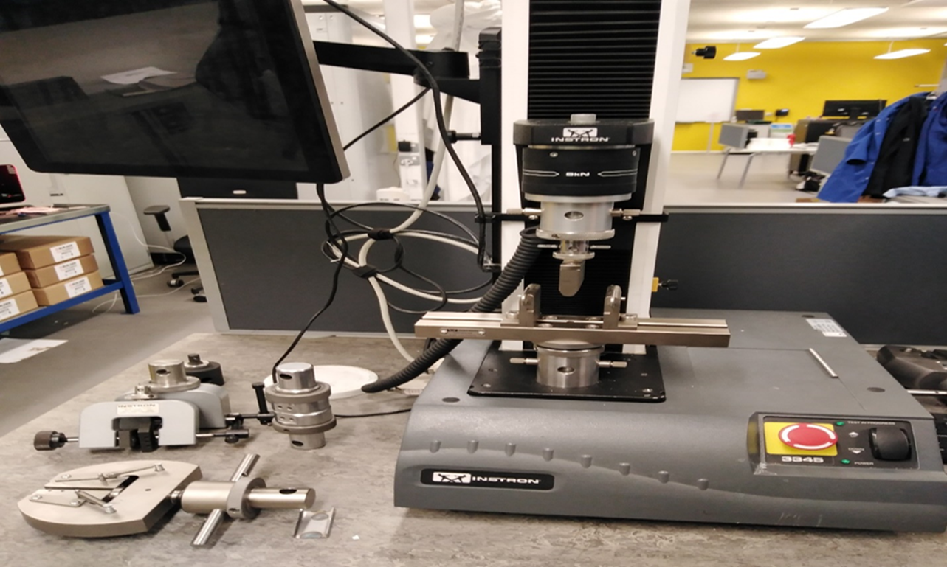
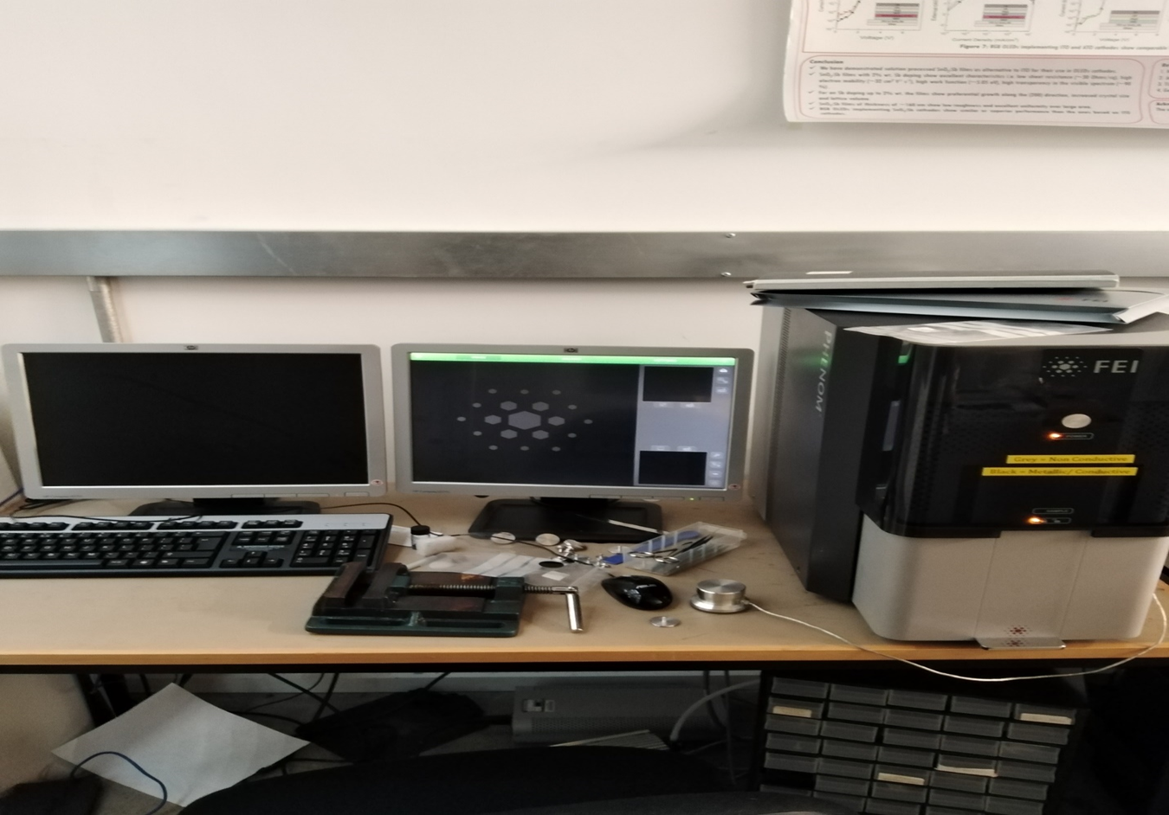
Manufacturing Of Engineered Novel Additive Manufactured Polymer Material From Phase-field
EMMANUEL FOLARIN ADEFUYE
1st Year PhD Student – Engineering Department
Supervisor: Prof. Jianqiao Ye and Dr. Xiaonan Hou
Email: e.adefuye@Lancaster.ac.uk
Motivation
Lattice structures
Using ABAQUS & ANSYS
Objectives
The research study will be sponsored by TETFUND in order to develop country in west African and largest black nation because we have a gap in our manufacturing industry, manufacturing material, manufacturing procedures, and additive manufacturing, such as the novel development applications in Nigeria of newly lattice structured designed. This could be utilized in local content applications in Nigeria, following the recent local content bill was passed in the country. I want to harness these skills so that I can give back to my home country, where I am currently a lecturer of mechanical engineering. Thus, this PhD research will be very beneficial and also advance additive manufacturing.
There are different types of lattice structures, such as these cube-shaped lattice structures..
To develop finite element models using numerical tools like Abaqus and Ansys software to simulate the material in order to find the area with highest stress concentration on cube lattice structure parts.
To develop a model for cube lattice structure using numerical methods, via tools like Solidworks software to design the lattice in CAD file model, and finite element models using numerical tools like Abaqus and Ansys software to simulate different materials for the lattice structure.
To design a specimen’s block with ASTME 638 mm will be used for mechanical testing to determine compression and tension test limits using Instron 3383 testing Machine.
To determine tensile tests using Instron testing machine to results on ultimate tensile strength test, yield strength test, ductility tests, elastic modulus test, and elongation test.
To determine compression tests resulting to stress test, strain test, tensile displacement, tensile stress test, tensile strain test, and hardness test.
To develop finite element models using numerical tools like Abaqus and Ansys software to simulate the material in order to find the area with highest stress concentration on cube lattice structure parts.
Planar cube- shaped
Straight cube- shaped
Polymerization Material
Additive Manufacturing Materials
The polymerization material to test is ABS and PLA in order to know the performance of the material, the biomedical application will be used in this research study in order to reduce stiffness, because is closer to that of bone and the application stands as a supporting load when compressing the materials. Each specimen is designed using ASTM D638 standard. Simulations are used to find the area with highest stress concentration on cube lattice structure parts to identify the failure regions.
Mechanical Properties of various polymers
Experiment and Results
MATERIALS | COMPRESSION YIELD STRENGTH | TENSILE STRENGTH* | IMPACT STRENGTH* (FT.-LBS./IN.)
PVC (TYPE I) | 75 | 41.4-71 | 8-9
PVC (TYPE II) | 60 | 42.1 | 15
CPVC | 75 | 48.9-50.3 | 8-9
ACRYLIC | 85 | 55.2-77.6 | 0.04-0.5
LDPE POLYETHYLENE | n/a | 27.6-28.3 | 1.1
POLYETHYLENE | n/a | 27.6-28.3 | 1.1
POLYCARBONATE | 90 | 55.2-110.3 | 1.5-18
POLYPROPYLENE | n/a | 17.2-37.2 | 0.9-10.1
POLYSULFONE | 80 | 70.3 | 1.3
ULTEM | 150 | 97.9-117.2 | 0.05-1.0
The technique for solving the problem is thermal residual by determine the mechanical loads, thermal loads, or phase changes. In view that, In this research study, six blocks of cube lattice structure will be manufactured for mechanical testing of tension tests in order to know the behaviour of the material under a compressive load by testing for the following tests ultimate tensile strength test, yield strength test, ductility test, elastic modulus test, elongation test. Secondly, tests will also be conduct on compression tests, Stress test, strain test, hardness test, tensile displacement, tensile stress test, tensile strain test. Furthermore, a specimens will also be design with ASTM D 638 to determine the tensile properties of plastics, such as tensile strength, elongation at yield, modulus of elasticity, etc.
Project Justification
Equipment and Tools
There is a gap in the manufacturing industry that requires a material, stress-strain compression, and an improvement in the existing manufacturing process. This research topic:’’ Manufacturing of an engineered novel additive manufactured polymerization material from phase-field’’ would help to address some of the exciting problems in the industry and provide solutions that are sustainable and applicable to both developed countries and developing countries. Due to this, this research study, we hope to achieve some mechanical testing numerical modelling, and novel material development.
References
Ning F, W Cong, J Qiu, Wei J and Wang S 2015 Additive manufacturing of carbon fibre reinforced thermoplastic composites using fused deposition modelling Compos. Part B Eng. 80 369–78.
Tekinalp H L, Kunc V, Velez-Garcia G M, Duty C E, Love L J, Naskar A K, Blue C A and Ozcan S 2014 Highly oriented carbon fibre-polymer composites via additive manufacturing,” Compos. Sci. Technol. 105 144–50.
Li N, Li Y and Liu S 2016 Rapid prototyping of continuous carbon fibre reinforced polylactic acid composites by 3D printing J. Mater. Process. Tech. 238 218–25.
Thiago R, Ferreira L, Cardoso I, Assis T and Bürger D 2017 Experimental characterization and micrography of 3D printed PLA and PLA reinforced with short carbon fibres Compos. Part B 124 88– 100.
Mohammed A, Ahsan M, and Raghavan S 2019 compression behaviour of three-dimensional printed polymer lattice structures; Proc imechE part .: Materials: Design and Applications, Vol. 244 8 1574- 1584.
Acknowledgement
I wish to acknowledge the support from both of my PhD Supervisors: Prof. Jianqiao Ye and Dr Xiaonan Hou.
Also, thanks to the staff and members of the Engineering Department of Lancaster University, UK.
Also acknowledge support of Dr Chiemela Victor Amaechi.
Thanks to the organisers of the FST Conference 2022.
Instron Mechanical Test machine
FST Conference 2022, FST Science Week: Shaping Our Future, Friday April 1st 2022, @ LUMS Hub
Zeiss microscopic machine

