Slide 1
Contributions of declarative and procedural memory to second language development
Diana Pili-Moss & Kara Morgan-Short
Sixth Implicit Learning Seminar, Budapest 25-26 May 2017

Slide 2
Internal factors mediating artificial language learning
Cognitive individual differences (different types of long-term memory, working memory, executive function, etc.) Faretta-Stutenberg & Morgan-Short (2017); Tagarelli et al. (2011); Kapa & Colombo, 2014
Developmental factors Ferman & Karni, 2010; Wonnacott et al. 2011; Pili-Moss (2017)
Proficiency level Morgan-Short et al. (2014)
Notes:
We know that a number of internal and external factors have an effect on second language learning and in particular artificial language learning.
Internal factors include for example cognitive individual differences of different types, or developmental factors, but also proficiency
External factors are environmental variables, such as the type of instruction the learner is exposed to or the context of learning.
In the last twenty years studies have investigated and found evidence for the relevance of these factors individually or in combinations.

Slide 3
In this talk
A number of studies found evidence that long-term declarative and procedural memory play a role in L2 learning (Antoniou et al., 2016; Ettlinger, Bradlow, & Wong, 2009; Morgan-Short et al., 2014; Morgan-Short et al., 2015)
It is not clear how these internal factors mediate practice, e.g. affect the emergence of automatization phenomena in language comprehension and accuracy in comprehension and production
Build on and extend the analysis of data already discussed in Morgan-Short et al. 2014
Notes:
In this talk we will focus on the role of internal factors, in particular individual differences in declarative and procedural learning ability.
Most previous studies have investigated the effect of individual cognitive differences on language learning looking at outcome measures taken offline, for example using GJTs. In this study we are looking at the effect of cognitive factor during practice.
In order to do so, we did not collect a a new set of data, but extended the analysis of data already collected in Morgan-Short et al. 2014.
So I will now turn to briefly reviewing this initial study before I move on to extend on the analysis.

Slide 4
Morgan-Short et al. (2014)
Investigated whether declarative and procedural memory predicted L2 learning ability at low and/or high levels of language proficiency
Trained 14 adults (M = 22.21) in the artificial language Brocanto2 over a two-week period using aural language stimuli in the context of a computer game
Notes:
14 adults participated in the study and learned Brocanto2 a fully productive artificial language in the context of a computer game and in implicit instruction conditions.
And with implicit instruction we meant that the participants did not receive instruction on the rules of the language syntax. They were also not aware they would be tested, intention to learn cannot be excluded because they were aware of the relationship between understanding the auditory input and progressing in the game the language was associated with.
Measures of declarative learning ability and procedural learning ability were taken.
And the outcome measure of language learning were two GJTs, respectively administered at the end of session 1, after a relatively small amount of language practice, and at the end of training.
KMS:
You might want to change “implicit instruction” to “implicit condition” or “implicit training condition” or when you explain it say “did not receive any explanation about the ruls of the language’s syntax”;
regarding “intention to learn,” before the implicit language training started, they were told that they would be learning an artificial language, so they were definitely aware that they would be learning a language.

Slide 5
Study Design
(4) Language Training and Practice
Vocabulary and game moves trained previously.
Vocabulary training: 4 token symbols, how to say ‘round’/
‘square’, name of the 4 moves and 2 possible directions, one article
10 CBs + 10 PBs
(1) Cognitive Measures
(5) Language Training and Practice
(2) Language Training and Practice
10 CBs + 10 PBs
6 CBs + 6 PBs
(6) Language Training and Practice
(3) Gram. Judgement Task 1
10 CBs + 10 PBs
CB = comprehension block
PB = production block
(7) Gram. Judgement Task 2
Notes:
Briefly this is the design of the study, with seven session in total over two weeks, one to three days apart.
Two of the sessions were assessment, and one used to collect cognitive measures.
The remaining four were practice. In each one of these sessions the participants would first listen to a set of Brocanto2 sentences associated to visual stimuli (the associated game moves) and then would play alternating comprehension and production game blocks
-----------
They were interested in whether declarative and procedural memory predicted L2 learning ability at low and/or high proficiency
14 adults (M = 22.21) trained in the artificial language Brocanto2 over a two-week period. 72 training blocks in total alternating 2 comprehension and 2 production blocks
Implicit training condition
Auditory language stimuli
Behavioural measures of long-tem declarative learning ability and long-term procedural learning ability
Two GJT tasks; one administered at the end of session 1 (low proficiency) and one administered at the end of training (high proficiency)
KMS:
I wonder if session 4 can be situated in the right column rather than in the middle? You could do that by moving it up high, and moving sessions 5, 6, & 7 over to the middle of the slide and put CB and PB on the right side possibly.

Slide 6
Cognitive Measures
Declarative composite score
Declarative learning ability | MLAT (part V); Carrol & Sapon, 1959 | Continuous Visual Memory Task; Trahan & Larrabee, 1988
Procedural learning ability | Tower of London; Kaller et al. 2012 | Weather Prediction Task; Foerde et al. 2006
Procedural composite score
Notes:
As for the cognitive measures two cognitive measures of declarative and procedural learning ability were taken respectively. The part V of the MLAT as a verbal index of declarative long-term memory and the Continuous Visual Memory Task as an index of visual long-term declarative memory.
For procedural memory the TOL and the WPT.
And then composite scores for procedural and declarative memory were calculated (mainly to overcome collinearity issues)
KMS:
I would move the entire table down a bit and put “Declarative composite score” on top of the box and “Procedural composite scores” on the bottom; Note that we converted the raw scores from the cognitive tests to Z scores and then averaged the Z scores for the composite score.

Slide 7
Declarative composite score
Children | Declarative learning ability | Short Story Recall (Vicari, 2007) | Visual-Spatial Recall (Vicari, 2007)
Adults |  | Short Story Recall (Mapelli et al., 2011) | Rey-Osterrieth Complex Figure (Caffarra et al., 2002)
Children/Adults | Procedural learning ability | ASRT Task (Hedenius, 2013; Lum et al., 2010) – accuracy score | ASRT Task (Hedenius, 2013; Lum et al., 2010) – RT score
Procedural composite score
Notes:
As for the cognitive measures two cognitive measures of declarative and procedural learning ability were taken respectively. The part V of the MLAT as a verbal index of declarative long-term memory and the Continuous Visual Memory Task as an index of visual long-term declarative memory.
For procedural memory the TOL and the WPT.
And then composite scores for procedural and declarative memory were calculated (mainly to overcome collinearity issues)
KMS:
I would move the entire table down a bit and put “Declarative composite score” on top of the box and “Procedural composite scores” on the bottom; Note that we converted the raw scores from the cognitive tests to Z scores and then averaged the Z scores for the composite score.

Slide 8
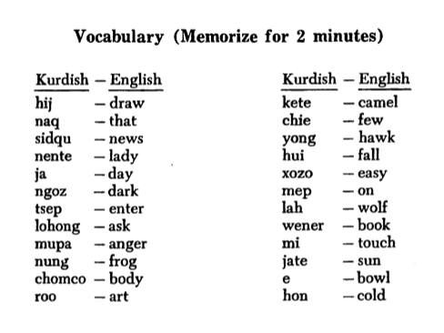
Modern Language Aptitude Test – Section V(MLAT-V)
Notes:
Verbal measure of declarative memory
Participants studied and memorized 24 Kurdish-English word pairs completed a multiple-choice test in which they chose the translation of a Kurdish word from 5 English word options. Score: number of correct items

Slide 9
Continuous Visual Memory Test (CVMT)
Notes:
Nonverbal measure of declarative memory, designed to minimize reliance on verbal strategies/knowledge
Participants viewed a series of complex, abstract designs; and stated whether each image was novel “new” or had appeared before, “old”
Each image would appear for 2 seconds, participants gave their judgment of NEW or OLD, and then another image would appear for a total of 112 slides. Score based on correct identification of OLD images.

Slide 10
Tower of London task (TOL)

Slide 11
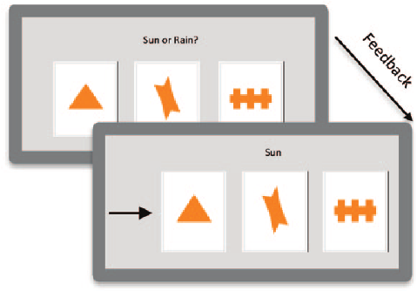
Weather Prediction Task (WPT)
picture from Waltzman, Knowlton, Suthana, & Asarnow (2013)
Notes:
Dual task version, probabilistic learning
Primary task: Presented with different patterns of tarot cards, each representing a different probability of ‘sunshine’ or ‘rain’, participants view each trial and predict weather as best they can (told that they will have to guess at first), given feedback after each trial (sunshine/rain)
Secondary distractor task of counting high tones, interspersed with low tones
Score: accuracy on final block

Slide 12
Study Design
(4) Language Training and Practice
Training:
144 sentences with the corresponding moves on screen
Practice:
36 comprehension + 36 production blocks
20 trials per block
1440 trials
10 CBs + 10 PBs
(1) Cognitive Measures
(5) Language Training and Practice
(2) Language Training and Practice
10 CBs + 10 PBs
6 CBs + 6 PBs
(6) Language Training and Practice
(3) Gram. Judgement Task 1
10 CBs + 10 PBs
CB = comprehension block
PB = production block
(7) Gram. Judgement Task 2
Notes:
Briefly this is the design of the study, with seven session in total over two weeks, one to three days apart.
Two of the sessions were assessment, and one used to collect cognitive measures.
The remaining four were practice. In each one of these sessions the participants would first listen to a set of Brocanto2 sentences associated to visual stimuli (the associated game moves) and then would play alternating comprehension and production game blocks
-----------
They were interested in whether declarative and procedural memory predicted L2 learning ability at low and/or high proficiency
14 adults (M = 22.21) trained in the artificial language Brocanto2 over a two-week period. 72 training blocks in total alternating 2 comprehension and 2 production blocks
Implicit training condition
Auditory language stimuli
Behavioural measures of long-tem declarative learning ability and long-term procedural learning ability
Two GJT tasks; one administered at the end of session 1 (low proficiency) and one administered at the end of training (high proficiency)
KMS:
I wonder if session 4 can be situated in the right column rather than in the middle? You could do that by moving it up high, and moving sessions 5, 6, & 7 over to the middle of the slide and put CB and PB on the right side possibly.

Slide 13
Brocanto2 features
Comprehension: To listen to a sentence in the new language and earn points if the move it describes is performed
correctly
(Morgan-Short, 2007)
Production: To see a move on screen and tell the researcher a sentence in the new language that describes it
Feedback
Running score and percentage correct score given at the end of each 20-move block
Limited time to respond
Notes:
In the comprehension blocks the task is to listen to a Brocanto2 sentence and perform the corresponding move correctly. After each move a feedback correct/incorrect appears and the game immediately progresses to the next stimulus sentence.
In production, on the other hand, participants watch a move on screen and utter the corresponding Brocanto sentence.
KMS:
Seems like it would be good to move the vocab and gam training to the previous slide and incorporate it into the session 2 box

Slide 14
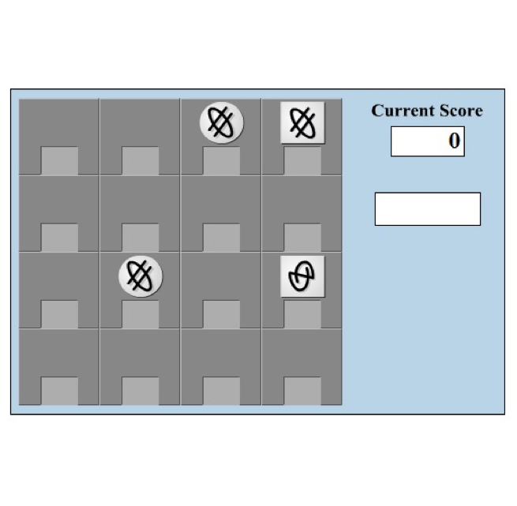
Brocanto2: example
NP - NP - Adv - V
N - Adj - Art
Blom trois-o lu blom neim-o lu zayma nim
Blom round-_{FEM} the-_{FEM} blom square-_{FEM} the-_{FEM} horizontally captures
[The round blom token captures the square blom token horizontally]
Notes:
And this is a Brocanto2 example sentence a participant may hear in a comprehension block.
Capturing is one of the four moves allowed, so in this case the sentence would prompt the participant to perform a move where….
The language syntax is totally productive and sentences can have different levels of complexity given this pattern.

Slide 15
Study Design
(4) Language Training and Practice
Morgan-Short et al. (2014)
Do declarative or procedural learning ability predict grammatical ability at low/high levels of proficiency?
10 CBs + 10 PBs
(1) Cognitive Measures
(5) Language Training and Practice
(2) Language Training and Practice
10 CBs + 10 PBs
6 CBs + 6 PBs
(6) Language Training and Practice
(3) Gram. Judgement Task 1
10 CBs + 10 PBs
CB = comprehension block
PB = production block
(7) Gram. Judgement Task 2
Notes:
Briefly this is the design of the study, with seven session in total over two weeks, one to three days apart.
Two of the sessions were assessment, and one used to collect cognitive measures.
The remaining four were practice. In each one of these sessions the participants would first listen to a set of Brocanto2 sentences associated to visual stimuli (the associated game moves) and then would play alternating comprehension and production game blocks
-----------
They were interested in whether declarative and procedural memory predicted L2 learning ability at low and/or high proficiency
14 adults (M = 22.21) trained in the artificial language Brocanto2 over a two-week period. 72 training blocks in total alternating 2 comprehension and 2 production blocks
Implicit training condition
Auditory language stimuli
Behavioural measures of long-tem declarative learning ability and long-term procedural learning ability
Two GJT tasks; one administered at the end of session 1 (low proficiency) and one administered at the end of training (high proficiency)
KMS:
I wonder if session 4 can be situated in the right column rather than in the middle? You could do that by moving it up high, and moving sessions 5, 6, & 7 over to the middle of the slide and put CB and PB on the right side possibly.

Slide 16
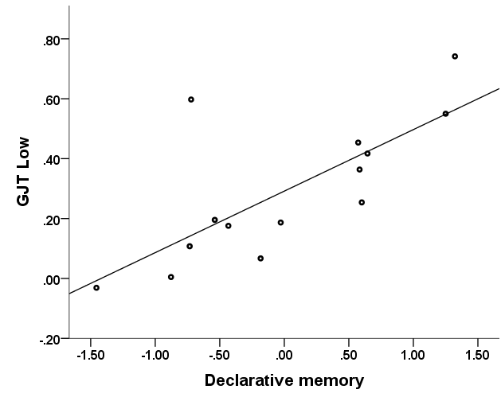
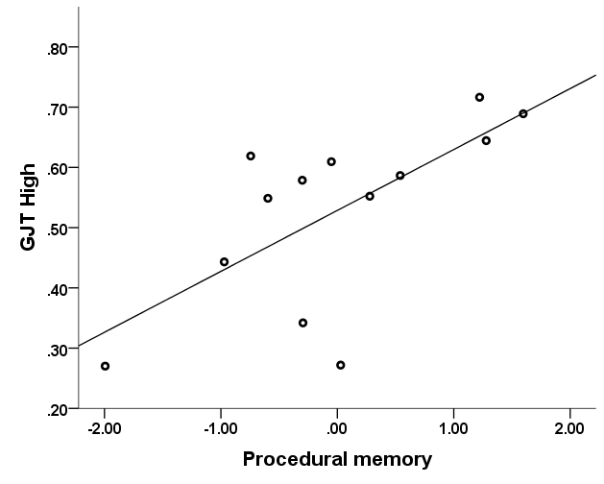
Results
Variable | B | SEB | β
Declarative | .198 | .060 | .711*
Procedural | .028 | .051 | .118
Constant | .292 | .047
Note. R² = .556; F (2, 11) = 6.27 p < .05 *p < .05
Low proficiency
(GJT 1)
Variable | B | SEB | β
Declarative | .011 | .042 | .065
Procedural | .099 | .036 | .661*
Constant | .529 | .934
Note. R² = .459; F (2,11) = 4.25, p < .05 *p < .05
High proficiency
(GJT 2)

Slide 17
Study Design
(4) Language Training and Practice
This study
RQ1:
Do declarative and/or procedural learning ability predict accuracy in language comprehension/production at any stage during practice?
10 CBs + 10 PBs
(1) Cognitive Measures
(5) Language Training and Practice
(2) Language Training and Practice
10 CBs + 10 PBs
6 CBs + 6 PBs
(6) Language Training and Practice
(3) Gram. Judgement Task 1
10 CBs + 10 PBs
CB = comprehension block
PB = production block
(7) Gram. Judgement Task 2
Notes:
Briefly this is the design of the study, with seven session in total over two weeks, one to three days apart.
Two of the sessions were assessment, and one used to collect cognitive measures.
The remaining four were practice. In each one of these sessions the participants would first listen to a set of Brocanto2 sentences associated to visual stimuli (the associated game moves) and then would play alternating comprehension and production game blocks
-----------
They were interested in whether declarative and procedural memory predicted L2 learning ability at low and/or high proficiency
14 adults (M = 22.21) trained in the artificial language Brocanto2 over a two-week period. 72 training blocks in total alternating 2 comprehension and 2 production blocks
Implicit training condition
Auditory language stimuli
Behavioural measures of long-tem declarative learning ability and long-term procedural learning ability
Two GJT tasks; one administered at the end of session 1 (low proficiency) and one administered at the end of training (high proficiency)
KMS:
I wonder if session 4 can be situated in the right column rather than in the middle? You could do that by moving it up high, and moving sessions 5, 6, & 7 over to the middle of the slide and put CB and PB on the right side possibly.

Slide 18
Results
Results: accuracy in comprehension
Variable | M | SD | corr DECL | corr PROC
ACCcompr1 | 11.45 | 4.00
ACCcompr2 | 16.64 | 3.31
ACCcompr3 | 18.43 | 1.61
ACCcompr4 | 18.58 | .50
∧p < .10 – significance corrected for multiple comparisons bootstrapped values

Slide 19
Results
Results: accuracy in comprehension
Variable | M | SD | corr DECL | corr PROC
ACCcompr1 | 11.45 | 4.00 | .647∧ | .164
ACCcompr2 | 16.64 | 3.31 | .624∧ | .079
ACCcompr3 | 18.43 | 1.61 | .491 | .166
ACCcompr4 | 18.58 | .50 | .409 | .165
∧p < .10 – significance corrected for multiple comparisons bootstrapped values

Slide 20
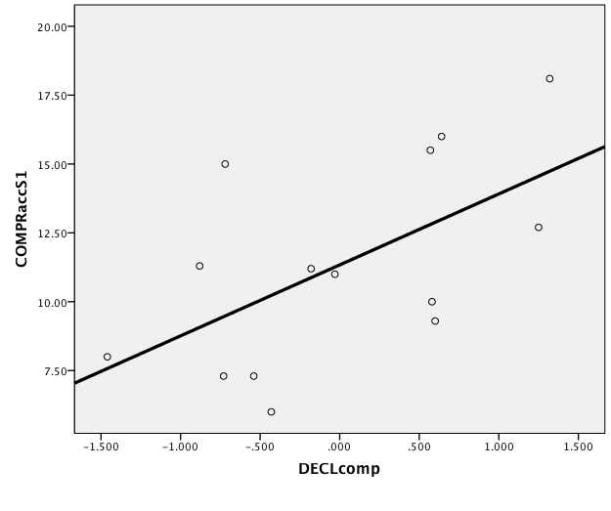
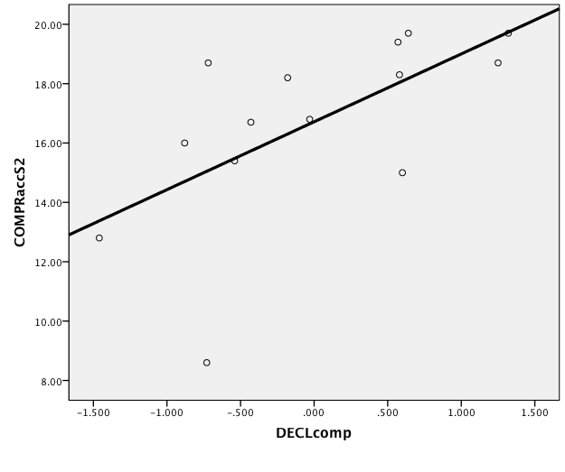
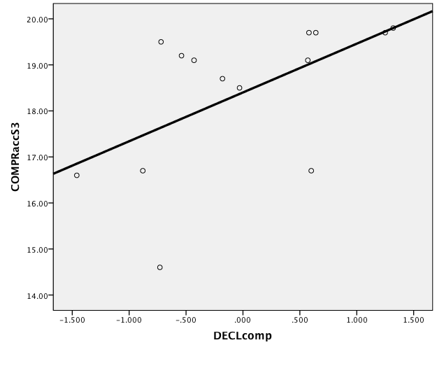
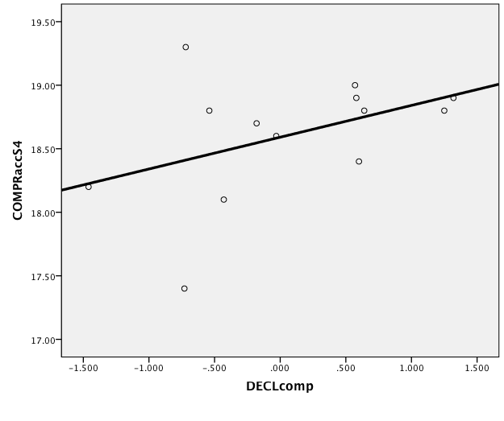
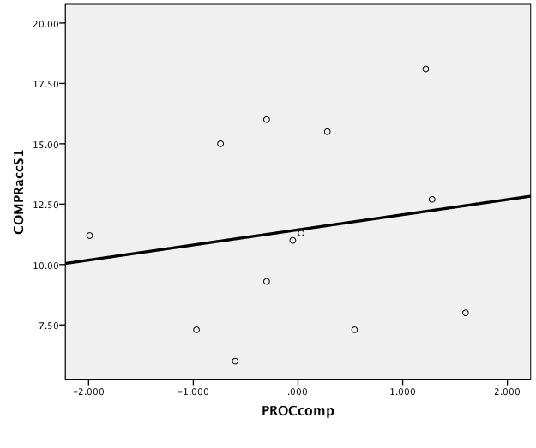
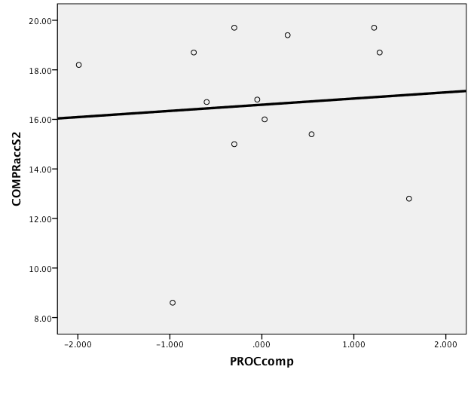
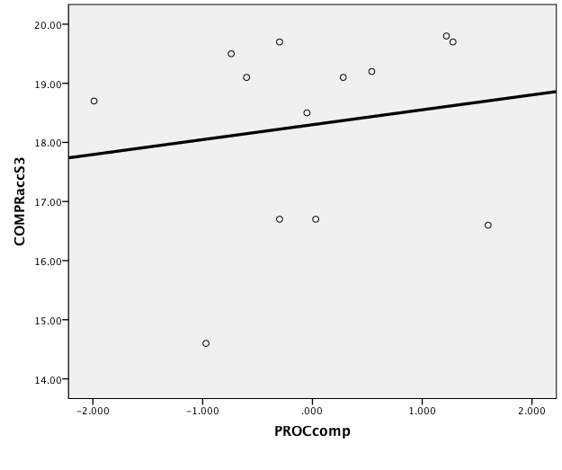
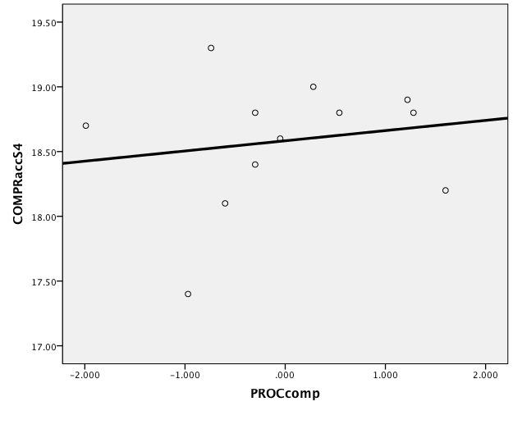
Results: accuracy in comprehension
∧
∧
D
R² = .343
R² = .388
R² = .309
R² = .184
P
R² = .027
R² = .006
R² = .024
R² = .027
1
2
3
4

Slide 21
Multiple regression model: accuracy in comprehension
DV: number of accurate trials per session
Predictors: DECLcomp; PROCcomp
1
2
Variable | B | SEB | β
Declarative | 2.74 | 1.13 | .615*
Procedural | .125 | .970 | .033
Constant | 11.56 | .913
Note. R² = .387; F (2,12) = 3.16, p < .10 sign.corrected *p < .05 bootstrapped values
B | SEB | β
2.31 | .946 | .624*
-.173 | .810 | -.054
16.69 | .763
Note. R² = .378; F (2,12) = 3.03, p < .10

Slide 22
Results
Results: accuracy in production
Variable | M | SD | corr DECL | corr PROC
ACCprod1 | 3.96 | 6.18
ACCprod2 | 11.01 | 8.08
ACCprod3 | 14.57 | 7.01
ACCprod4 | 17.83 | 3.03
*p < .05 – significance corrected for multiple comparisons bootstrapped values

Slide 23
Results
Results: accuracy in production
Variable | M | SD | corr DECL | corr PROC
ACCprod1 | 3.96 | 6.18 | .709* | .387
ACCprod2 | 11.01 | 8.08 | .356 | .157
ACCprod3 | 14.57 | 7.01 | .325 | .311
ACCprod4 | 17.83 | 3.03 | .345 | .281
*p < .05 – significance corrected for multiple comparisons bootstrapped values

Slide 24
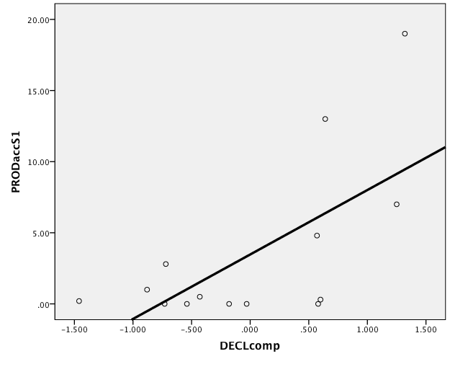
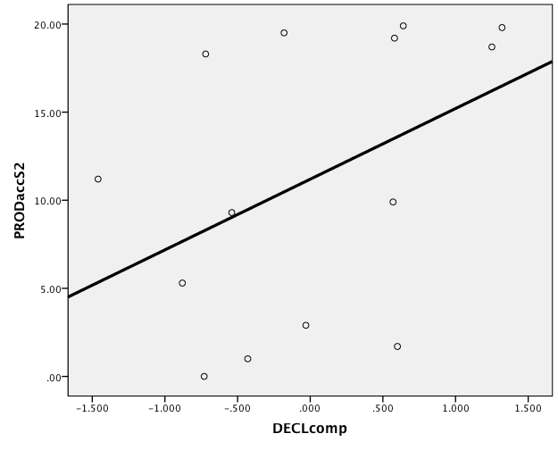
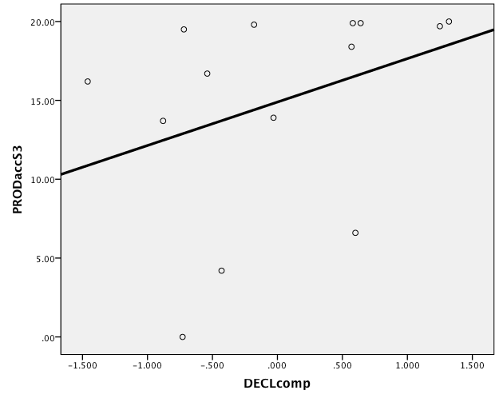
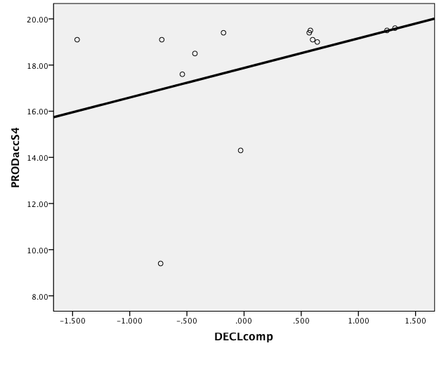
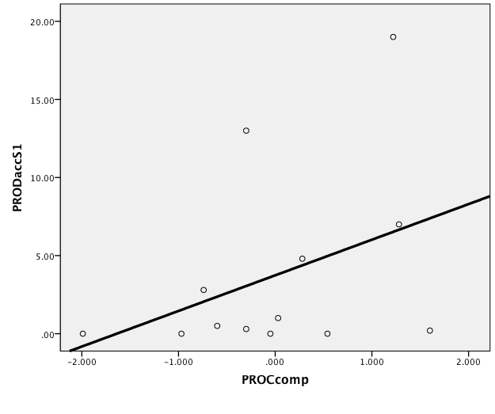
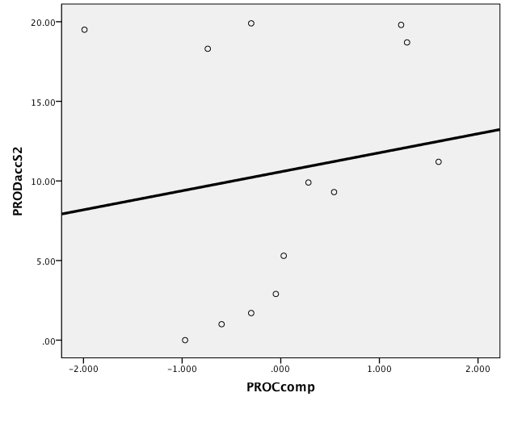
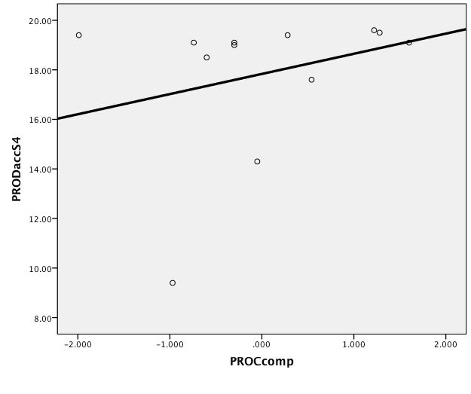
Results: accuracy in production
*
D
R² = .427
R² = .181
R² = .123
R² = .133
P
R² = .146
R² = .023
R² = .097
R² = .079
1
2
3
4

Slide 25
Multiple regression model: accuracy in production
DV: number of accurate trials per session
Predictors: DECLcomp; PROCcomp
1
Variable | B | SEB | β
Declarative | 4.60 | 1.49 | .660*
Procedural | 1.43 | 1.27 | .241
Constant | 3.94 | 1.20
Note. R² = .562; F (2,12) = 6.42, p < .05 sign.corrected *p < .05 bootstrapped values

Slide 26
Summary: accuracy
Declarative learning ability predicts accuracy in comprehension and in production at early stages but not at later stages of practice (similarly to what found for the grammaticality judgement tasks)
Procedural learning ability however does not predict accuracy in comprehension or production at any stage (unlike what found for the grammaticality judgement tasks)
Notes:
The fact that procedural learning ability predicts accuracy in the second GJT task but fails to predict accuracy in comprehension/production at higher stages of proficiency in practice points at the difference of what participants need to know to attain accurate performance in the two cases.
Accurate performance in the GJT requires detection of well-formed syntactic patterns independently of context, while in the case of accurate practice trials a number of semantic cues are still key to accurate performance.

Slide 27
Automatization in the Brocanto paradigm
Advantages:
Investigating automatization in the processing of full meaningful sentences (most previous studies focused on word learning)
Deploying a limited linguistic system (vs. investigating the automatization of complex natural language systems)
The practice task and the task used to measure automatization are the same (automatic performance does not easily transfer across contexts; DeKeyser, 1997)
Notes:
KMS:
I think here, you want to remind the audience that MSetal only looked at GJT but not at what was actually happening during language learning/use/practice… something like that….

Slide 28
Study Design
(4) Language Training and Practice
This study
RQ2:
Do declarative and/or procedural learning ability predict automatization at any stage during practice?
10 CBs + 10 PBs
(1) Cognitive Measures
(5) Language Training and Practice
(2) Language Training and Practice
10 CBs + 10 PBs
6 CBs + 6 PBs
(6) Language Training and Practice
(3) Gram. Judgement Task 1
10 CBs + 10 PBs
CB = comprehension block
PB = production block
(7) Gram. Judgement Task 2
Notes:
Briefly this is the design of the study, with seven session in total over two weeks, one to three days apart.
Two of the sessions were assessment, and one used to collect cognitive measures.
The remaining four were practice. In each one of these sessions the participants would first listen to a set of Brocanto2 sentences associated to visual stimuli (the associated game moves) and then would play alternating comprehension and production game blocks
-----------
They were interested in whether declarative and procedural memory predicted L2 learning ability at low and/or high proficiency
14 adults (M = 22.21) trained in the artificial language Brocanto2 over a two-week period. 72 training blocks in total alternating 2 comprehension and 2 production blocks
Implicit training condition
Auditory language stimuli
Behavioural measures of long-tem declarative learning ability and long-term procedural learning ability
Two GJT tasks; one administered at the end of session 1 (low proficiency) and one administered at the end of training (high proficiency)
KMS:
I wonder if session 4 can be situated in the right column rather than in the middle? You could do that by moving it up high, and moving sessions 5, 6, & 7 over to the middle of the slide and put CB and PB on the right side possibly.

Slide 29
Measure of automatization
Performance is increasingly faster but also more stable
Automatization operationalized as processing stability, a significant decrease of the ratio between intraindividual standard deviation and reaction time (Segalowitz & Segalowitz, 1993; Segalowitz 2010)
Coefficient of variation (CV)
CV = SD/RT
Mean RT
Itemized RT
Notes:
There have been basically two ways to understand and measure automatization, in terms of a speed up of accurate performance or in terms of a speed-up in performance associated to increasingly more stable processing >> more stable processing being indicated by increasingly small intraindividual standard deviations.
Segalowitz and colleagues have argued for the second type of definition and proposed a coefficient of variation as an index of automatized performance.

Slide 30
Results
Variable | M | SD | corr DECL | corr PROC
CV1 | .72 | .12
CV2 | .70 | .13
CV3 | .66 | .14
CV4 | .61 | .15
*p < .05 – significance corrected for multiple comparisons bootstrapped values

Slide 31
Results
Variable | M | SD | corr DECL | corr PROC
CV1 | .72 | .12 | .166 | -.328
CV2 | .70 | .13 | -.489 | -.708*
CV3 | .66 | .14 | -.443 | -.686*
CV4 | .61 | .15 | -.483 | -.689*
*p < .05 – significance corrected for multiple comparisons bootstrapped values

Slide 32
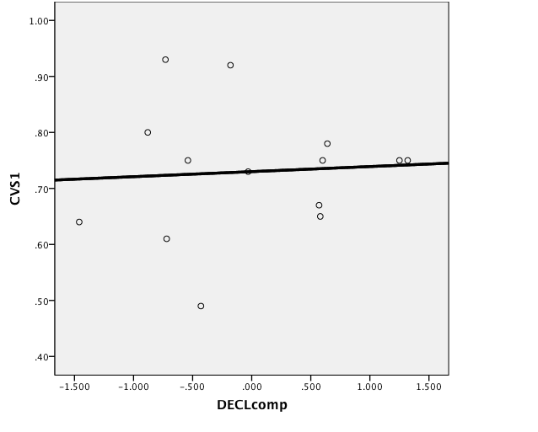
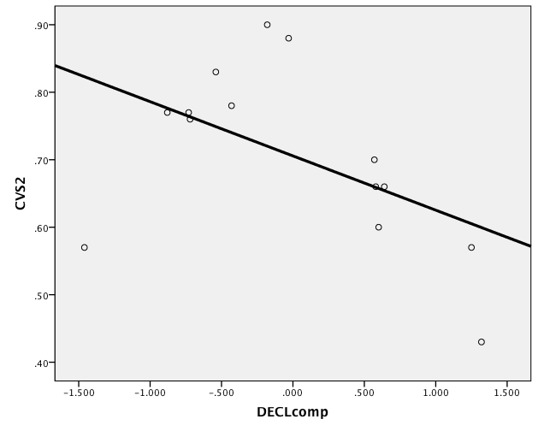
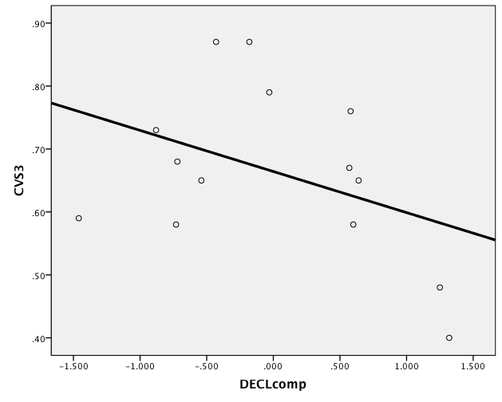
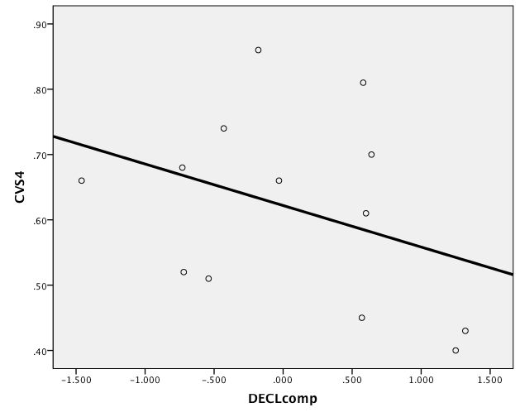
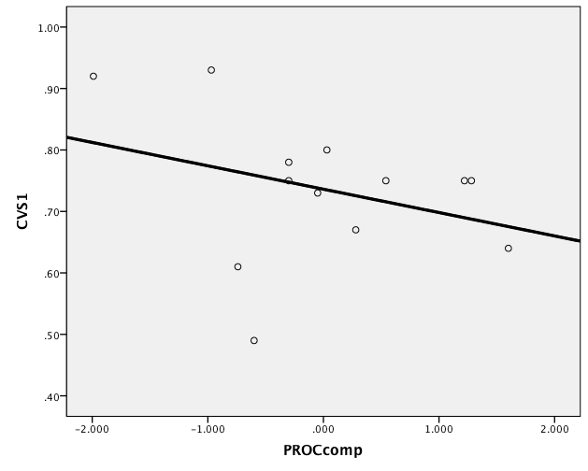
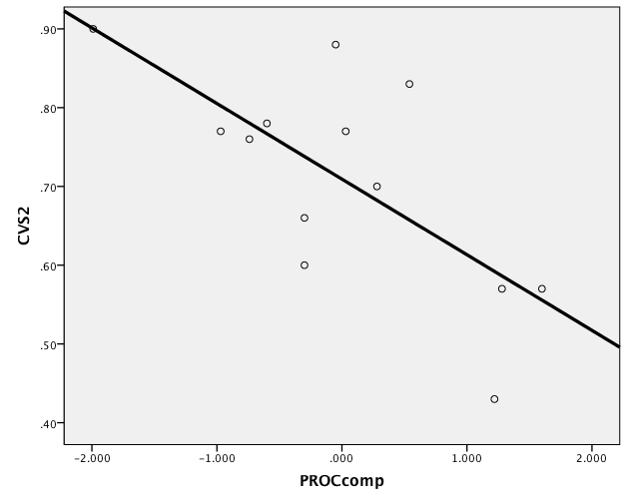
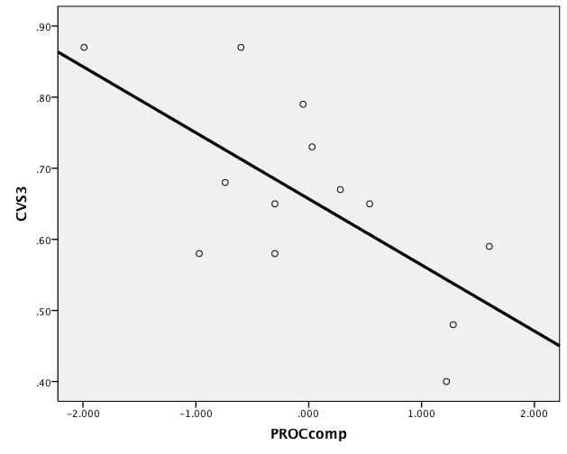
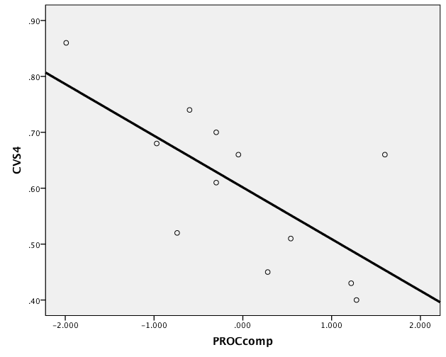
Results: automatization
R² = .004
R² = .260
R² = .165
R² = .132
D
R² = .104
R² = .491
R² = .457
R² = .475
P
*
*
*
1
2
3
4

Slide 33
Multiple regression model
DV: mean CV per session
Predictors: DECLcomp; PROCcomp
2
3
4
Variable | B | SEB | β
Declarative | -.059 | .032 | -.370
Procedural | -.085 | .027 | -.622*
Constant | .707 | .026
Note. R² = .622; F (2,12) = 8.21, p < .05 sign. corrected *p < .05 bootstrapped values
B | SEB | β
-.054 | .034 | -.336
-.085 | .027 | -.604*
.654 | .028
Note. R² = .565; F (2,12) = 6.48, p < .05
B | SEB | β
-.056 | .036 | -.345
-.082 | .029 | -.611*
.603 | .029
Note. R² = .588; F (2,12) = 6.41, p < .05

Slide 34
Summary: automatization
Declarative learning ability does not predict automatization at any stage (although it probably also plays a role)
Procedural learning ability is a significant predictor of automatized language processing from relatively early on in training (session 2)

Slide 35
Conclusions
Evidence that long-term memory plays a role in language learning from the earliest stages of practice
The declarative long-term memory system plays a role in accurate performance (at early stages of practice)
The procedural long-term memory system mediates automatization of performance
Notes:
In different places in the literature we find the idea that proceduralized language knowledge is automatic.
If this is the case this study would be among the first, I don’t know of any other, that actually showed a relationship between established behavioral cognitive measures of procedural learning ability and a measure of automatization.

Slide 36
Further developments/questions
Further investigation of the role of declarative learning ability and other cognitive factors in automatization (e.g. working memory, executive function)
Replication of a similar experimental design with more participants
Use of a repeated-measures analysis that accounts for random effects (e.g. mixed-effects model)
Investigate automatization of sequences not processed for meaning and see how it compares to automatization of sentences processed in context/which cognitive measures predict it.

Slide 37
Thank you!
Special thanks to:
Mandy Faretta-Stutenberg (Northern Illinois University)
Kate Brill-Schuetz (University of Illinois, Chicago)
references available upon request
d.pilimoss@lancaster.ac.uk
Diana Pili-Moss
Lancaster University
Kara Morgan-Short
University of Illinois (Chicago)

Slide 38
Additional slides

Slide 39
RTs cleaning procedure
only correct RTs are considered (84% of the whole data)
RTs are further cleaned calculating means in intervals of six consecutive blocks and accepting trials that are +/-2SDs from the mean
the first block (block 1) is omitted (training effect)
In total the cleaning procedure leads to the exclusion of 6% of the correct RTs from the analysis
Notes:
KMS:
I think you need a slide to say again that you are using the comprehension data from M-Setal and will be looking at Accuracy and RT of those responses.

Slide 40
Results
Variable | M | SD | MLAT-V | CVMT | TOL | WPT
GJT Low | .29 | .24 | .620* | .497^ | .187 | .281
GJT High | .54 | .15 | -.053 | .420 | .588* | .557*
*p < .05
 | Accuracy |  |  | d' |  |  | d'log10
Assessment | M | SD |  | M | SD |  | M | SD
GJT Low | .69 | .16 |  | 1.26 | 1.37 |  | .29 | .24
GJT High | .86 | .11 |  | 2.62 | 1.07 |  | .54 | .15

Slide 41
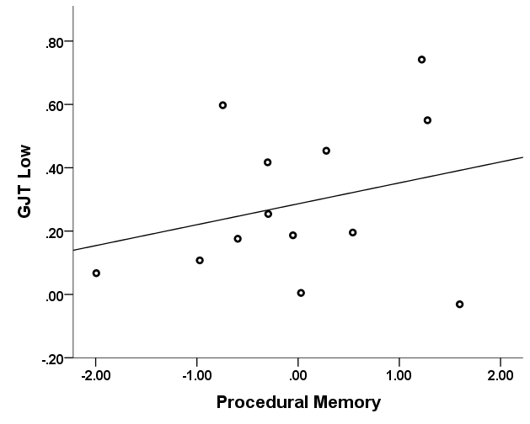
Results
Multiple regression model
DV: d’_{log10} at GJT Low
Predictors: Declarative & Procedural composites
Variable | B | SEB | β
Declarative | .198 | .060 | .711*
Procedural | .028 | .051 | .118
Constant | .292 | .047
Note. R² = .556; F (2, 11) = 6.27 p < .05 *p < .05

Slide 42
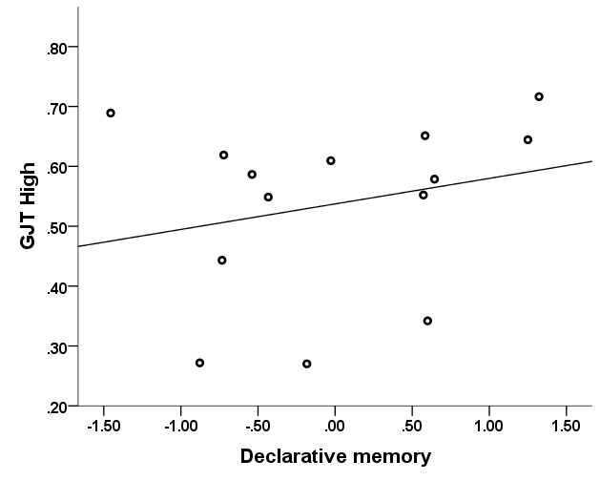
Results
Multiple regression model
DV: d’_{log10} at GJT High
Predictors: Declarative & Procedural composites
Variable | B | SEB | β
Declarative | .011 | .042 | .065
Procedural | .099 | .036 | -.661*
Constant | .529 | .934
Note. R² = .459; F (2,11) = 4.25, p < .05 *p < .05

Slide 43
This study- Research Questions (2)
RQ3a: Is there a relationship between declarative learning ability and automatization at different stages of practice?
RQ3b: Is there a relationship between procedural learning ability and automatization at different stages of practice?
RQ4: Will declarative and procedural learning ability predict automatization at different stages of practice?

Slide 44
Automatization
4 training and practice sessions
Composite measures of declarative and procedural learning ability
we looked at accuracy from comprehension and RTs of those responses (unlike Morgan-Short et al., 2014)
DV: mean CV per session

Slide 45
CV variation
The CV decreases overall between session 1 (M = .72) and session 4 (M = .61)
t(12) = 2.17, p = .050
Overall there is a positive and significant relationship between CV and mean RT
r = .476, p = .004

Slide 46
CV/RT correlation

Slide 47
This study- Research Questions (1)
RQ1a: Is there a relationship between declarative learning ability and accuracy in comprehension/production at different stages of practice?
RQ1b: Is there a relationship between procedural learning ability and accuracy in comprehension/production at different stages of practice?
RQ2: Will declarative and procedural learning ability predict accuracy in comprehension/production at different stages of practice?

Slide 48
Accuracy in comprehension/production
4 training and practice sessions
Composite measures of declarative and procedural learning ability
DV: number of correct trials per session

Slide 49
**

