Slide 1
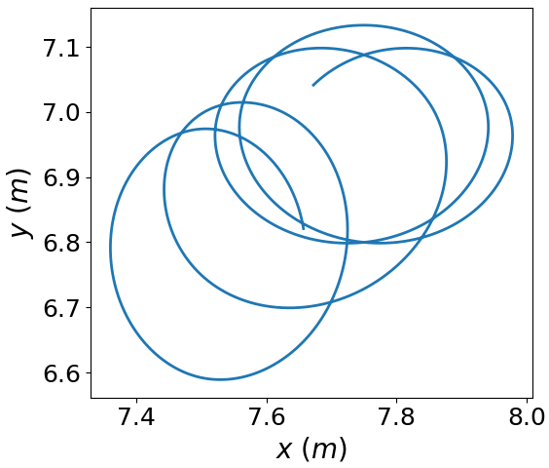
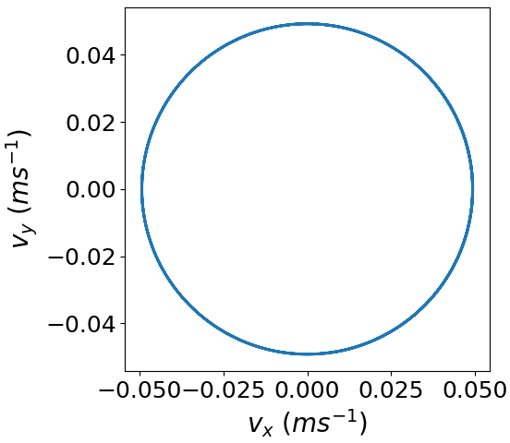
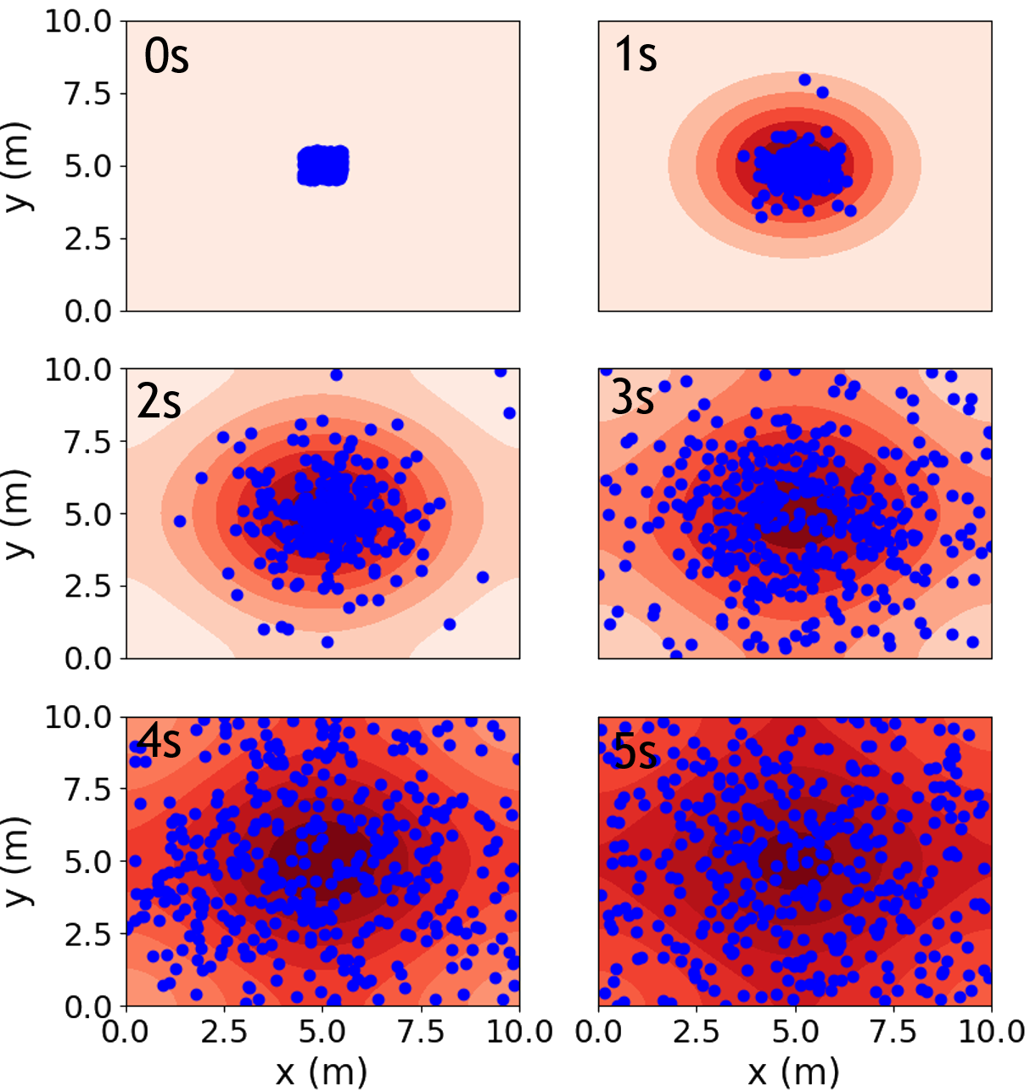
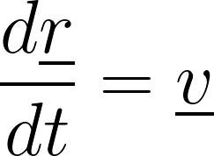
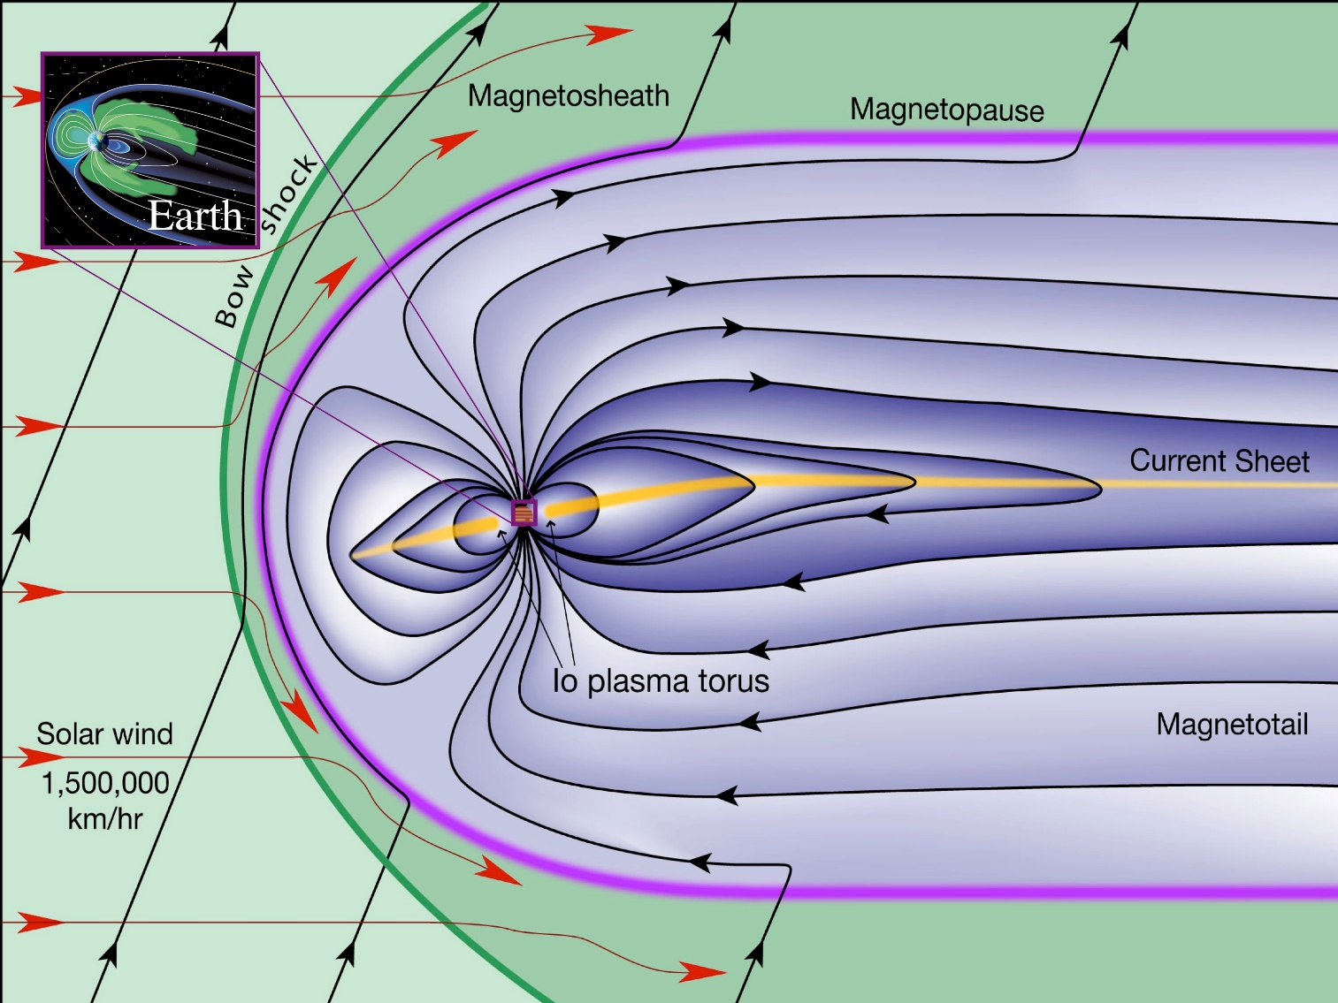
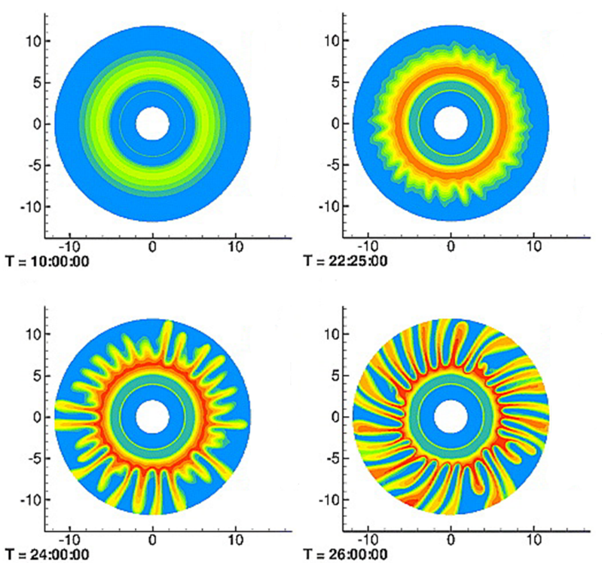
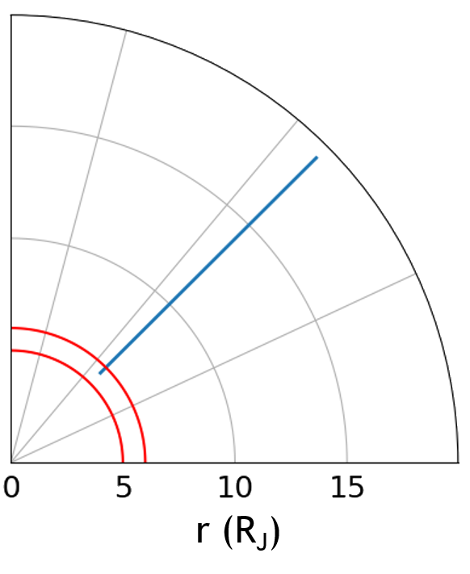
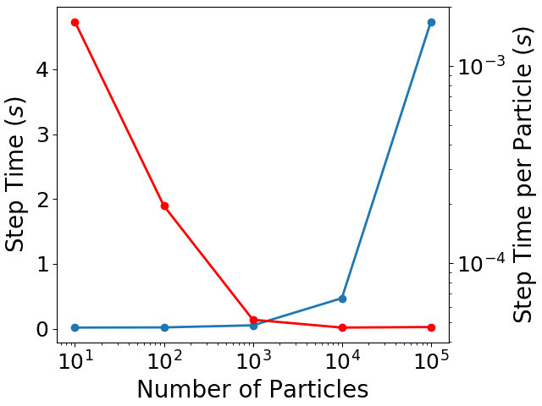
Hybrid Magnetospheric Modelling at the Outer Planets using Python
2. How to Model the Jovian Magnetosphere
4. Initial Results
4.1 Ion Gyro-Motions
We have been developing a 2.5D hybrid kinetic-ion, fluid-electron model. The ions are modelled using a Particle-In-Cell (PIC) description and the electrons are a neutralising magnetohydrodynamic (MHD) fluid^{5,6}. A Cartesian grid is overlaid across the simulation region on the vertex's of which the electromagnetic (EM) fields are calculated.
i,j+1
A
A 30s ray-trace of a proton’s path is shown. The region through which the particle travels contains a uniform magnetic field of 1nT. Comparing theoretical values to the results finds close agreement between those calculated and those observed in the model. The ion’s guiding centre drifts along its initial velocity vector, gyrating perfectly circularly in velocity space.
A
Josh Wiggs & Chris Arridge
i,j
i+1,j
j.wiggs@lancaster.ac.uk
Department of Physics, Lancaster University,
Lancaster, LA1 4YB, UK
The model is advanced through time numerically, with the magnetic field being obtained with a modified MacCormack Predictor-Corrector scheme in order to minimise numerical instabilities allowing larger time steps.
Initial & boundary conditions
Ions are pushed numerically considering the Electromagnetic, Coriolis and Centrifugal forces
Radii: ~0.2m
Period: ~6.5s
1. Why Model Magnetospheres?
It is important to understand how magnetospheres function and how they respond to external forces. Obtaining an exact solution to the governing equations is very difficult, this means it is necessary to construct a simplified model¹.
Jupiter’s magnetosphere differs significantly from the Earth’s. The main physical factors for this are:
Jupiter’s magnetic field is ~14 times greater in magnitude
The planetary spin rate is much greater at ~10 hours
The volcanic moon Io ejects 1000 kgs⁻¹ of plasma into the magnetosphere loading it and creating the plasma torus
Update particle positions & velocities
4.2 Diffusion
Ions diffuse from an initially compressed distribution to occupy all space available. 400 particles (in blue) were initialised in a 1x1m area at the centre of the model. The particle positions on each second are plotted over a diffusive fluid model of the same region. It is seen that the particle distribution matches well with the contours of the fluid.
Interpolate particle parameters
Parameters are obtained from ion distributions using first-order interpolation onto the EM field grid vertices
Δt
The magnetic field is updated using Faraday’s Law and the electric field using the MHD momentum equation for massless electrons
Update magnetic field
Calculate electric field
4.3 Rotational Motions
By turning off the EM fields it is possible to directly observe the effects of the Centrifugal and Coriolis pseudo-forces. Examining the path of a single ion over 3 hours reveals it moving radially outwards with a small deflection in the azimuthal direction. It is initialised with a position that would be expected to be within Io’s plasma tours.
Credit: F. Bagenal & S. Bartlett
Liu et al, 2010
3. Model Performance
We are particularly interested in the simulation of plasma convection from Jupiter’s plasma torus radially outwards. This convecting plasma is theorised to undergo the radial interchange instability. Interchange motions occur between magnetic flux tubes and are responsible for the bulk transport of plasma from Io into the inner & middle magnetosphere^{3,4}. It is therefore necessary to examine the plasma at the ion-inertial scale in order capture the motion of particles between flux tubes whilst maintaining the computational capacity to resolve length scales on the order of the planetary radii.
Our aim is to produce a hybrid plasma model capable of reproducing radial outflows from Io’s torus into the middle magnetosphere over multiple planetary rotations. The 2D magnetosphere will be coupled to the Ionosphere
A series of performance tests on the current version of the hybrid model were carried out. A 10x10m surface was constructed with a 51x51 grid. It was determined as the number of particles increased:
The time taken to complete one time step increases linearly
The time taken to computed each particle’s motion decreases
Once particle operations dominate the run time the time per particle becomes constant at 47μs. Compared to the particle operation time of a
5. Future Work
highly optimised PIC model⁷ it is approximately 2 orders greater, emphasising the need for optimisation.
Optimise memory usage by model to reduce computational time per particle
Parallelise code to decrease overall run time of simulations
Couple magnetosphere described by model to a Ionosphere
Alter background fields, initial conditions and boundary conditions to Jovian values
and will provide insight into interchange ion motions.
V. M. Vasyliunas. 1970. In Particles and Fields in the Magnetosphere. B. M. McCormac (Springer, Dordrecht).
X. Liu, T. W. Hill, R. A. Wolf, et al. 2010. J. Geophys. Res., 115, A12254
Southwood, D. J., & Kivelson, M. G. 1987, J. Geophys. Res., 92, 109
Southwood, D. J., & Kivelson, M. G. 1989, J. Geophys. Res., 99, 299
Winske, D., Yin, L., Omidi, N., et al. 2003. In Space Plasma Simulation, ed. J. Büchner, C. T. Dum, & M. Scholer (Springer, Berlin), 136
Bagdonat, T. 2004, PhD Thesis, University of Braunschweig
Decyk, V. K., & Singh, T. V. 2014, Comput. Phys., 185, 708
Test System Specs:
CPU: Intel® Xeon® Processor E3-1271 v3 (@ 3.60GHz)
Memory: 32Gb Samsung DDR3 (@ 1600 MHz)
Software: Python 3.7.3 / Numpy 1.17.0

