Slide 1
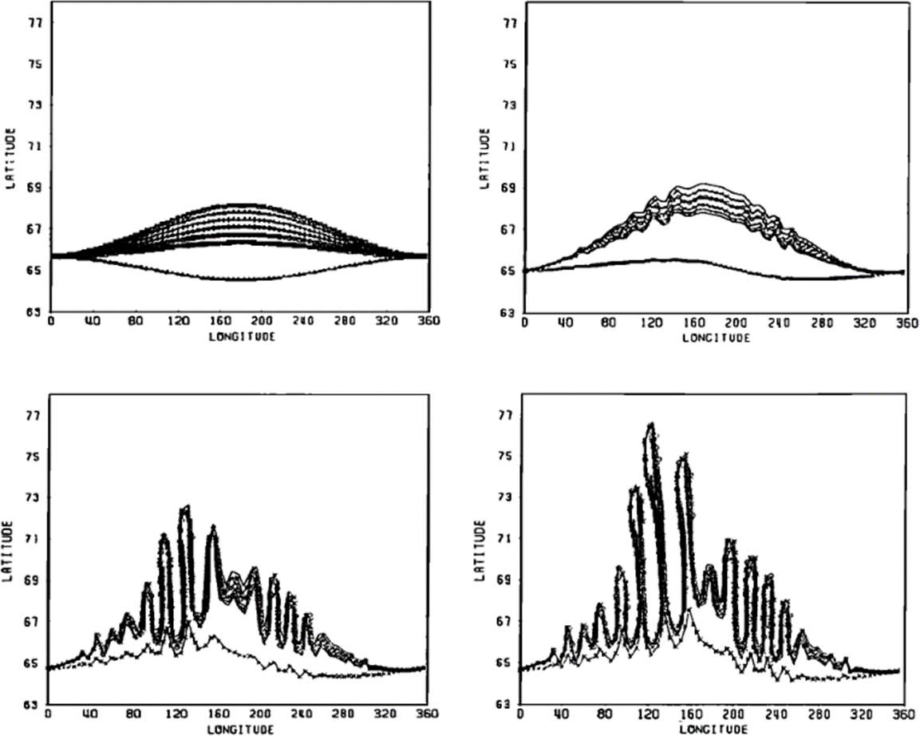
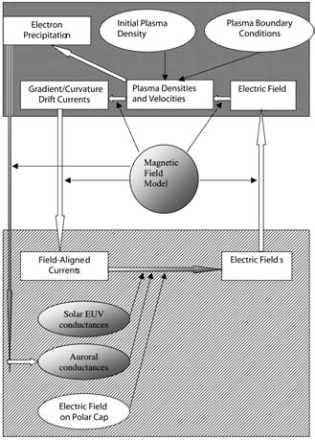
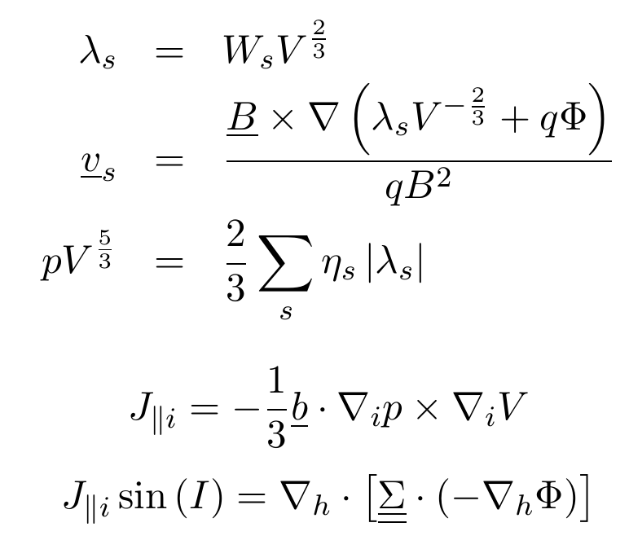
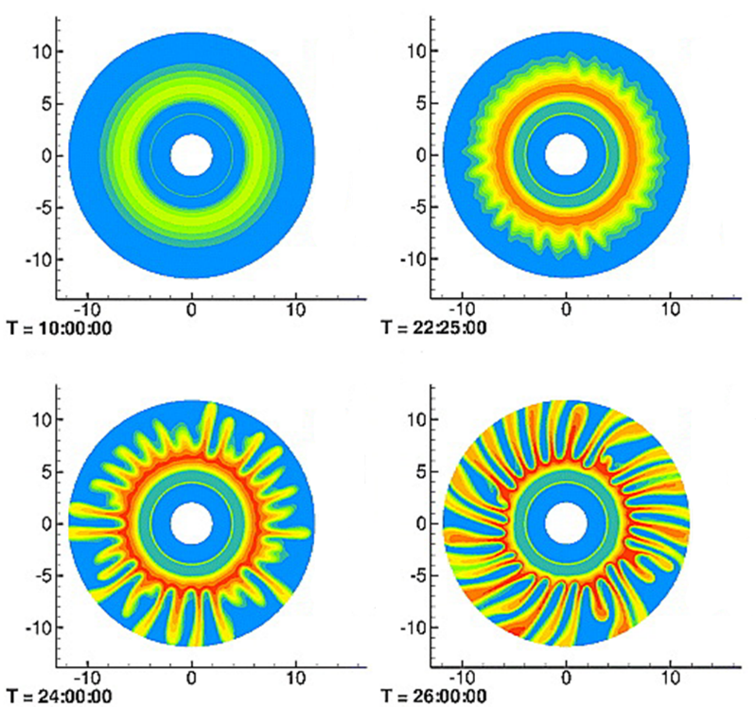
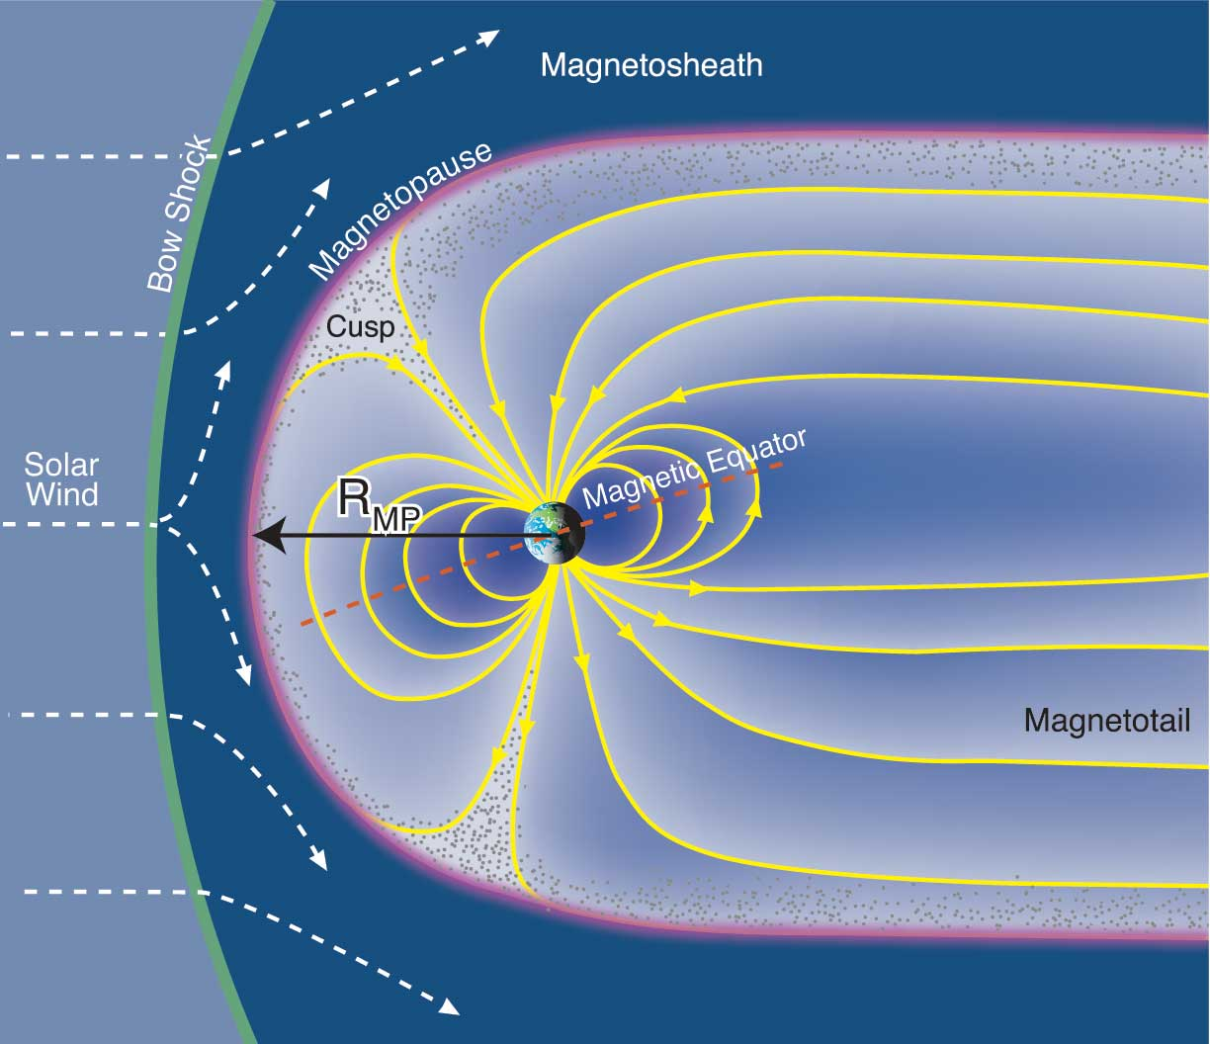
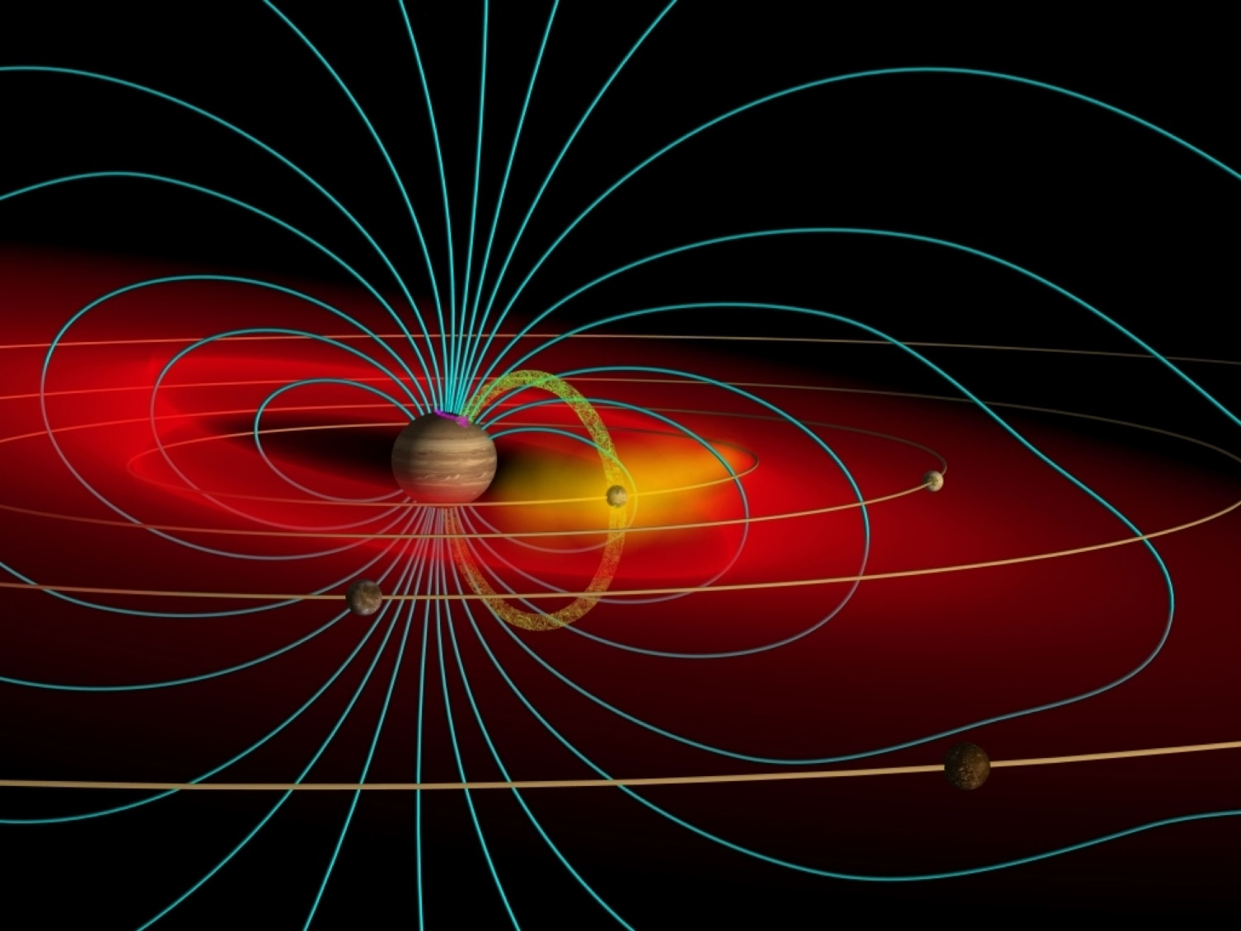
Magnetospheric Modelling from Earth to Jupiter using the Rice Convection Model
2. Rice Convection Model
4. RCM-J Results
A long-standing magnetospheric model, the RCM self-consistently computes plasma motions & electric fields and couples these down into the Ionosphere along magnetic field lines for the inner & middle magnetosphere. The magnetic field typical utilised by the RCM is time dependant, however is pre-defined and hence not responsive to dynamics evolving within the model. The RCM is further simplified by bounce-averaging the particles and applying the guiding-centre approximation. Plasma convection speeds in the RCM are considered to be much less than the fast wave mode².
The computational loop used by the RCM is based on the one first proposed by Vasyliunas (1970). The updated loop can be seen below with equations corresponding to each step in the matching coloured box.
Early runs of the RCM-J examined plasma convection from the Io plasma torus radially outward. These runs determined that if the plasma was initialised with a longitudinal asymmetry, even small, that the convecting plasma would break up into fingers which transported it radially outwards. The size of these fingers were at least partially a function of the radial density gradient in the torus. The physical mechanism
R_{J}
J. A. Wiggs & C. S. Arridge
j.wiggs@lancaster.ac.uk
Department of Physics, Lancaster University, Lancaster, LA1 4YB, UK
Yang et al. 1994
1. Modelling Magnetospheres
attributed to the creation of these fingers is the radial interchange instability and is thought to be the main process by which plasma is transported radially outwards.
Further studies have examined the impacts of including addition forces on the plasma and determined:
It is important to understand how magnetospheres function and how they respond to external forces. It is therefore convenient to create computerised simulations in order to investigate these regions of space. However, obtaining an exact solution to the governing equations for a system as complex as a magnetosphere is very difficult, this means it is necessary to construct a simplified model¹.
We are particularly interested in the simulation of plasma convection from Jupiter’s plasma torus radially outwards. This convecting plasma is theorised to undergo the radial interchange instability (centrifugal instability). The most recognised model that currently simulates plasma convection in Jupiter’s magnetosphere and which has the radial interchange instability present is the Rice Convection model (RCM). This model originally examined flows in Earth’s magnetosphere but was modified to explore Jupiter’s.
The Coriolis forces impounds the plasma convection and bends the fingers azimuthally
A finite plasma pressure enhances the interchange instability up to 50%
RCM-J results have been compared to observations and found to be largely in agreement.
Adapted from Sazykin, 2000
In the equation above most variables take their usual definitions. However, under these assumptions it is possible obtain the following invariants in the system³:
λ_{s} is an energy invariant that is constant along a particles drift path
η_{s} is the particles per unit magnetic flux
pV^{5/3} is invariant by definition due to the final equation in the particle densities and velocities box.
Liu et al, 2010
5. Beyond the RCM-J
3. RCM to RCM-J
The RCM-J has had great success in providing initial insights into plasma convection in Jupiter’s magnetosphere. However, we hope to address a number of issues with our own model in the future, these are:
Kinetic modelling on finer spatial scales will give insight into smaller scale structures as particles undergo the instability
The rate of plasma convection through the magnetosphere in the model is in the order of 10’s hours, observations have determined the flow to be on the order on 100’s hours
Instantaneous coupling between the ionosphere and magnetosphere is non-physical, consideration of Alfvén speed profiles would provide more sensible temporal coupling.
Open boundaries on the outer edge of the radial simulation region would allow for plasma convection over longer time periods to be examined
To adapt the RCM to model Jupiter’s magnetosphere several alterations must be made to form the RCM-J. The major alterations that need to be made to the computations are:
Due to Jupiter’s higher rotation rate and stronger magnetic field particle drift due to the centrifugal force must be considered with the equation,
Particle ExB drift is reconsidered to obey the ideal magnetohydrodynamic approximation, making hot and cold plasma species drift together
The magnetic field model is changed to a Jupiter specific model
Model inputs, the oval boxes in the diagram above, such as the conductance tensor must be altered to reflect physical conditions at the planet
The boundary conditions also must be altered to reflect the new environment
Once these changes are made consideration is given to the region in the new magnetospheric set up where the plasma flow speed is below the fast mode⁵.
Credit: F. Bagenal & S. Bartlett
Credit: J. Spencer.
Jupiter’s magnetosphere differs significantly from the Earth’s. The main physical factors for this are:
Jupiter’s magnetic field is approximately 14 times greater in magnitude than the Earth’s
The planetary spin rate is much greater completing one approximately every 10 hours
The volcanic moon Io ejects 1000 kgs⁻¹ of plasma into the magnetosphere loading it and creating the plasma torus
References
1. V. M. Vasyliunas. 1970. in Particles and Fields in the Magnetosphere. B. M. McCormac.
2. F. Toffoletto, S. Sazykin, R. Spiro, & R. Wolf. 2003. Space Sci. Rev., 107, 175
3. R. A. Wolf. 1983. in Solar-Terrestrial Physics. R. L. Carovillano, & J. M. Forbes.
4. S. Sazykin. 2000. PhD Dissertation, University of Utah.
5. Y. S. Yang, R. A. Wolf, R. W. Spiro, & T. W. Hill. 1994. J. Geophys. Res., 99, 8755
6. X. Liu, T. W. Hill, R. A. Wolf, et al. 2010. J. Geophys. Res., 115, A12254

