Slide 1

Numerical design of Novel Composite risers for deep water applications
Amaechi Chiemela Victor
5th July 2018
PGR Conference 2018
@Room A076, Old Engineering Building
3rd Year PhD Student
PhD Status: Full-time
Department: Engineering Department
Supervisor: Prof. Jianqiao Ye
Research Sponsors:
1. NDDC (Niger Delta Development Commission), Nigeria.
2. Engineering Department, Lancaster University, Lancaster, UK.
Notes:
LANCASTER UNIVERSITY POWERPOINT TEMPLATES
These PowerPoint templates are for use by all Lancaster University staff. Please see below for further information regarding the use of these templates. Should you have any further queries, please contact the marketing team via marketing-services@lancaster.ac.uk
Template slide 3: Insert a new slide
If you need to insert a new slide, from the ‘home’ toolbar, click on ‘new slide’ and select from the templates the style you require from the dropdown box.
Template slide 4: Typing new text and copying text from another document
New text should be typed over the text in the appropriate template. Copy and pasting text from another document will result in changing the style of the typography and layout. This is unavoidable as it is part of the Microsoft software. We appreciate that in sometimes you will need to copy text from another document into this template. Once you have pasted the existing text into the template, you will need to change the formatting so that they typefaces, sizes, colour, line spacing and alignment are consistent with the rest of the template.
Template slide 5: Inserting images
There are three choices of templates with images already inserted. Please use the template with the relevant image size and positioning. To insert an image, please go to ‘insert’ then ‘picture’ and find your image, highlight it and ‘insert’. Resize the image and position as per the example template.
Template slide 6: Text boxes
If a text box is deleted, either insert a new slide (using the appropriate template) or go to another slide and copy a text box. To select a text box for copying, please click on the outer edge of the text box so that the line goes solid (not dashed). Right click your mouse and select ‘copy’, then go back and ‘paste’ it into the slide where the text box is missing which should paste into the correct position on the slide.
Template slide 7: Other information
Typefaces, sizes and colours
All copy is Calibri.
Slide title copy throughout:
Size: 36 point
Colour Lancaster University red: (RGB) R: 181 G: 18 B: 27 (recent colours on PowerPoint)
Small copy on first and last slide:
Size: 16 point
Colour grey: (RGB) R: 102 G: 102 B: 102 (recent colours on PowerPoint)
Sub-headings:
Size: 24 point – italics
Colour grey: (RGB) R: 102 G: 102 B: 102 (recent colours on PowerPoint)
Bullets copy and body copy:
Size: 24 point (see below for a further option)
Colour grey: (RGB) R: 102 G: 102 B: 102 (recent colours on PowerPoint)
It isn’t advisable to have too much text on a slide, however on rare occasions it may be necessary, therefore there is a slide using 20 point bullet pointed text.
Line spacing and alignment
Single line spacing (apart from the main headings which is ‘exactly 35 point’)
All text is aligned left
Slide title options
There are two options for titles on the slides – one line or two lines for longer titles. Ideally, the one line title should be used, however on rare occasions a two line title maybe needed.

Slide 2
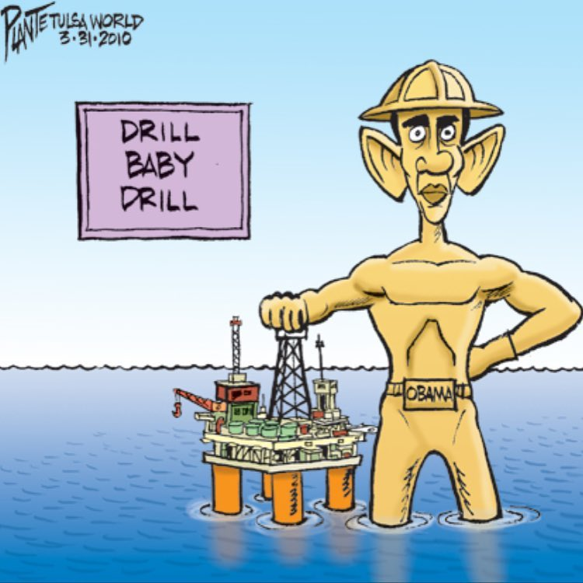
Objectives
Abstract
Due to recent challenges in oil exploration, there has been an increase in oil exploration from shallow waters to deep waters. This requires more length of the risers and thus an increase in the weight of the risers on the offshore structure. Risers are conduits which are used to transport fluid from the oil well to the offshore platform of transport vessel. The application of composites in riser design is to harness the properties of composites. This includes the reduction in the weight of the structure, and to improve the material behaviour. Submarine hoses are also a type of risers that are connected to buoys and other offshore structures but have short service periods. The design for some load cases on the composite riser is presented.
To develop a numerical model for composite riser for deep water applications;
To study motion characterisation of composite riser and the fatigue behaviour; and
To optimize the composite riser.

Slide 3
Background on Composite Risers
Different types and sizes of pipes are used, like the drill pipes, risers and the horizontal pipes. The dimensions could be 30” (76cm) or more as they are large capacity pipelines.
The earliest known oil wells were drilled in China in 347 AD or earlier. They had depths of up to about 800 feet (240 m) and were drilled using bits attached to bamboo poles.
The history of oil exploration dates to 1891 when the first oil well was drilled at Grand Lake St Mary’s, Ohio. In 2003 in Gulf of Mexico, only 35% of production was from wells at depths of >300m. By 2015, was 95%.
The various uses of a riser system determines its description, and thus its purpose-drilling, production / injection, export / import, fluids circulation, completion/workover. (Bai et al, 2013).
Composite materials offer a range of benefits that could improve riser technology (Hatton, 2015).
Ochoa (2001) opined that fiber reinforced polymeric composites are emerging as strong alternatives for ultra-deepwater drilling and production application; as they have light weight, strength, and durability.
Salama (1986) presented a study on the application of composites in offshore, using Conoco’s Hutton TLP, the cost comparison against fabricated steel and proposed an evaluation program for future design.

Slide 4
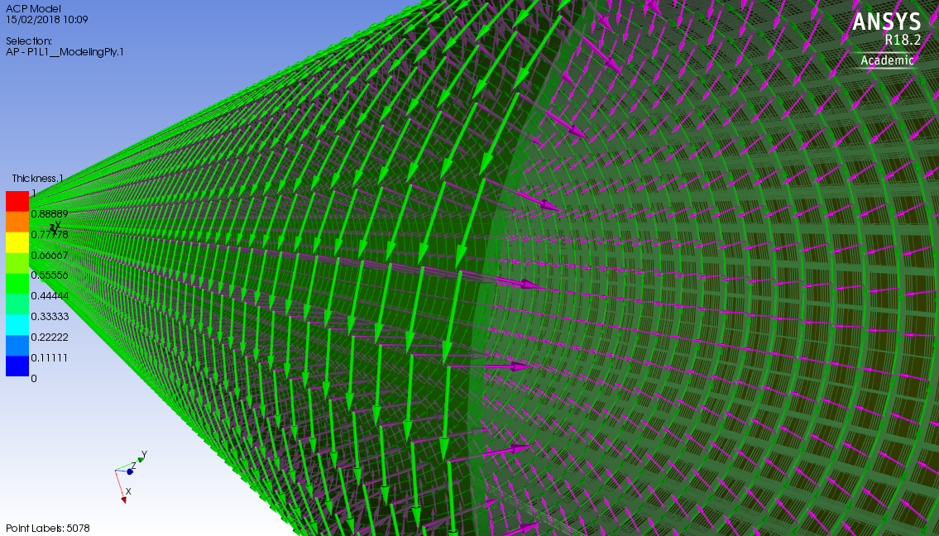
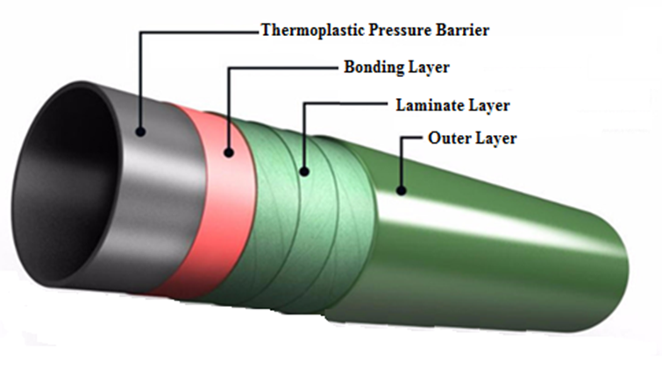
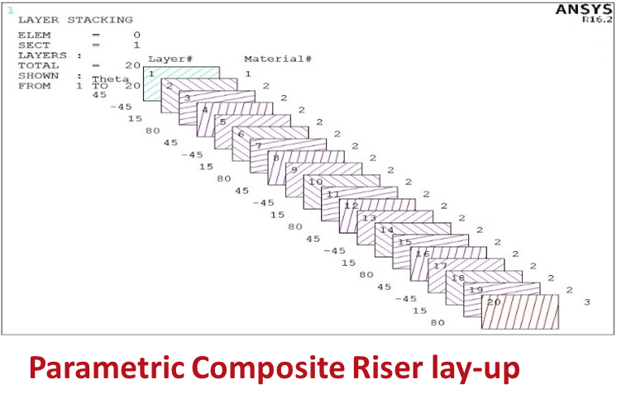
Importance of Composite Risers
Composites are light – High specific strength
Can be formed into complex shapes
Very good fatigue resistance claimed
High corrosion resistance
Maintenance cost is low
Comparatively low axial and bending stiffness when compared to steel
Potential ease of installation (i.e. Reeled pipe)
Can be designed into desired form

Slide 5
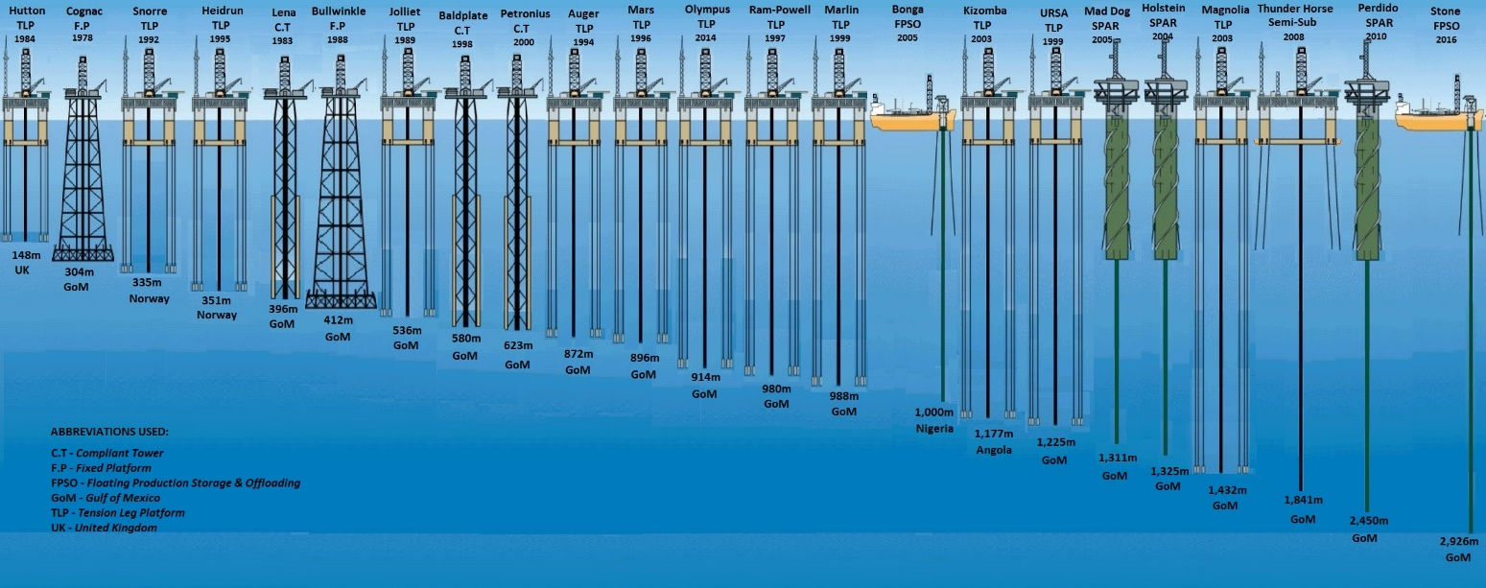
History on Offshore Deep waters
Amaechi C.V. & Ye J., 2017. A numerical modeling approach to composite risers for deep waters. In International Conference on Composite Structures (ICCS20) Proceedings. Paris, France: Societa Editrice Esculapo

Slide 6
Riser Configurations
Free Hanging Catenary
Lazy Wave
Steep Wave
Tethered Lazy Wave / Reverse Pliant Wave
Lazy-S
Steep-S
Pliant Wave
Chinese-lantern
Amaechi C.V. & Ye J., 2017. A numerical modeling approach to composite risers for deep waters. In International Conference on Composite Structures (ICCS20) Proceedings. Paris, France: Societa Editrice Esculapo

Slide 7
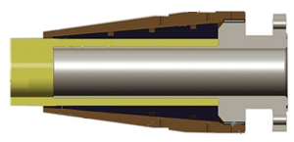
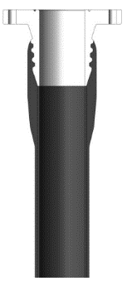
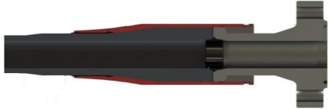
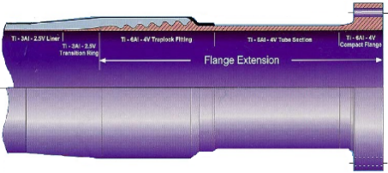
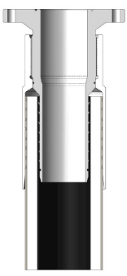
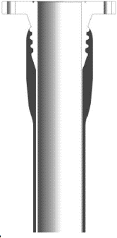
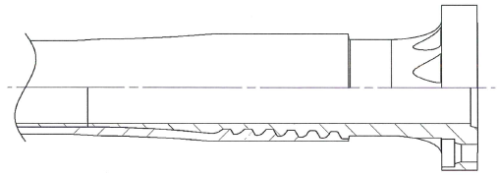
Composite riser End-fitting designs
End-fitting | Description of the design | Reference
Airborne end-fitting design |  | Airborne, (2016)
Traplock end-fitting design |  | Hatton et al., (2013)
Magma end-fitting design |  | Magma, (2016)
Swagged End-fitting |  | Hatton et al., (2013)
Heidrun End-fitting |  | Salama et al. (2005)
Metallic liner end-fitting |  | Hatton et al., (2013)
Multiple Traplock end-fitting |  | RPSEA Report

Slide 8
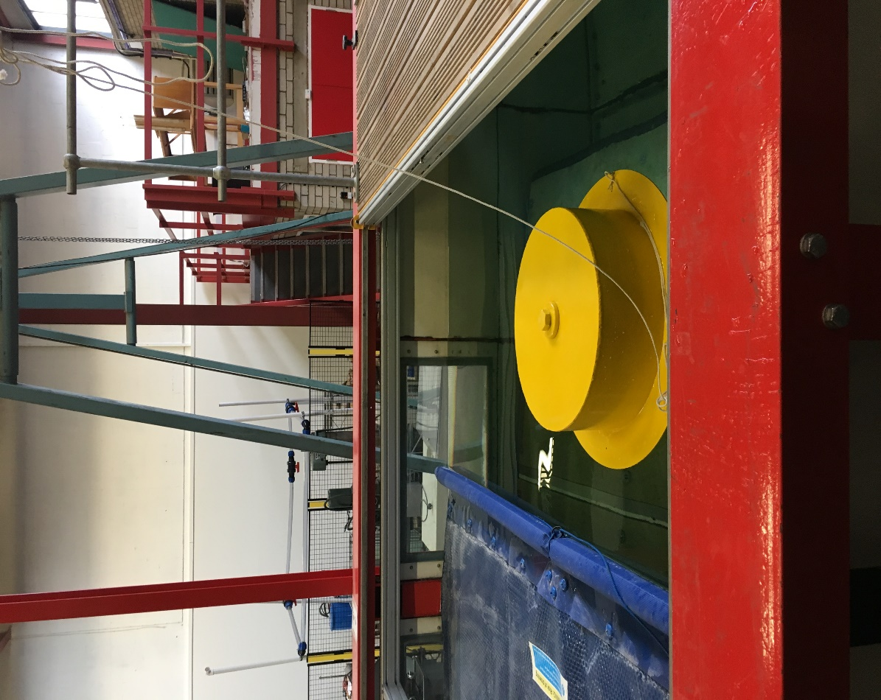
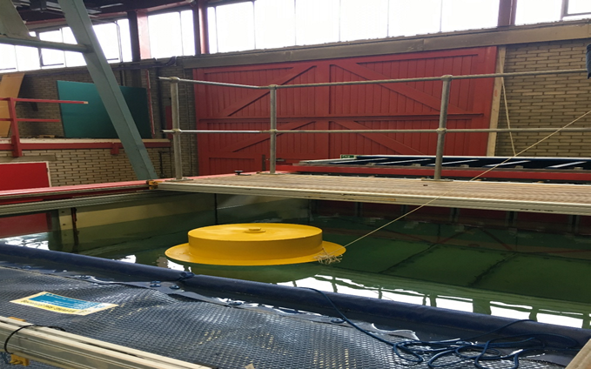
Issues with Composite Risers
Need more work due to more deep water needs
Very expensive (high cost of material)
Limited track record in the offshore industry but high applications in other industries
Design codes, specifications and standards are limited as regards direct applicability to composite risers (recent ones by ABS and DNV have been introduced)
Hard to inspect sub-laminar damage
More design models on composite risers are needed and on the composite materials
Metal Composite Interface (MCI)
End-Fitting,
Liners and Resins,
Composite Riser Pipe
Riser Load Categories (DNV, 2010)
Functional loads,
Environmental loads,
Accidental loads, and
Pressure loads.
Experimental Set-Up @Wave Tank

Slide 9
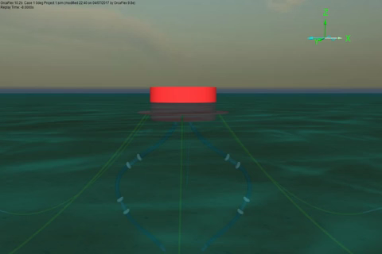
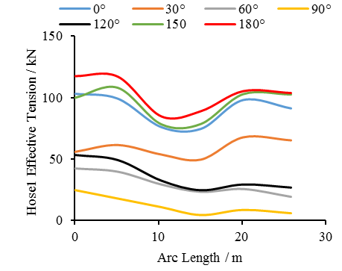
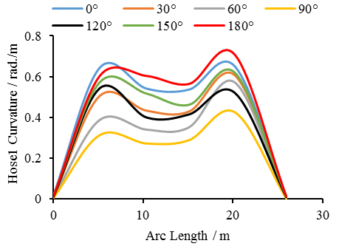
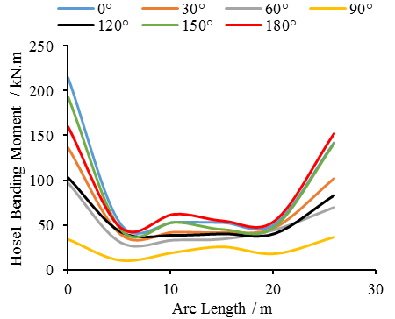
CALM buoy’s floating hose

Slide 10
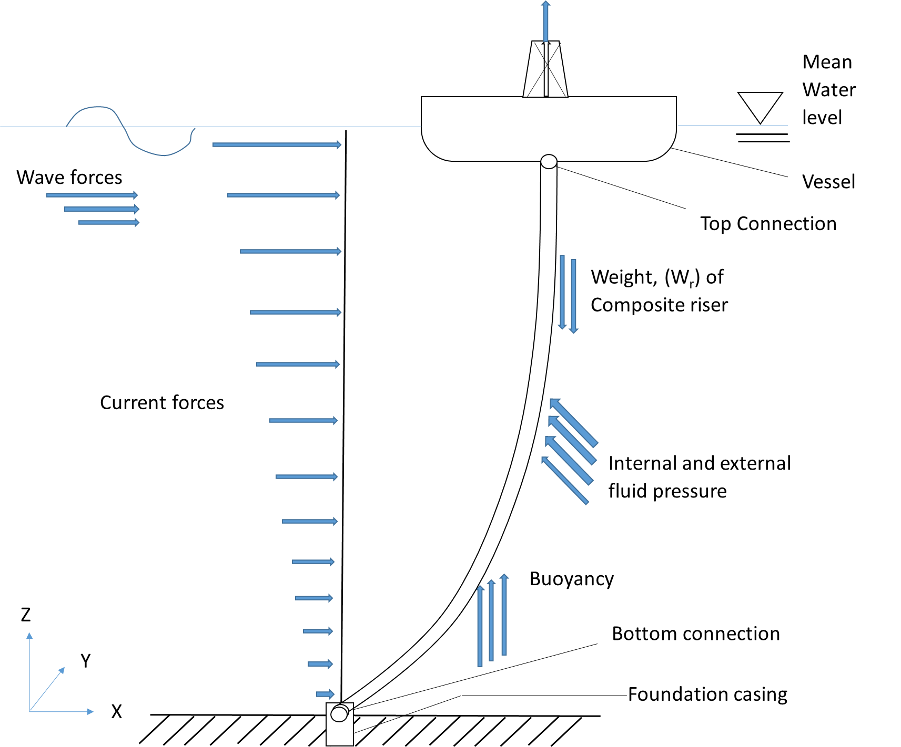
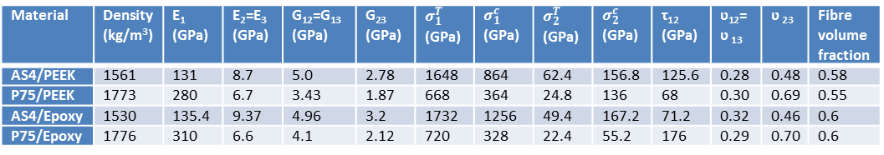
Design Load Cases & Strength Parameters
Load Case | Name | Description
Load Case 1 | Burst Case | An internal pressure of 155.25 MPa is applied
Load Case 2 | Collapse Case | An external pressure of 60 MPa is applied
Load Case 3 | Pure Tension Case | The local factor of 2.25 with maximum tension
Load Case 4 | External Pressure and Tension Case | The load factor of 2.25 is applied on 19.5MPa external pressure
Load Case 5 | Buckling Case | An external pressure of 60 MPa is applied
Material | Density (kg/m3) | Elastic Modulus (MPa) | Yield Stress (MPa) | Ultimate Stress (MPa) | Elongation at break (%) | Poisson’s ratio, ʋ
Aluminium (1953T1) | 2780 | 71 | 480 | 540 | 7.5 | 0.3
PEEK 450G | 1300 | 3.64 | 120 | --- | --- | ---
Titanium (Ti6Al4V) | 4430 | 113.8 | 880 | 950 | 14 | 0.342
Steel (X80) | 7850 | 207 | 880 | 950 | 5.9 | 0.3
Material | Density (kg/m³) | E₁ (GPa) | E₂=E₃ (GPa) | G₁₂=G₁₃ (GPa) | G₂₃ (GPa) | $σ_{1}^{T}$ (GPa) | $σ_{1}^{c}$ (GPa) | $σ_{2}^{T}$ (GPa) | $σ_{2}^{c}$ (GPa) | τ₁₂ (GPa) | ʋ₁₂= ʋ ₁₃ | ʋ ₂₃ | Fibre volume fraction
AS4/PEEK | 1561 | 131 | 8.7 | 5.0 | 2.78 | 1648 | 864 | 62.4 | 156.8 | 125.6 | 0.28 | 0.48 | 0.58
P75/PEEK | 1773 | 280 | 6.7 | 3.43 | 1.87 | 668 | 364 | 24.8 | 136 | 68 | 0.30 | 0.69 | 0.55
AS4/Epoxy | 1530 | 135.4 | 9.37 | 4.96 | 3.2 | 1732 | 1256 | 49.4 | 167.2 | 71.2 | 0.32 | 0.46 | 0.6
P75/Epoxy | 1776 | 310 | 6.6 | 4.1 | 2.12 | 720 | 328 | 22.4 | 55.2 | 176 | 0.29 | 0.70 | 0.6
Layer | Thickness (mm) | Orientation (°) | Description
1 | 9.0 | 0 | Liner
2 | 1.58 | 90 | Axial
3 |  | 90
4 |  | 90
5 | 1.88 | 53.5 | Angled
6 |  | -53.5
7 |  | 53.5
8 |  | -53.5
9 |  | 53.5
10 |  | -53.5
11 |  | 53.5
12 |  | -53.5
13 |  | 53.5
14 |  | -53.5
15 | 1.62 | 0 | Hoop
16 |  | 0
17 |  | 0
18 |  | 0
Design Case | Liner material | Fibre | Matrix | Lay-up | Lamina thickness (mm)
 |  |  |  |  | 0° | 53.5° | 90°
1 | Titanium | AS4 | PEEK | [0₅,(±53.5)₅,90₅] | 2.49 | 1.7 | 1.7
2 | Titanium | AS4 | PEEK | [0₅,(±53.5)₅,90₅] | 2.49 | 1.7 | 0.6
3 | Titanium | AS4 | PEEK | [0₆,(±53.5)₅,90₄] | 2.49 | 1.7 | 1.7
4 | Titanium | AS4 | PEEK | [0₆,(±53.5)₅,90₄] | 2.49 | 1.7 | 0.6
5 | Titanium | AS4 | PEEK | [90₅,(±53.5)₅,0₅] | 2.49 | 1.7 | 0.6
6 | Titanium | AS4 | PEEK | [90₅,(±53.5)₅,0₅] | 1.15 | 1.7 | 1.84
7 | Titanium | AS4 | PEEK | [(±53.5)₅,90₅,0₅] | 1.15 | 1.7 | 1.84
8 | Titanium | AS4 | PEEK | [(±53.5)₅,90₅,0₅] | 1.15 | 1.7 | 3.25

Slide 11
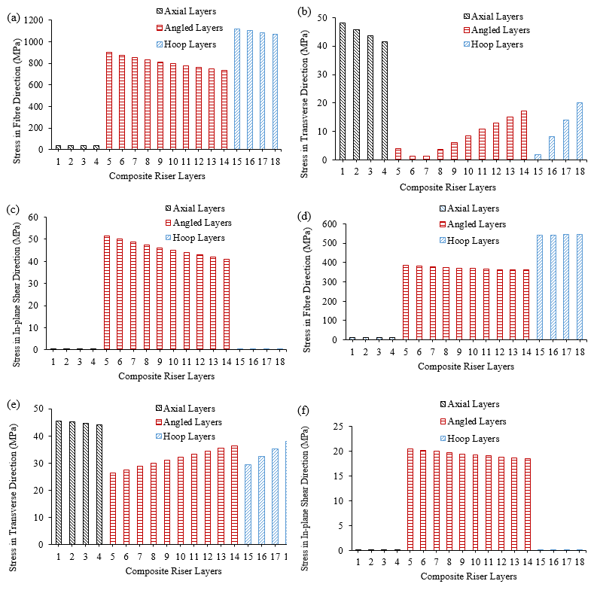
Design Load: Burst and Collapse Cases
Burst Case
Collapse Case

Slide 12
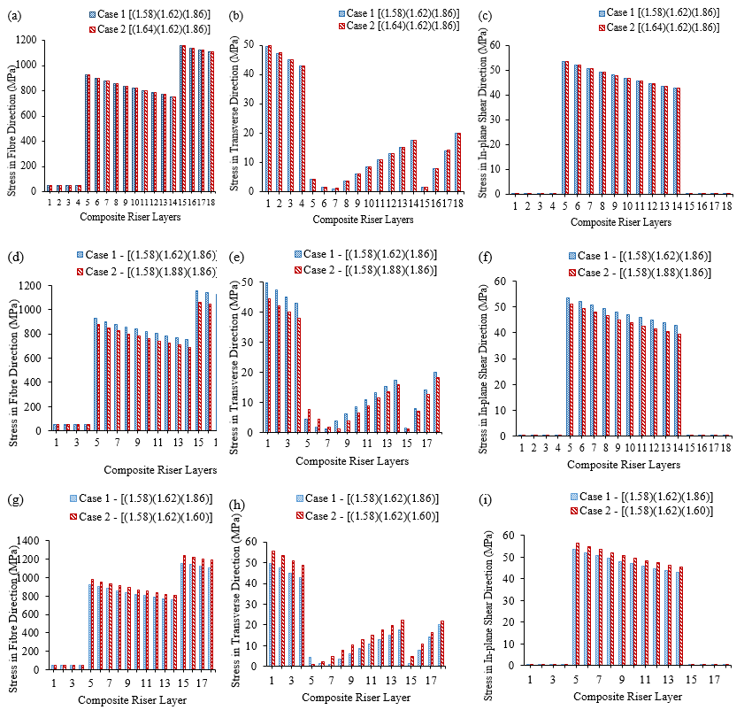
Effect of layer thickness

Slide 13
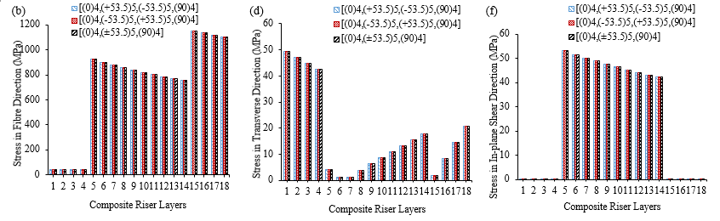
Some Results on Composite Riser Local Design
Effect of different liner materials
Effect of layer order
Strength comparison of composites
Effect of Order of Angled Layers

Slide 14
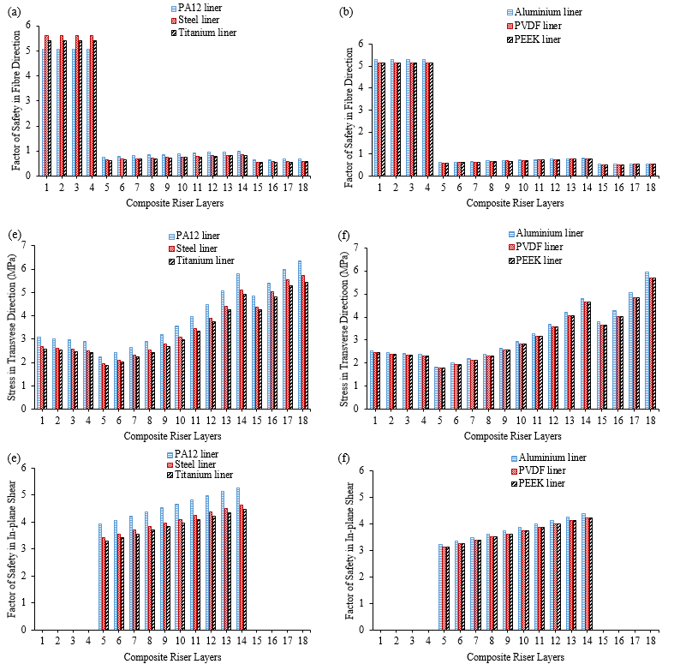
Factor of Safety of P75/PEEK

Slide 15
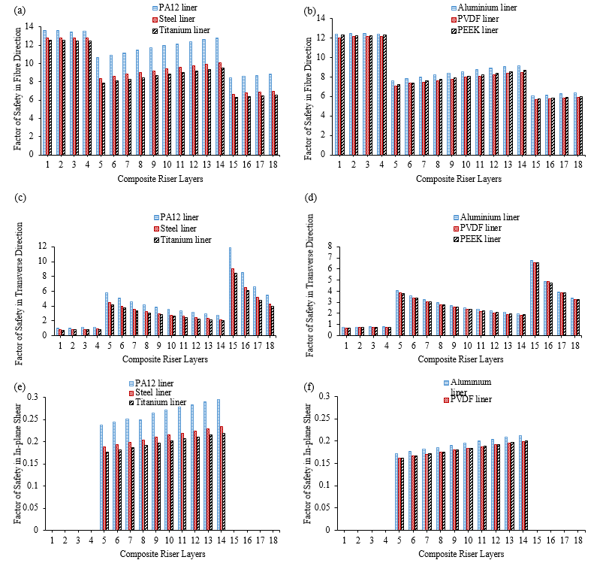
Factor of Safety of Glass Fibre/Epoxy

Slide 16
Publications
Amaechi C.V. & Ye J., 2017. A numerical modeling approach to composite risers for deep waters. In International Conference on Composite Structures (ICCS20) Proceedings. Paris, France: Societa Editrice Esculapo.
Amaechi C.V., Gillet N., Hou X., Ye J. 2018. Composite risers for deep waters using a numerical modelling approach. Submitted to Composite Structures Journal (under review).
Amaechi, C.V. & Ye, J., 2018. State-of-the-art review on composite risers. (draft for Ocean Engineering Journal)
Amaechi C.V., Agbomerie C.O., Facheng W., Ye J. 2018. Strength of submarine hoses in Chinese-lantern configuration from hydrodynamic loads on CALM buoy. (draft for Ocean Engineering Journal)
Acknowledgement
Thank my supervisor Prof Jianqiao Ye and also the members of my research group. Also, to the Technicians of Engineering Department, specially Nick and Mark for the construction of the CALM buoy.

Slide 17
Thank You

