Slide 1

Numerical Modeling of Composite Risers for deep waters
Christmas Conference 2017 Lancaster University FST
Amaechi Chiemela Victor; Prof. Jianqiao Ye
c.amaechi@lancaster.ac.uk; j.ye2@lancaster.ac.uk
Conference Dates: Tue., 19th Dec., 2017
Presentation Time: 12:06am
Venue: Lancaster University Management School LT1
Affiliation: Engineering Department, Lancaster University, UK
Research Sponsors:
1. NDDC (Niger Delta Development Commission), Nigeria.
2. Engineering Department, Lancaster University, Lancaster, UK.
Notes:
LANCASTER UNIVERSITY POWERPOINT TEMPLATES
These PowerPoint templates are for use by all Lancaster University staff. Please see below for further information regarding the use of these templates. Should you have any further queries, please contact the marketing team via marketing-services@lancaster.ac.uk
Template slide 3: Insert a new slide
If you need to insert a new slide, from the ‘home’ toolbar, click on ‘new slide’ and select from the templates the style you require from the dropdown box.
Template slide 4: Typing new text and copying text from another document
New text should be typed over the text in the appropriate template. Copy and pasting text from another document will result in changing the style of the typography and layout. This is unavoidable as it is part of the Microsoft software. We appreciate that in sometimes you will need to copy text from another document into this template. Once you have pasted the existing text into the template, you will need to change the formatting so that they typefaces, sizes, colour, line spacing and alignment are consistent with the rest of the template.
Template slide 5: Inserting images
There are three choices of templates with images already inserted. Please use the template with the relevant image size and positioning. To insert an image, please go to ‘insert’ then ‘picture’ and find your image, highlight it and ‘insert’. Resize the image and position as per the example template.
Template slide 6: Text boxes
If a text box is deleted, either insert a new slide (using the appropriate template) or go to another slide and copy a text box. To select a text box for copying, please click on the outer edge of the text box so that the line goes solid (not dashed). Right click your mouse and select ‘copy’, then go back and ‘paste’ it into the slide where the text box is missing which should paste into the correct position on the slide.
Template slide 7: Other information
Typefaces, sizes and colours
All copy is Calibri.
Slide title copy throughout:
Size: 36 point
Colour Lancaster University red: (RGB) R: 181 G: 18 B: 27 (recent colours on PowerPoint)
Small copy on first and last slide:
Size: 16 point
Colour grey: (RGB) R: 102 G: 102 B: 102 (recent colours on PowerPoint)
Sub-headings:
Size: 24 point – italics
Colour grey: (RGB) R: 102 G: 102 B: 102 (recent colours on PowerPoint)
Bullets copy and body copy:
Size: 24 point (see below for a further option)
Colour grey: (RGB) R: 102 G: 102 B: 102 (recent colours on PowerPoint)
It isn’t advisable to have too much text on a slide, however on rare occasions it may be necessary, therefore there is a slide using 20 point bullet pointed text.
Line spacing and alignment
Single line spacing (apart from the main headings which is ‘exactly 35 point’)
All text is aligned left
Slide title options
There are two options for titles on the slides – one line or two lines for longer titles. Ideally, the one line title should be used, however on rare occasions a two line title maybe needed.

Slide 2
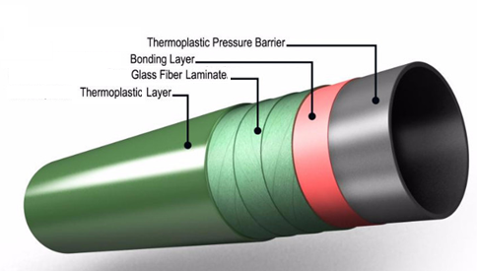
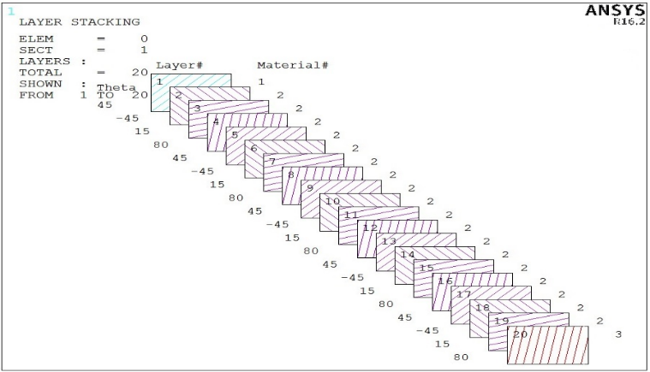
Numerical Modeling of Composite Risers for deep waters
First time composite risers deployed successfully on Heidrun Platform-1995;
Composites have high strength and light weight properties that can be harnessed in the offshore industry;
Composite materials can be modeled in -ANSYS ACP, ABAQUS;
Composite Materials offer a range of benefits which could be utilised in the offshore riser application to improve risers;
Research on Composite Risers have been on for about 27 years;
Companies like Airborne and Magma have successful applications of composite pipes and composite risers;

Slide 3
Brief on Research
Current trend in oil and gas led to more technologies
Need for lighter materials led to the need for composites
Composites have high strength and light weight properties that can be harnessed in the offshore industry;
Composite materials can be modeled using softwares and codes -ANSYS ACP;
Composite Materials have advantages which could be utilised in the offshore riser application to improve riser technology;
Oil and Gas Industry
Onshore
Mainstream
Offshore
Riser Systems
Drilling Risers
Flexible Risers
Composite risers
Pull tube Risers
Steel Catenary Risers
Top-tensioned Risers
Riser towers
Mooring lines
Risers
Pipelines, etc.
Platforms
Flexible Risers
Rigid Risers
Hybrid Risers
Composite Risers

Slide 4
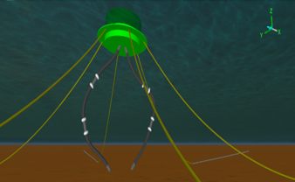
Loads on Composite Risers
Mean Water level
Vessel
Need more work due to more deep water needs
Very expensive (high cost of material)
Limited track record in the offshore industry but it has high applications in other industries
Design codes, specifications and standards are limited as regards direct applicability to composite risers (recent ones by ABS and DNV have been introduced)
Hard to inspect sub-laminar damage
More design models on composite risers are needed on both the composite materials and composite riser structure
Top Connection
Wave forces
Weight, (W_{r}) of Composite riser
Current forces
Internal and external fluid pressure
Buoyancy
Z
Bottom connection
Y
X
Foundation casing

